Slide 1
Calibration error vs number of frames
Calibration was performed using: [5 10 20 40 60 80 100] frames
Six methods were evaluated:
  No optimization
  7 param and 2D cost function minimization (red)
  8 param and 2D cost function minimization (blue)
  7 param and 3D cost function minimization (green)
  8 param and 3D cost function minimization (magenta)
2D reprojection error (measured in pixels) was calculated using a validation sequence of 250 frames (200 points were segmented).
Outlier rejection was performed in all the cases
Plots show rms error and standar desviation

Slide 2
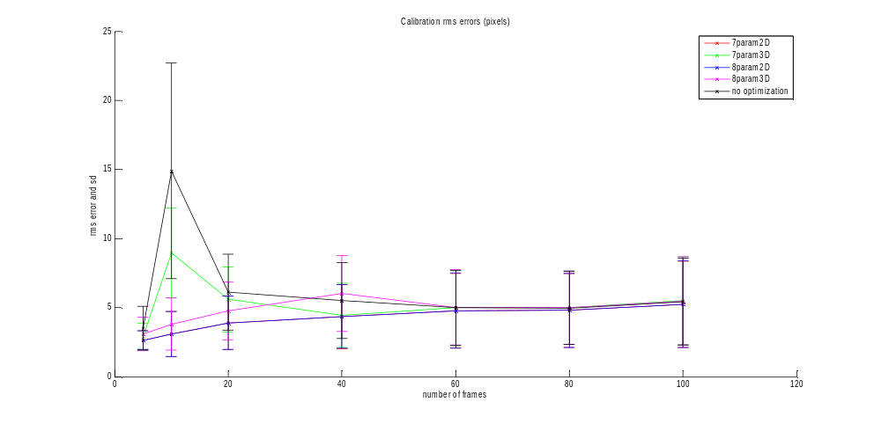
Calibration error vs number of frames

Slide 3
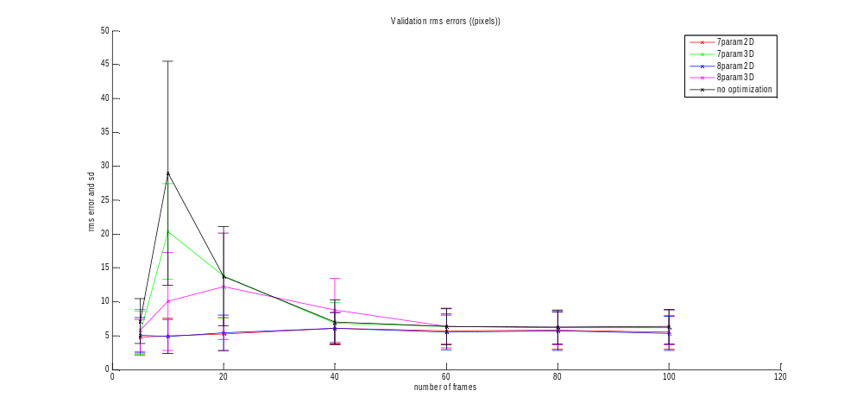
Validation error vs number of frames

Slide 4
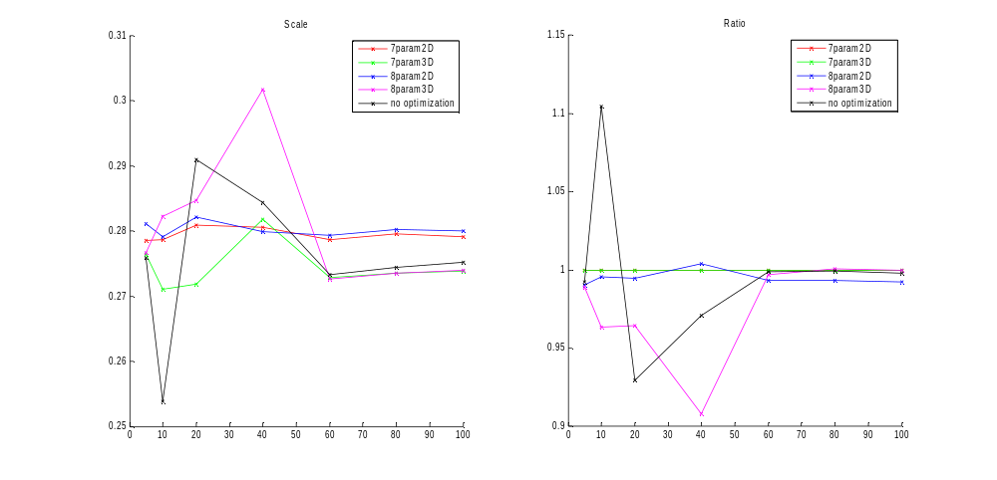
Ratio and scale vs number of frames

Slide 5
Mobile window
Calibration was performed using nine frames
Center of the window was moved
  centersOfWindow = [5 15 25 35 45 55 65];

Slide 6
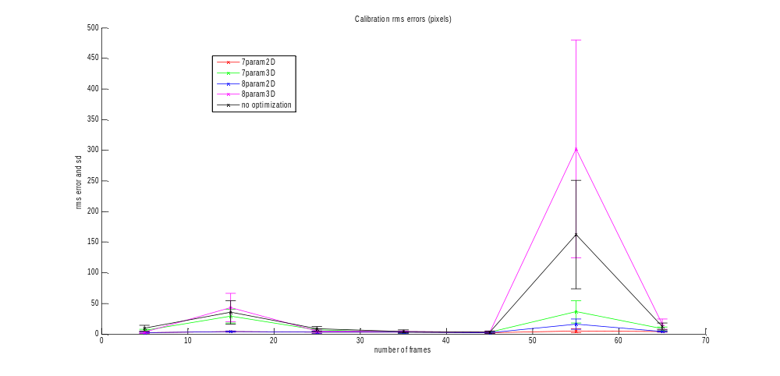
Moving the center of the windows (calib)

Slide 7
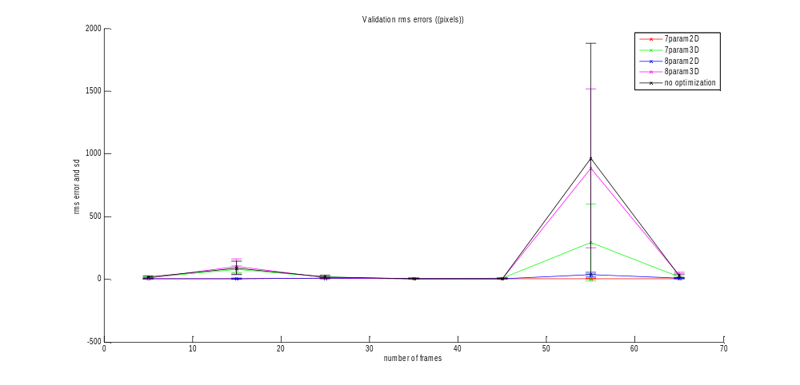
Moving the center of the windows (valib)

Slide 8
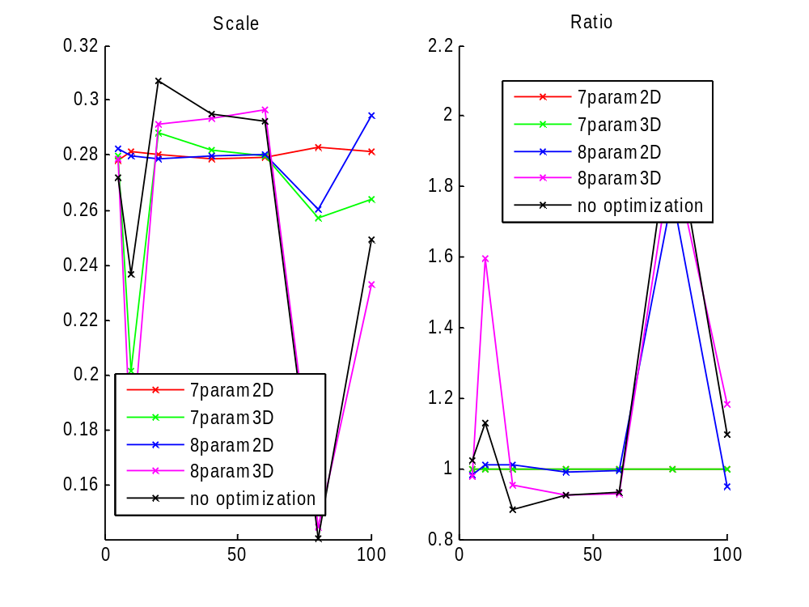
Moving the center of the windows (scale)

Slide 9
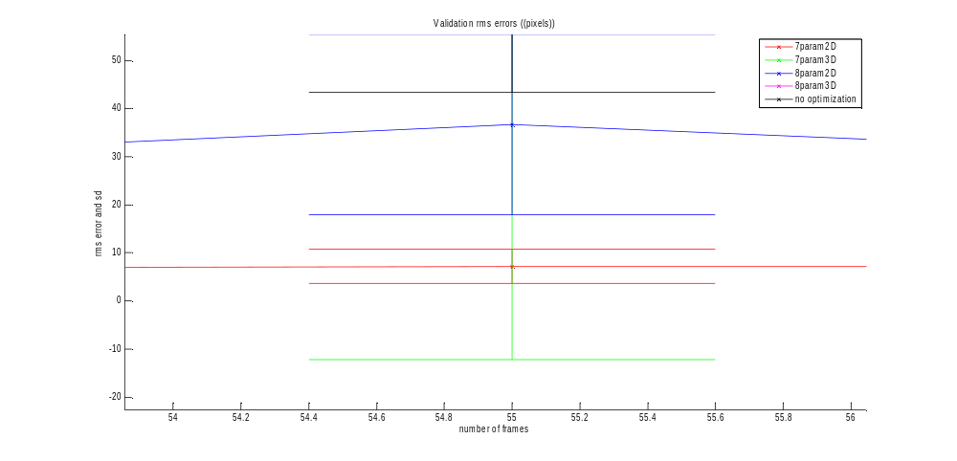
Moving the center of the windows (worst case)

Slide 10
Incremental frame distance
10 frames were used for calibration
9 configuration were tested
Frames used were:
  selectedFrames(k,:)=1:k:k*numberOfFrames
  k=1…6, 8..10

Slide 11
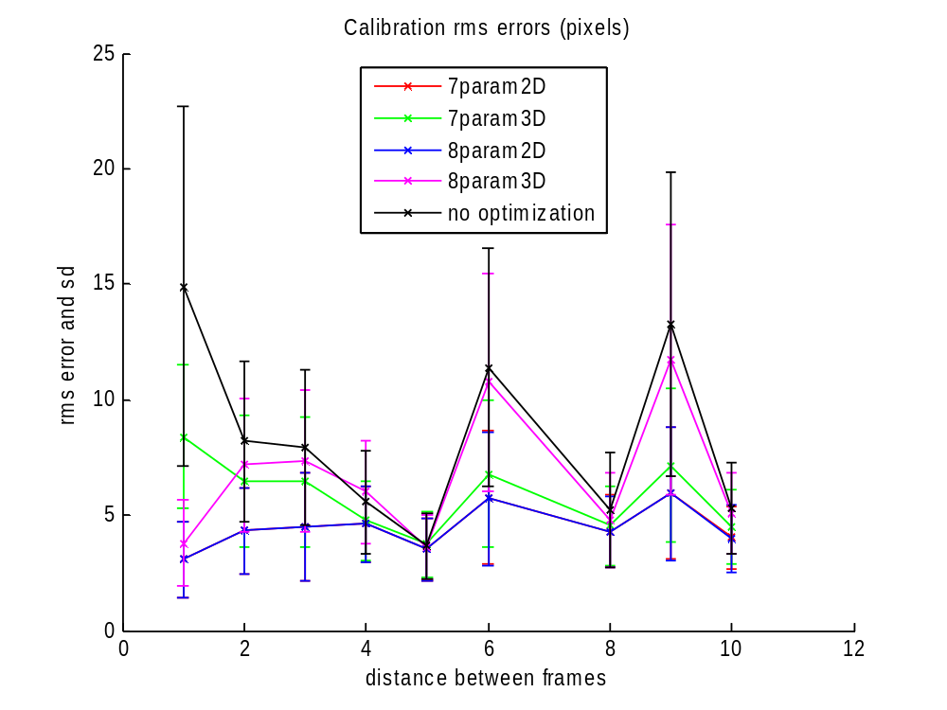
Incremental frame distance(calib)

Slide 12
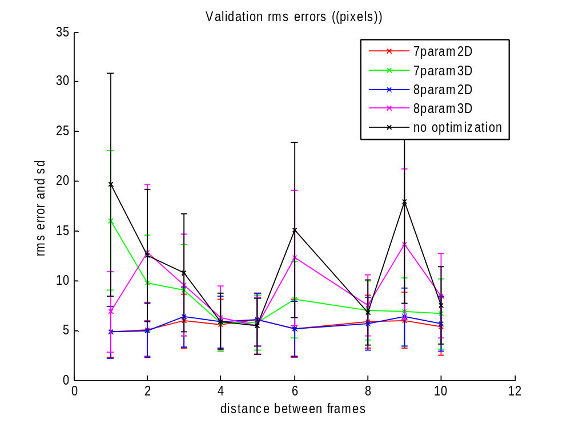
Incremental frame distance(valid)

Slide 13
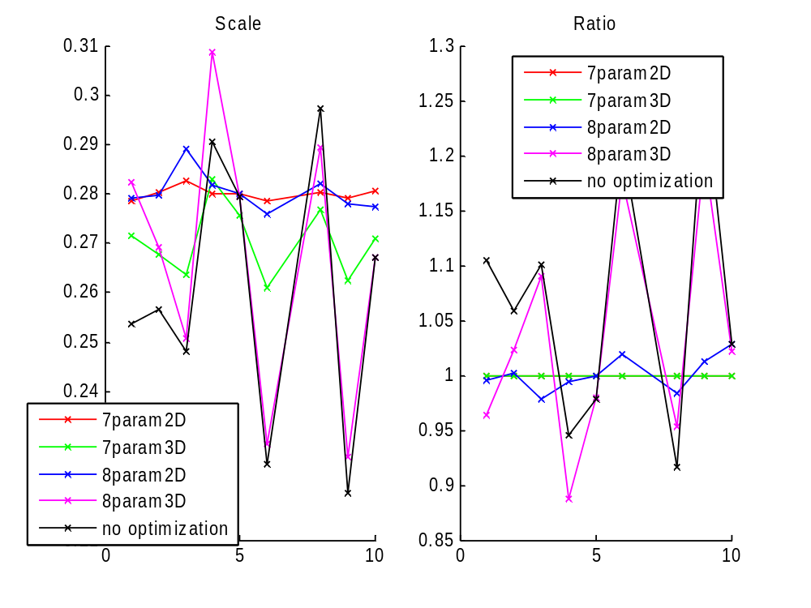
Incremental frame distance(scale)

