Slide 1
Calibration error vs number of frames
Calibration was performed using: [5 10 20 40 60 80 100] frames
Six methods were evaluated:
  No optimization
  7 param and 2D cost function minimization (red)
  8 param and 2D cost function minimization (blue)
  7 param and 3D cost function minimization (green)
  8 param and 3D cost function minimization (magenta)
2D reprojection error (measured in pixels) was calculated using a validation sequence of 250 frames (200 points were segmented).
Outlier rejection was performed in all the cases
Plots show RMS error and standard deviation

Slide 2
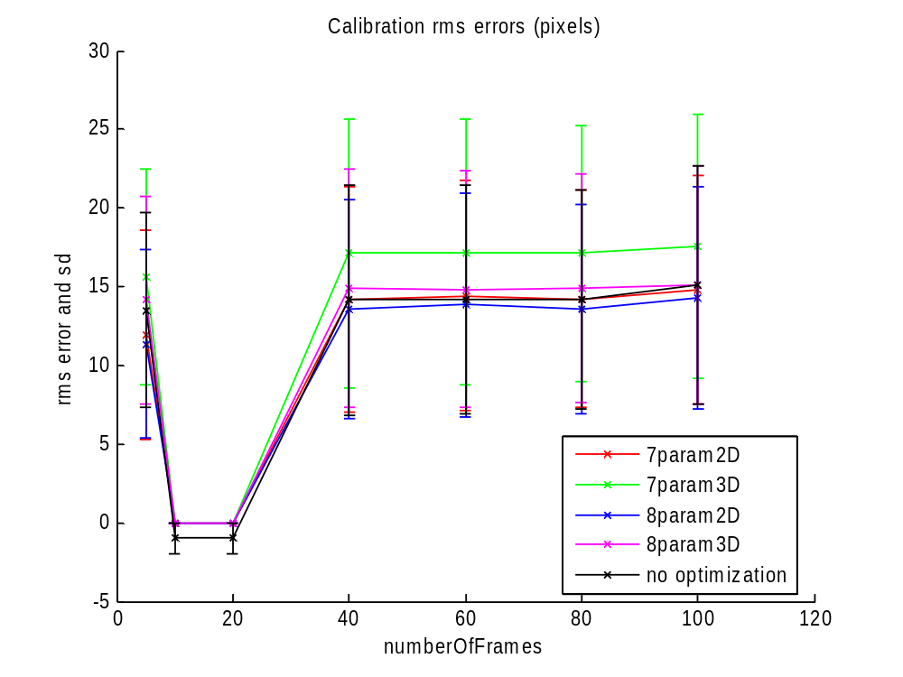
Calibration error vs number of frames

Slide 3
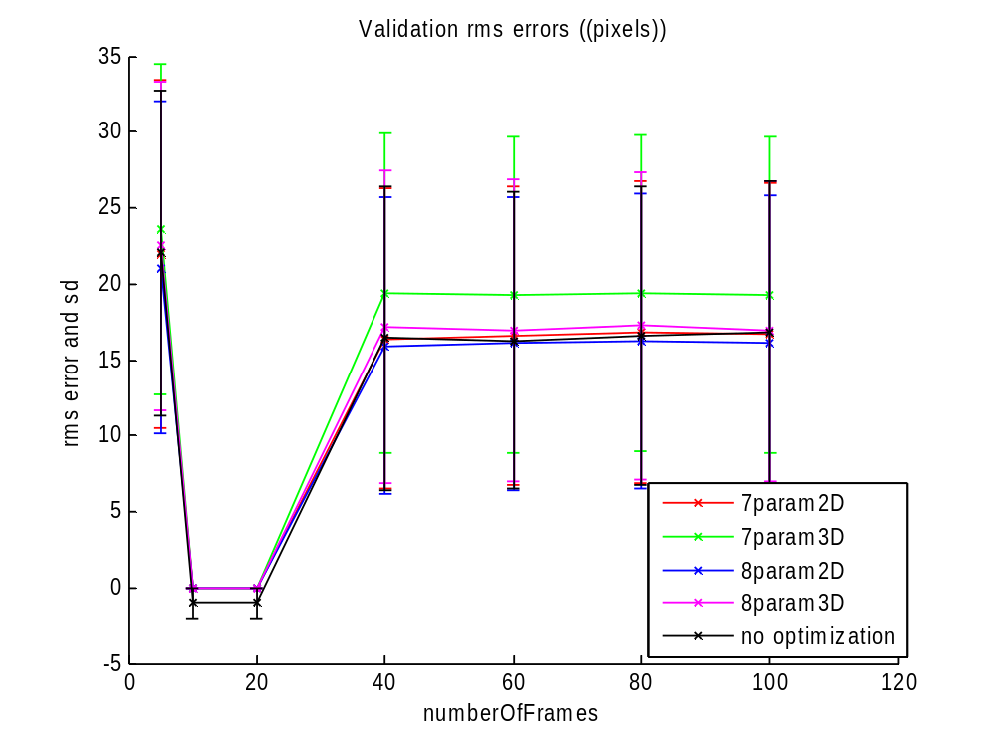
Validation error vs number of frames

Slide 4
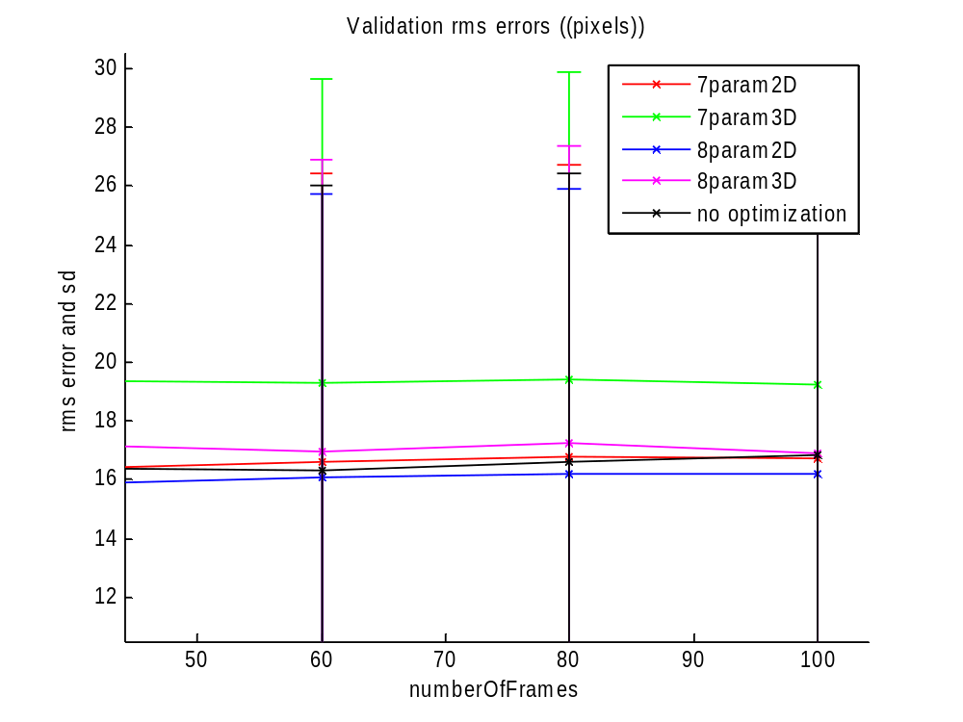
Validation error vs number of frames

Slide 5
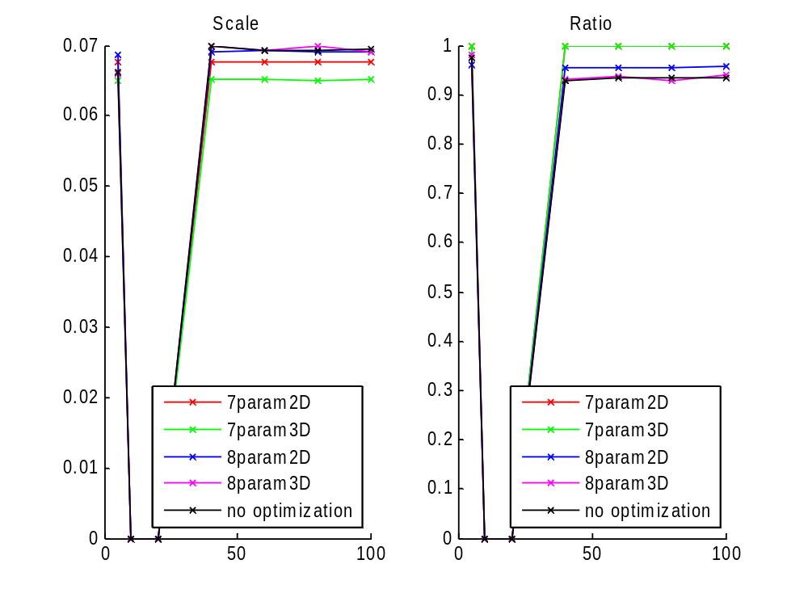
Ratio and scale vs number of frames

Slide 6
Mobile window
Calibration was performed using nine frames
Center of the window was moved
  centersOfWindow = [5 15 25 35 45 55 65 75];

Slide 7
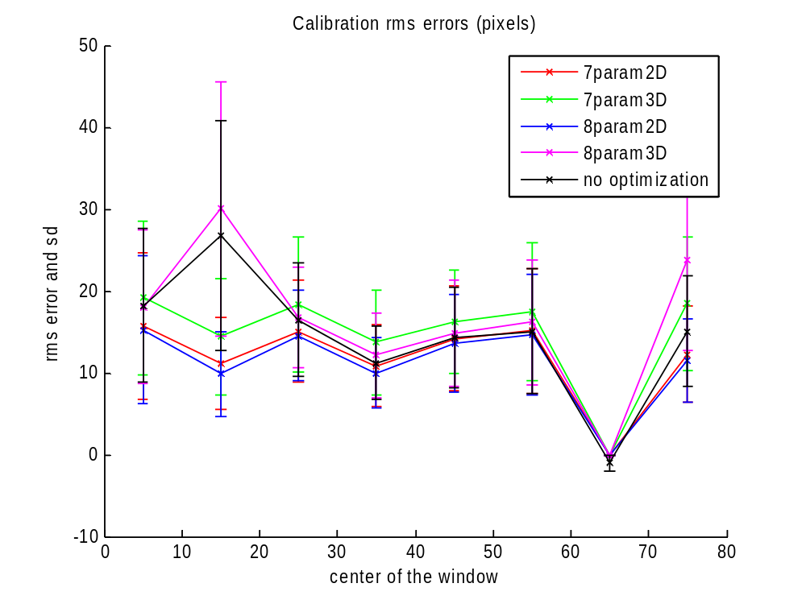
Moving the center of the windows (calib)

Slide 8
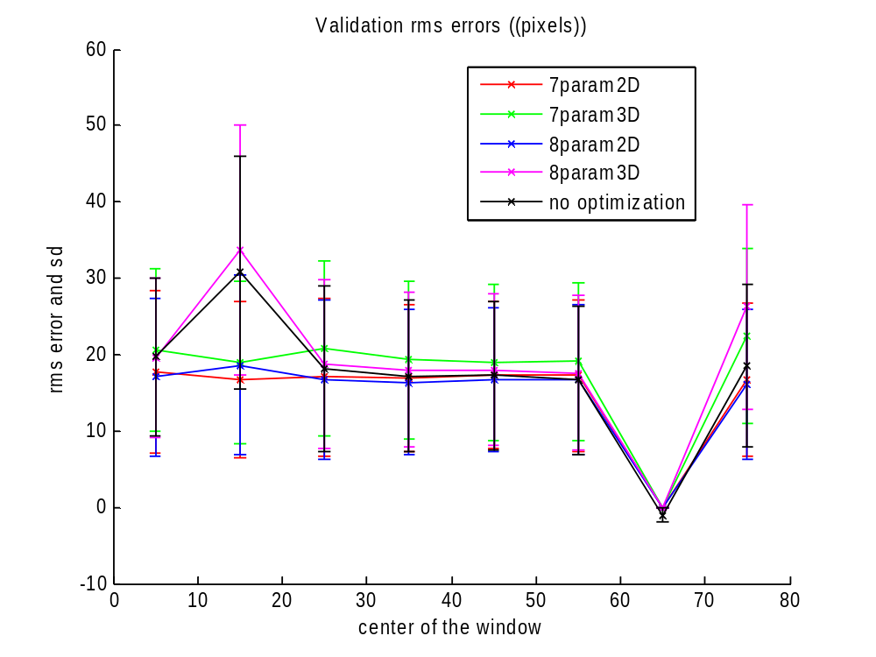
Moving the center of the windows (valib)

Slide 9
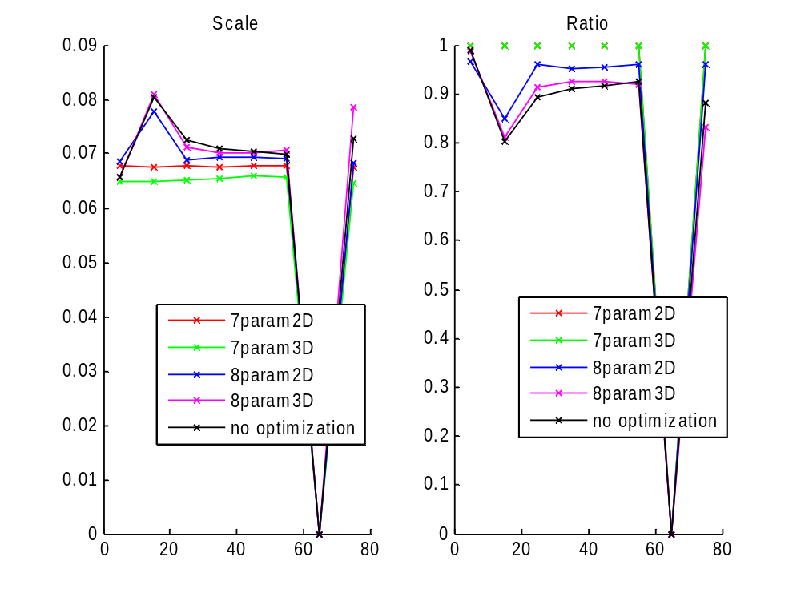
Moving the center of the windows (scale)

Slide 10
Incremental frame distance
10 frames were used for calibration
9 configuration were tested
Frames used were:
  selectedFrames(k,:)=1:k:k*numberOfFrames
  k=1…6, 8..10

Slide 11
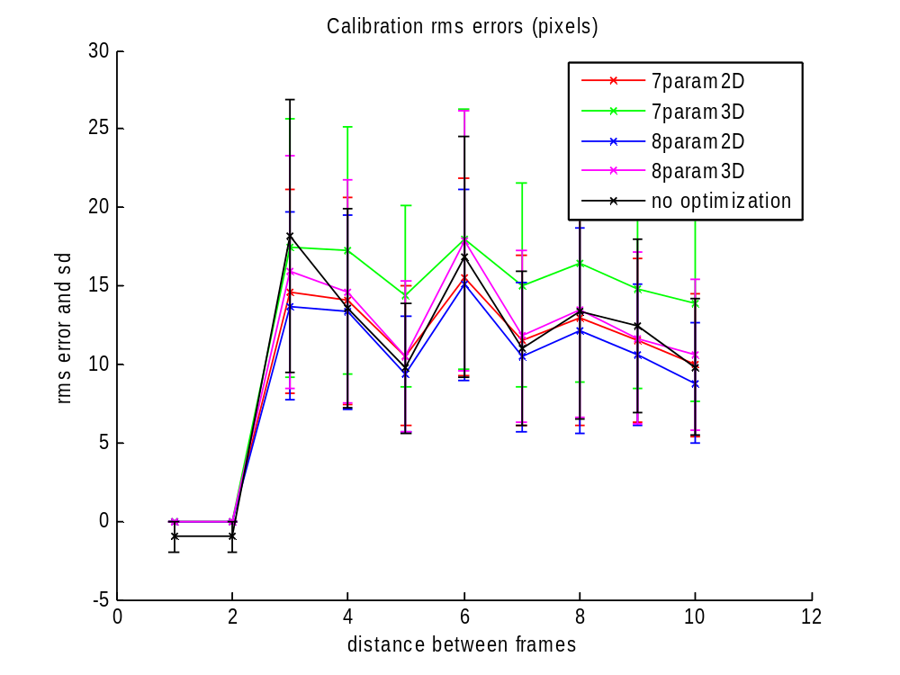
Incremental frame distance(calib)

Slide 12
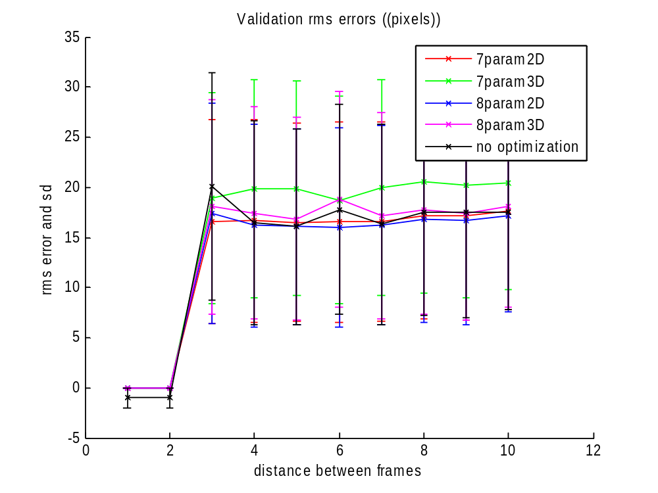
Incremental frame distance(valid)

Slide 13
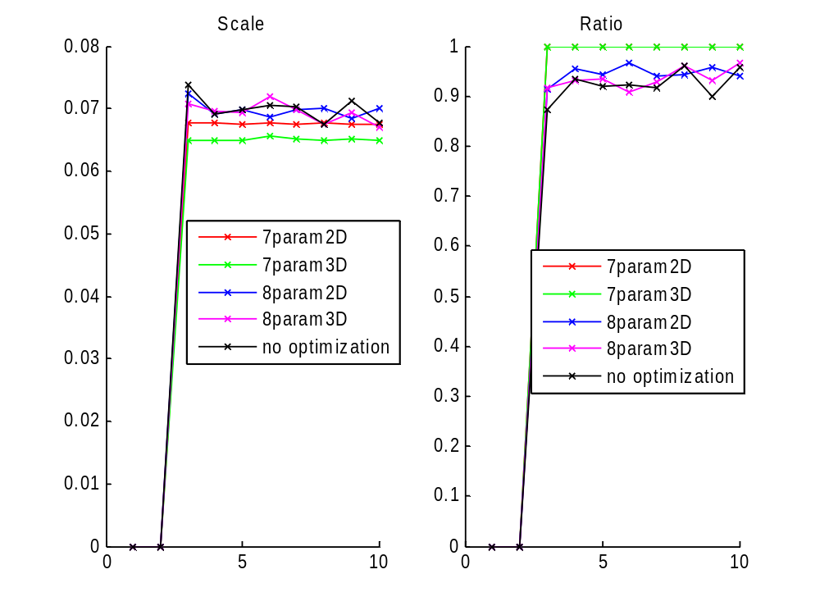
Incremental frame distance(scale)

Slide 14
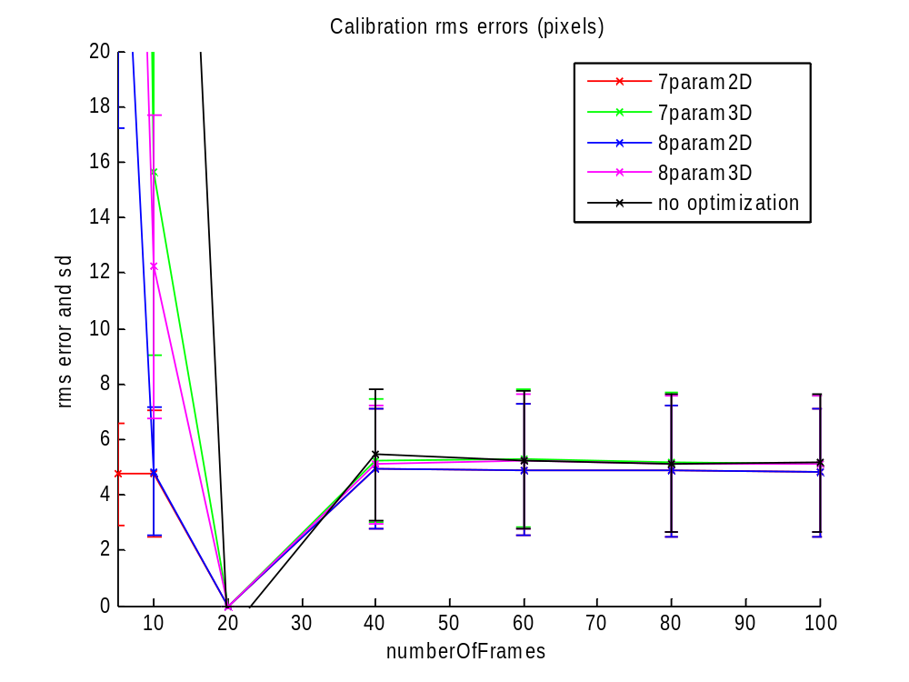
Curvilinear probe DEPTH 10

Slide 15
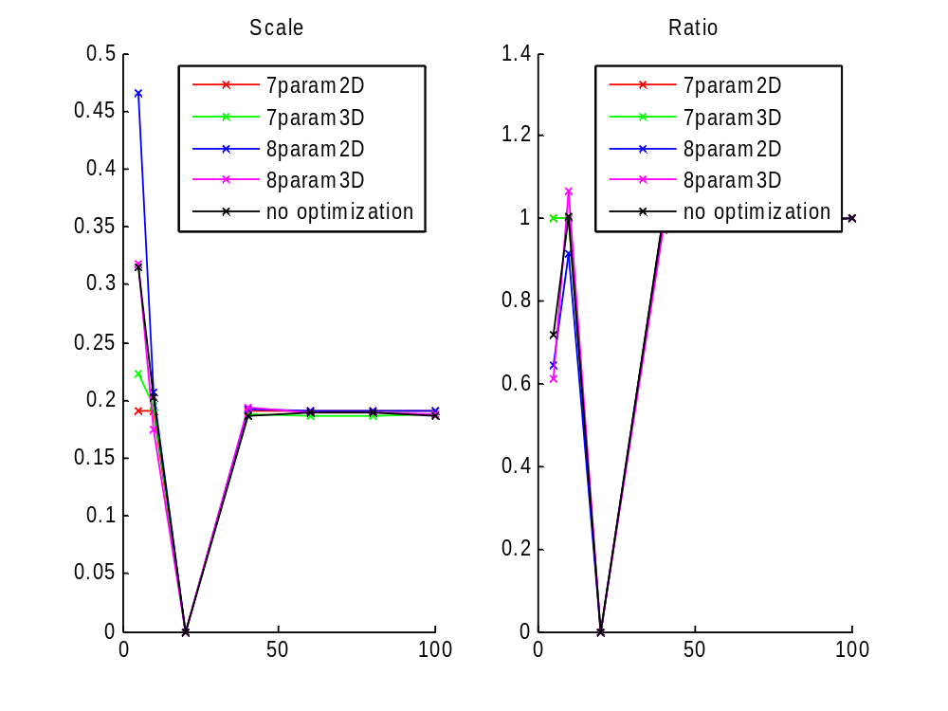
Curvilinear probe DEPTH 10

Slide 16
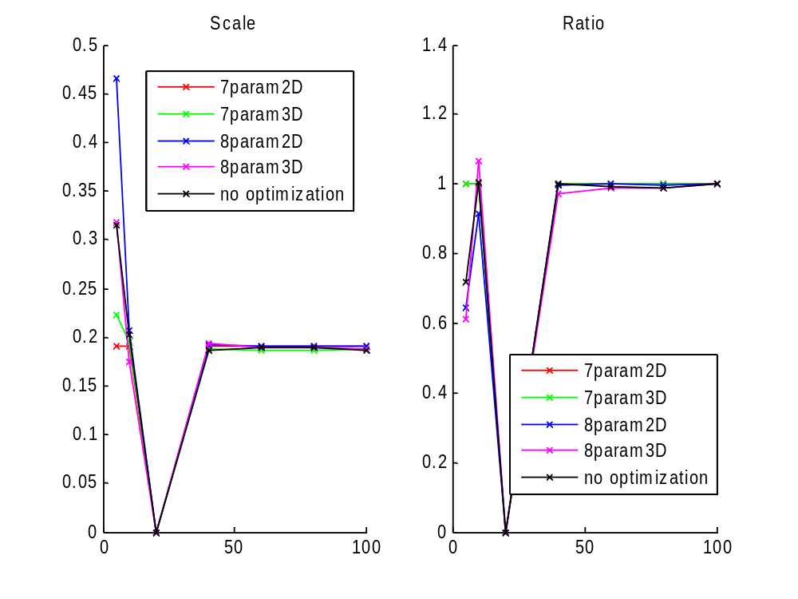
Curvilinear probe DEPTH 10

Slide 17

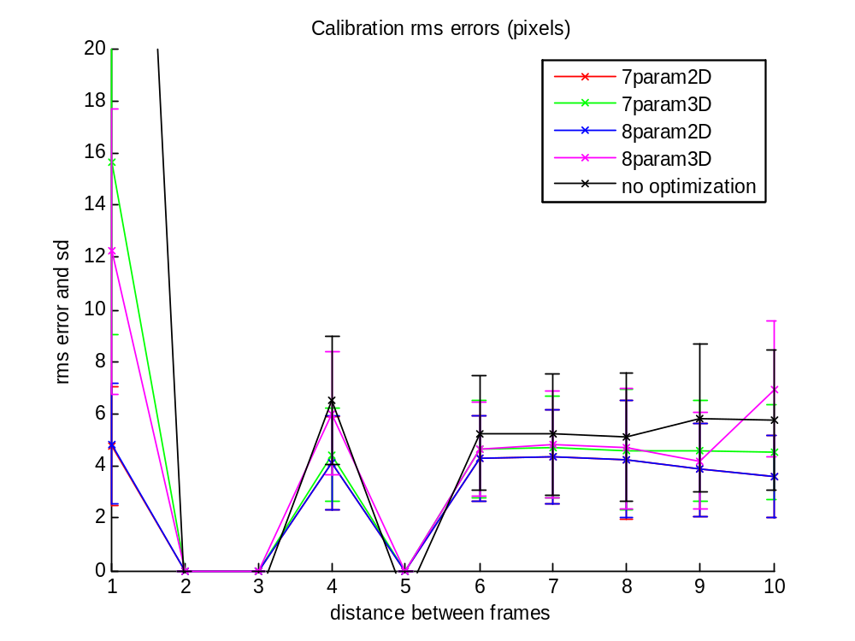

Slide 18

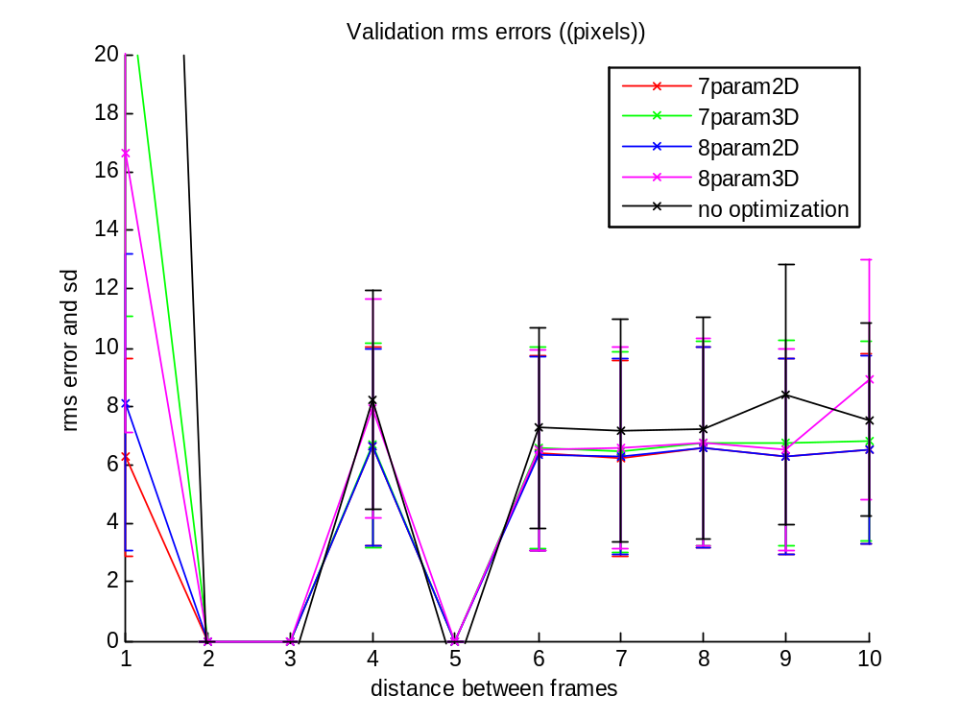

Slide 19
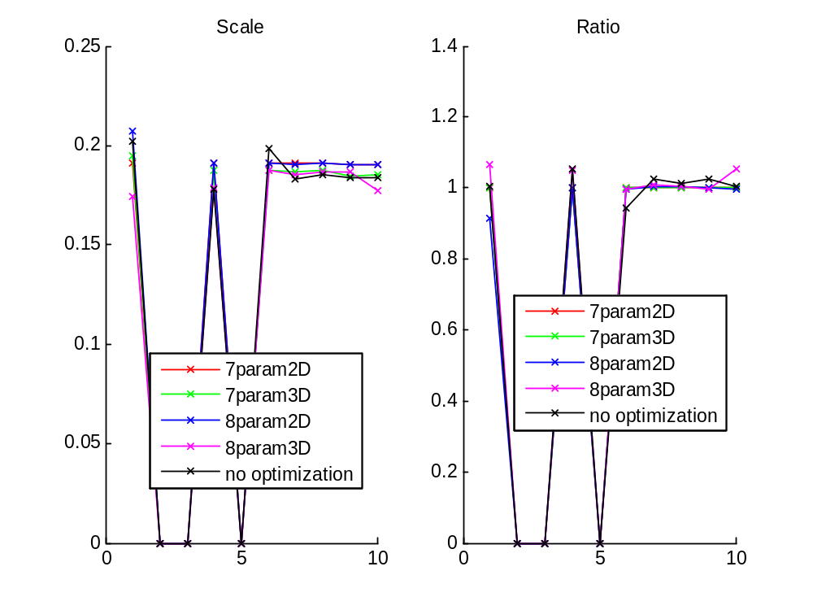

Slide 20
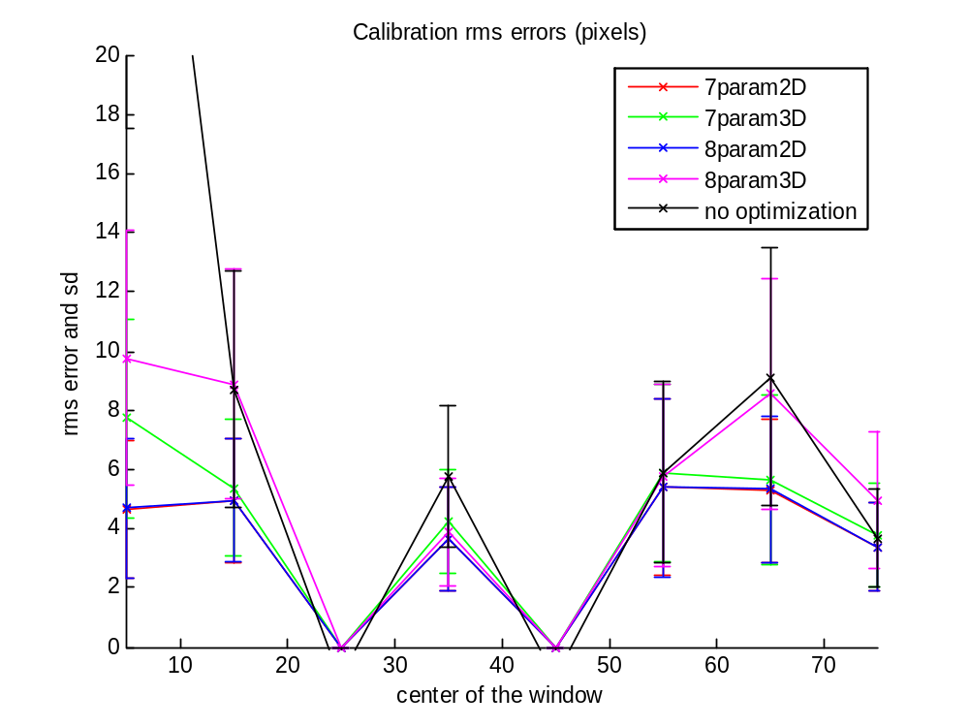

Slide 21
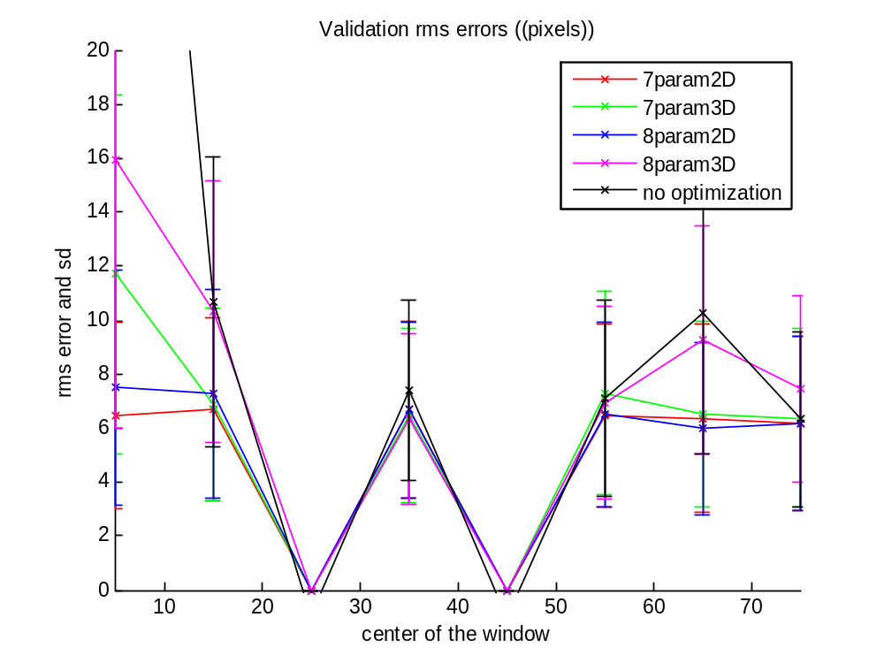

Slide 22
