Slide 1
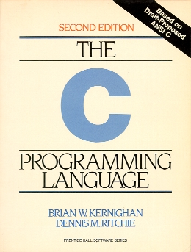
Getting Started
Andrew Christlieb (Instructor)
  D319 Wells Hall
  christli@msu.edu
  office hours
  Thursday 3-5
Classroom: 3353 Engineering Building

Slide 2
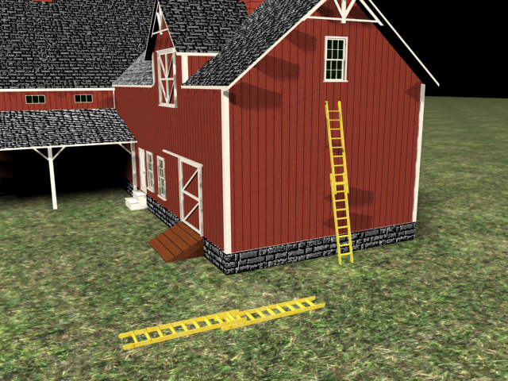
Structure of the Course
Get a quick intro to C programming
Learn enough Unix to use it
Get some experience with
C-oriented tools.
Get some experience writing code

Slide 3
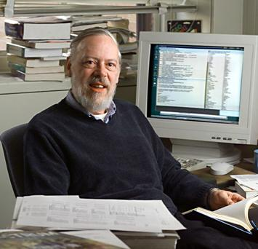
What is C?
C is a rather old programming language (1972, Richie, Bell Labs)
Originally designed as a systems software platform (OS and the like)
Procedural, block oriented language
(no object-oriented programming)
Dennis Ritchie
Inventor of the
C Programming Language

Slide 4
Why learn C?
Small, extensible language. Progenitor of many languages.
Many applications and much support due to its age and general use
Many tools written to support C development.
Close to the hardware, programmer manages memory
Common embedded systems language
Can be fast, efficient (most cited reason)

Slide 5
Disadvantages of C?
Flexible language allows programmers to commit many sins without warning
Hard to debug, fix code
Speed depends on programmer as much as the language
Managing memory can be dangerous, difficult, painful
Lacks modern features (OOP, exceptions, etc.)

Slide 6
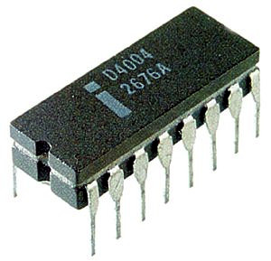
Why do you care?
Programming Microprocessor
Applications:
Robotics
Controller Area Networks
  Automotive
  Caterpillar
  Aircraft
Video Gaming (GPUs)
High End Computing For Comp EM (GPGPUs)
Adaptive Controls
Remote Sensing (Bridge Failure?)
Digitally Controlled Adaptive Filters
ALL OF ECE IS IMPACTED!
All modern micro possessors are designed to be programmed via C. Industry Standard!

Slide 7
Course Structure

Slide 8
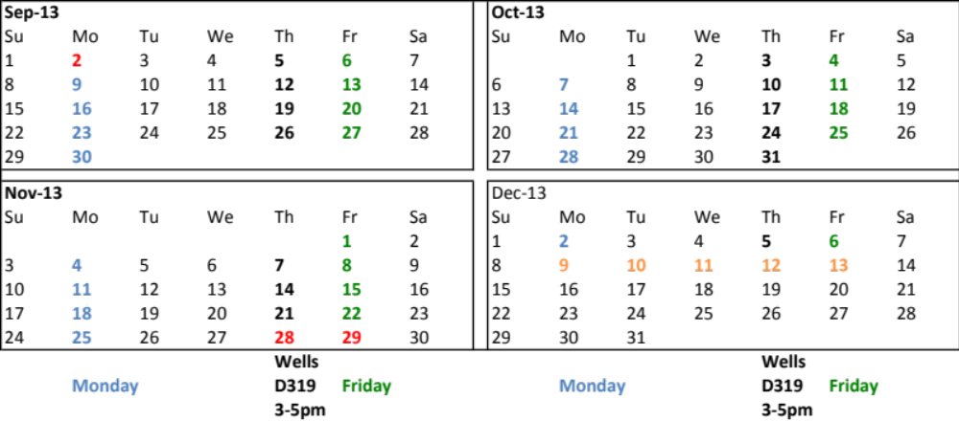

Course will be Lecture/Step
This is a 1 credit course, meets only 14 times!
Lecture/Step approach
  Spend some time on a lecture topic.
  Spend some time doing “hands-on” work.
  lecture/step will have some exercise you will have to turn in at the end
`
calendar

Slide 9
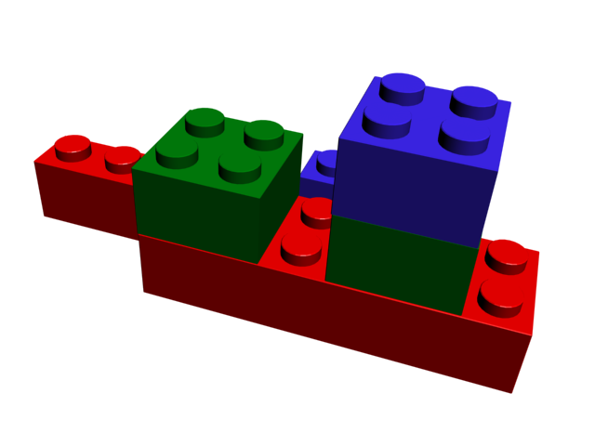
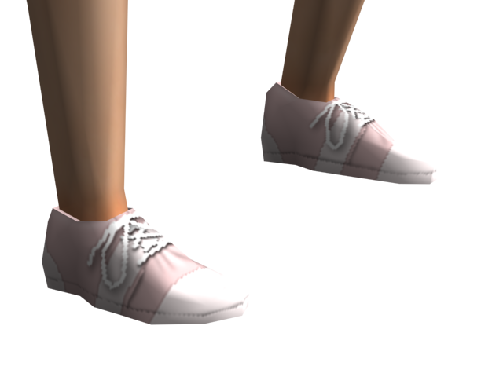
Grading
3 projects, each for 15% of the grade, total 45%
13-15 Step assignments, exercises, total 55%
That’s it. No exams, no quizzes

Slide 10

Attendance is important
We drop the lowest step assignment grade!
Should go without saying that in a course like this attendance is important.

Slide 11
Step exercises
These can be collaborative, done with discussion and help from anyone during lab. Talk to people, ask questions.
Lab time is a time to figure stuff out

Slide 12
Projects are individual
No collaboration on projects
They will be checked by cheat check
Just don’t do it. Do your own work
No makeups! There are only 3 and I’ll give plenty of notice. Get it in on time.

Slide 13
Get Started, booting

Slide 14
Rebooting to linux
Machines are split to run either linux (a unix variant) or Windows
You can reboot to run “diskless” and bring any machine up in linux.
Let’s do that now!

Slide 15
Booting
If your machine says “press control-alt-delete to log in”, do so, but use the red button in the lower right corner to shut the machine down. Then restart, selecting “diskless” when prompted.
Before logging in, use the Session menu to select GNOME as your session.
Once logged in, select Applications/Internet/Iceweasel Web Browser.
Go to http://www.cse.msu.edu/~cse251
Initial password is your PID (starts with A)
0

Slide 16
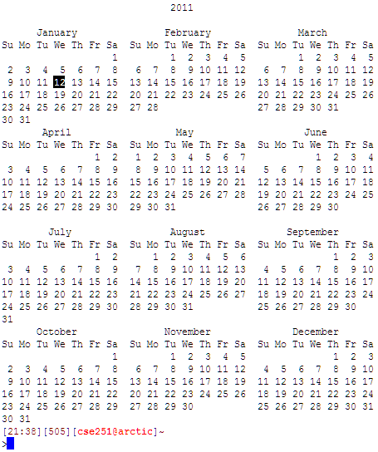
Bringing up…
Bring up a terminal
Window
Applications/
Accessories/Terminal
Type:
cal 2011

Slide 17
Directories

Slide 18

What is a directory/folder?
Be it Windows, Linux or OS X, all OS’s maintain a directory structure.
A directory is a container of files or other directories
These directories are arranged in a hierarchy or tree

Slide 19
Directory Structure
/
Root
Has a root node, with branch nodes, ends in leaf nodes
The directory structure is a tree
Each directory can hold files and ‘point to’ parent and children directories
/user
/bin
Branches
/cse251
/john
ls
myhello.c
/exercises
a.out
Leaves
hello.c
a.out

Slide 20

File Path
/
A path to a file is a path through the hierarchy to the node that contains a file or directory
/user/cse251/exercises/hello.c
/user
/bin
/cse251
/john
ls
myhello.c
/exercises
a.out
  Path is from root node /, to
  user directory, to cse251 directory, to exercises directory, where the file hello.c resides.
hello.c
a.out

Slide 21
The current directory
As you type in the command shell, you are presently “in” one current directory
Many commands are available to navigate by changing your current directory

Slide 22
Unix command caution(s)
Names are short. This is to avoid typing. Get used to it
Most commands take “switches”, parameters which modify the behavior of the command. Usually preceded by a ‘-’
All commands, all switches, all paths, all filenames are case sensitive

Slide 23
Some Unix Commands
pwd – Displays the current working directory
ls – Lists the contents of the current directory
cd – Changes the current directory
mkdir – Creates a new directory
1

Slide 24
Path String
a valid path string is a series of directories (separated by ‘/’) which indicates a valid path in the directory structure
‘/user/cse251/exercises/hello.c’ is a valid path string but ‘/cse251/hello.c’ is not

Slide 25
Three special directory names
‘.’ is shortcut for current directory you are in
  ‘./a.out’ is the same as ‘/user/cse251/exercises/a.out’ if you’re currently in /user/cse251/exercises directory
‘..’ is shortcut for the name of the parent directory of the current directory you are in
  ‘../a.out’ is the same as ‘/user/cse251/a.out’ if you’re currently in /user/cse251/exercises directory
‘~’ is a shortcut for your home directory
  ‘~/myhello.c’ is the same as ‘/user/john/myhello.c’ if your login name is john
2

Slide 26
mv (changes a file)
mv is the move command. Rename a file in place or move to a new directory
  mv file.c newFile.c
    rename file.c to newFile.c in current directory
  mv file.c /user/ptan/
    move file.c in the current directory to /user/ptan. The target directory must already exist
  mv ~/file.c ./newFile.c
    move file.c in home directory to the current directory with the name newFile.c

Slide 27
cp, copy a file
cp file.c newFile.c
  Create a new file called newFile.c in current directory from the file file.c, which is also in current directory
cp ../file.c ~/programs
  cp file.c in parent directory to the sub-directory programs under the home directory

Slide 28
rm, remove a file
Cannot be undone, be careful
rm /user/cse251/exercises/a.out
  remove the file called a.out
rm ./file.c
  remove file.c in the current directory
rm –i ./file.c
  interactive, are you sure?
3

Slide 29
man
man pages exist on Unix, providing documentation (a lot of documentation) on each command
man ls
  man page on the ls command
man -k graphics or apropos graphics
  every man page that has “graphics” as a word
man -S 2 mount
  man page for section 2 of mount

Slide 30
Better man pages
Almost every distribution of Linux provides a better way to view man pages
On Debian/Ubuntu, the program yelp (the help program) will show man pages
yelp, then man ls
  show man page on ls in a nice way
yelp runs using the “lifesaver” icon. Go to Advanced options, man pages
4

Slide 31
What’s the shell
the shell is the program that interacts with you through the terminal window
there are many, and you can change it easily
  csh
  ksh
  tcsh
  bash
by default, you are using tcsh

Slide 32
Prompt
Default prompt looks like:
<47 nelson:/usr/include >
  47, which command in the history this is
  nelson, the name of the machine you are on
  /usr/include, current directory
can be configured differently
[19:19][31][cse251@nelson]~
>
  two lines: time, history, who@machine, path

Slide 33
Job control
Only one job runs in foreground (sending text to console), but many can run in background
Foreground job controls the console
  emacs myFile.c &
    & mean run emacs in background. Console remains responsive to commands
  jobs
    lists all jobs running in background. Numbers can be used to control job

Slide 34
ps: List of processes
Typically, each job that is executing is called a process
  Sometimes, a job can produce (fork) multiple processes
Use “ps” command to list all your current processes (including those that were suspended or running in background)
  It also shows the background processes (including the shell program you’re using)
5

Slide 35
Command completion
Type a partial command, followed by tab. it will complete as much as it can

Slide 36
Compiling

Slide 37
compile to make an executable
In C, you cannot directly execute the source code. You go through a process called compilation
Compilation makes sure you “followed the rules of C” (even if you did something stupid), and makes an executable
Compilation errors are rule “mistakes”. A compilation error means no executable
The executable file is the thing you run

Slide 38
gcc: gnu compiler
There are others, but this is a good one and it is free (and on all Linux distributions, can be added to the MacOS and runs under Cygwin on windows)
Has just around a zillion switches. Can be pretty impressive if you read the man page.

Slide 39
Example gcc usage
gcc file.c
  if it compiles, makes an executable called a.out in the same directory as file.c
  can run a.out by typing ./a.out (meaning the a.out in the current directory)
gcc -o myExec file.c
  make the executable called myExec

Slide 40
Compilation errors
You didn’t follow the rules
You have to fix the source code before the compiler can make an executable
Errors can be cryptic, but at the very least they list the line number where it went wrong
Doesn’t prevent run-time errors

Slide 41
Editors

Slide 42
Many Editors
Examples:
  gedit
  vi
  emacs
  pico
  kate
I’m going to suggest using gedit in this course.
6

