Slide 1
Embedded Systems & IoT Workshop
Building Connected Devices with ESP32
Workshop Dates · Venue · Instructor(s)

Slide 2
SECTION 03
ESP32 Architecture & Hardware

Slide 3
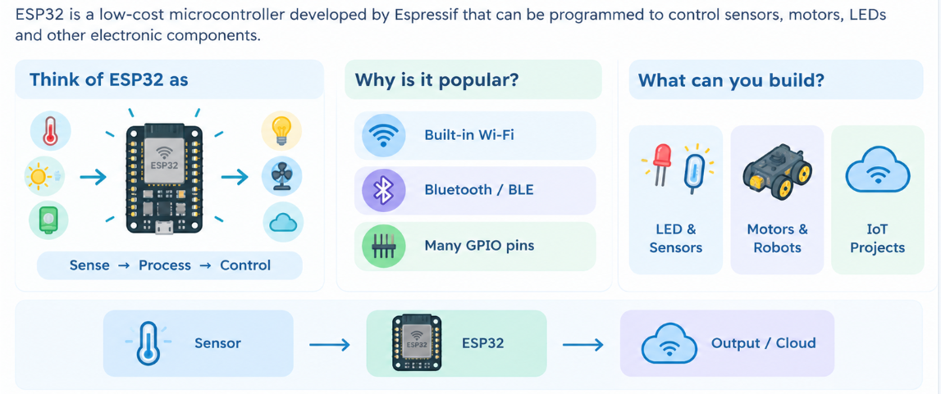
ABOUT ESP32

Slide 4
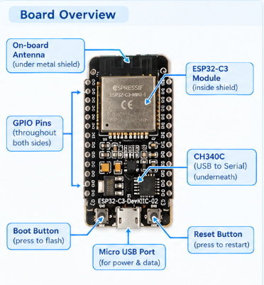
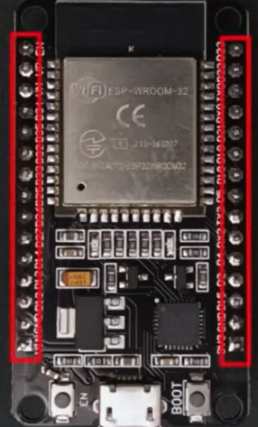
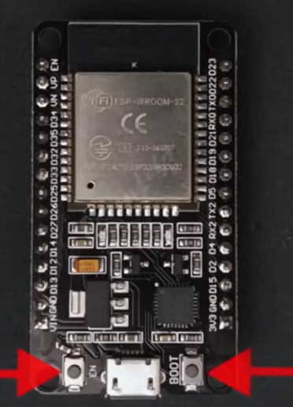
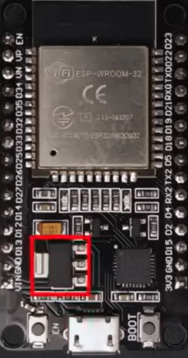
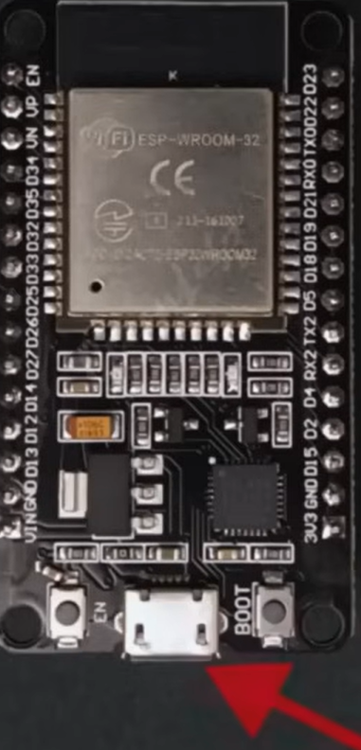
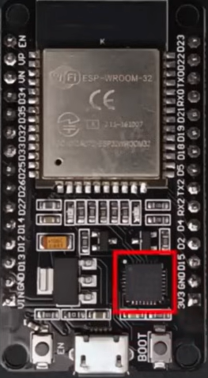
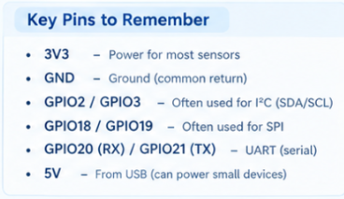
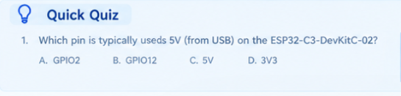


PIN DIAGRAM AND BOARD OVERVIEW
USB PORT USB TO SERIAL CONV
GPIO PINS RESET AND BOOT 3.3V REGULATOR

Slide 5
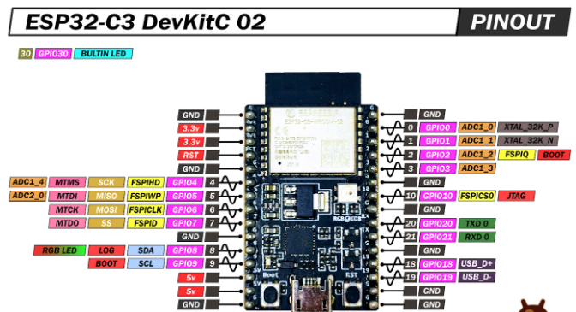

Slide 6
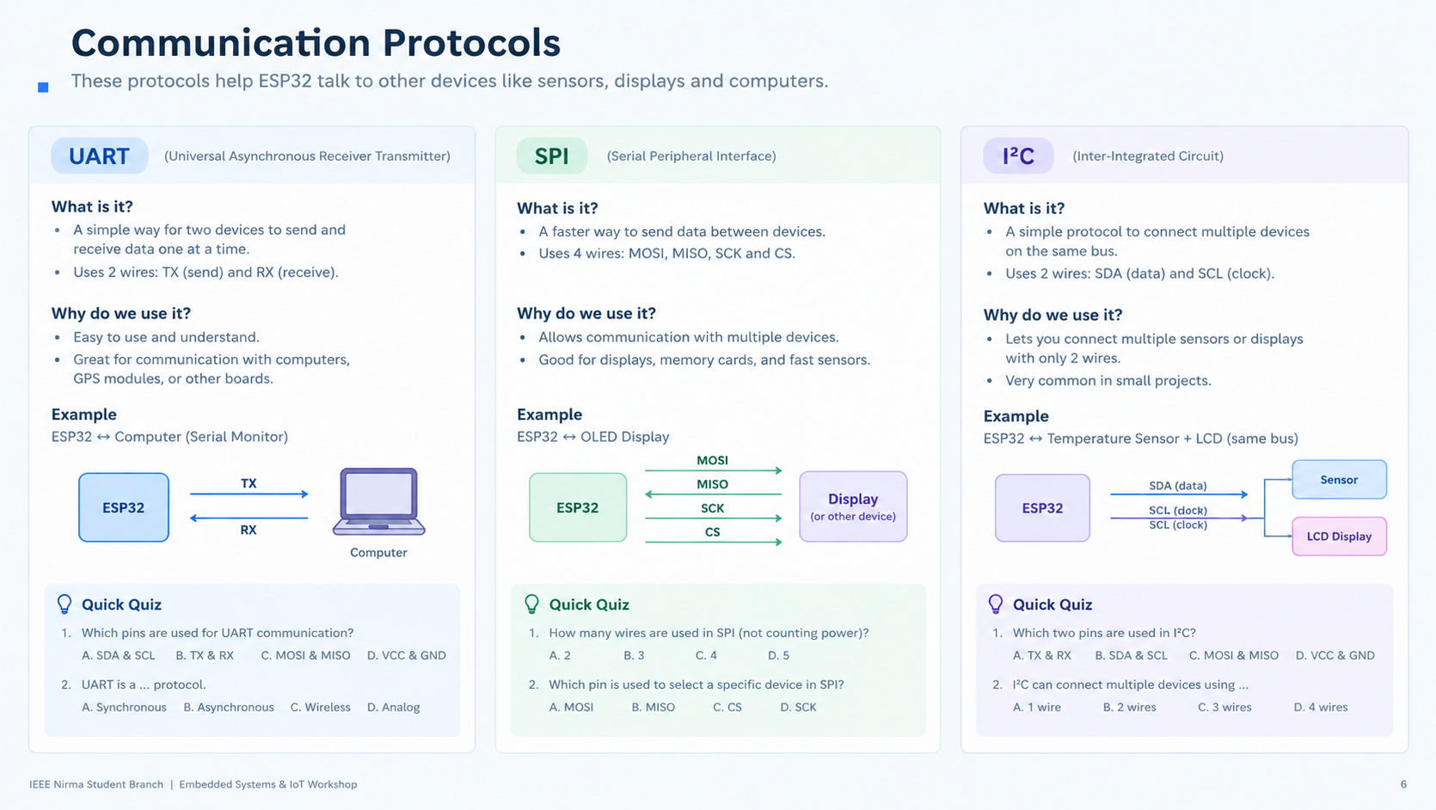
Communication Protocols
Column A · e.g. UART
Column B · e.g. SPI
Column C · e.g. I2C

Slide 7
Sensors & Peripherals
Text Content · key points about the sensor / peripheral
Image

Slide 8
Ultrasonic Sensor
Interface
Operating Voltage
Range
Key Pins
Component Photo

Slide 9
LCD
Interface
Operating Voltage
Range
Key Pins
Component Photo

Slide 10
ESP-NOW vs. Wi-Fi
Feature | Option A | Option B

Slide 11
Wi-Fi & Web Servers
wifi_web_server.ino
// code block · syntax-highlighted snippet goes here

Slide 12
IoT Gateway — Architecture
Diagram / Block Canvas · drop blocks, arrows & icons here

Slide 13
Mini Challenge: Activity Title
1
2
3
Step 1
Step 2
Step 3

Slide 14
Demo: Smartphone IoT
Live Demo Area

Slide 15
Recap
Key Takeaway 1
Key Takeaway 2
Key Takeaway 3

Slide 16
Thank You
Questions?
ieee.nirma@example.edu · @ieee_nirma

