Slide 1

Binary Search Presentation
Group 2 Members:
Mark Diokno
Michaela Yusilon
Niel Villaverde
Zach Señado

Slide 2
What is Binary Search?
Binary Search helps find something quickly in a sorted list. It splits the list into two halves to reduce the search area.
Why use it? It’s fast and saves time compared to checking everything one by one (like in linear search). It works on sorted lists only.

Slide 3
The Key Idea
1. Look at the middle item in the list.
2. If the middle item is what you're looking for, stop – you've found it!
3. If not:
If the target is smaller, search the left half.
If the target is bigger, search the right half.
4. Keep repeating until you find it or the list ends.

Slide 4
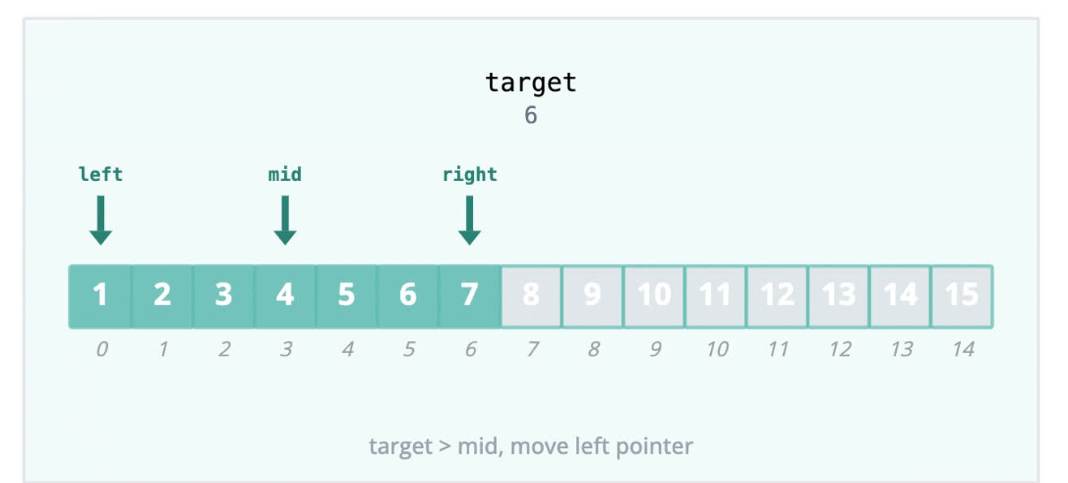
A Simple Visualization

Slide 5
Example for Understanding
Find number 8 in this sorted list:
[2, 4, 6, 8, 10, 12]
1. Middle item: 6. Is it 8? No.
3. New middle item: 10. Is it 8? No.
2. Is 8 bigger or smaller than 6? Bigger.
4. Is it 8? No.
Search the left half: [8].
Search the right half: [8, 10, 12].
5. Found it!

Slide 6
Pseudocode
BinarySearch(array, target):
1. Set low = 0
2. Set high = size of array - 1
3. While low <= high:
a. Calculate mid = (low + high) / 2
b. If array[mid] == target:
Return mid
c. Else If array[mid] < target:
Set low = mid + 1
d. Else:
Set high = mid - 1
4. Return -1

Slide 7
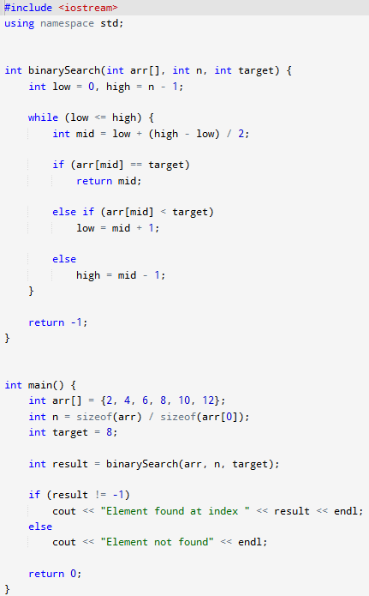
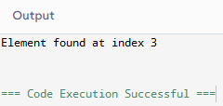
Source Code
Output:

Slide 8
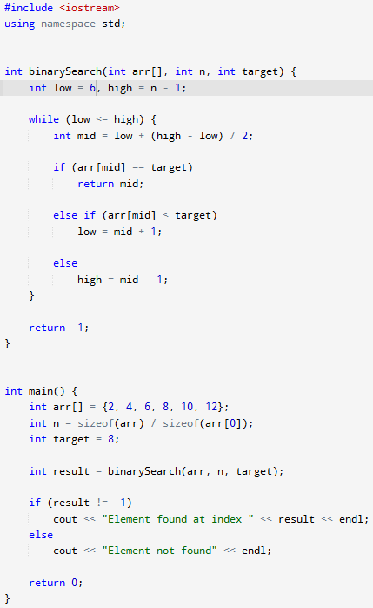
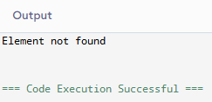
Output:

Slide 9
Thank You For Listening!

