Slide 1
Quality of Life Assessment through Smart Video Monitoring
Develop a smart video-based system that recognises and tracks human activities to support wellbeing and independent living.
Raadhesh Kannan, PhD Researcher, University of Plymouth

Slide 2
Motivation & Goals
Growing need for non-intrusive health monitoring systems.
Video-based activity tracking offers valuable behavioural insights.
Goal: Recognise activities such as walking, sitting, standing, and falling.
Enable carers and doctors to monitor wellbeing and detect risks early.
Raadhesh Kannan, PhD Researcher, University of Plymouth
Notes:
Explain the problem of sedentary behaviour and the importance of non-contact health monitoring.

Slide 3
Experimental Setup
Camera: Fixed HD camera positioned in room corner (4×4 m coverage).
Environment: Indoor lab or living-room setting.
Subjects: 1–3 individuals performing daily tasks.
Hardware: PC or Jetson Nano for model inference.
Software: Python, OpenCV, TensorFlow/PyTorch, Flask for UI.
Optional: Multi-camera setup for occlusion handling.
Raadhesh Kannan, PhD Researcher, University of Plymouth
Notes:
Briefly describe the physical environment, camera positioning, and computing setup.

Slide 4
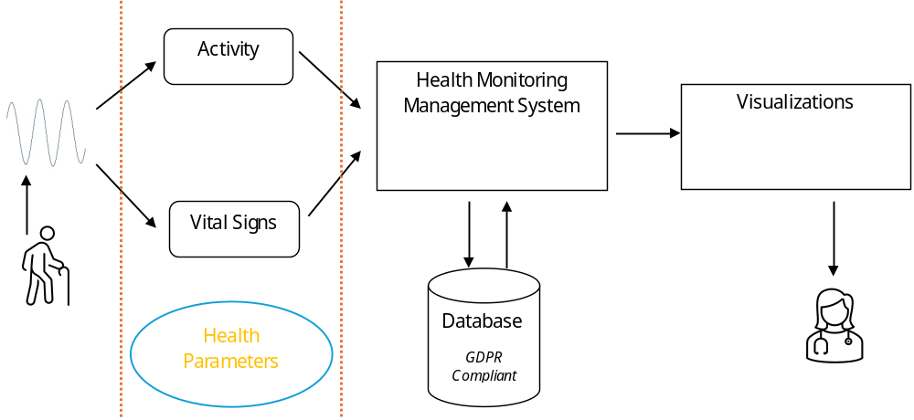
System Architecture
Camera Input
Frame Preprocessing
Activity Recognition
(CNN + LSTM)
Event Logging
User Interface
Display
Pattern Analysis
Raadhesh Kannan, PhD Researcher, University of Plymouth
Notes:
Explain each component: camera capture, frame processing, deep learning model, logging detected events, user interface visualisation, and long-term pattern analysis.

Slide 5
Recognised Activities & Extensions
Basic Activities: Walking, Sitting, Standing, Falling.
Extended: Lying down, Reaching, Bending, Picking up objects.
Advanced (optional): Walking speed, Posture analysis, Multi-person tracking.
These extensions increase the system’s capability for detailed behavioural analysis.
Raadhesh Kannan, PhD Researcher, University of Plymouth
Notes:
Discuss which activities are detected and how the model could be expanded to more complex behaviours.

Slide 6
Analysis of observed activities
Time spent in the house or room.
When and how long time is spent on each activity
Recognition and categorization of daily habits.
Quality of life improvement or deterioration over time.

Slide 7
Expected Outcomes
Functional prototype demonstrating smart video monitoring.
Insights into daily activity patterns and sedentary behaviour.
Practical applications in elderly care and rehabilitation.
Foundation for future multi-sensor integration and health analytics.
Raadhesh Kannan, PhD Researcher, University of Plymouth
Notes:
Summarise the tangible results, showing practical use cases and possible extensions.

Slide 8
Thank You / Questions?
Raadhesh Kannan, PhD Researcher, University of Plymouth
Notes:
Invite questions and feedback. End with appreciation.

