Slide 1

What have we done so far?

Slide 2
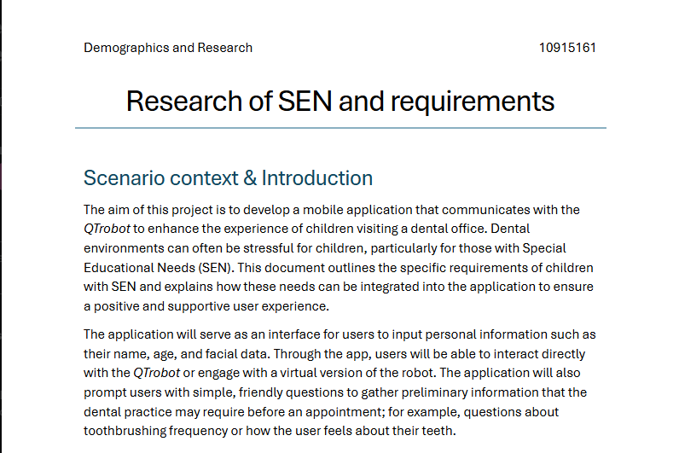
Research
Established the special requirements of SEN users
Interviewed qualified professionals about features they would recommend
Researched SEN and noted the implications for the design of the application

Slide 3
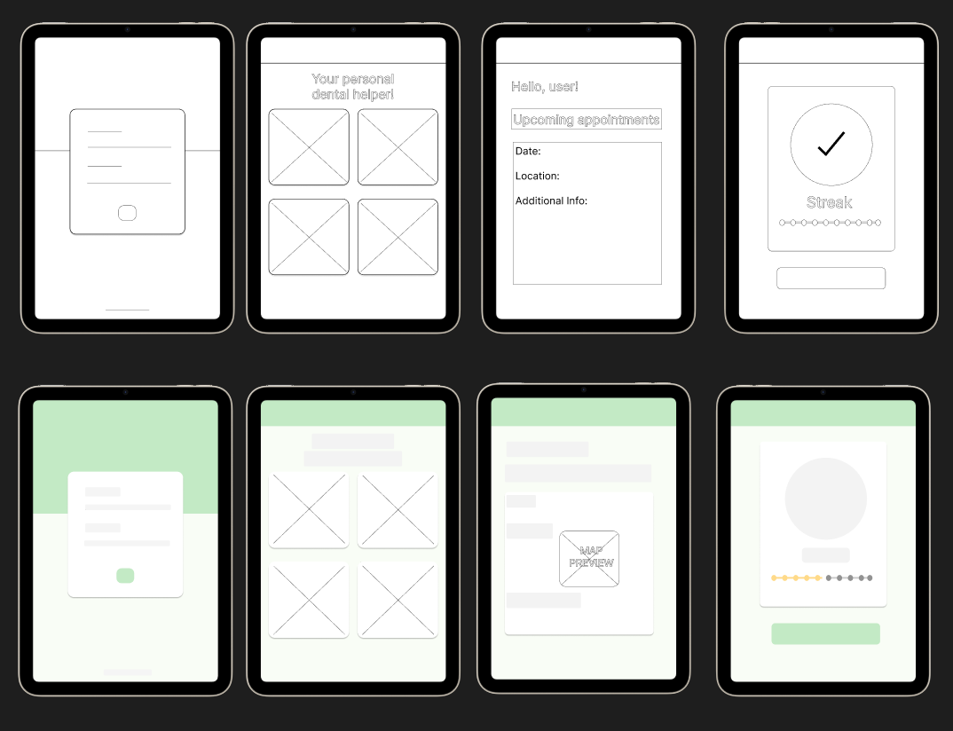
Wireframes
The colour scheme is not finalised, just an example of how the application will look.

Slide 4
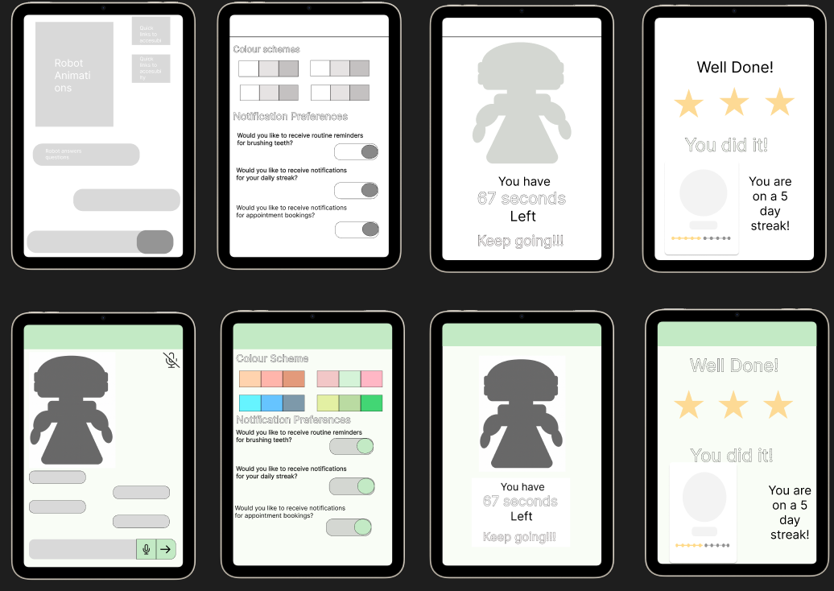
Wireframes
The following designs are based on initial user requirements, subject to being updated upon requirement refinement

Slide 5
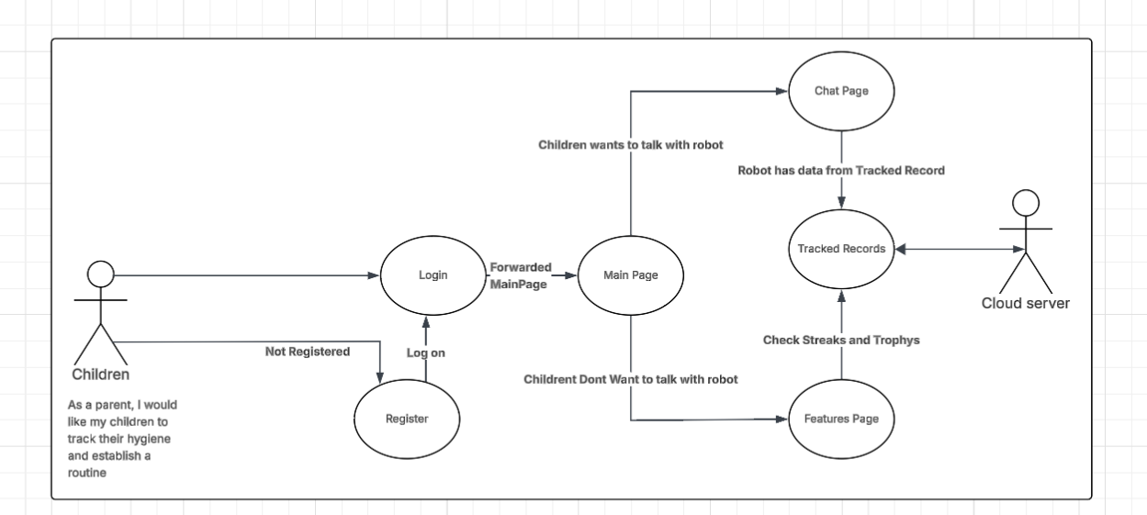
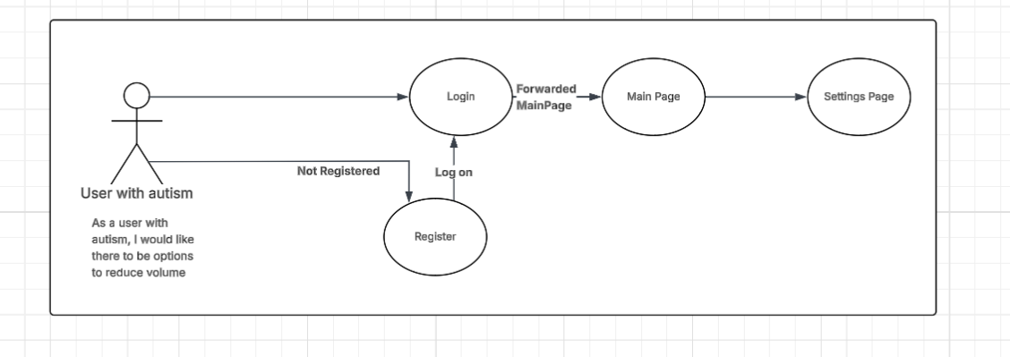
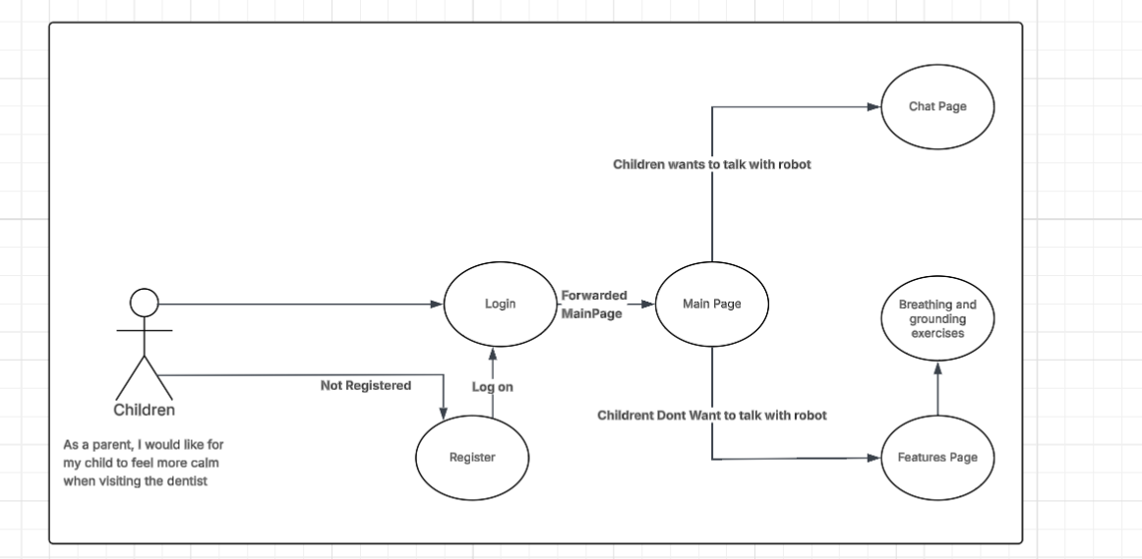
User Stories

Slide 6
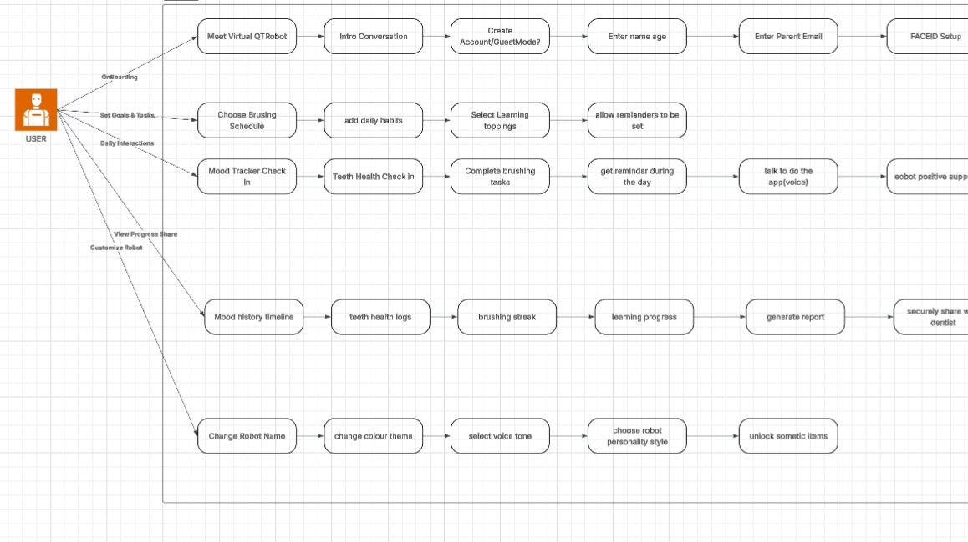
Use case Diagram

Slide 7
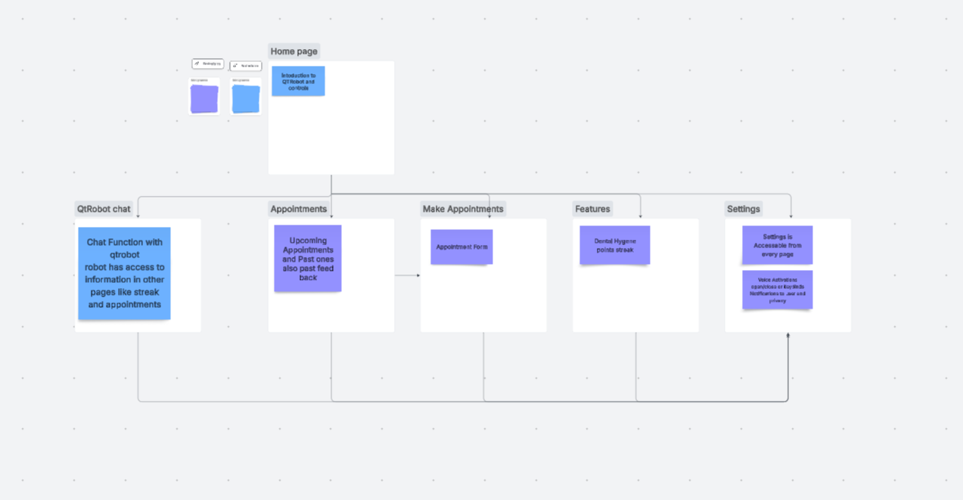
Flow Diagram

Slide 8
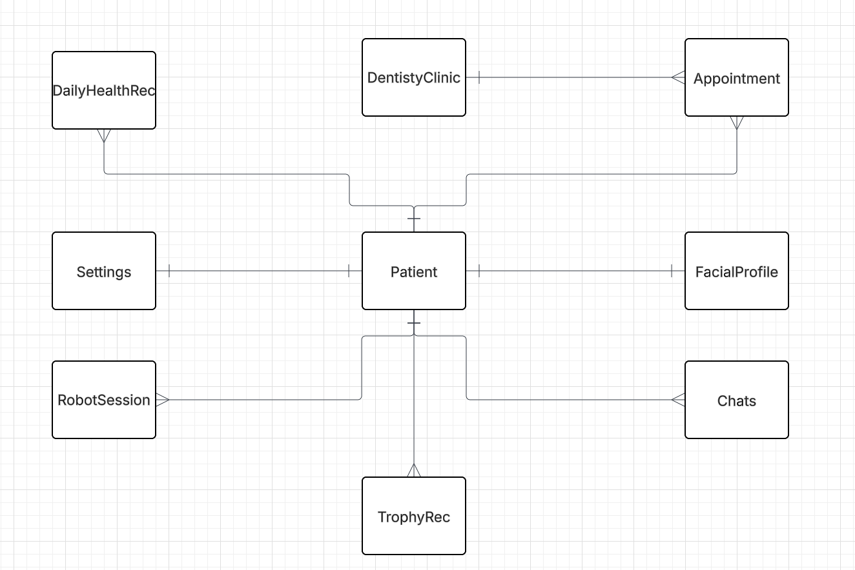
Initial ERD
One Patient can have many DailyHealthRecords
One Patient can have one FacialProfile
One Patient can have one Settings configuration
One Patient can have many TrophyRecords
One Patient can have many RobotSessions
One Patient can have many Chats
One Patient can have many Appointments
Many appointments can belong to One DentistryClinic

Slide 9
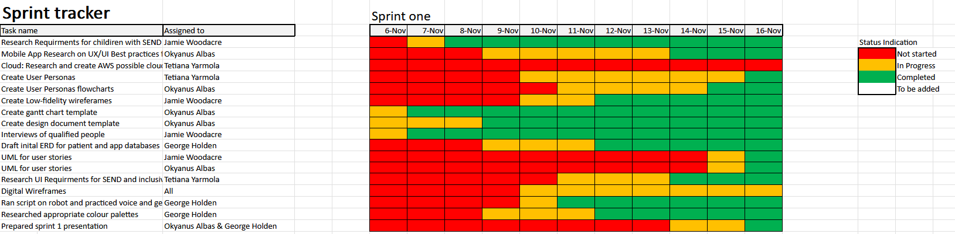
Our Gantt Chart

