Slide 1
Briefing, Practice & Progress

Slide 2
Goals
Improve engagement
Build skills
Reduce workload

Slide 3
“Briefing”
Weekly, zoom-based, whole-cohort
Monday 10am
15-30 minutes
Build community
Orient students to weekly tasks, deadlines, expectations
Introduce ‘practice’ tasks
Reflect on previous week’s tasks

Slide 4
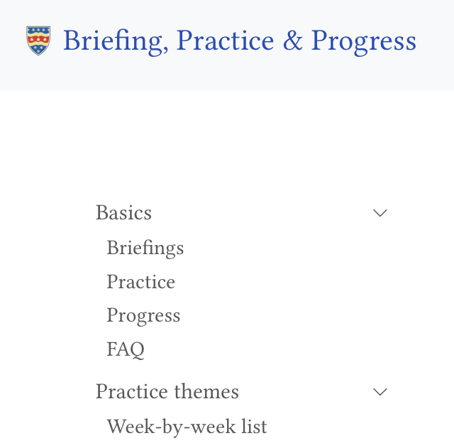
“Practice”
Weekly, small, structured tasks,
15-25 minutes each
Studying, Thinking, Writing, Speaking, & Growth
Develop positive study habits
Engage with essential academic and personal skills
Designed to make automated feedback possible
Provide a simple metric for engagement

Slide 5

“Practice”
Posted to online learning log*
(AI) formative feedback

Slide 6
“Progress”
Meet students twice per semester (+1 at the start)
40 minutes
In pairs/threes
Weeks 1/2, 5/6 and wk 11 (semester 1)
Linked to practice tasks
Later meetings: agenda student led (a task for them)

Slide 7
What you will need to do
5 progress meetings each year
In your office
(for later meetings)
Briefly scan student’s ‘practice’ log to prompt discussion

Slide 8
How does this compare?
. . .
Old stage 1: 1578 staff hours in total
. . .
New scheme:
Briefings: 45 hours.
Practice: ~300 hours to develop in year 1;
time to administer Psylab, automated feedback.
Progress: ~812 hours (max)

