Slide 1
The OpenSesame program normally runs on a local computer. A few things have to be done to turn this into an online study. The school has its own JATOS server which hosts these online studies. You have been given an account on this server:
https://jatos.plymouth.ac.uk/jatos/login
You will eventually give participants online links that allow them to run your study in any browser.

Slide 2
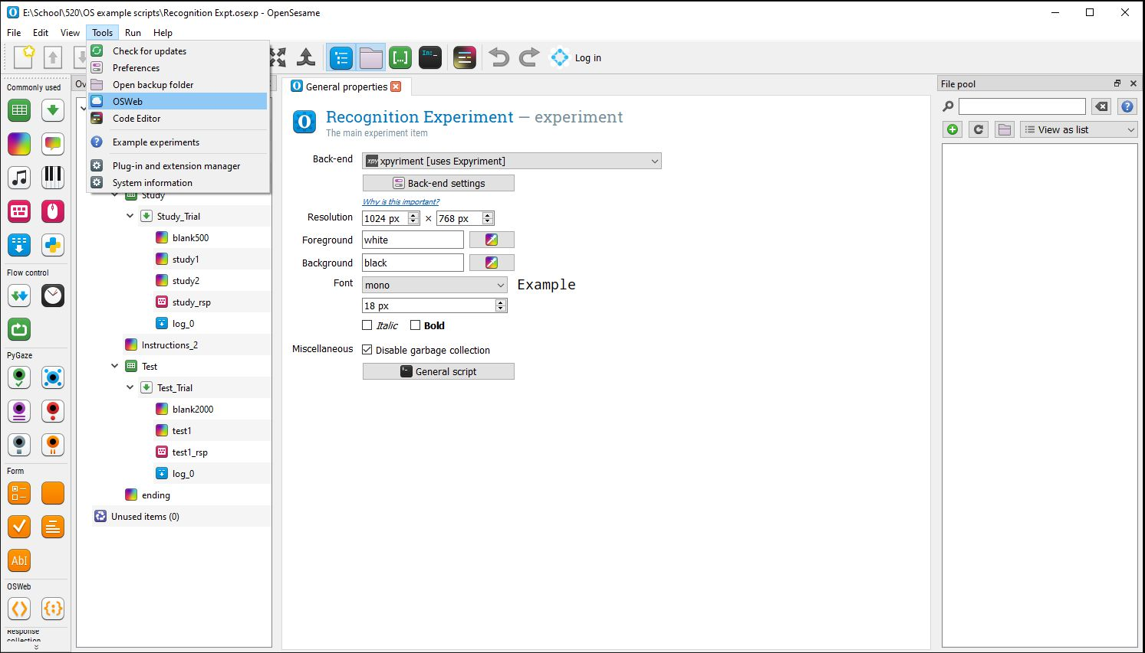
Step 1. Test your program to see if it’s compatible with running online.
Click: Tools → OSWeb

Slide 3
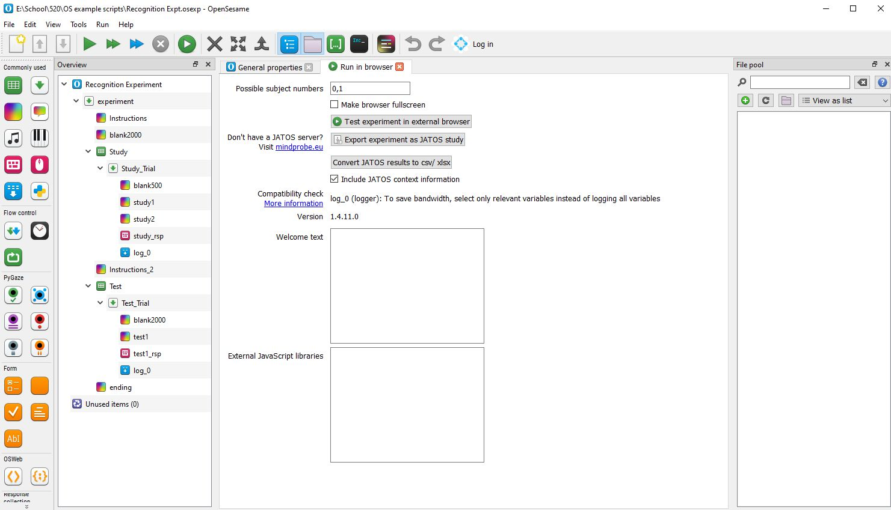
Deleting 0, 1
Remember to delete "0, 1" top row of the possible subject number

Slide 4
Step 2. Run the Experiment in an external browser with this button
If it doesn’t run properly in the browser view, it won’t run online!

Slide 5
Step 3. Export the Experiment with this button
It will turn your program into a zip file (.zip extension) – save this file.

Slide 6
Step 4. The zip file that you saved is now ready to be uploaded to the JATOS server.
Watch the “Uploading an OpenSesame Experiment” video on the student resources page for instructions on how to do this.
If you have multiple experiment programs (e.g. one for each between-subjects condition in your study) you will do this for each program.

