Slide 1
The OpenSesame program normally runs on a local computer. A few things have to be done to turn this into an online study. The school has its own JATOS server which hosts these online studies. You have been given an account on this server:
https://jatos.plymouth.ac.uk/jatos/login
You will eventually give participants online links that allow them to run your study in any browser.
To export your OpenSesame script to a format that can be used on JATOS, follow the instructions in the following pages:
For OpenSesame version 3, check the instructions on pages 2-6
If you have installed or updated OpenSesame to version 4, check the instructions on pages 7-12 instead

Slide 2
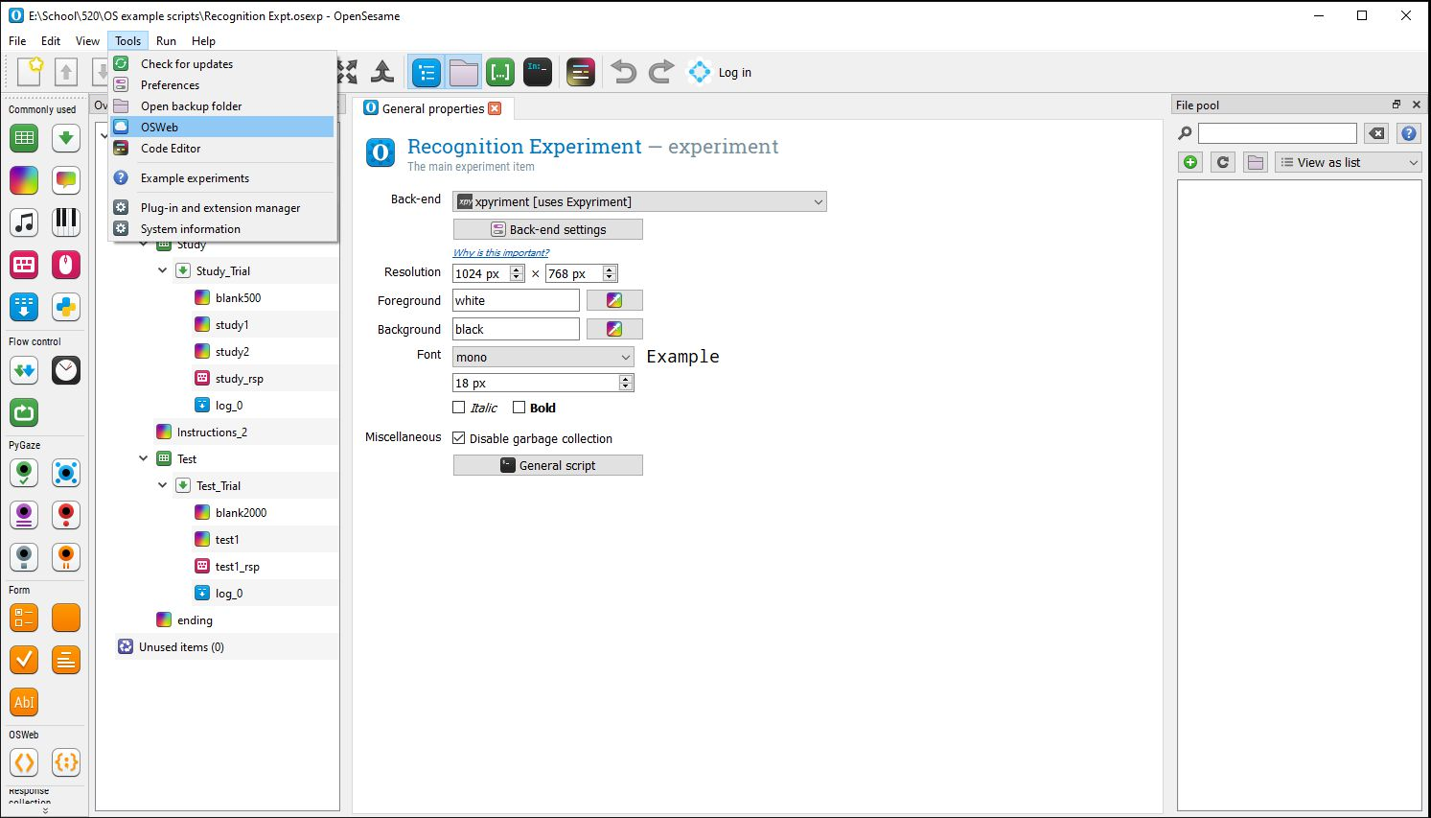
OpenSesame
version 3.x
Step 1. Test your program to see if it’s compatible with running online.
Click: Tools → OSWeb

Slide 3
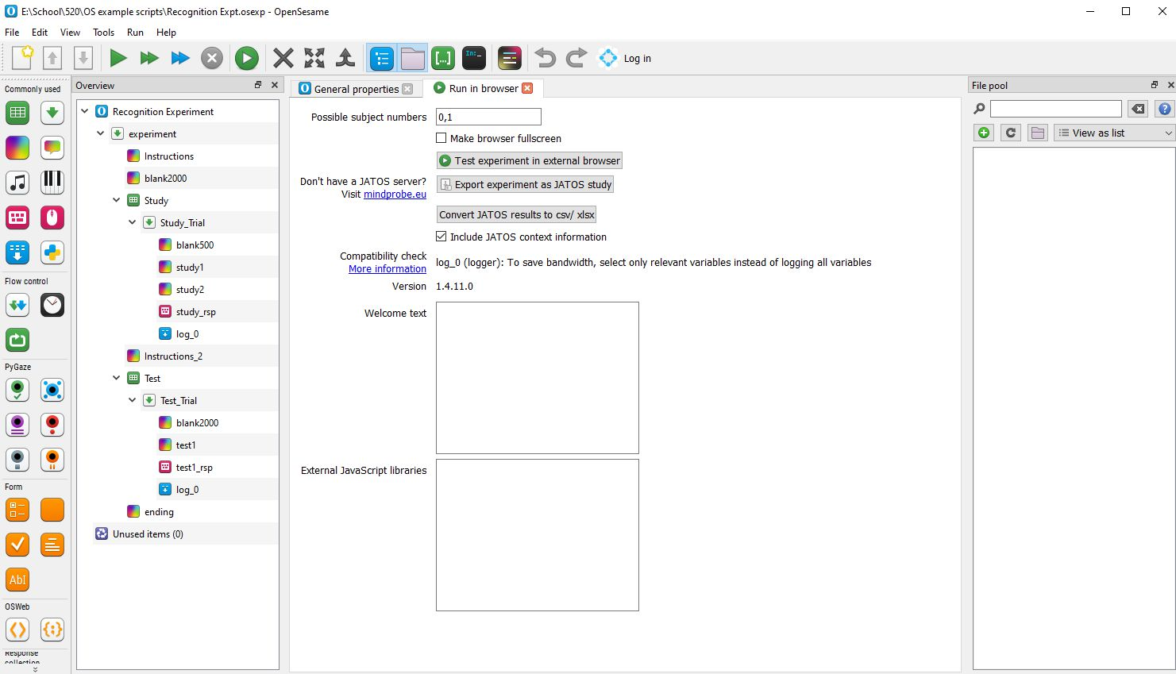
Deleting 0, 1
OpenSesame
version 3.x
Remember to delete "0, 1" top row of the possible subject number

Slide 4
OpenSesame
version 3.x
Step 2. Run the Experiment in an external browser with this button
If it doesn’t run properly in the browser view, it won’t run online!

Slide 5
OpenSesame
version 3.x
Step 3. Export the Experiment with this button
It will turn your program into a zip file (.zip extension) – save this file.

Slide 6
OpenSesame
version 3.x
Step 4. The zip file that you saved is now ready to be uploaded to the JATOS server.
Watch the “Uploading an OpenSesame Experiment” video on the student resources page for instructions on how to do this.
If you have multiple experiment programs (e.g. one for each between-subjects condition in your study) you will do this for each program.

Slide 7
OpenSesame
version 4.x
Follow the instructions on pages 8-12 only if you have installed or updated OpenSesame to version 4

Slide 8
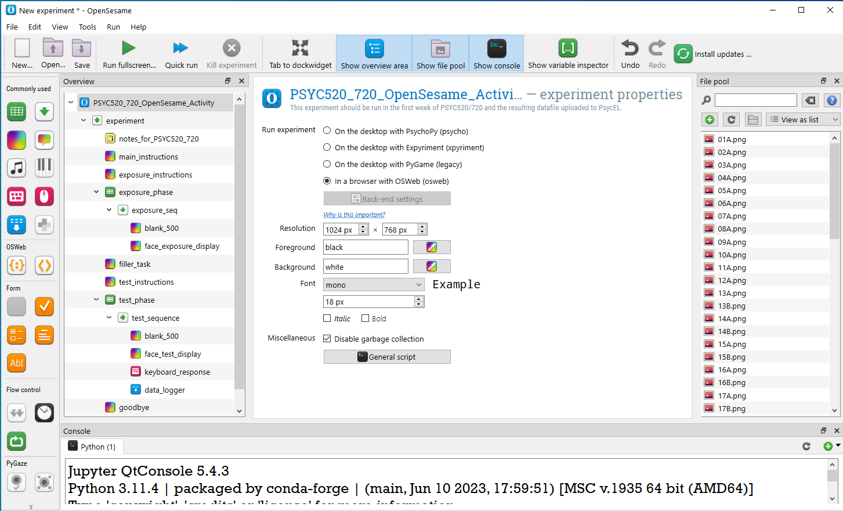
OpenSesame
version 4.x
Step 1. Test your program to see if it’s compatible with running online.
In the experiment properties, check “in a browser with OSweb”
Run your experiment as usual. It should open in a browser window (we recommend Google Chrome).
If it doesn’t run properly in the browser view, it won’t run online!
Once you have tested that your experiment works as expected in a browser, remember put this setting back to “On the desktop with Expyriment” if you want to test your experiment further on your laptop

Slide 9
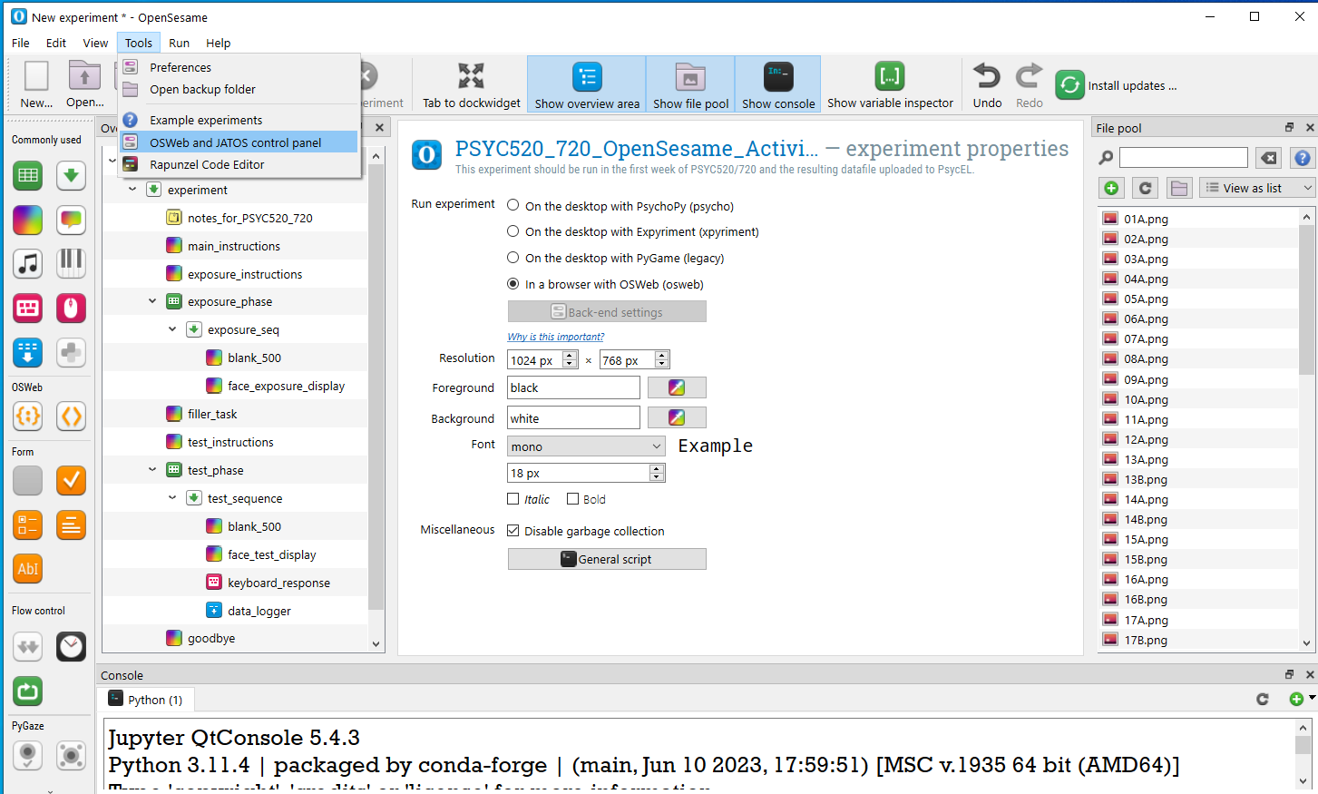
OpenSesame
version 4.x
Step 2. Export the Experiment to a .jzip file
Open the “OSWeb and JATOS control” panel from the “Tools” menu

Slide 10
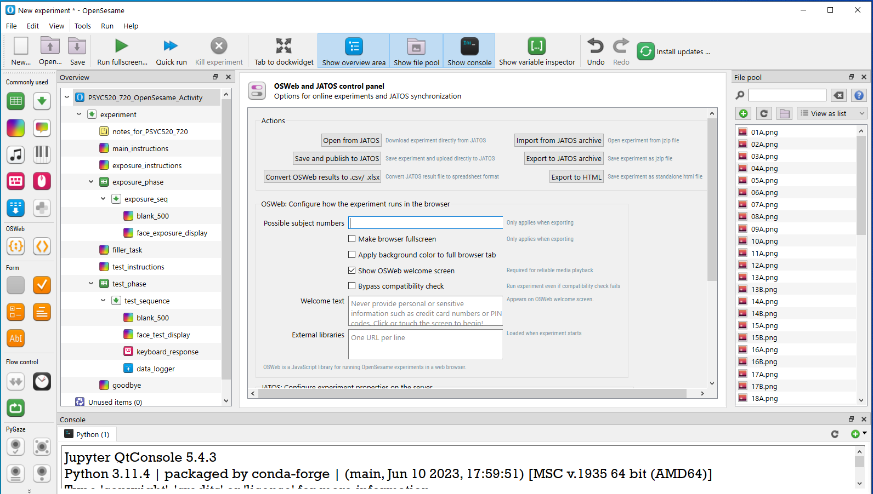
OpenSesame
version 4.x
Step 3. Export the Experiment to a .jzip file
Make sure you delete the "0, 1" values in the “possible subject number” field

Slide 11
OpenSesame
version 4.x
Step 4. Export the Experiment to a .jzip file
Click the “Export to JATOS archive” button
This will turn your program into a jzip file (.jzip extension) – save this file.

Slide 12
OpenSesame
version 4.x
Step 5. The jzip file that you saved is now ready to be uploaded to the JATOS server.
Watch the “Uploading an OpenSesame Experiment” video on the student resources page for instructions on how to do this.
If you have multiple experiment programs (e.g. one for each between-subjects condition in your study) you will do this for each program.

