Slide 1

Structure-Aware Financial Forecasting using Hankel Matrices and Dual LSTM Fusion
B.Tech (AIDS)
UG-II (IV-Semester)
Subject Coordinator
Presented By:
Mathematics for Intelligent Systems IV
Dr. Anirban Tarafdar (Assistant Professor)
Team 11
Dhwanit Sharma (DL.AI.U4AID24111)
Kanan Goel (DL.AI.U4AID24017)
Parkhi Mahajan (DL.AI.U4AID24126)
Punit Lohan (DL.AI.U4AID24127)
AMRITA VISHWA VIDYAPEETHAM, DELHI NCR, FARIDABAD
Department of Artificial Intelligence & Data Science (AIDS)

Slide 2

CONTENTS
Problem Statement
Literature Review
Research Novelty & Contribution
Objectives of the project
Proposed Methodology
Tools and Technologies
Experimental setup
Results
Challenges
Conclusions & Future scope
References

Slide 3
Problem Statement
The Engineering Problem: Forecasting financial time-series accurately is challenging due to noisy short-term fluctuations, long-term market dependencies, and hidden structural changes.
Why it Matters: Traditional forecasting methods often rely only on historical price values and fail under volatile market conditions. A structure-aware multi-scale system can improve forecasting robustness and reliability.
Real-World Context: Modern financial markets are influenced by both asset-specific behavior and cross-market factors such as oil prices, currency rates, and crypto trends. Ignoring these interactions reduces prediction performance.
Applications
Stock market prediction
Risk management
Portfolio optimization
Multi-asset analytics

Slide 4
Literature Review
System 1: Statistical Forecasting Models
Method: Uses historical linear trends for prediction.
Limitation: Poor performance in nonlinear volatile markets.
System 2: Single LSTM Models
Method: Uses sequential deep learning for time-series forecasting.
Limitation: Learns only one feature scale and ignores macro dependencies.
System 3: Black-Box Deep Models
Method: Uses deep neural networks for prediction.
Limitation: High complexity with low interpretability and no uncertainty estimation.
Limitation of Existing Methods
No joint modelling of short-term and long-term market dynamics
No structural feature extraction from temporal patterns
No uncertainty estimation for forecast reliability
Research Gap:
Need for an integrated forecasting framework that combines multi-scale market features, structural time-series analysis, and confidence-aware prediction.

Slide 5
Objectives of the Project
Objective 1: To extract micro and macro financial indicators from multi-asset datasets.
Objective 2: To model structural patterns using Hankel matrices and Singular Value Decomposition.
Objective 3: To develop a dual-branch LSTM fusion model for forecasting.
Objective 4: To estimate prediction uncertainty using Monte Carlo simulation.
Training Objective:
$L= αL_{micro}+\left(1−α\right)L_{macro}+L_{fusion}$

Slide 6
Proposed Methodology
Step 1 – Data Collection & Preprocessing
Collect historical datasets for TCS, Bitcoin, Crude Oil, and USD/INR.
Clean, align, normalize, and merge multi-asset data.
Step 2 – Feature Extraction
Generate micro indicators and macro correlation features.
Step 3 – Structural Modeling (Hankel + SVD)
Construct Hankel matrix from each windowed segment.
Apply Singular Value Decomposition (SVD).
Compute structural feature vector (ratio, entropy, rank proxy) using singular value spectrum.
Step 4 – Model Development
Train dual LSTM branches and fuse outputs future structural-state forecasting.
Step 5 – Uncertainty Estimation
Apply Monte Carlo dropout to generate confidence bands and assess prediction reliability.

Slide 7
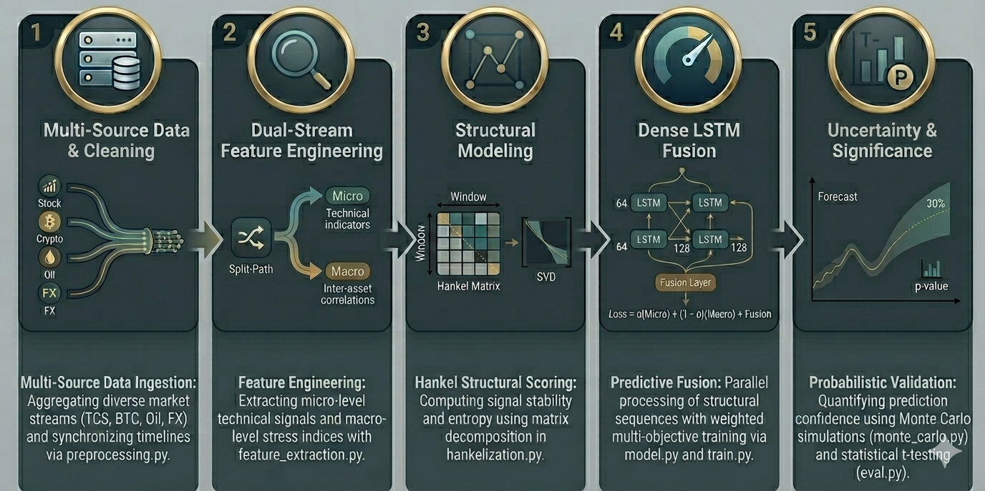
Proposed Methodology

Slide 8
Tools & Technologies
Programming Environment: Python 3.x for implementation and experimentation
Scientific Computing
NumPy — numerical computations and array operations
Pandas — dataset handling and feature engineering
Scikit-learn — data normalization and evaluation metrics
Deep Learning: PyTorch — Dual LSTM model development and optimization
Visualization: Matplotlib — plotting forecasting trends and uncertainty bands
Mathematical Techniques
Hankel Matrix Construction Singular Value Decomposition Adam Optimization Monte Carlo Dropout

Slide 9
Experimental Setup
Dataset Description
Real-world historical financial datasets were collected from multiple market domains to capture both micro and
macro influences:
Tata Consultancy Services (TCS): equity market behavior
BTC/USD (Binance): cryptocurrency market dynamics
Crude Oil WTI Futures: global commodity movement
USD/INR Exchange Rate: forex market
Sample Size: All datasets were temporally aligned and merged into a unified multi-asset time-series after preprocessing. 1554 synchronized observations obtained after preprocessing, cleaning, and common-date alignment across all asset datasets.
Simulation Environment
Python-based implementation using PyTorch deep learning framework.
Multi-scale sequential training performed using CPU/GPU execution.
Preprocessing, feature extraction, and forecasting pipeline executed offline.
Model Parameters
Sequence length for LSTM input: 30
Train-test split: 80% / 20%
Dual-branch LSTM architecture for micro and macro feature learning
Dense fusion layer for final forecast generation
Monte Carlo dropout enabled for uncertainty estimation
Evaluation Metrics
Mean Squared Error (MSE)
Root Mean Squared Error (RMSE)
Trend Accuracy

Slide 10
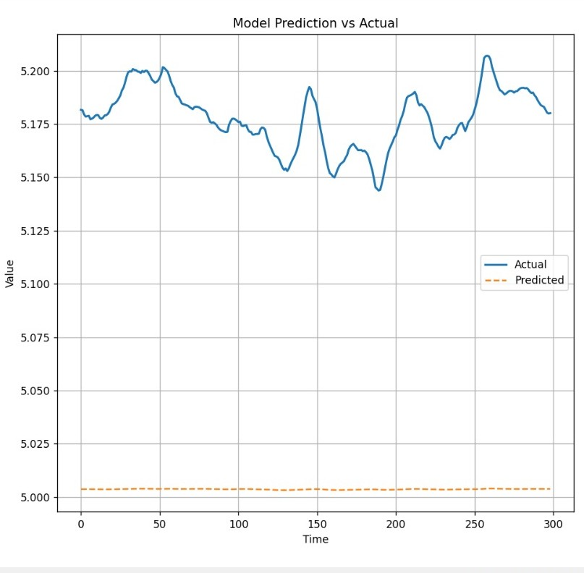
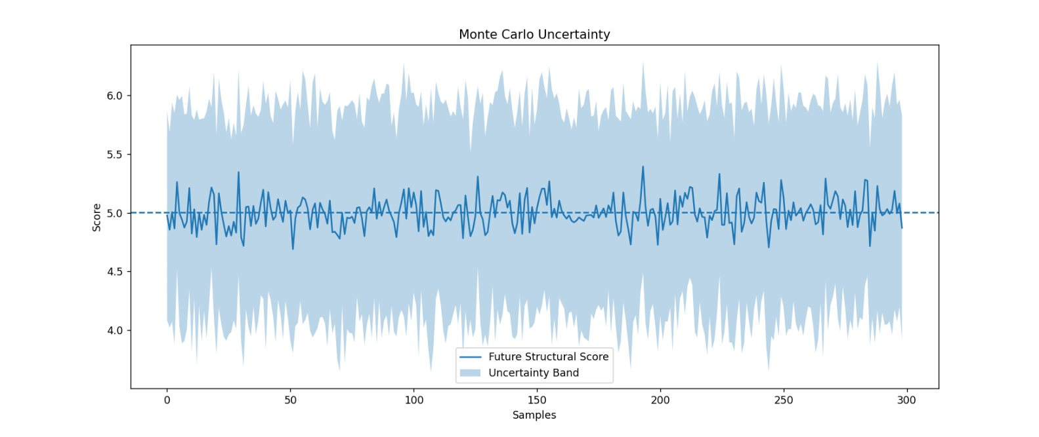
Results
Forecast confidence band generated using Monte Carlo dropout.
Comparison of model forecast against actual financial sequence.
Quantitative Performance
Mean Squared Error (MSE): 0.03058
Root Mean Squared Error (RMSE): 0.17487
Trend Accuracy: 66.44%
Key Observations
Predicted sequence follows broad market direction.
Short-term fluctuations require further tuning.
Monte Carlo confidence band indicates predictive uncertainty.
Proposed forecasting pipeline successfully validated

Slide 11
Challenges
Multi-Asset Data Alignment: Synchronizing stock, crypto, commodity, and currency datasets with common trading dates and missing-value handling.
Avoiding Underfitting: Preventing overly smooth or flat predictions while preserving generalization capability.
Hyperparameter Selection: Choosing optimal sequence length, hidden units, learning rate, and dropout settings.
Handling Noisy Data: Financial markets are highly stochastic, making pattern learning and stable forecasting difficult.
Uncertainty Calibration: Ensuring Monte Carlo confidence bands realistically reflect forecast reliability.

Slide 12
Conclusions & Future Scope
Summary of Work Completed: A structure-aware multi-scale forecasting framework was developed using Hankel matrices and Dual LSTM fusion.
Expected Outcome: Improved robustness through structural learning and multi-source data fusion.
Future Scopes:
Hyperparameter optimization
Validation on larger real-world datasets
Real-time forecasting
Attention based models
Explainable AI integration

Slide 13
References:
[1] N. Golyandina and A. Zhigljavsky, Singular Spectrum Analysis for Time Series, Springer, 2013.
[2] S. Hochreiter and J. Schmidhuber, ‘Long Short-Term Memory,’ Neural Computation, vol. 9, no. 8, pp. 1735–1780, 1997.
[3] Y. Qin et al., ‘A Dual-Stage Attention-Based Recurrent Neural Network for Time Series Prediction,’ IJCAI, 2017.
[4] Y. Gal and Z. Ghahramani, ‘Dropout as a Bayesian Approximation: Representing Model Uncertainty in Deep Learning,’ ICML, 2016.
[5] R. J. Hyndman and G. Athanasopoulos, Forecasting: Principles and Practice, OTexts, 2018.

Slide 14
Thank
You

