Slide 1
Final Presentation
Design of Digital Platforms
Steven Janssens
Pieter Maene
Kristof Mariën

Slide 2
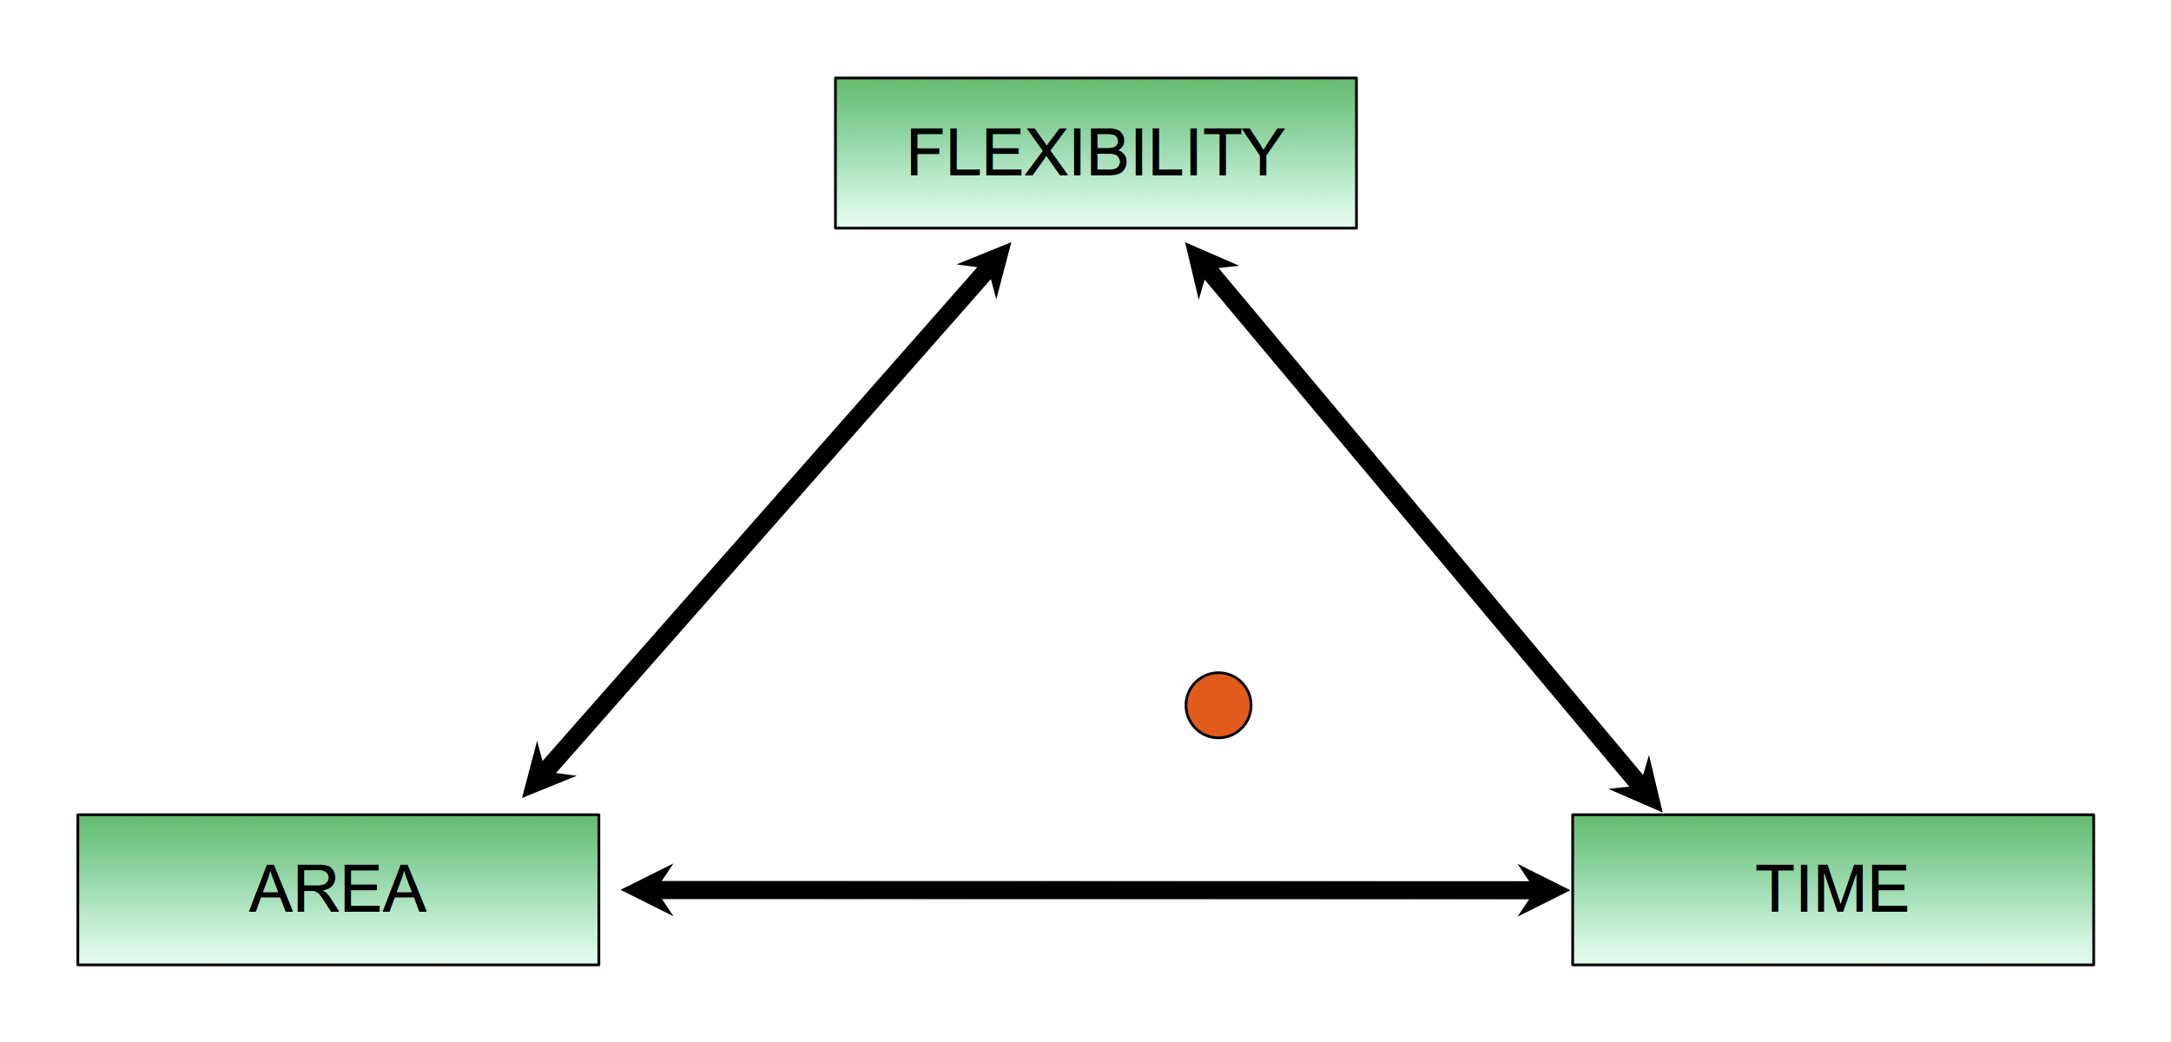
Overall Architecture
Encryption: 69456 cycles
Decryption: 3073095 cycles

Slide 3
Overall Architecture
Boundaries:
  Full Gezel implementation
  Software one to pass data
Interface:
  One block of data
  2-way-handshake protocol

Slide 4
Overall Architecture
Test strategy:
  Maple version of RSA
Further optimizations:
  Reduce registers

