Slide 1
Automated Podcast Summarization and Highlight Generation
Group: Meagan Dyer, Parth Malik, Marin Witherspoon, Aakash Singhal

Slide 2


Basic Idea:
Problem: Summarizing podcasts efficiently
Objective: Automate Podcast Summarization and Highlight Generation
Approach: Transcription of audio to text, NLP techniques such as TF-IDF, LDA for Topic Modelling
Notes:
Meagan
Today, we're tackling the challenge of condensing lengthy podcasts into digestible summaries.
Podcasts offer valuable insights, but their length can be overwhelming for listeners seeking concise information.
Our objective is to streamline the podcast consumption experience by automating the summarization process.
Our goal is to automate the summarization of podcasts, making it easier for listeners to access key information without listening to the entire episode.
By generating highlights from podcasts, we aim to provide listeners with a quick overview of the episode's main points and topics.
Automating this process saves time for listeners and helps them discover relevant content more efficiently.
We start by transcribing audio podcasts into text transcripts using automatic speech recognition (ASR) technology.
TF-IDF helps us identify significant words and phrases in the text
By combining transcription with NLP techniques, we can efficiently summarize podcasts and generate highlights that capture the essence of the episodes.

Slide 3
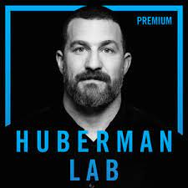
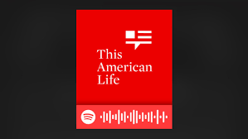
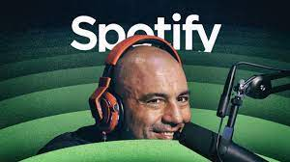
Data Acquisition:
Utilize Spotify Podcast API
Dataset: Joe Rogan, TAL, Andrew Huberman podcasts
Additional Data Import:
Downloading and importing cleaned transcripts from GitHub repository
Notes:
Meagan
We chose to use a varied number of podcasts from Joe Rogan, This American Life and Andrew Huberman. These podcasts were acquired
RSS Feed Retrieval: Fetch podcast episodes from an RSS feed using rss_to_dataframe function.
XML Parsing: Parse XML content to extract episode metadata like titles, download URLs, and publication dates.
Data Extraction: Extract relevant information from XML elements, including episode numbers and guest names.
DataFrame Creation: Organize extracted metadata into a Pandas DataFrame for analysis and exploration.
Return: The function returns the Data Frame containing metadata for all podcast episodes fetched from the RSS feed.

Slide 4
Text Preprocessing:
Download NLTK Resources:
Downloads necessary NLTK resources like tokenizers and stopwords for text processing.
Load Podcast Dataset:
Reads a CSV file containing podcast data into a Pandas DataFrame.
Tokenize Text:
Defines a function to tokenize text using NLTK's word tokenizer.
Removes punctuation and stopwords from the tokens.
Stems the tokens using Porter stemming algorithm.
Update Dataset:
Adds the tokenized transcripts as a new column to the dataset.
Saves the updated dataset to a new CSV file.
Notes:
Meagan
Data Loading: We start by loading the podcast datasets ('final_df_raw.csv') using Pandas.
Audio Data Download: Utilizing download_audio function, we fetch audio content from specific URLs, handling any download errors gracefully.
Text Tokenization: Textual preprocessing is performed using NLTK. The tokenize_text function tokenizes, removes punctuation, stopwords, and applies stemming.
Tokenization Process: We iterate through each transcript in the dataset, tokenize it, and append the tokens to a list.
Integration with Dataset: Tokenized transcripts are added back to the original dataset under 'tokenized_transcript' column.
Dataset Saving: The updated dataset, now containing tokenized transcripts, is saved to 'all_podcast_with_tokens.csv'.
Quick note on challenges:
There were some challenges faced with preprocessing in specific removing the time stamps from the podcasts data. Since most of the time stamps were set up in a different orientation within each section of the podcasts and there was a stamp every minute or so the removal process for all time stamps posed a challenge. Most were removed using code specifications on the formatting but some still remained.
Ideally all time stamps being removed would be best but with the short project window the removal was not ideal.

Slide 5
Speech to Text
Model used: facebook/wav2vec2-base-960h from the Wav2Vec2 series.
Methodology
Issues: data size, computational power, model selection.
Notes:
Marin

Slide 6
Methodology
Load CSV file with link to audio files
Clean data
Convert audio files to processable format
Convert to text in batches
Update CSV
Summaries from the text
Topic Modelling on Text generate from audio
Notes:
Marin

Slide 7
Challenges
Model and audio files taking too long to process.
Selected more efficient model.
Data batching
Removed VOX podcasts due to its extensive audio file lengths (2-4 hours)
Generating topic modelling is highly dependant on text quality. Fine tuning various parameters to get the better results
Notes:
Marin

Slide 8
Preprocessing for Summarizing
Challenges with Audio to Text Generated Summaries:
No Punctuation
Miss-Recognitions
Extreme Spelling Errors
3 Main Preprocessing Approaches:
Base: Case Normalization, Noise Reduction, Contraction Expansion, White space normalization
NER: Spacy’s "en_core_web_sm" model to identify and temporarily replace entities with placeholders,
NER + Spell Check: Using SpellChecker Library
Notes:
Parth

Slide 9
Summarization Model Setup
BART - Bidirectional and Auto-Regressive Transformers:
Utilizes the "facebook/bart-large-cnn" variant, optimized for concise and effective summarization.
Trained on CNN's news dataset, ideal for summarizing complex audio transcriptions.
max_length=300 & min_length=100 for concise yet comprehensive summaries.
length_penalty=2.0 to promote detail and depth in summaries.
Employed num_beams=4 for a balanced and thorough exploration of potential summaries.
Activated early_stopping=True to streamline processing, ensuring timely and efficient summarization.

Slide 10
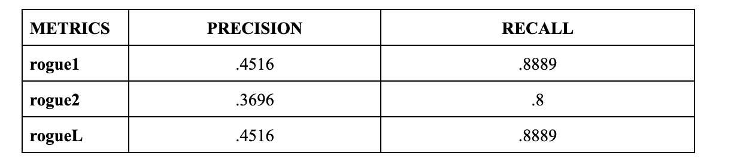
Summarization Evaluation
ROUGE-1, ROUGE-2, and ROUGE-L measure unigram, bigram, and longest common subsequence overlaps, respectively.
Focus on ROUGE-L for sentence-level structure similarity crucial for fluent summaries.
Emphasis on Recall: Chose high recall to ensure all essential information is captured, crucial for accuracy in detail-critical applications.
Precision Trade-off: Transcription inaccuracies, such as miss-recognitions from audio-to-text models, introduce errors that lower precision in summaries.

Slide 11
Topic Modelling
Methodology:
Taking the generated Transcribed Text to extract the main keywords discussed in podcast. Implemented through TFIDF.
Implemented using gensim library for Topic modelling. Extracted 5 topics from the text out of which top 3 were filtered as key highlight.
The model will run 15 passes on each text to generate topics.
The model used Latent Dirichlet Allocation(LDA) techniques which involves extracting main keywords along with topics and vice versa.
The LDA works on gibbs sampling and then generated the main selected topics .
Tota, 20 topics has been assigned for the entire corpus.depending upon the document the topic are assigned depending upon its context.
Objective:
It will to understand as what are the main topics discussed in the podcast.
Notes:
Aakash

Slide 12
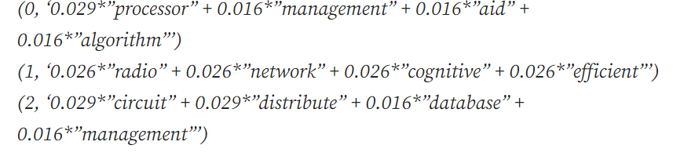

Model Results:
As a sample results shows different topics assigned different probabilities of the individual podcast.
Based on the highest probabilities the top topics has been selected
Notes:
Aakash

