Slide 1
Prediction Challenge 2
Peter Marchese

Slide 2
What to Base our Model off of
Our decision tree needs to compose of multiple, relevant factors that contribute to the letter grades the students will receive.
From previous Moody data sets, we already know that score is the main factor contributing to grade followed by participation.
We can then test for relevance of asking questions using the permutation function.
We already know from previous Moody data sets that leaving early has very little effect on students’ letter grade.

Slide 3

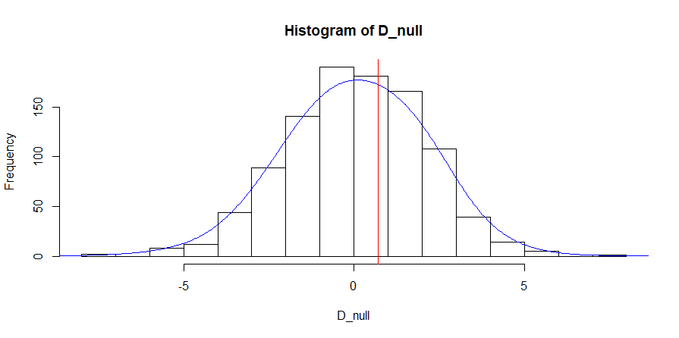
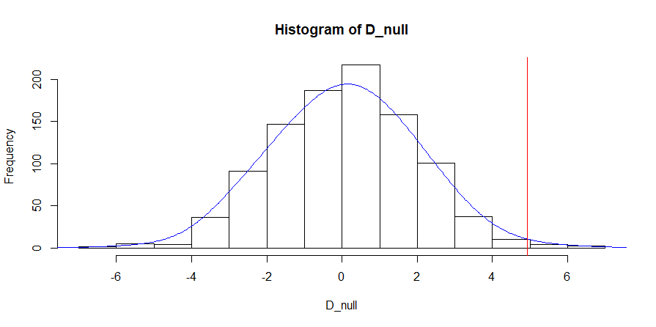
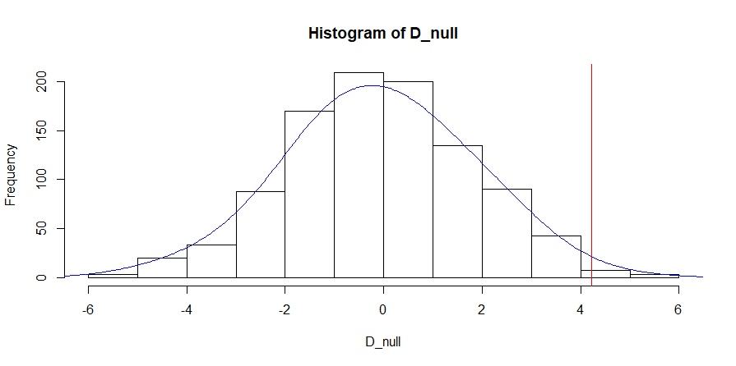
P-values for Asking Questions
Comparing all categories for asking questions we get the following p-values:
Never_Always = 0.014
Sometimes_Always = 0.005
Sometimes_Never = 0.363

Slide 4
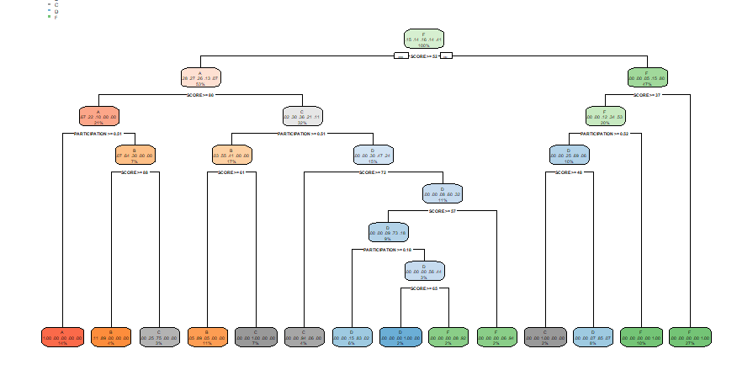
Decision Tree
Using our newfound knowledge, we can formulate a decision tree.

Slide 5
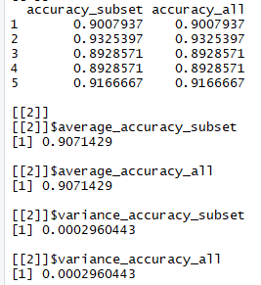
Cross-Validation
Upon our cross-validation we have similar columns for both the subset and all.
The values we are given are also very close to our success rate (1-error) which is ~5%
The decision tree is ~95% accurate at prediction students letter grades.

