Slide 1
Prediction Challenge 4
Peter Marchese

Slide 2
Testing the Variables
Multiple factors have influence over the earnings for each students.
However, after trying different prediction models, using rpart with no factors yields the best result.
Therefore my prediction model will have no factors.

Slide 3
Other Prediction Models
Using Linear Regression I was able to achieve an MSE of ~300,000.
This is much too high to be competitive or call accurate.

Slide 4
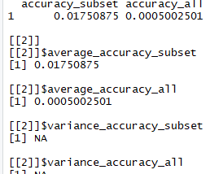
Cross-Validation
Cross-validation for numerical values often yields poor results
However, using my current model I was able to achieve thee best results I could.

Slide 5
My model
After messing around with different control options, I found setting cp to 0.000001 yielded much better results than without.
Other cp values (especially those above 1) would yield very poor results.

Slide 6
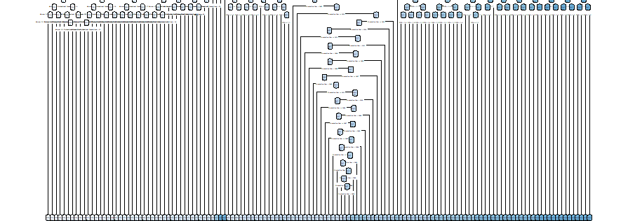
My decision Tree

