Slide 1
Prediction challenge #1
Peter Marchese

Slide 2

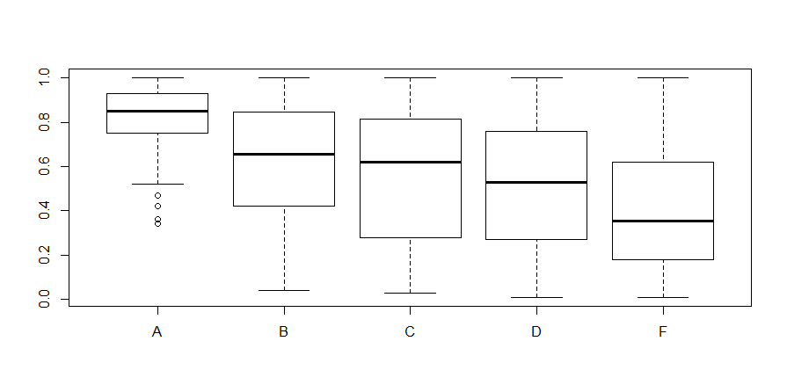
What Can change your grade?
The overall score you obtain is what will alter your grade the most.
As seen on the left, participation can also play a key role in determining your final grade.

Slide 3
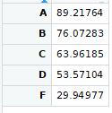
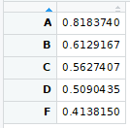
Means of scores and participation
On the top we have the mean for the scores per each letter grade and the bottom we have the participation per letter grade.
This will help us determine where grades are at depending on these variables

Slide 4
The prediction Model
The model will include using scores as the main determining factor for any given grade.
Using both the ranges and means of the scores we can estimate a grade letter.
Utilizing the participation variable we can pinpoint exactly which letter grade will bee given to each student.

Slide 5
The results
Upon testing against given data we end up with an error of 22.4%
Although this percent error is not quite there, we can say that for a major portion of the grades this prediction model contains a foundation for the given data.

