Slide 1
Prediction challenge 3
Peter Marchese

Slide 2
Which Attributes are relevant
Out of the four given attributes, two seem to be the most relevant with the other two not mattering much.
The categories are Coffees and Calories.
Favorite song seems to have some consistencies however, seems too random to conclude anything.
This was tested by using multiple rpart decision trees each of which featured lower accuracy results when using favorite song.
Social media is more or less the same through all parties.

Slide 3
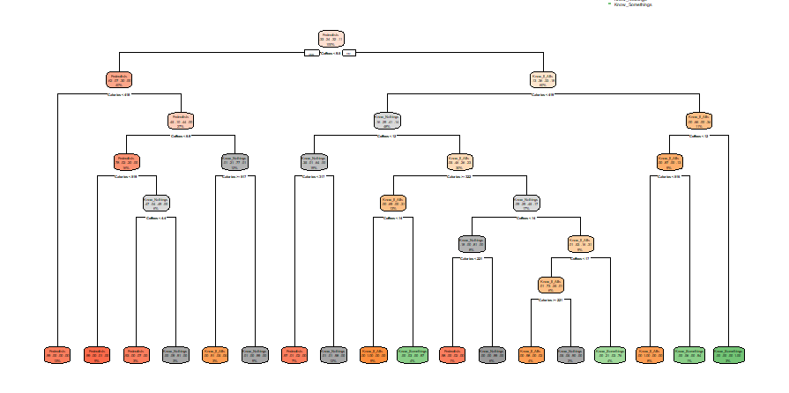

Creating the Decision Tree
The decision tree created would consist of first the Coffees attribute followed by the Calories attribute.
Adding or changing these attributes resulted in lower accuracy tests among different rpart models.
Different controls tested would also lower the accuracy percent and therefore were not used.

Slide 4
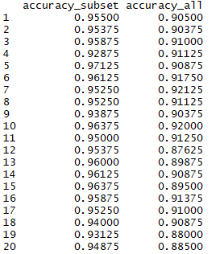
Cross-Validation
After cross validating we get relatively similar results to our on accuracy percent.
We also get a subset vector and all vector that are close to one another with the subset having a slightly higher percents.

