Slide 1
Analysis of Mega Million numbers.
A data analysis project
By Peter Marus

Slide 2
Introduction
Hello. This is the first project I have created. I wanted to test my data analysis skills I have been learning, and I was inspired by my wife to do this project. I Have another Python program I wrote to generate random numbers for the major multi-state lotteries. She suggested I look at the winning numbers and see what the most common ones are drawn.
I used the dataset at this link as the data for my research:
https://www.kaggle.com/datasets/aspillai/megamillions-winning-numbers-2017-to-2024

Slide 3
Introduction
I have included in this presentation the code I wrote, and the bar graphs I generated for each white ball position and the Mega Ball. I did each white ball position since usually the winning numbers are listed lowest to highest, and my logic was if you get the most common from each position you should get common numbers that would hit if you tried. I also have included the code and results of finding the average number of each ball drawn.

Slide 4
Introduction
Why am I doing this?
Because I wanted to test my skills. I also wanted an exercise to use GitHub and try to learn the process.

Slide 5
Introduction
I know it's probably a stupid simple project, but I am proud that I was able to do this. I would love to hear some feedback on it and hopefully I will get better at this.
I plan on trying also doing this project in SQLite soon.
Thank you for taking the time to see and read this.

Slide 6
Initial coding
The first lines to import libraries and set variables

Slide 7

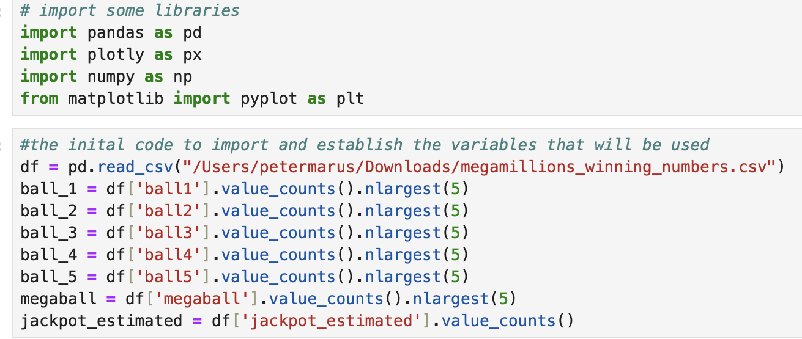
Initial Coding
This code imports the code libraries I will use for this project: Panda, Numpy, Matplotlib, and Plotly.
The next code I use imports the data I will use. It was in a CSV file.
Finally, I set variables I will use later in my coding. I set variables of each ball that counts how many times a number was selected in each position and returns the top5 of the five white balls and the Mega Ball. I also set a variable for the estimated jackpot for potential analysis of the jackpot amounts.

Slide 8
The most picked numbers
Using python to find and graph the data

Slide 9
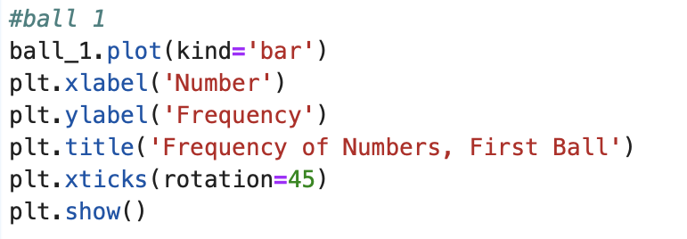
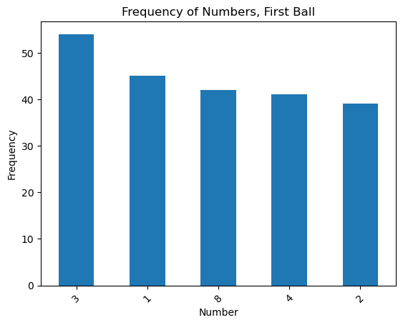
Finding the most often drawn balls: Ball 1
This code is for finding the five most common balls picked as “ball 1”. I am going with how the numbers were presented to the audience, so the numbers went ascending order.
As you can see from the chart, the five common numbers at the “ball 1“ position:
3, 1, 8, 4, 2

Slide 10
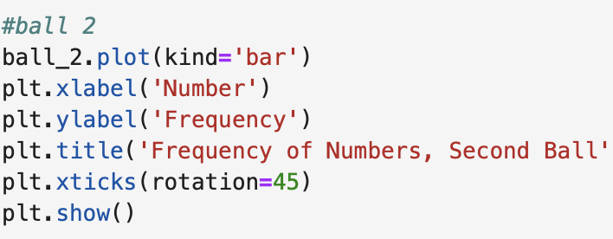
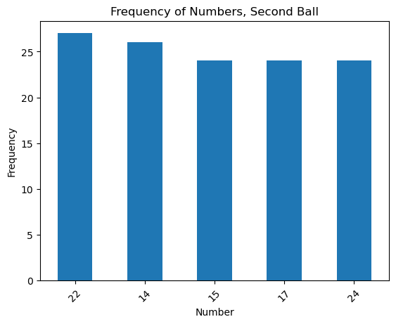
Finding the most often drawn balls: Ball 2
This code is for finding the five most common balls picked as “ball 2”. I am going with how the numbers were presented to the audience, so the numbers went ascending order.
As you can see from the chart, the five common numbers at the “ball 2“ position:
22, 14, 15, 17, 24

Slide 11
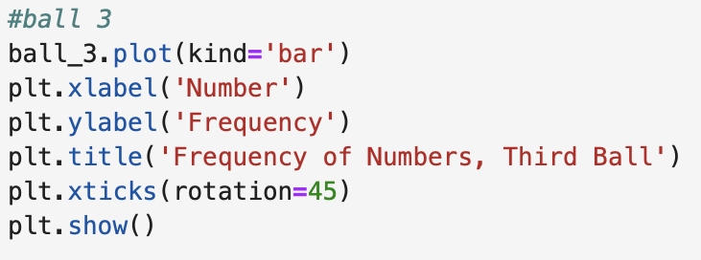
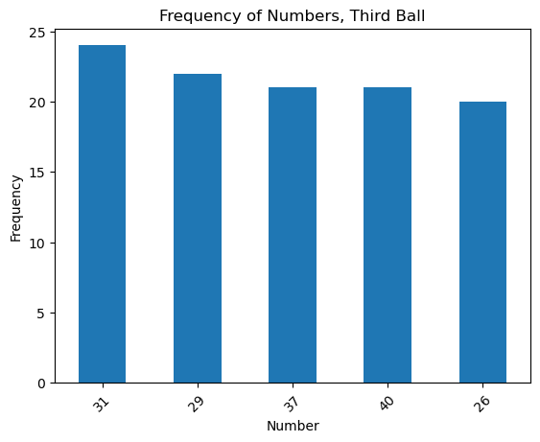
Finding the most often drawn balls: Ball 3
This code is for finding the five most common balls picked as “ball 3”. I am going with how the numbers were presented to the audience, so the numbers went ascending order.
As you can see from the chart, the five common numbers at the “ball 3“ position:
31, 29, 37, 40, 26

Slide 12
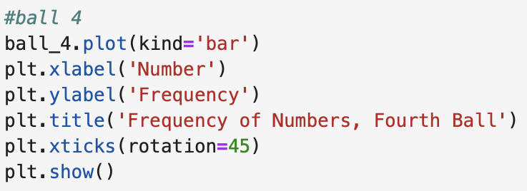
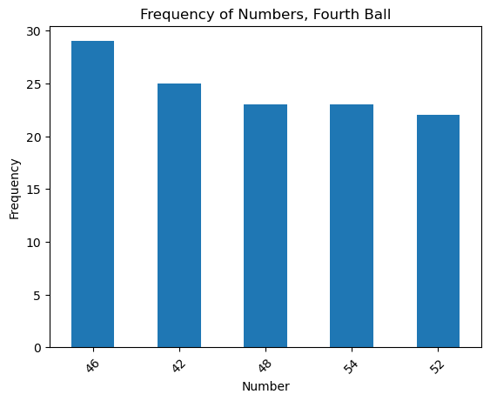
Finding the most often drawn balls: Ball 4
This code is for finding the five most common balls picked as “ball 4”. I am going with how the numbers were presented to the audience, so the numbers went ascending order.
As you can see from the chart, the five common numbers at the “ball 4“ position:
46, 42, 48, 54, 52

Slide 13
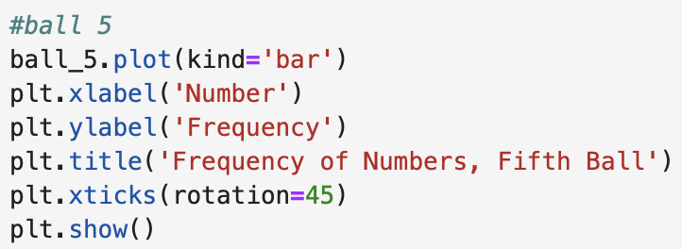
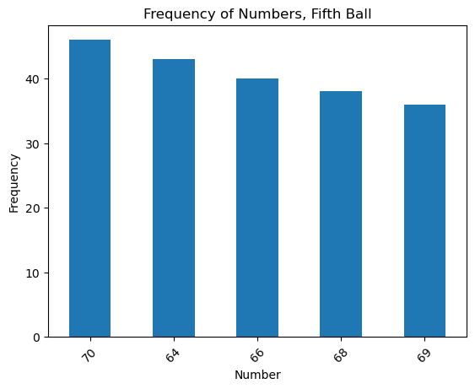
Finding the most often drawn balls: Ball 5
This code is for finding the five most common balls picked as “ball 5”. I am going with how the numbers were presented to the audience, so the numbers went ascending order.
As you can see from the chart, the five common numbers at the “ball 5“ position:
70, 64, 66, 68, 69

Slide 14
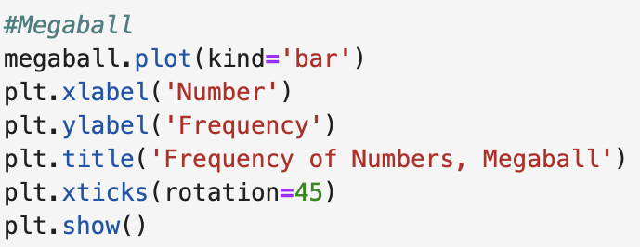
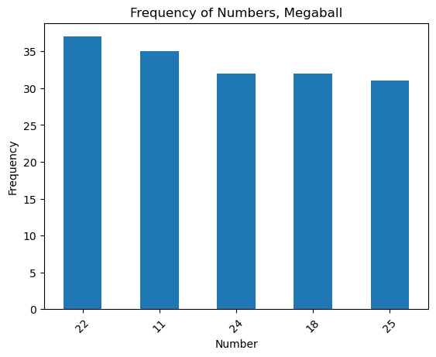
Finding the most often drawn balls: Mega Ball
This code is for finding the five most common balls picked Mega Balls. As you can see from the chart, the five common Mega Ball numbers:
22, 11, 24, 18, 25

Slide 15
Result:
The most common numbers selected at each ball position are:
3, 22, 31, 46, 70 MegaBall 22

Slide 16
We looked at the most common numbers picked.
Now we will look at the average number picked at each ball position

Slide 17
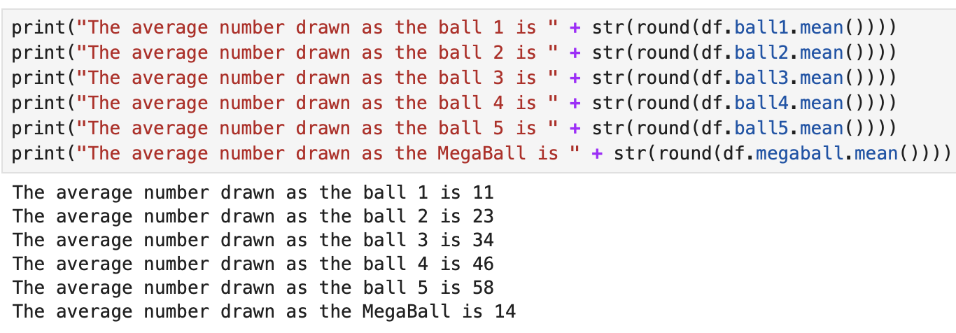
Average number picked at each ball position
I use the mean function of Python on each column to find the average number that was picked at those positions, and I utilized the round function of Python to make the number whole. I also wrote the code in a way that if you ran it the output would be a sentence.

Slide 18
The Average numbers from each position are:
11, 23, 34, 46, 58 MegaBall 14

Slide 19
Conclusion

Slide 20
If you wanted to play Mega Millions and do not want to let the lotto machine choose the numbers for you, you can try these two sets of numbers. Obviously the odds of winning are almost 300 Million to one, but you may win some money from a drawing.

Slide 21
Let’s review:
Most often numbers picked:
3, 22, 31, 46, 70 MegaBall 22
Average numbers at each ball position:
11, 23, 34, 46, 58 MegaBall 14

Slide 22
Thank you.

