Slide 1
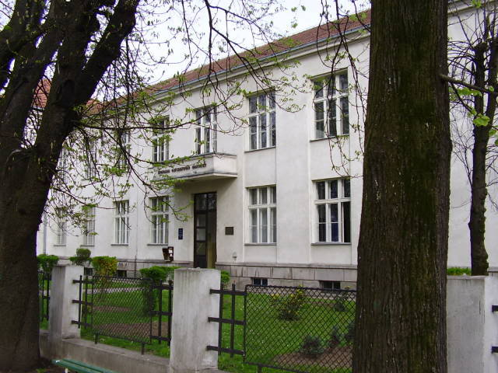
Primjena računara u biologiji
Vladimir Filipović
vladaf@matf.bg.ac.rs

Slide 2
Interval Estimation,
Hypothesis Testing
and
Type II Error

Slide 3
Elementary Statistics with R

Slide 4
Interval Estimation

Slide 5
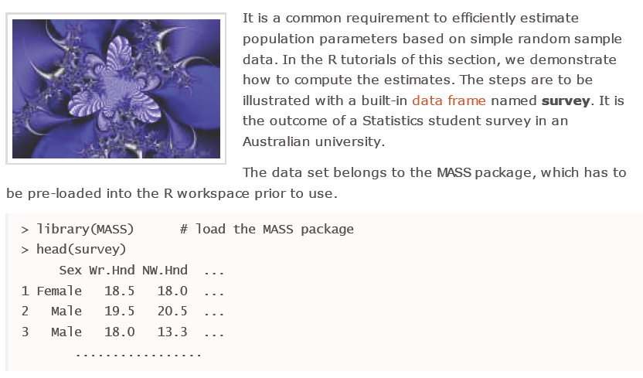
Interval Estimation

Slide 6
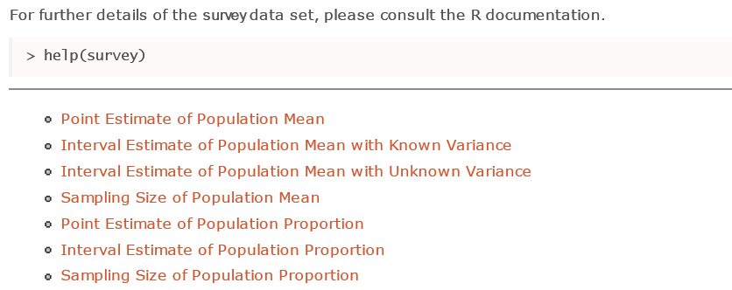
Interval Estimation (2)

Slide 7
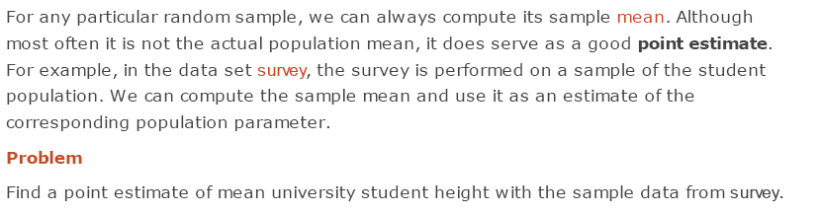
Point Estimate of Population Mean

Slide 8
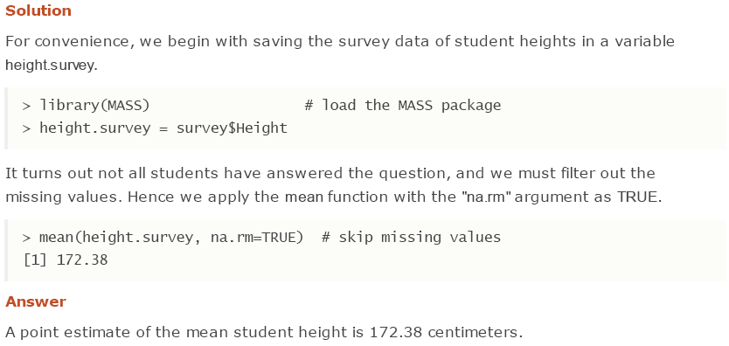
Point Estimate of Population Mean (2)

Slide 9
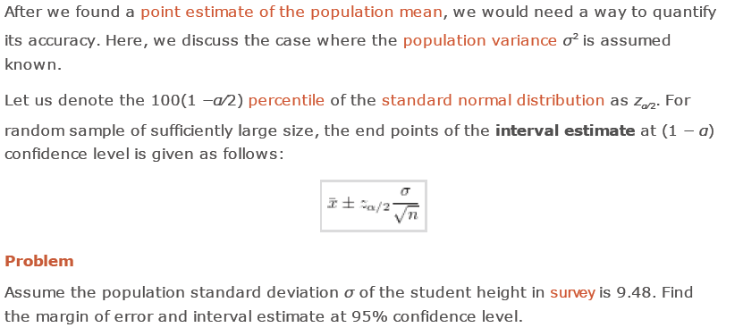
Interval Estimate of Population Mean with Known Variance

Slide 10
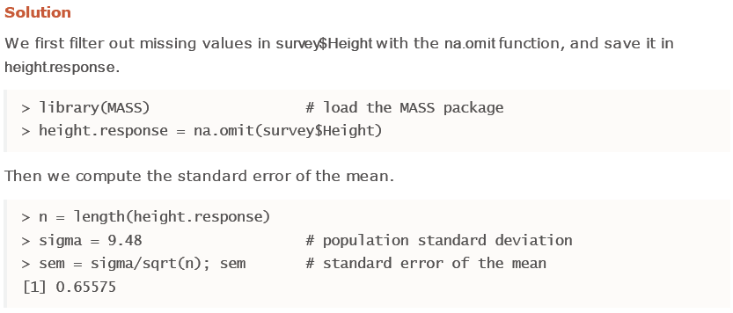
Interval Estimate of Population Mean with Known Variance (2)

Slide 11
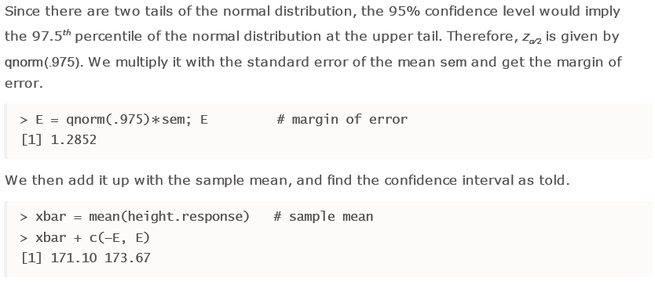
Interval Estimate of Population Mean with Known Variance (3)

Slide 12
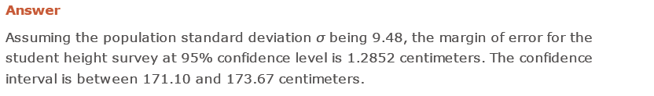
Interval Estimate of Population Mean with Known Variance (4)

Slide 13
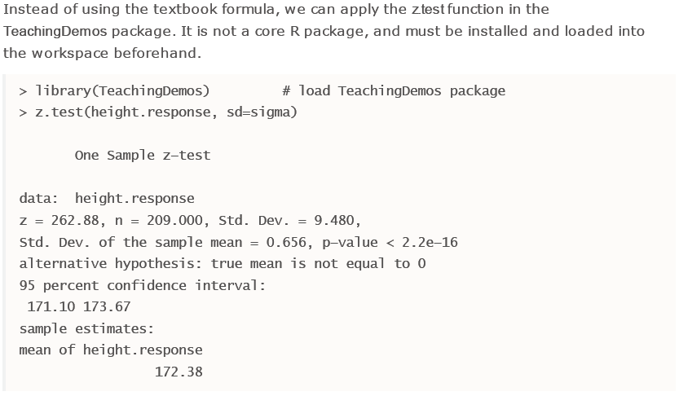
Interval Estimate of Population Mean with Known Variance (5)

Slide 14
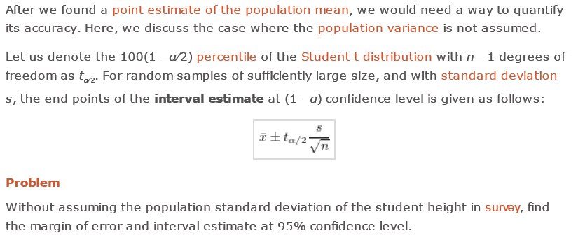
Interval Estimate of Population Mean with Unknown Variance

Slide 15
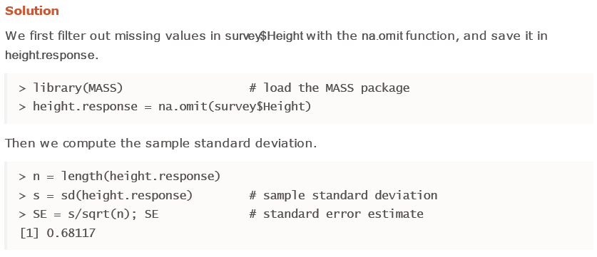
Interval Estimate of Population Mean with Unknown Variance (2)

Slide 16
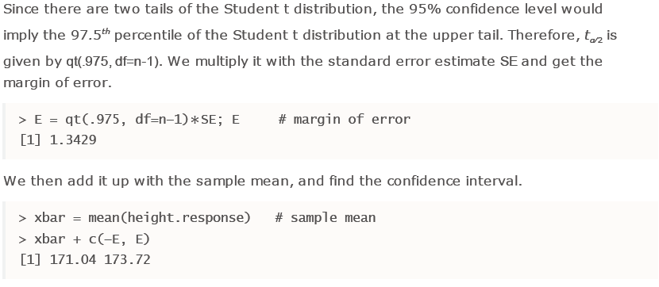
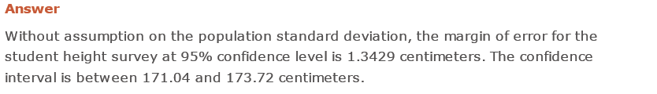
Interval Estimate of Population Mean with Unknown Variance (3)

Slide 17
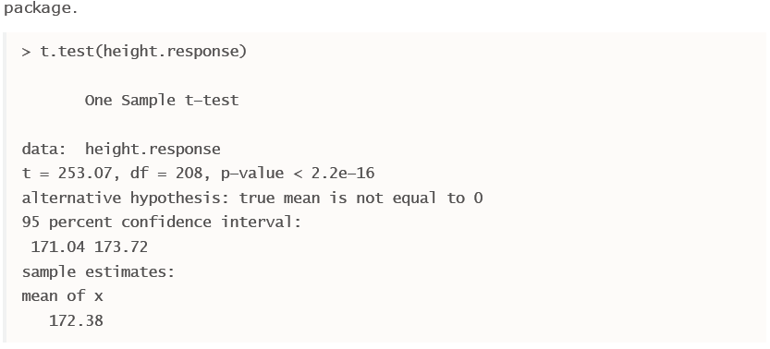
Interval Estimate of Population Mean with Unknown Variance (4)

Slide 18
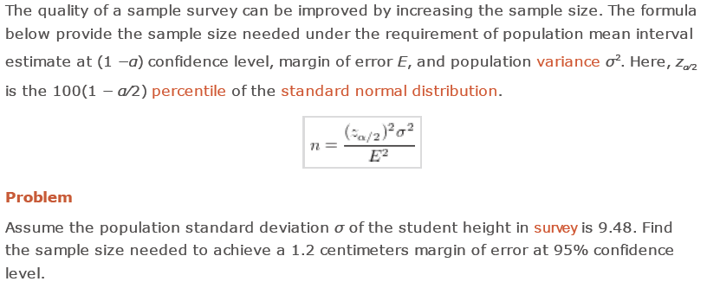
Sampling Size of Population Mean

Slide 19
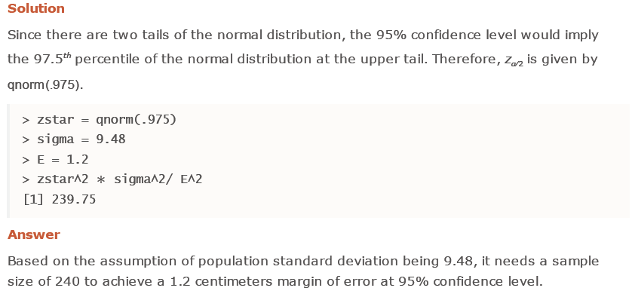
Sampling Size of Population Mean (2)

Slide 20
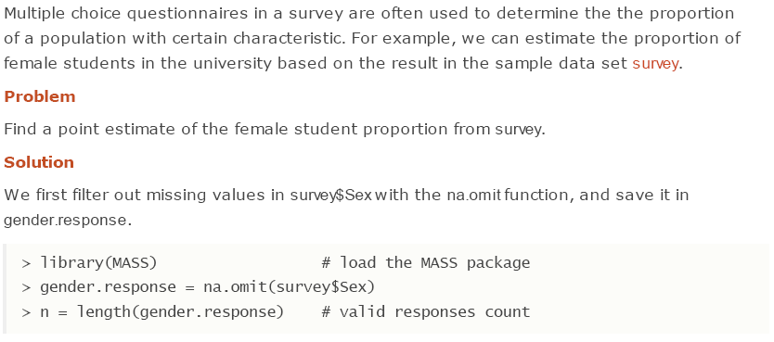
Point Estimate of Population Proportion

Slide 21
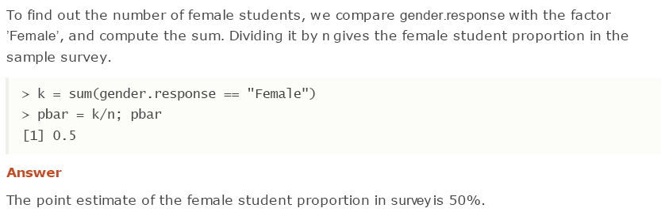
Point Estimate of Population Proportion (2)

Slide 22
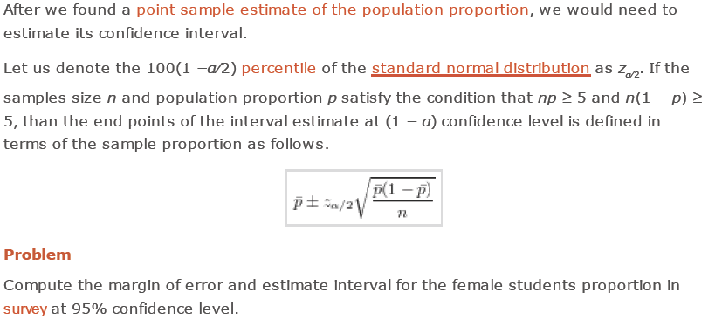
Interval Estimate of Population Proportion

Slide 23
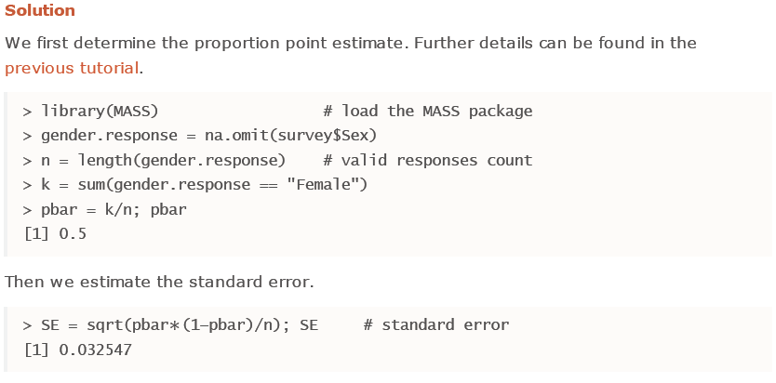
Interval Estimate of Population Proportion (2)

Slide 24
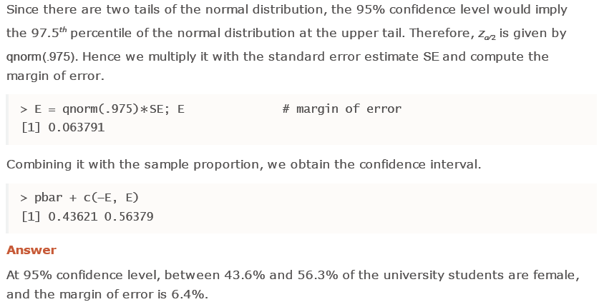
Interval Estimate of Population Proportion (3)

Slide 25
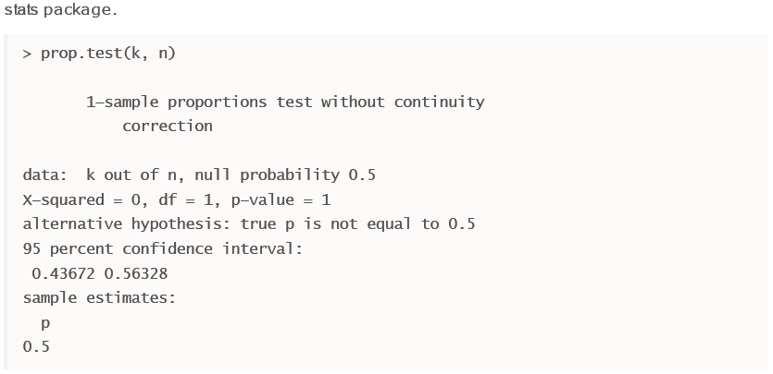
Interval Estimate of Population Proportion (4)

Slide 26
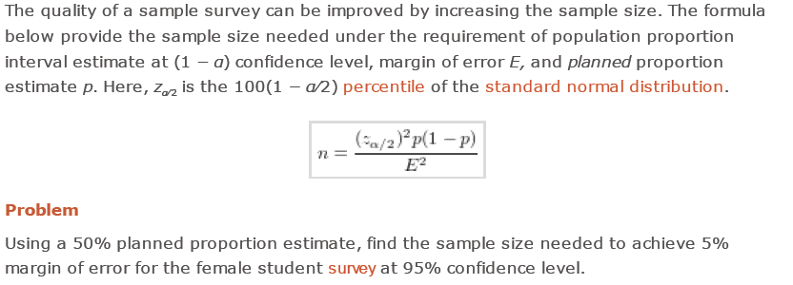
Sampling Size of Population Proportion

Slide 27
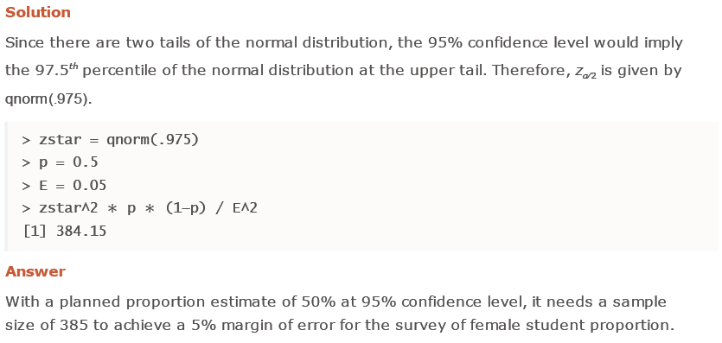
Sampling Size of Population Proportion (2)

Slide 28
Hypothesis Testing

Slide 29
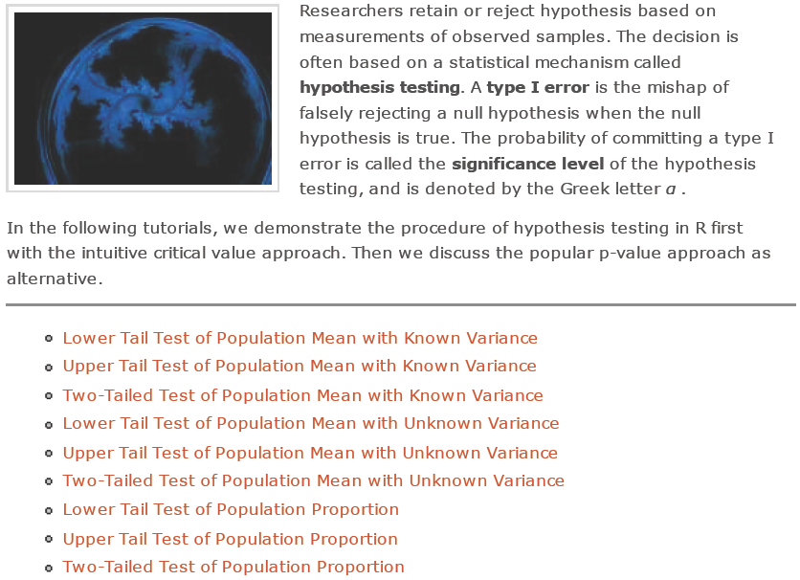
Hypothesis Testing

Slide 30
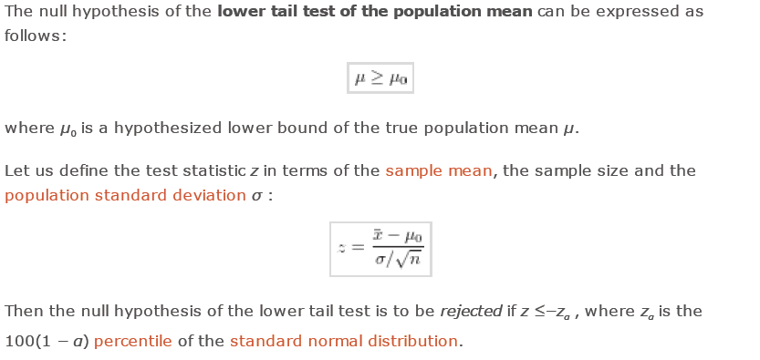
Lower Tail Test of Population Mean with Known Variance

Slide 31
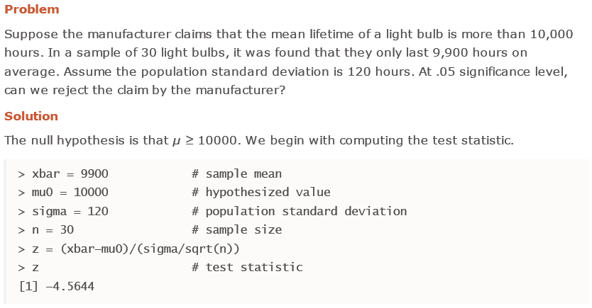
Lower Tail Test of Population Mean with Known Variance (2)

Slide 32
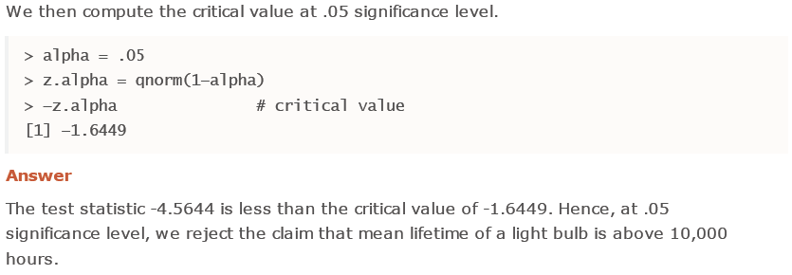
Lower Tail Test of Population Mean with Known Variance (3)

Slide 33
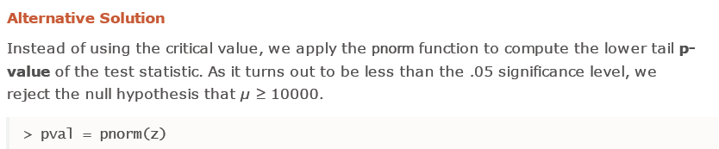
Lower Tail Test of Population Mean with Known Variance (4)

Slide 34

Upper Tail Test of Population Mean with Known Variance

Slide 35
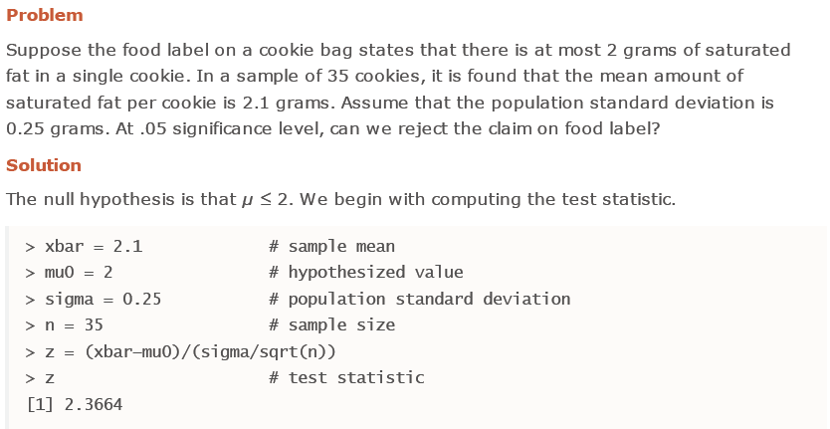
Upper Tail Test of Population Mean with Known Variance (2)

Slide 36
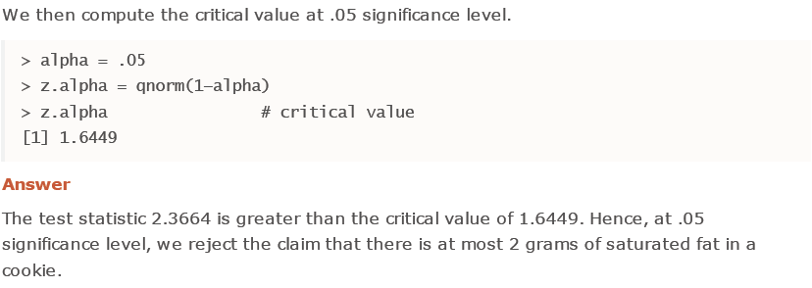
Upper Tail Test of Population Mean with Known Variance (3)

Slide 37
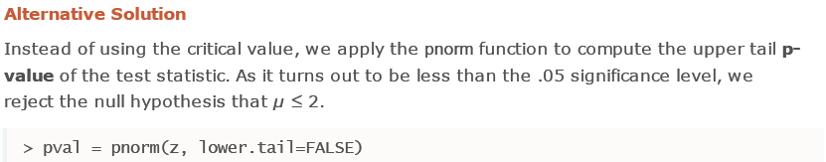
Upper Tail Test of Population Mean with Known Variance (4)

Slide 38
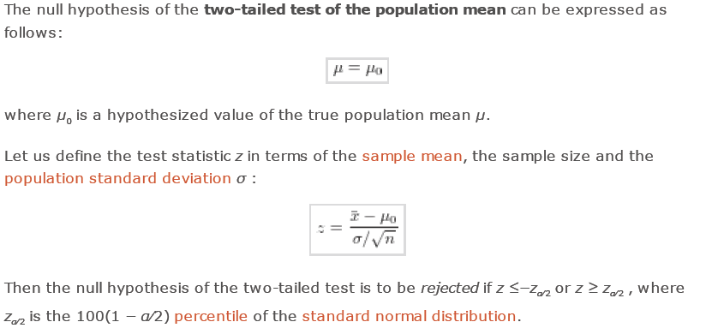
Two-Tailed Test of Population Mean with Known Variance

Slide 39
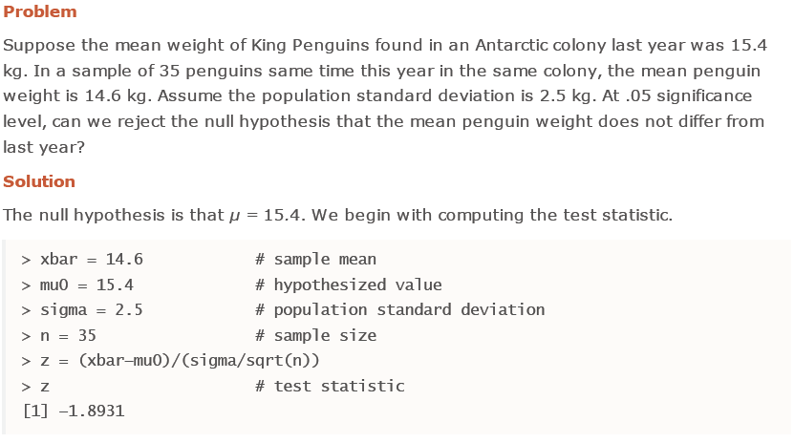
Two-Tailed Test of Population Mean with Known Variance (2)

Slide 40
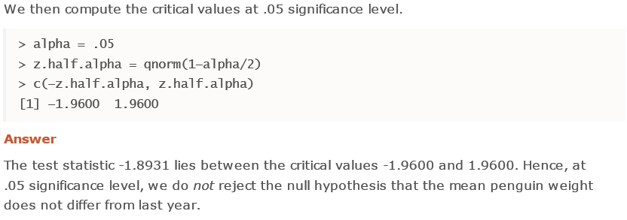
Two-Tailed Test of Population Mean with Known Variance (3)

Slide 41
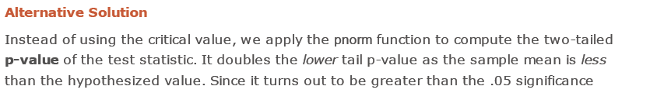
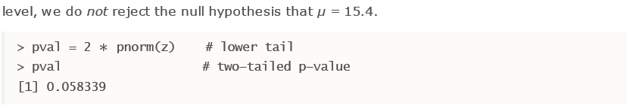
Two-Tailed Test of Population Mean with Known Variance (4)

Slide 42
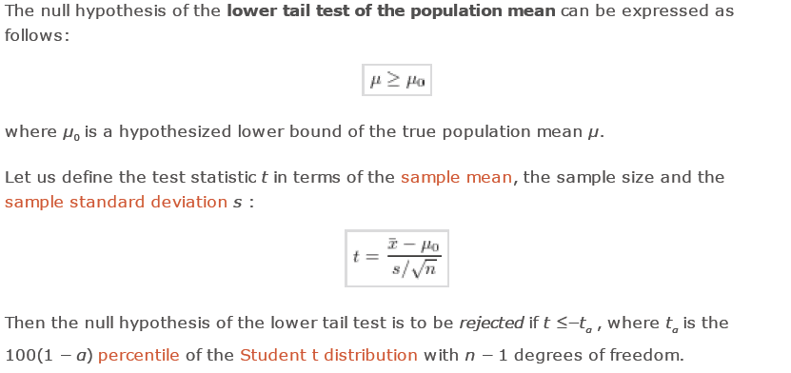
Lower Tail Test of Population Mean with Unknown Variance

Slide 43
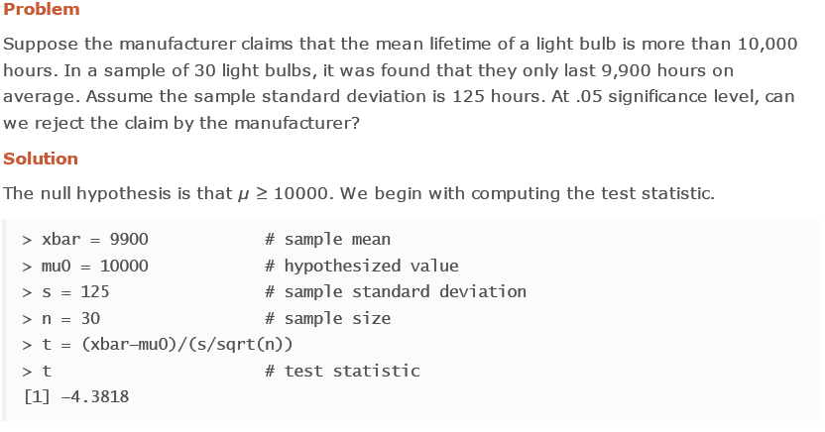
Lower Tail Test of Population Mean with Unknown Variance (2)

Slide 44
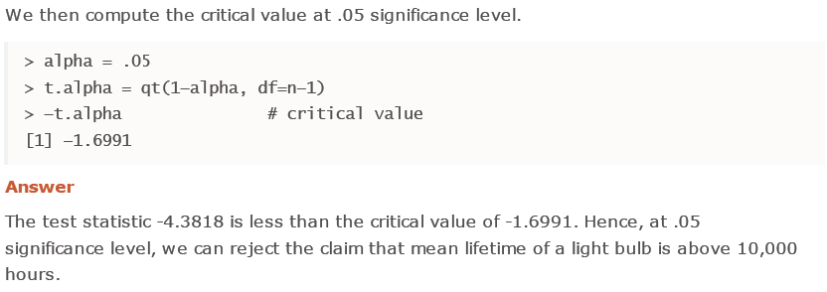
Lower Tail Test of Population Mean with Unknown Variance (3)

Slide 45
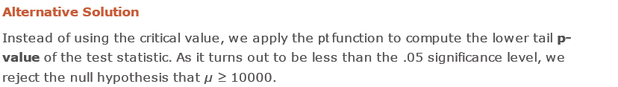
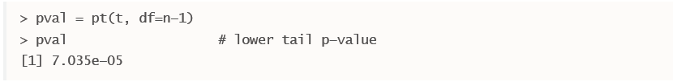
Lower Tail Test of Population Mean with Unknown Variance (4)

Slide 46
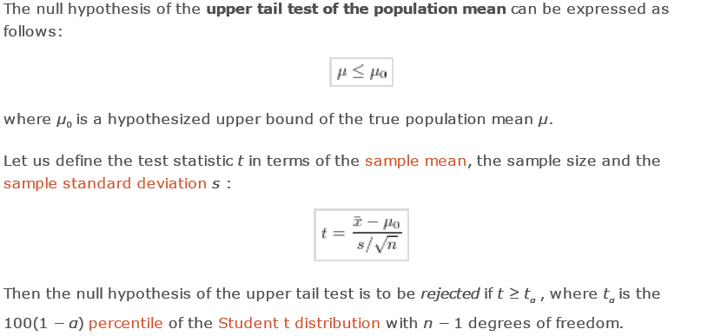
Upper Tail Test of Population Mean with Unknown Variance

Slide 47
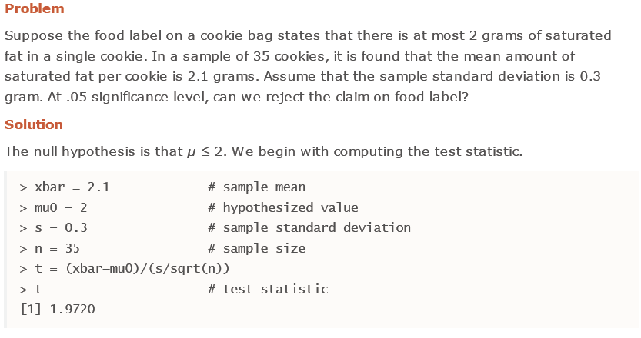
Upper Tail Test of Population Mean with Unknown Variance (2)

Slide 48
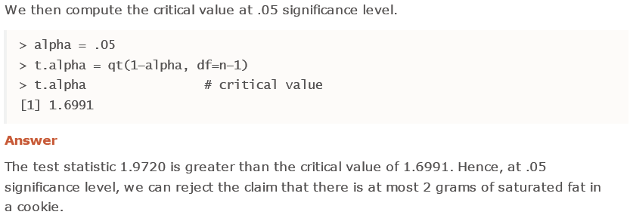
Upper Tail Test of Population Mean with Unknown Variance (3)

Slide 49
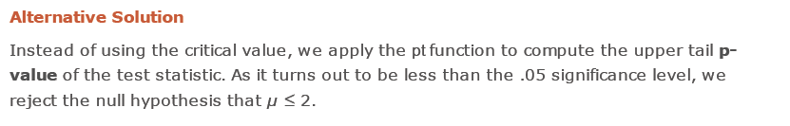
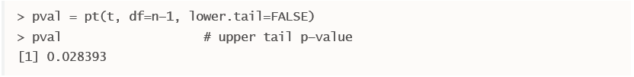
Upper Tail Test of Population Mean with Unknown Variance (3)

Slide 50
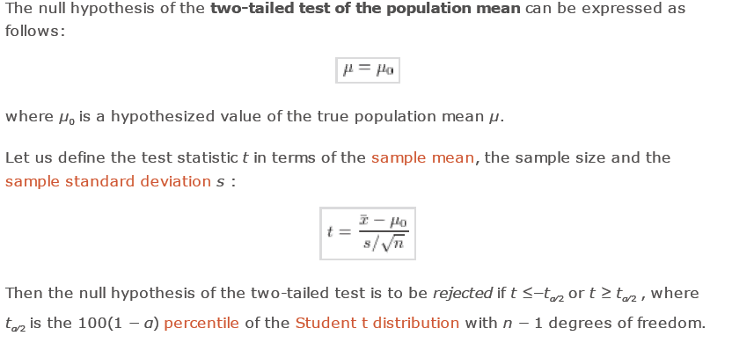
Two-Tailed Test of Population Mean with Unknown Variance

Slide 51
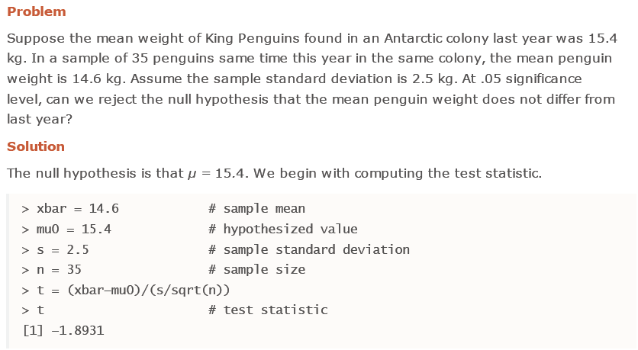
Two-Tailed Test of Population Mean with Unknown Variance (2)

Slide 52

Two-Tailed Test of Population Mean with Unknown Variance (3)

Slide 53


Two-Tailed Test of Population Mean with Unknown Variance (4)

Slide 54

Lower Tail Test of Population Proportion

Slide 55

Lower Tail Test of Population Proportion (2)

Slide 56

Lower Tail Test of Population Proportion (3)

Slide 57

Lower Tail Test of Population Proportion (4)

Slide 58

Lower Tail Test of Population Proportion (5)

Slide 59
Lower Tail Test of Population Proportion (5)

Slide 60

Upper Tail Test of Population Proportion

Slide 61

Upper Tail Test of Population Proportion (2)

Slide 62

Upper Tail Test of Population Proportion (3)

Slide 63

Upper Tail Test of Population Proportion (4)

Slide 64

Upper Tail Test of Population Proportion (5)

Slide 65
Upper Tail Test of Population Proportion (5)

Slide 66

Two-Tailed Test of Population Proportion

Slide 67

Two-Tailed Test of Population Proportion (2)

Slide 68

Two-Tailed Test of Population Proportion (3)

Slide 69

Two-Tailed Test of Population Proportion (4)

Slide 70

Two-Tailed Test of Population Proportion (5)

Slide 71
Type II Error

Slide 72

Type II Error

Slide 73

Type II Error in Lower Tail Test of Population Mean with Known Variance

Slide 74

Type II Error in Lower Tail Test of Population Mean with Known Variance (2)

Slide 75

Type II Error in Lower Tail Test of Population Mean with Known Variance (3)

Slide 76

Type II Error in Lower Tail Test of Population Mean with Known Variance (4)

Slide 77

Type II Error in Upper Tail Test of Population Mean with Known Variance

Slide 78

Type II Error in Upper Tail Test of Population Mean with Known Variance (2)

Slide 79

Type II Error in Upper Tail Test of Population Mean with Known Variance (3)

Slide 80

Type II Error in Upper Tail Test of Population Mean with Known Variance (4)

Slide 81

Type II Error in Two-Tailed Test of Population Mean with Known Variance

Slide 82

Type II Error in Two-Tailed Test of Population Mean with Known Variance (2)

Slide 83

Type II Error in Two-Tailed Test of Population Mean with Known Variance (3)

Slide 84

Type II Error in Two-Tailed Test of Population Mean with Known Variance (4)

Slide 85

Type II Error in Lower Tail Test of Population Mean with Unknown Variance

Slide 86

Type II Error in Lower Tail Test of Population Mean with Unknown Variance (2)

Slide 87

Type II Error in Lower Tail Test of Population Mean with Unknown Variance (3)

Slide 88

Type II Error in Lower Tail Test of Population Mean with Unknown Variance (4)

Slide 89

Type II Error in Upper Tail Test of Population Mean with Unknown Variance

Slide 90

Type II Error in Upper Tail Test of Population Mean with Unknown Variance (2)

Slide 91

Type II Error in Upper Tail Test of Population Mean with Unknown Variance (3)

Slide 92

Type II Error in Upper Tail Test of Population Mean with Unknown Variance (4)

Slide 93

Type II Error in Two-Tailed Test of Population Mean with Unknown Variance

Slide 94

Type II Error in Two-Tailed Test of Population Mean with Unknown Variance (2)

Slide 95

Type II Error in Two-Tailed Test of Population Mean with Unknown Variance (2)

Slide 96

Type II Error in Two-Tailed Test of Population Mean with Unknown Variance (3)

Slide 97
Acknowlegments
Some parts of the material in this presentation is taken from http://www.r-tutor.com/
Deo materijala je preuzet sa sajta http://www.e-statistika.rs

