Slide 1

Primjena računara u biologiji
Vladimir Filipović
vladaf@matf.bg.ac.rs

Slide 2
Inference About Two Populations
and
Goodness of Fit

Slide 3
Elementary Statistics with R

Slide 4
Inference About Two Populations

Slide 5
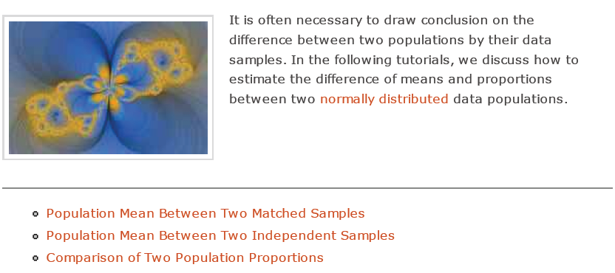
Inference About Two Populations

Slide 6
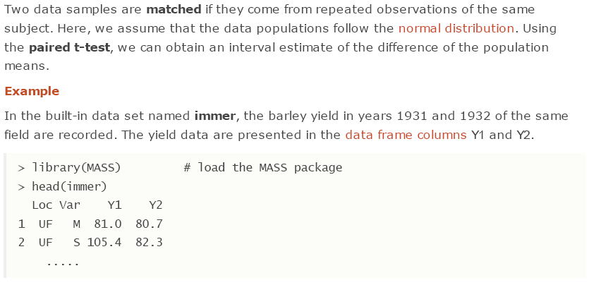
Population Mean Between Two Matched Samples

Slide 7
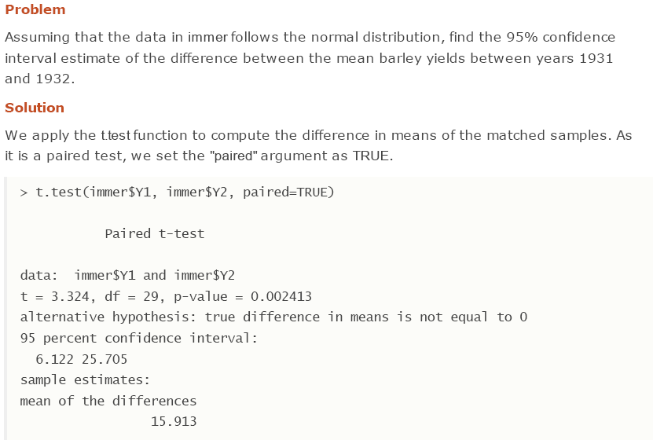
Population Mean Between Two Matched Samples (2)

Slide 8
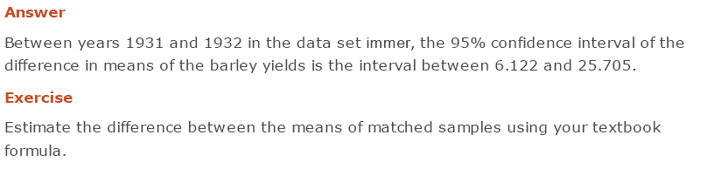
Population Mean Between Two Matched Samples (3)

Slide 9
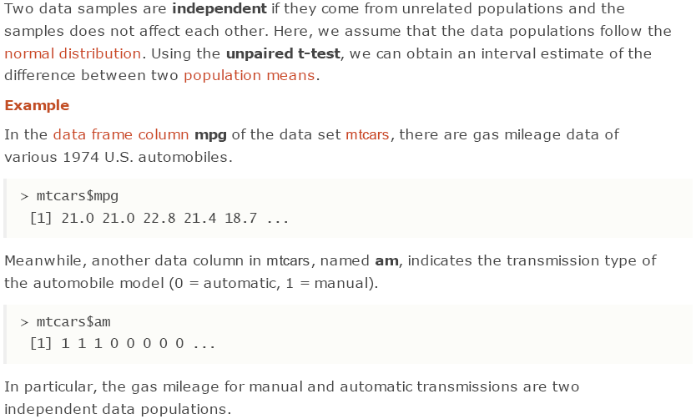
Population Mean Between Two Independent Samples

Slide 10
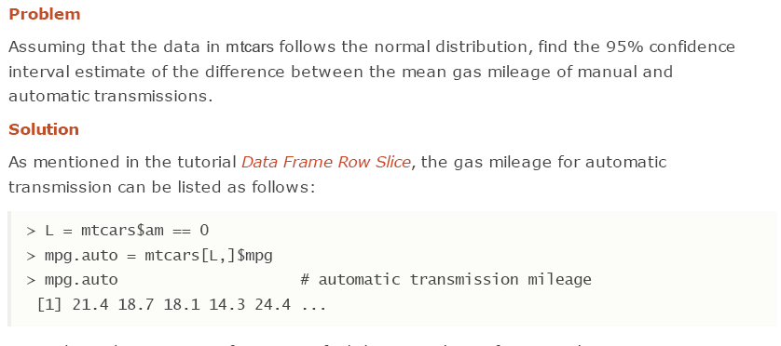
Population Mean Between Two Independent Samples (2)

Slide 11
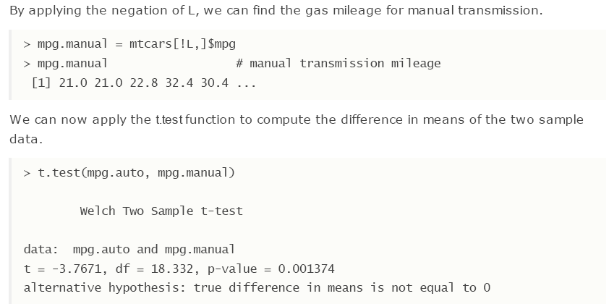
Population Mean Between Two Independent Samples (3)

Slide 12
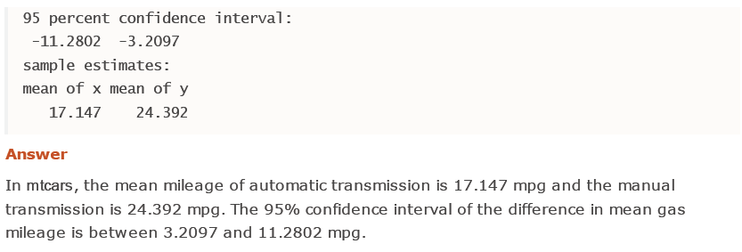
Population Mean Between Two Independent Samples (4)

Slide 13
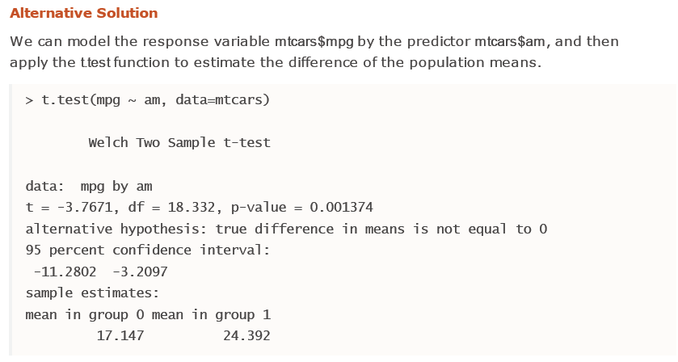
Population Mean Between Two Independent Samples (5)

Slide 14

Population Mean Between Two Independent Samples (6)

Slide 15
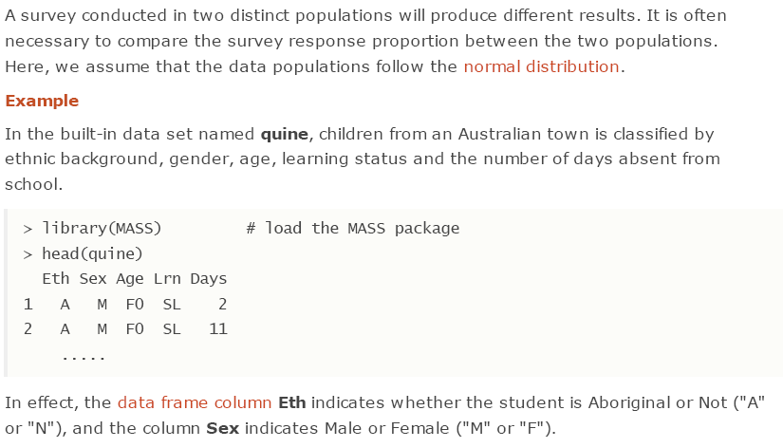
Comparison of Two Population Proportions

Slide 16
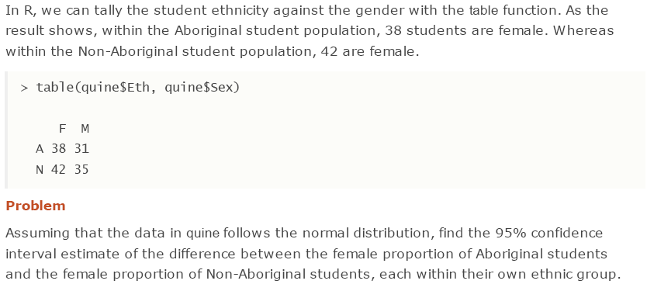
Comparison of Two Population Proportions (2)

Slide 17
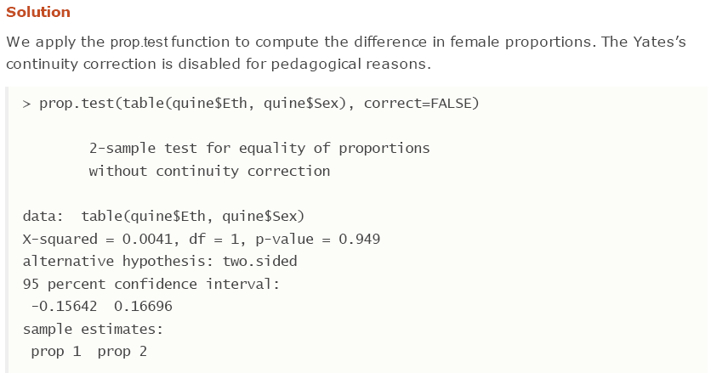
Comparison of Two Population Proportions (3)

Slide 18
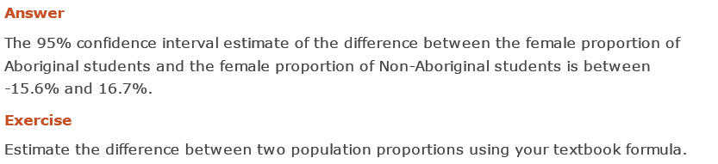
Comparison of Two Population Proportions (4)

Slide 19
Goodness of Fit

Slide 20
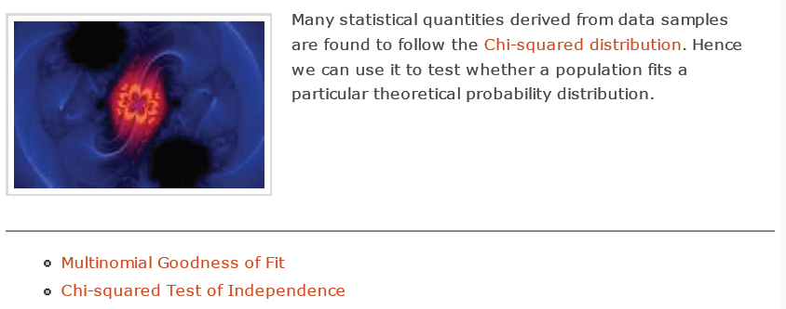
Goodness of Fit

Slide 21
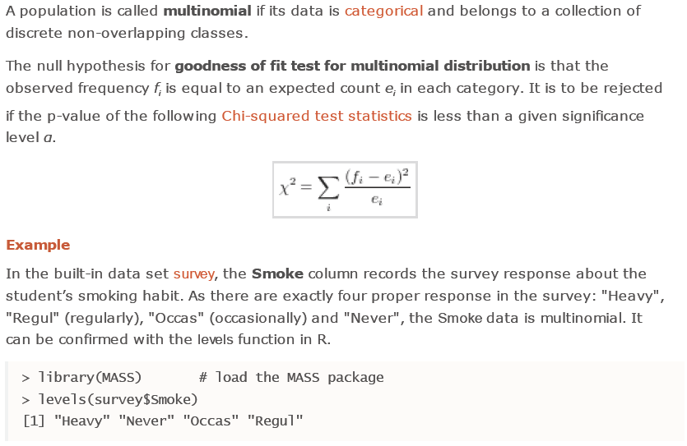
Multinomial Goodness of Fit

Slide 22
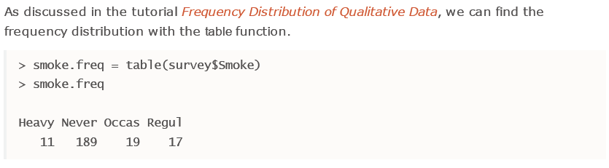
Multinomial Goodness of Fit (2)

Slide 23
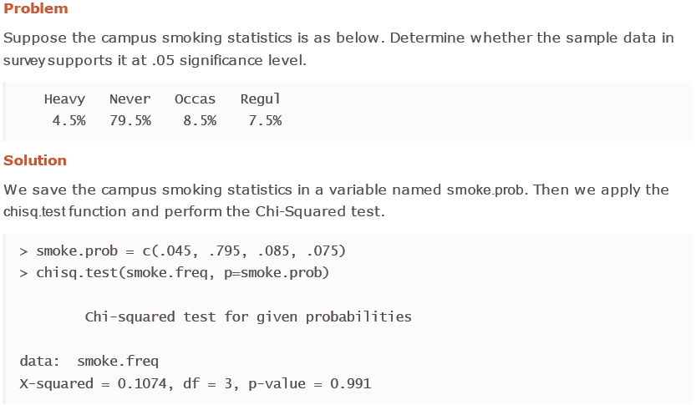
Multinomial Goodness of Fit (3)

Slide 24
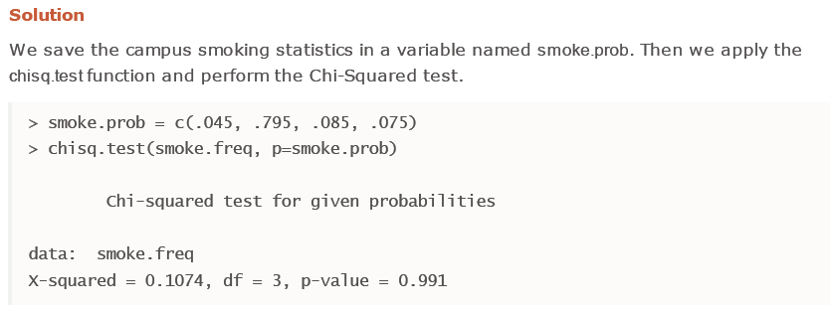
Multinomial Goodness of Fit (4)

Slide 25
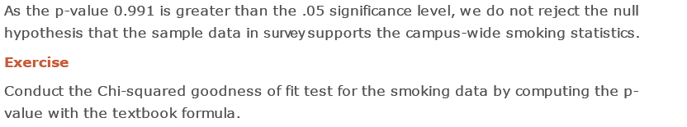
Multinomial Goodness of Fit (5)

Slide 26
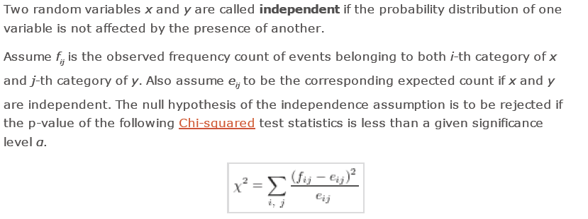
Chi-squared Test of Independence

Slide 27
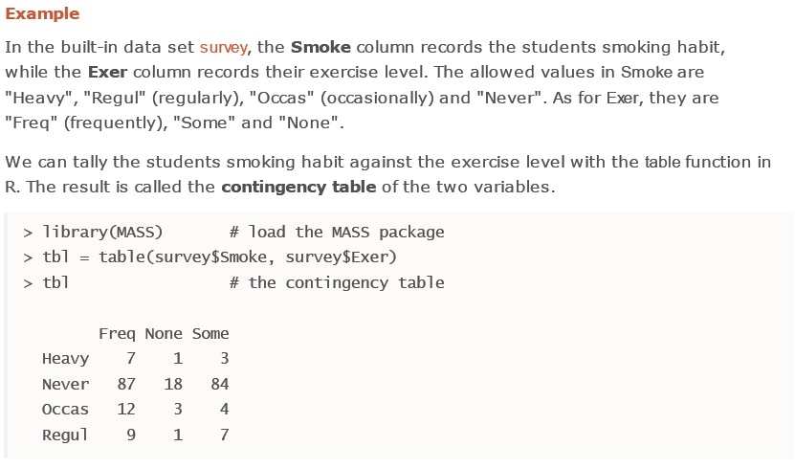
Chi-squared Test of Independence (2)

Slide 28
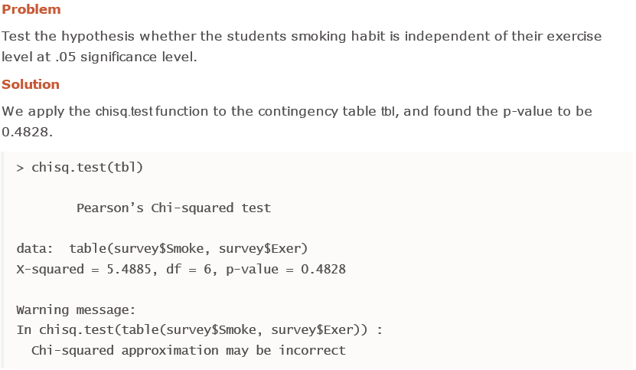
Chi-squared Test of Independence (3)

Slide 29
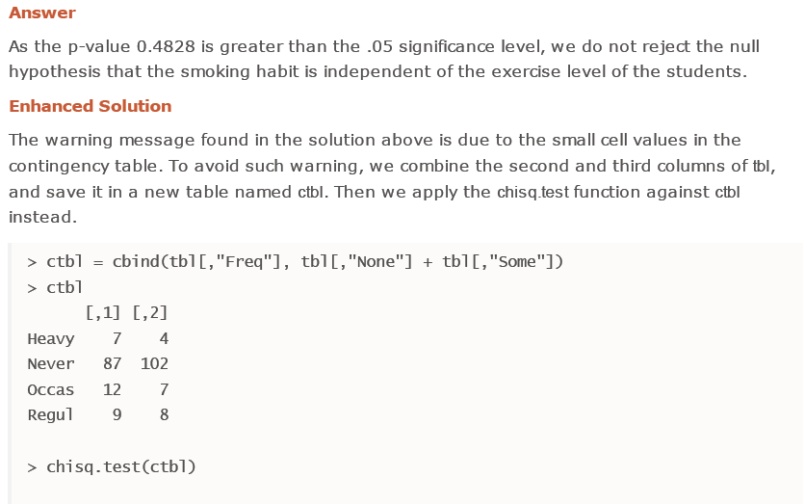
Chi-squared Test of Independence (4)

Slide 30
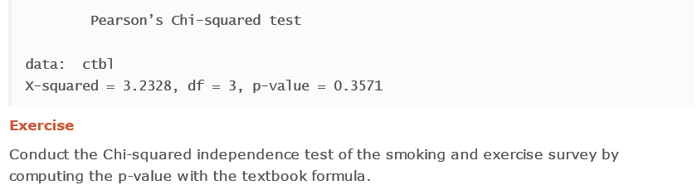
Chi-squared Test of Independence (5)

Slide 31
Acknowlegments
Some parts of the material in this presentation is taken from http://www.r-tutor.com/
Deo materijala je preuzet sa sajta http://www.e-statistika.rs

