Slide 1
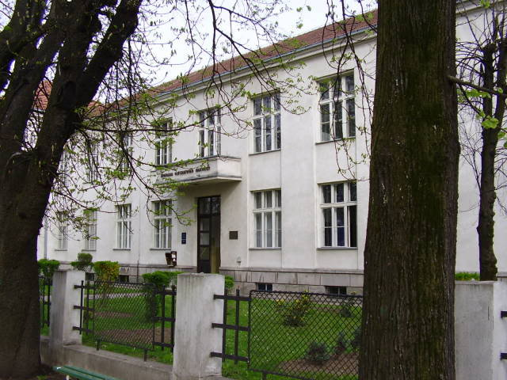
Primjena računara u biologiji
Vladimir Filipović
vladaf@matf.bg.ac.rs

Slide 2
Analysis of Variance
and
Non-parametric Methods

Slide 3
Elementary Statistics with R

Slide 4
Analysis of Variance

Slide 5
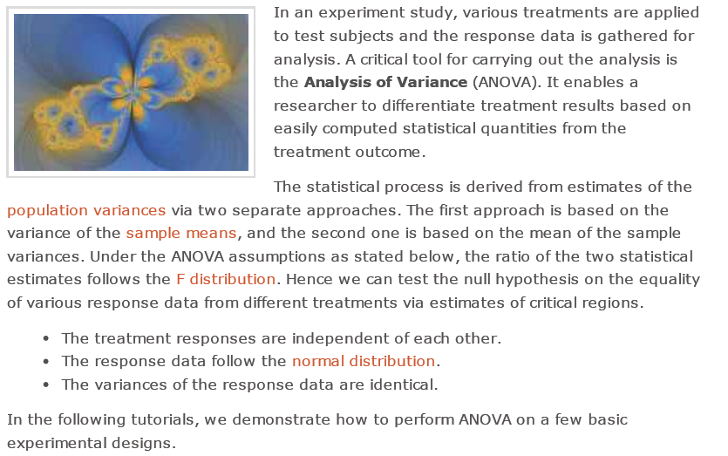
Analysis of Variance

Slide 6

Analysis of Variance (2)

Slide 7
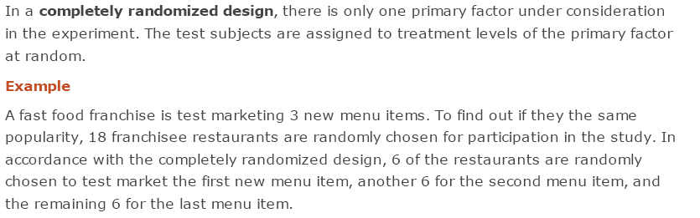
Completely Randomized Design

Slide 8
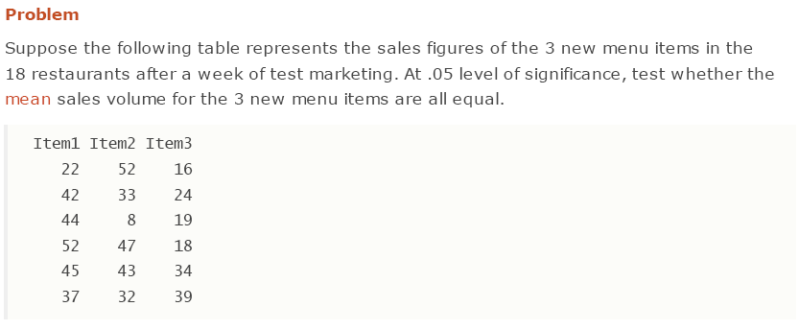
Completely Randomized Design (2)

Slide 9
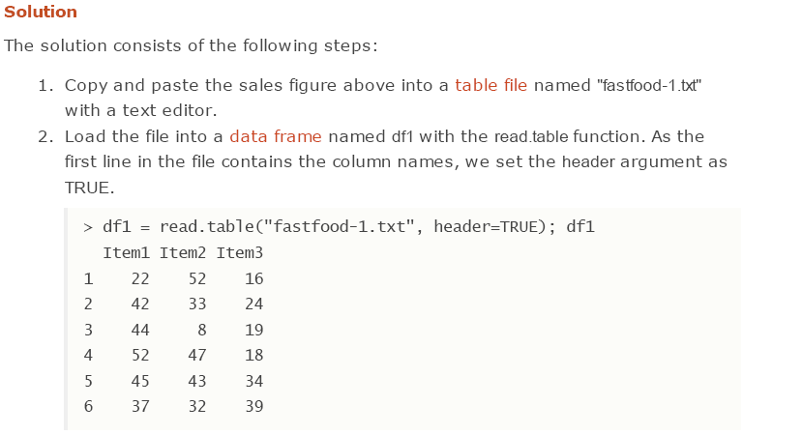
Completely Randomized Design (3)

Slide 10
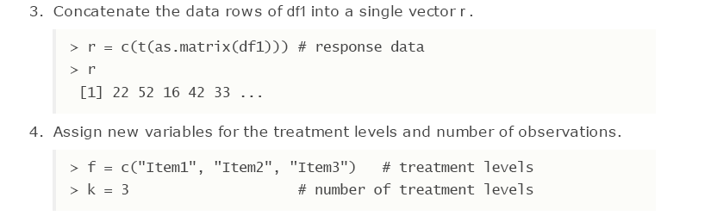
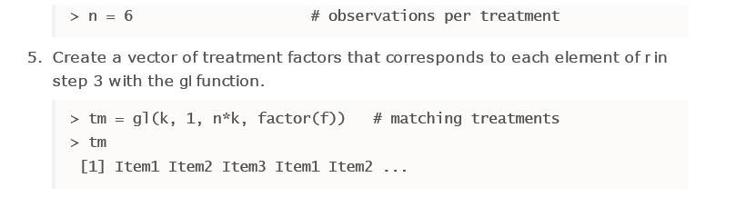
Completely Randomized Design (4)

Slide 11
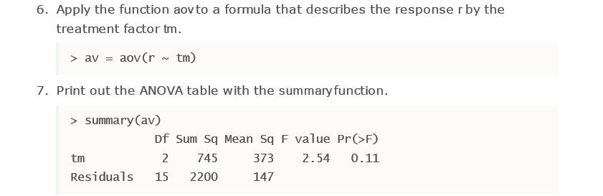
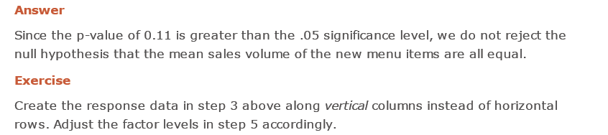
Completely Randomized Design (5)

Slide 12
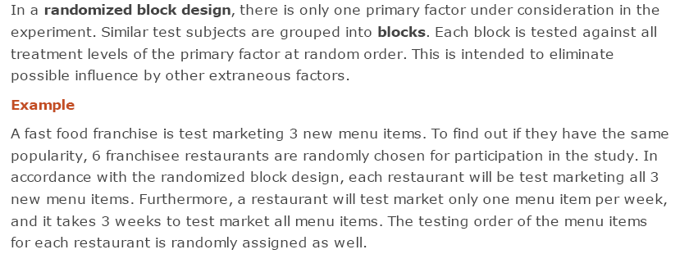
Randomized Block Design

Slide 13
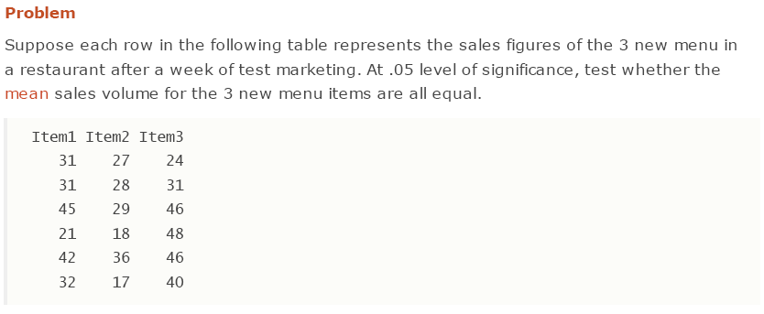
Randomized Block Design (2)

Slide 14
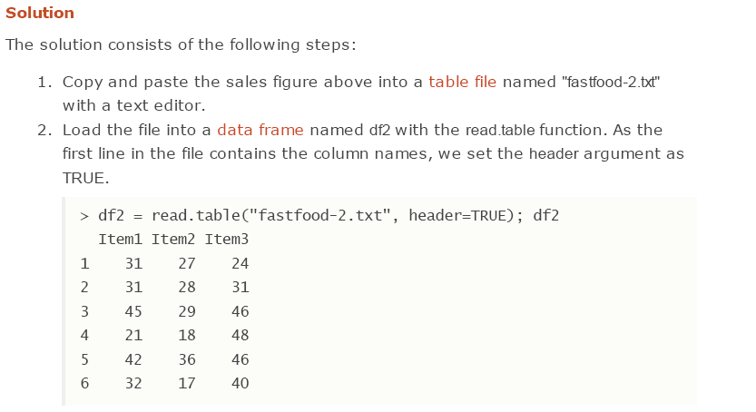
Randomized Block Design (3)

Slide 15
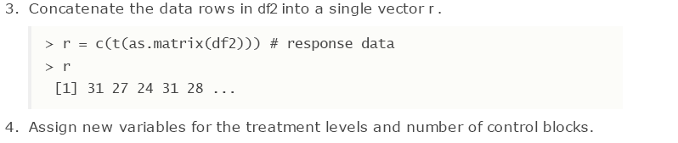
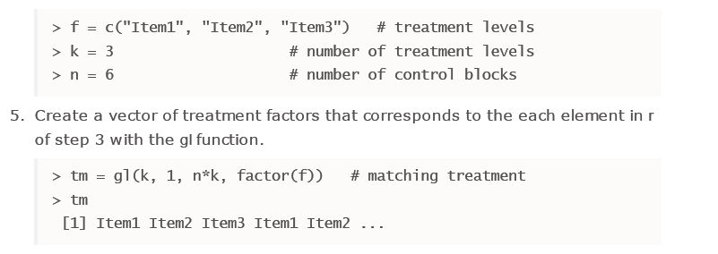
Randomized Block Design (4)

Slide 16
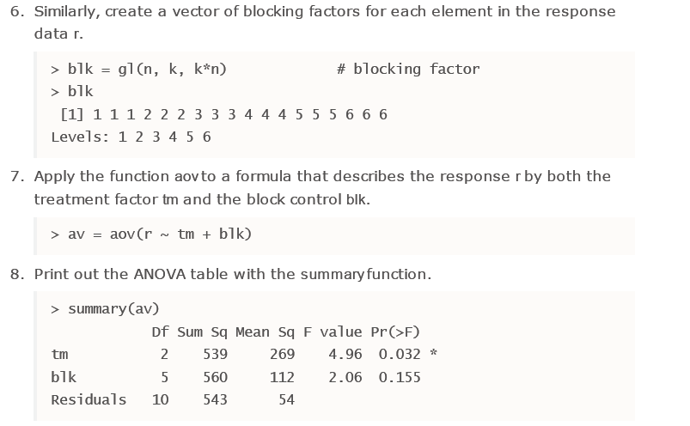
Randomized Block Design (5)

Slide 17
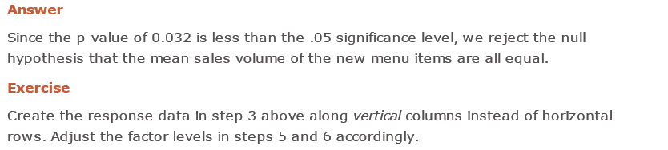
Randomized Block Design (6)

Slide 18
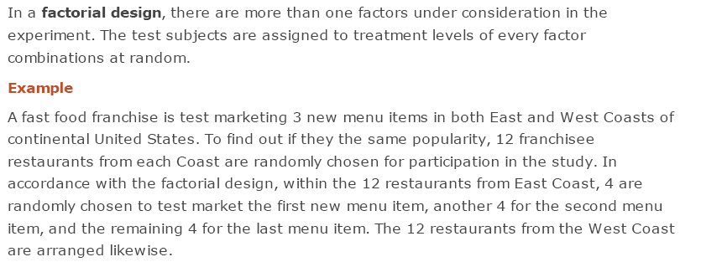
Factorial Design

Slide 19
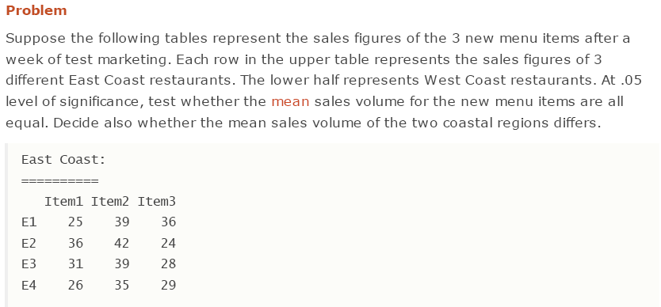
Factorial Design (2)

Slide 20
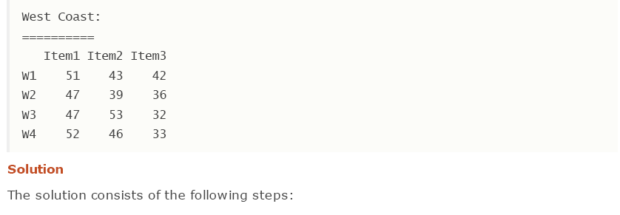
Factorial Design (3)

Slide 21
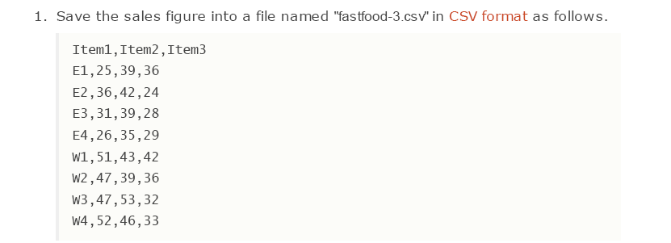
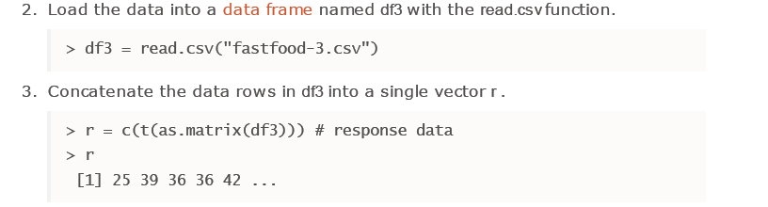
Factorial Design (4)

Slide 22
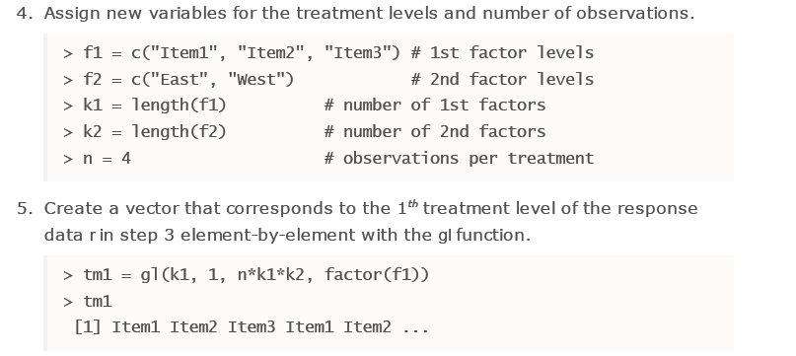
Factorial Design (5)

Slide 23
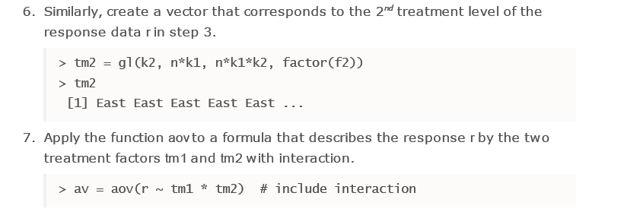
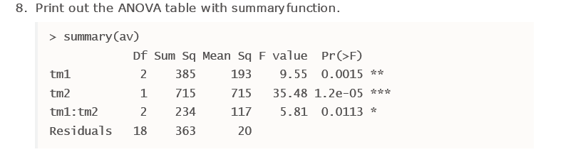
Factorial Design (6)

Slide 24
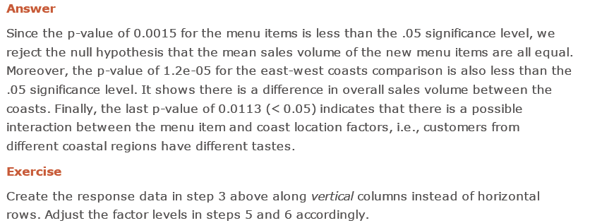
Factorial Design (7)

Slide 25
Non-parametric Methods

Slide 26
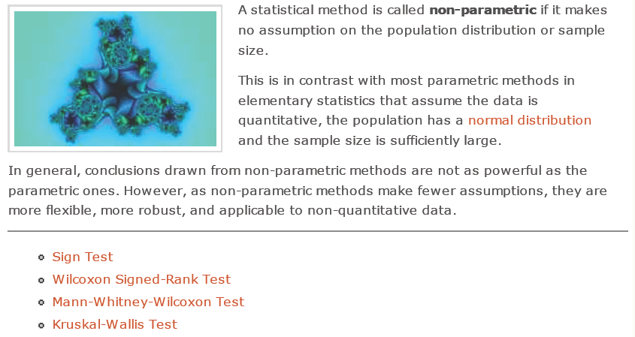
Non-parametric Methods

Slide 27
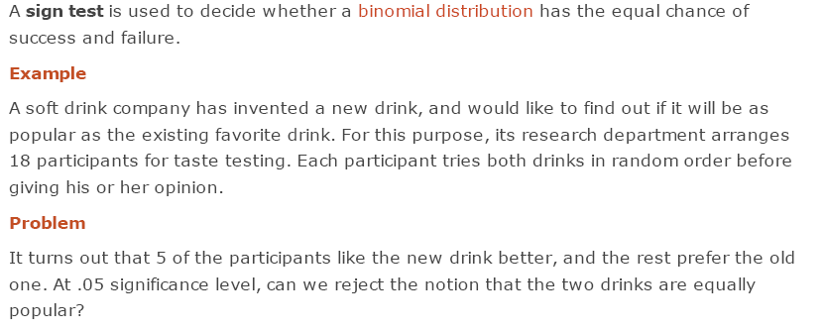
Sign Test

Slide 28
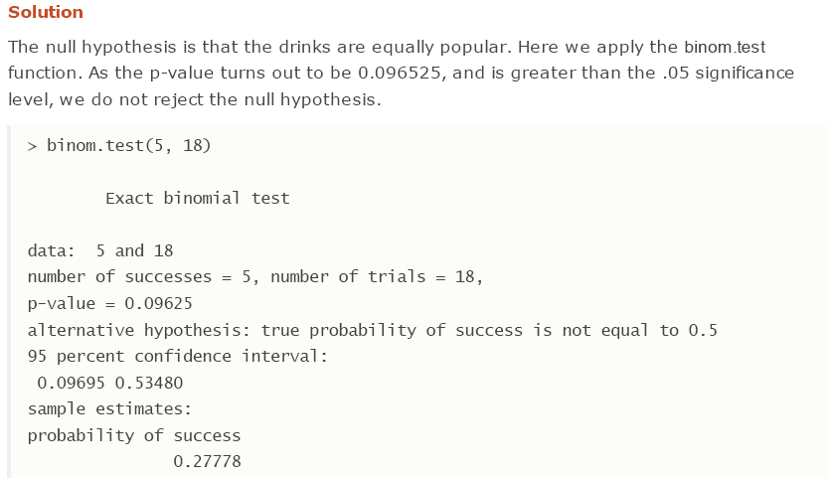
Sign Test (2)

Slide 29

Sign Test (3)

Slide 30
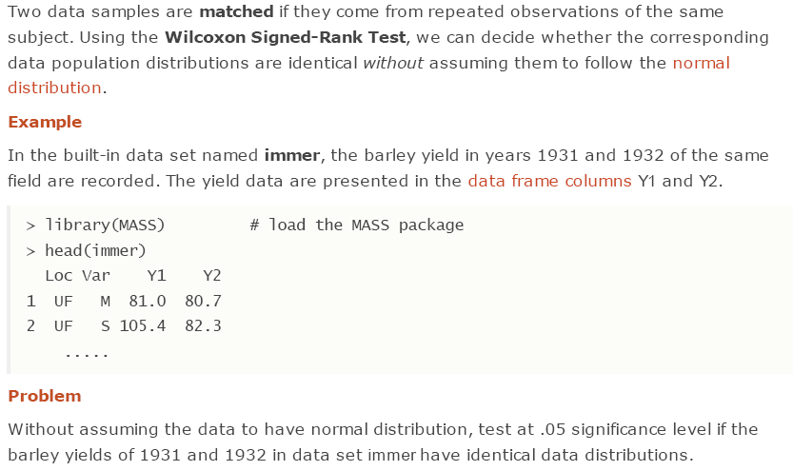
Wilcoxon Signed-Rank Test

Slide 31
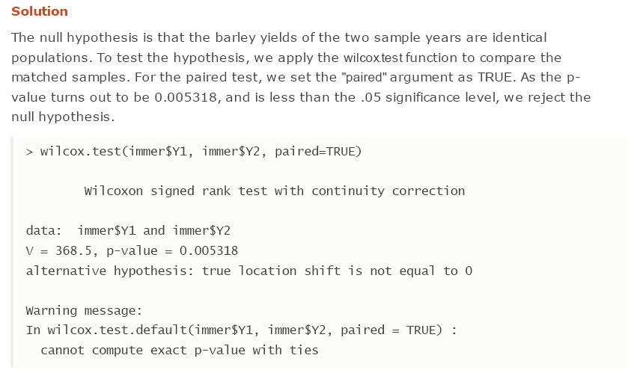
Wilcoxon Signed-Rank Test (2)

Slide 32

Wilcoxon Signed-Rank Test (3)

Slide 33
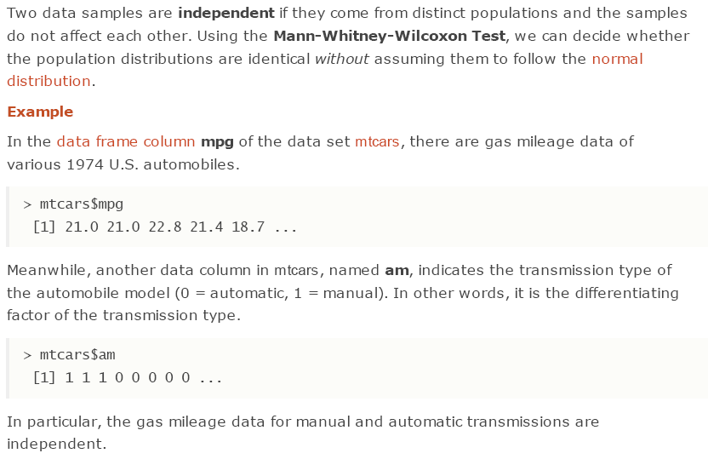
Mann-Whitney-Wilcoxon Test

Slide 34
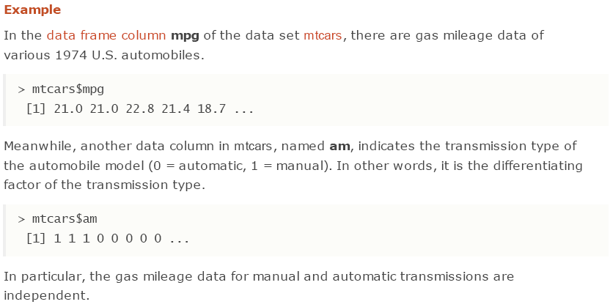
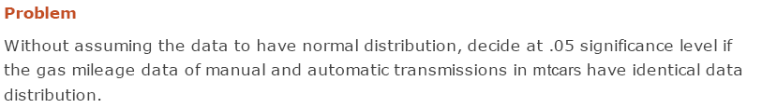
Mann-Whitney-Wilcoxon Test (2)

Slide 35
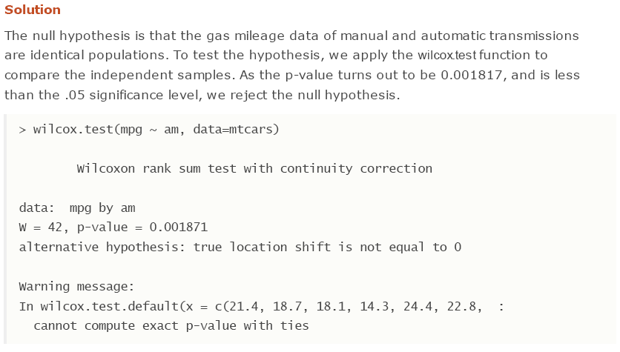
Mann-Whitney-Wilcoxon Test (3)

Slide 36

Mann-Whitney-Wilcoxon Test (4)

Slide 37
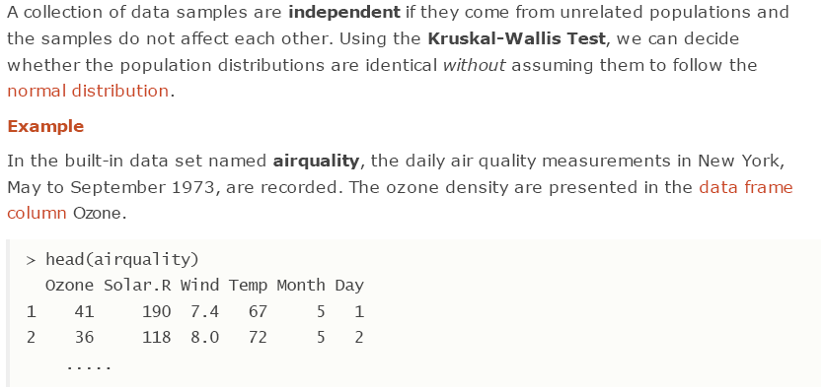
Kruskal-Wallis Test

Slide 38
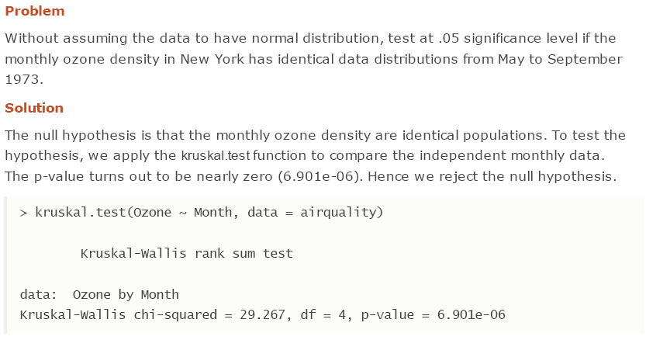
Kruskal-Wallis Test (2)

Slide 39

Kruskal-Wallis Test (3)

Slide 40
Acknowlegments
Material in this presentation is taken from
http://www.r-tutor.com/

