Slide 1

Primjena računara u biologiji
Vladimir Filipović
vladaf@matf.bg.ac.rs

Slide 2
Simple Linear Regression,
Multiple Linear Regression
and
Logistic Regression

Slide 3
Elementary Statistics with R

Slide 4
Simple Linear Regression

Slide 5
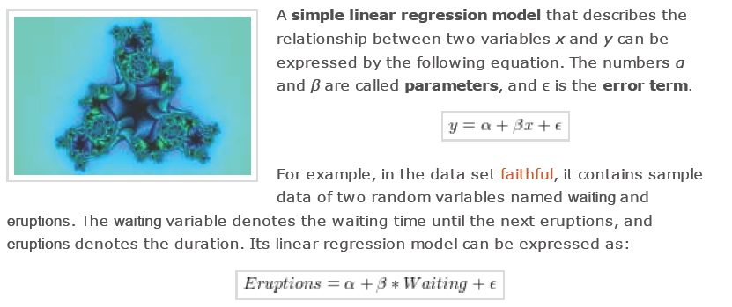
Simple Linear Regression

Slide 6
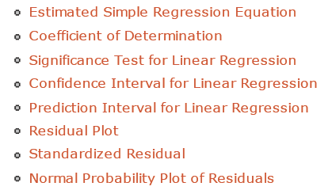
Simple Linear Regression

Slide 7
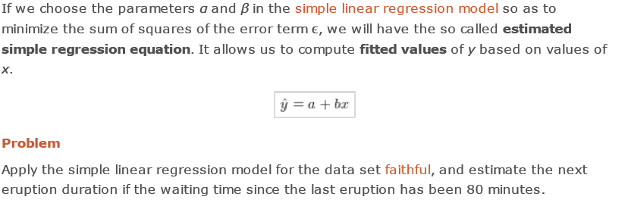
Estimated Simple Regression Equation

Slide 8
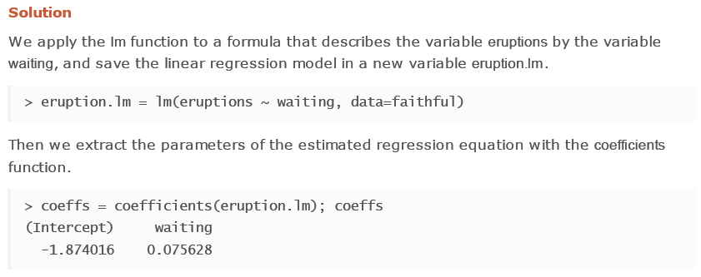
Estimated Simple Regression Equation (2)

Slide 9
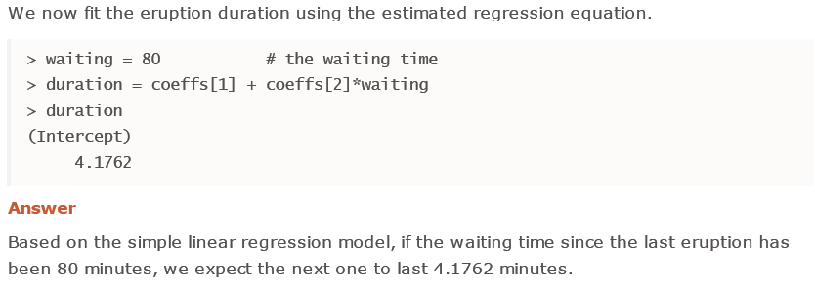
Estimated Simple Regression Equation (3)

Slide 10
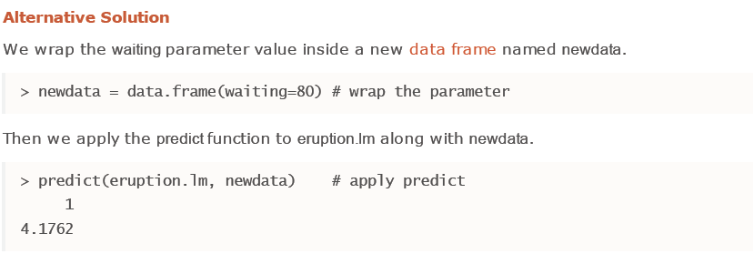
Estimated Simple Regression Equation (4)

Slide 11
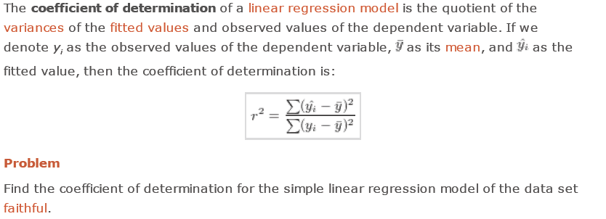
Coefficient of Determination

Slide 12
Coefficient of Determination

Slide 13
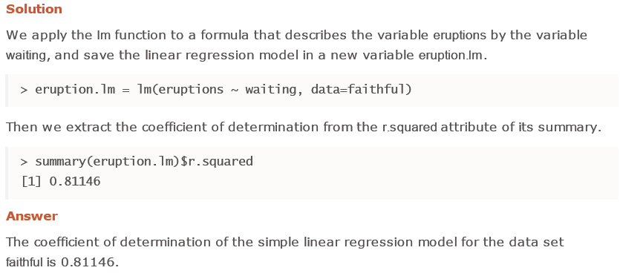
Coefficient of Determination (2)

Slide 14
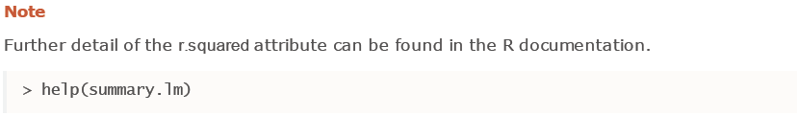
Coefficient of Determination (3)

Slide 15
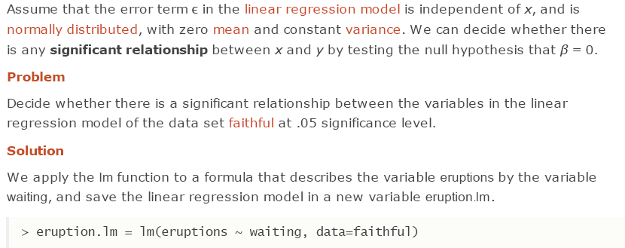
Significance Test for Linear Regression

Slide 16
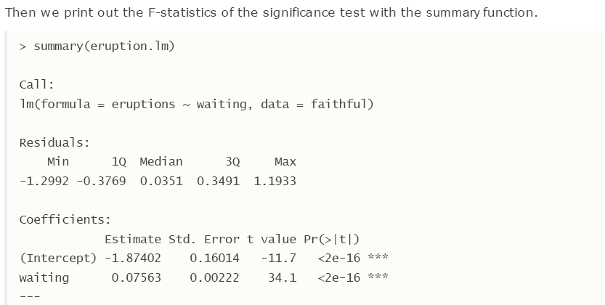
Significance Test for Linear Regression (2)

Slide 17
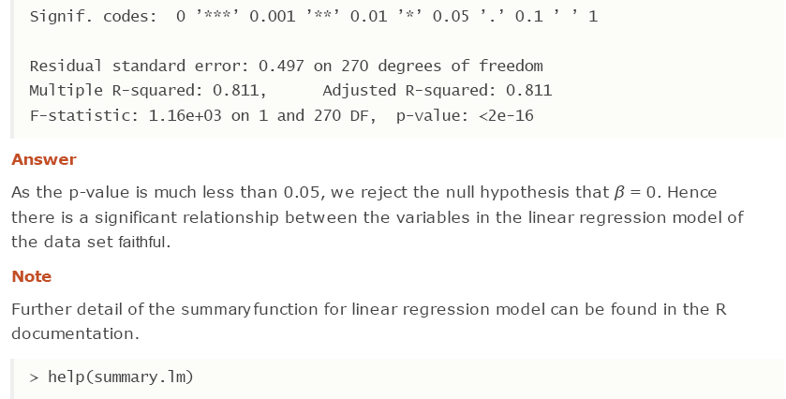
Significance Test for Linear Regression (3)

Slide 18
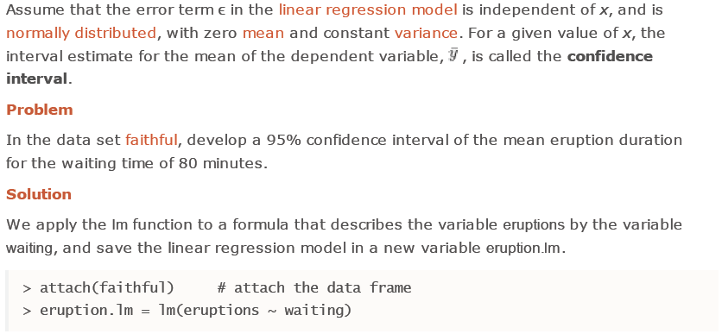

Confidence Interval for Linear Regression

Slide 19
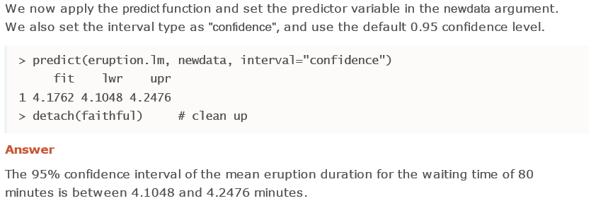
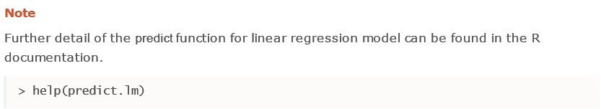
Confidence Interval for Linear Regression (2)

Slide 20
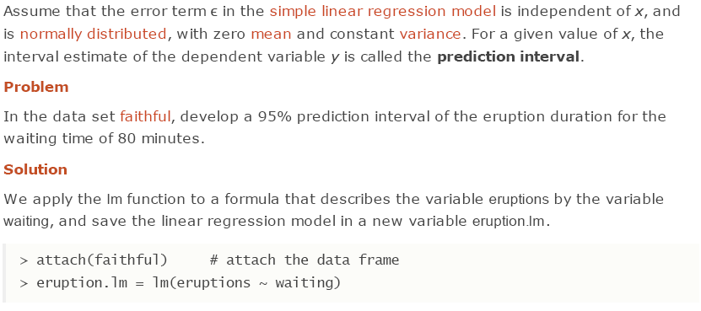
Prediction Interval for Linear Regression

Slide 21
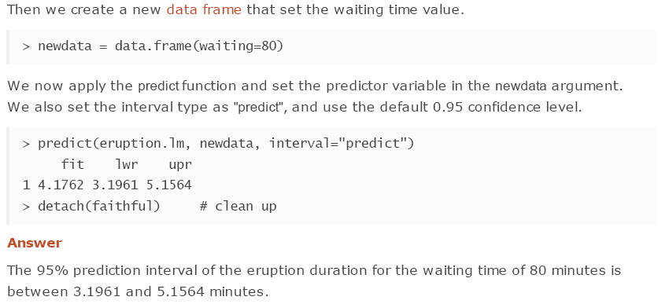
Prediction Interval for Linear Regression (2)

Slide 22
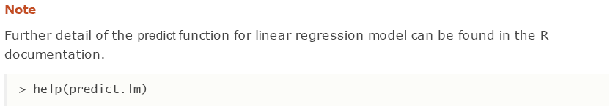
Prediction Interval for Linear Regression (3)

Slide 23
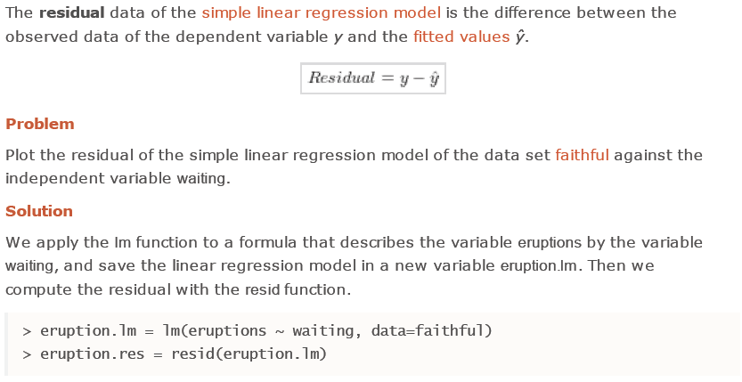
Residual Plot

Slide 24
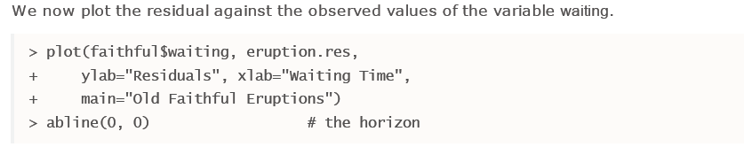
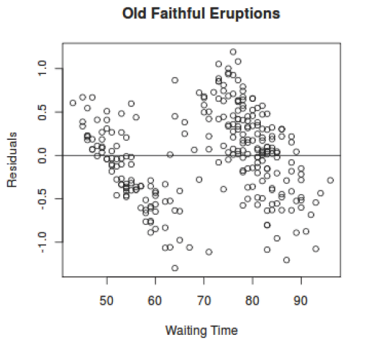
Residual Plot (2)

Slide 25
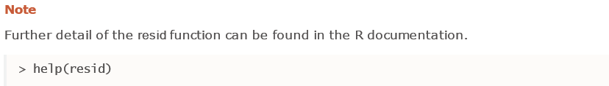
Residual Plot (3)

Slide 26
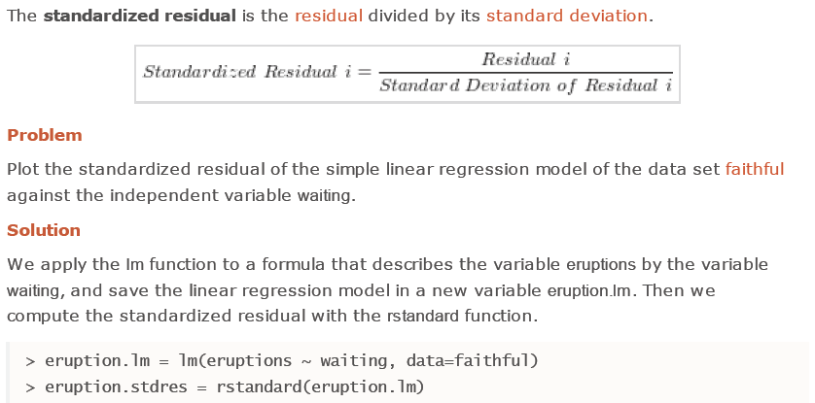
Standardized Residual

Slide 27
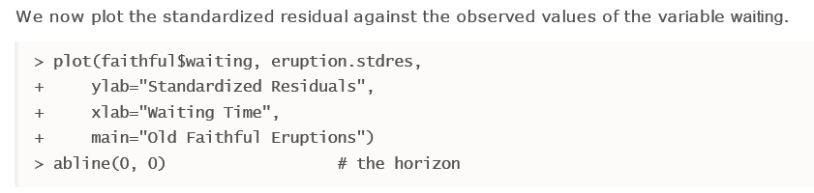
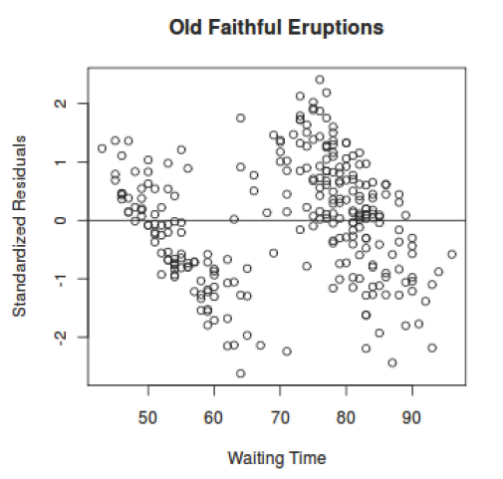
Standardized Residual (2)

Slide 28
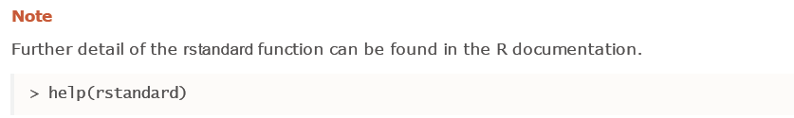
Standardized Residual (3)

Slide 29
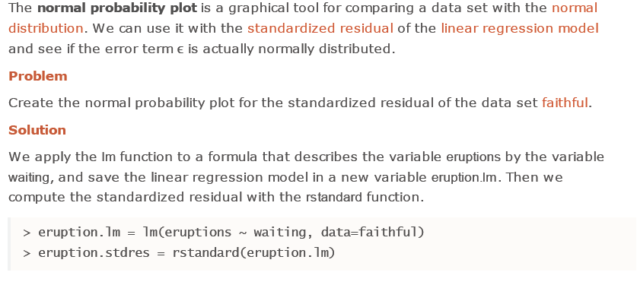
Normal Probability Plot of Residuals

Slide 30
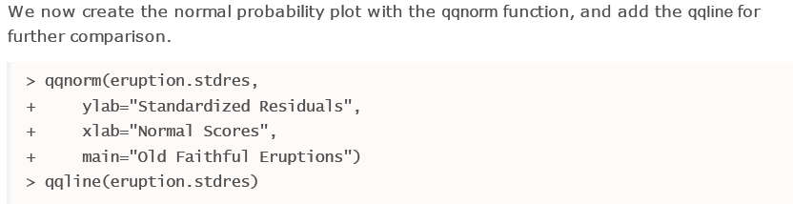
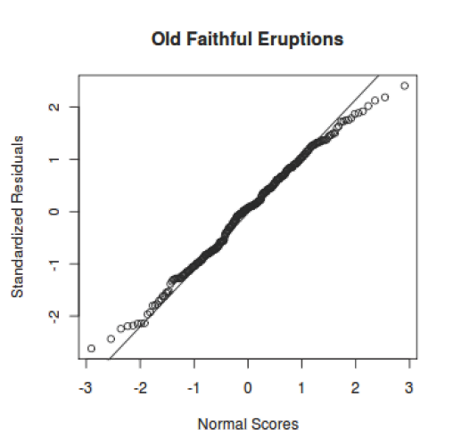
Normal Probability Plot of Residuals (2)

Slide 31
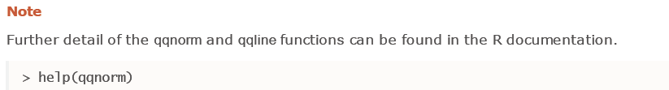
Normal Probability Plot of Residuals (3)

Slide 32
Multiple Linear Regression

Slide 33
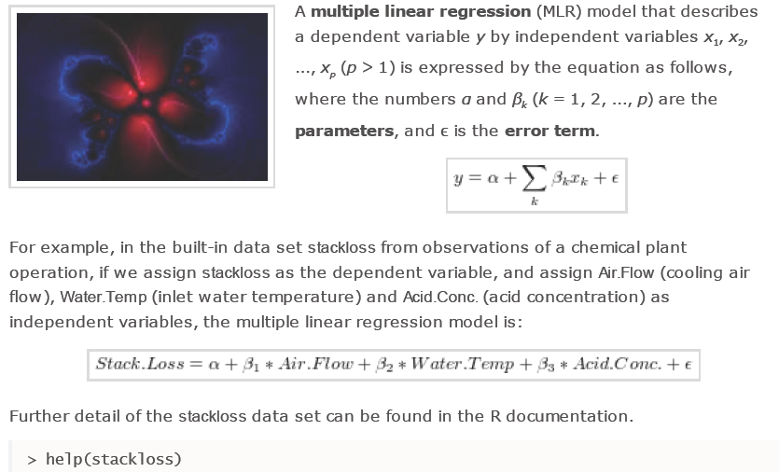
Multiple Linear Regression

Slide 34
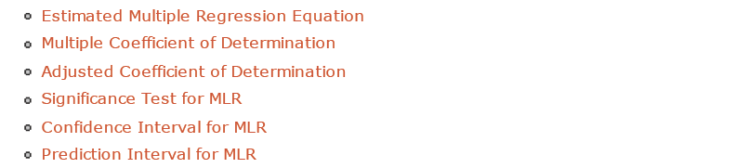
Multiple Linear Regression (2)

Slide 35
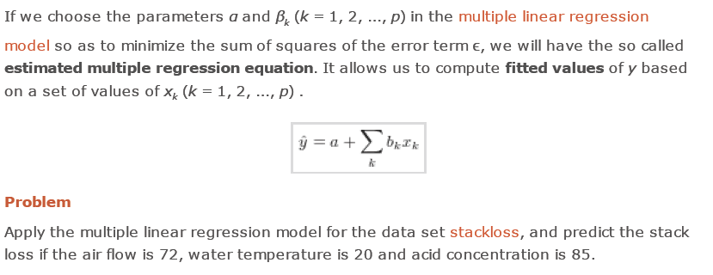
Estimated Multiple Regression Equation

Slide 36
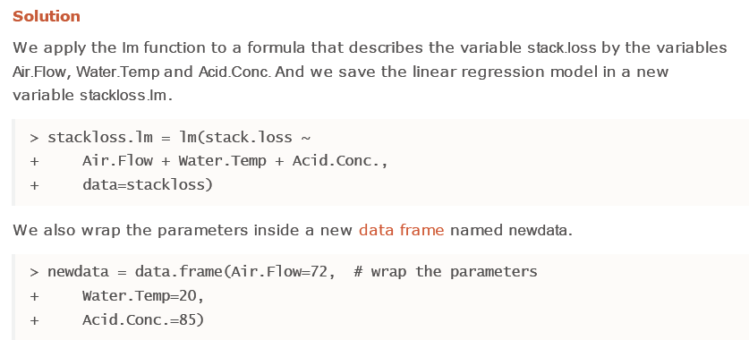
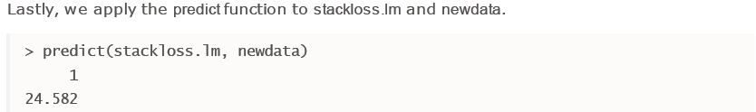
Estimated Multiple Regression Equation (2)

Slide 37

Estimated Multiple Regression Equation (3)

Slide 38
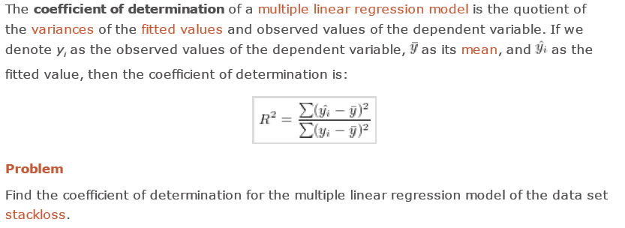
Multiple Coefficient of Determination

Slide 39
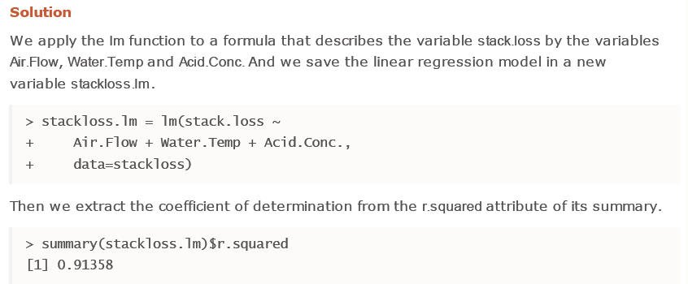
Multiple Coefficient of Determination (2)

Slide 40
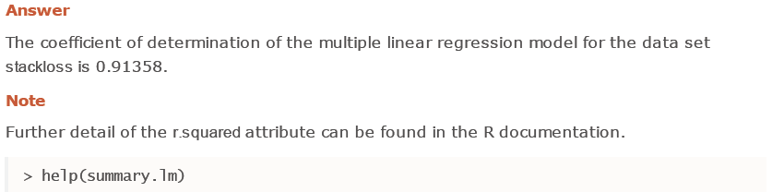
Multiple Coefficient of Determination (3)

Slide 41
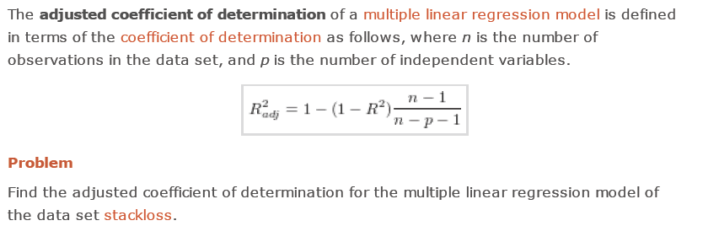
Adjusted Coefficient of Determination

Slide 42
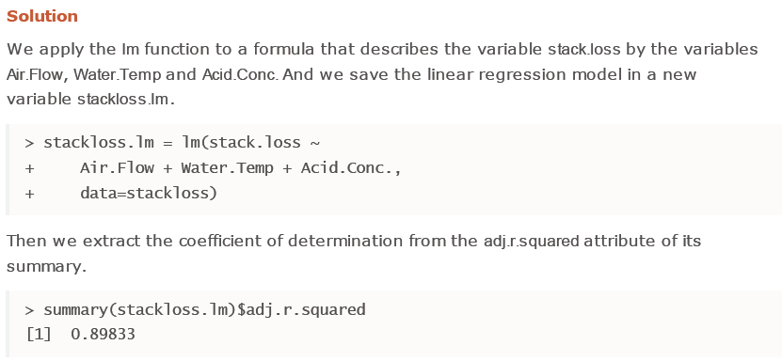
Adjusted Coefficient of Determination (2)

Slide 43
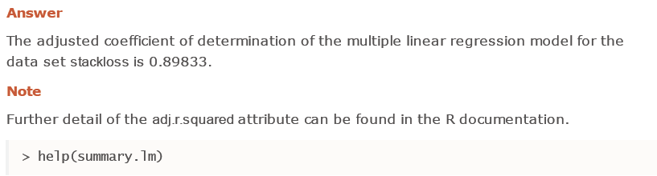
Adjusted Coefficient of Determination (3)

Slide 44
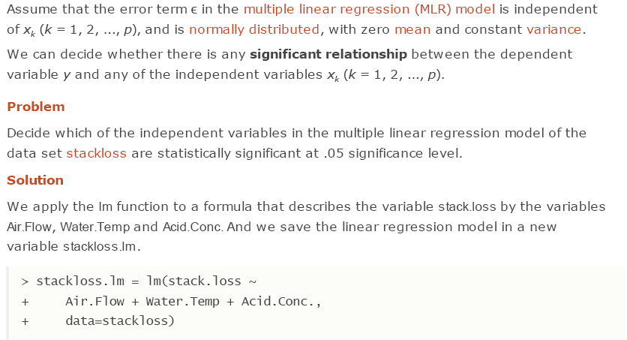
Significance Test for MLR

Slide 45
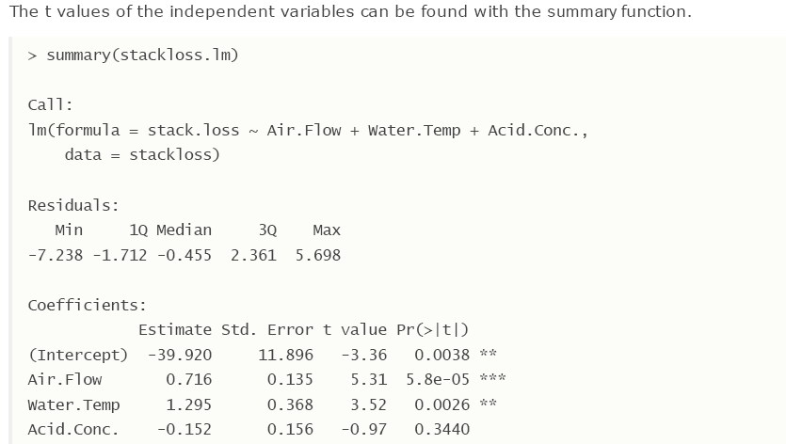
Significance Test for MLR (2)

Slide 46
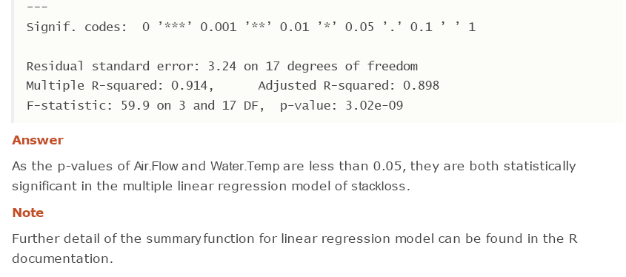
Significance Test for MLR (3)

Slide 47
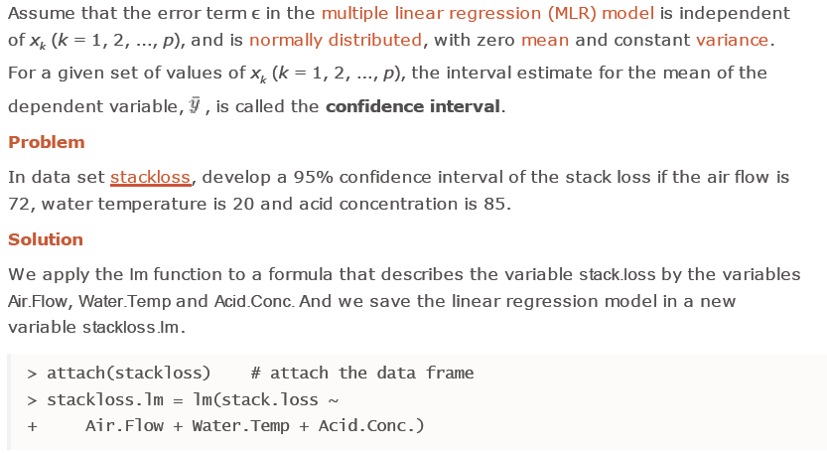
Confidence Interval for MLR

Slide 48
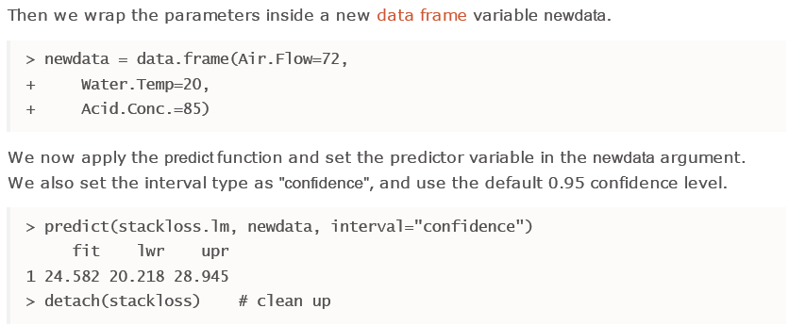
Confidence Interval for MLR (2)

Slide 49
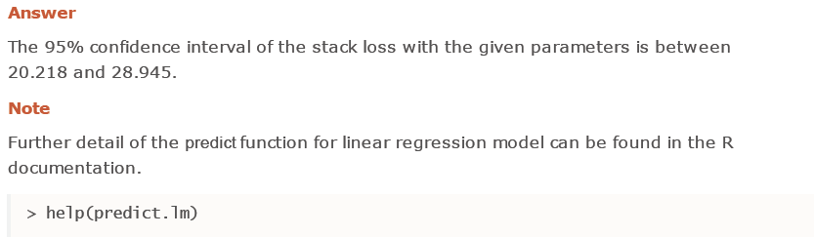
Confidence Interval for MLR (3)

Slide 50
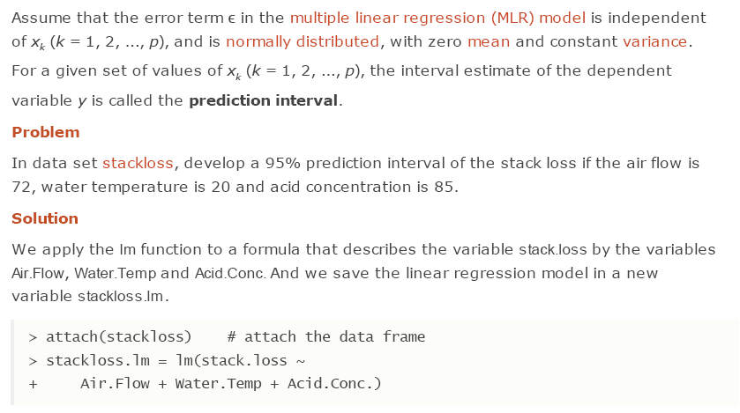
Prediction Interval for MLR

Slide 51
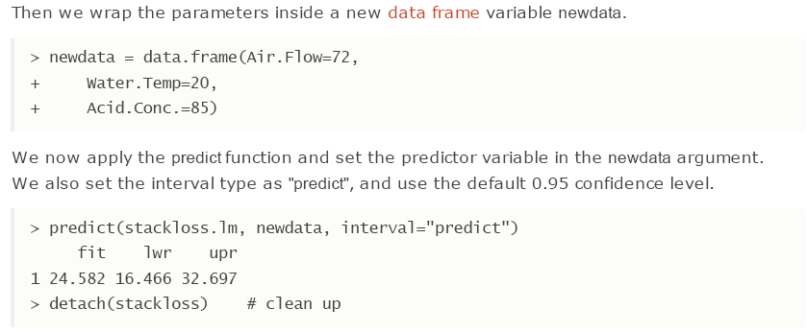
Prediction Interval for MLR (2)

Slide 52
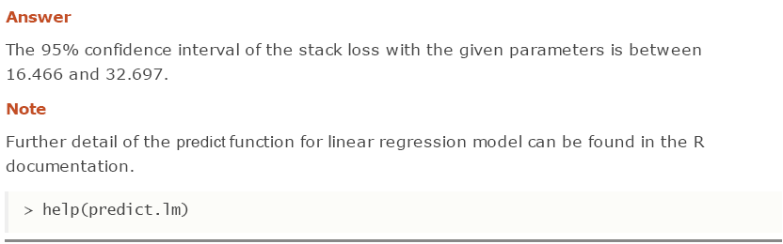
Prediction Interval for MLR (3)

Slide 53
Logistic Regression

Slide 54

Logistic Regression

Slide 55

Logistic Regression (2)

Slide 56

Estimated Logistic Regression Equation

Slide 57

Estimated Logistic Regression Equation (2)

Slide 58

Estimated Logistic Regression Equation (3)

Slide 59

Significance Test for Logistic Regression

Slide 60

Significance Test for Logistic Regression (2)

Slide 61


Significance Test for Logistic Regression (3)

Slide 62
Acknowlegments
Material in this presentation is taken from
http://www.r-tutor.com/

