Slide 1
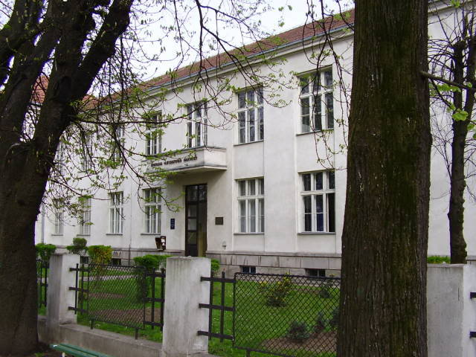
Примјена рачунара у биологији
Владимир Филиповић
vladaf@matf.bg.ac.rs

Slide 2
Рад са графовима

Slide 3
Графови
Bioclipse is a free and open source workbench for the life sciences.
Bioclipse is based on the Eclipse Rich Client Platform (RCP) which means that Bioclipse inherits a state-of-the-art plugin architecture, functionality, and visual interfaces from Eclipse, such as help system, software updates, preferences, cross-platform deployment etc.
Bioclipse provides advanced functionality in fields such as cheminformatics, bioinformatics, semantic web, spectrum analysis, drug discovery, safety assessment, and general chemistry education.

Slide 4
Gephi
Bioclipse is a free and open source workbench for the life sciences.
Bioclipse is based on the Eclipse Rich Client Platform (RCP) which means that Bioclipse inherits a state-of-the-art plugin architecture, functionality, and visual interfaces from Eclipse, such as help system, software updates, preferences, cross-platform deployment etc.
Bioclipse provides advanced functionality in fields such as cheminformatics, bioinformatics, semantic web, spectrum analysis, drug discovery, safety assessment, and general chemistry education.

Slide 5
Acknowlegments
Some material of the presentation is taken from
http://research.microsoft.com/en-us/projects/chem4word/
Some material of the presentation is taken from http://www.xml-cml.org/
Some material of the presentation is taken from http://www.bioclipse.net/

