Slide 1
Heart Disease Classification
Patrick O’Bryant

Slide 2
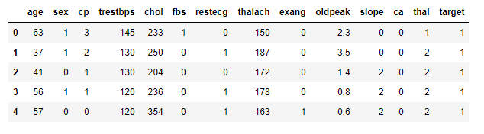
Introduction
Goal of the Project : Binary Classification problem
Column Discussion
Complex model / manipulation of cutoff value for FN rate
Simple model shiny app with practical applications

Slide 3
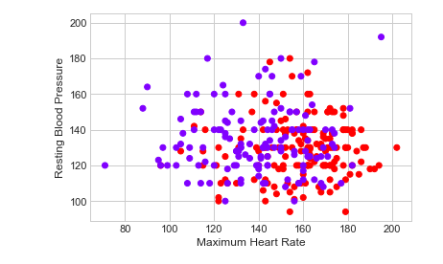
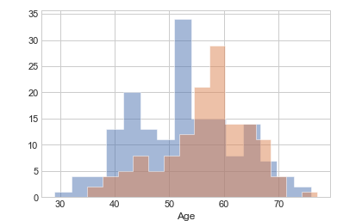
Exploratory Analysis
Early examination of relationships between variables
Maximum Heart Rate vs. Resting Blood pressure
Good separation between classes
Trend is inline with expectation (High HR and low BP = negative for heart disease).
Age Histograms comparing classes
Average of 50-55 years old for our sample
Small trend in which older = more likely for heart disease
Best in conjunction with other variables

Slide 4
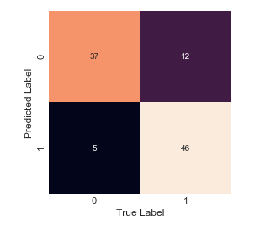
Preliminary Naïve Bayes Model
Benefits : Fast, straightforward prediction that is easily interpretable.
Good for baseline classification
Model used all features in the dataset
83% Accuracy
High false negative ratio
Will need to take extra precautions against this in future more complex models

Slide 5
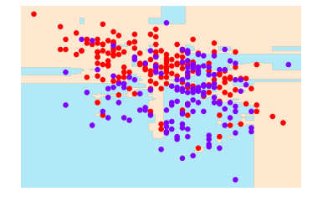
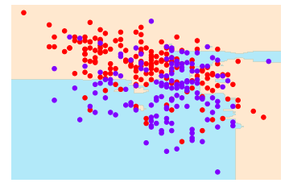
Overfitting and Hyper-Parameters
Initial Random Forest trained with all features and default hyper parameters
Noticeable overfitting as model is creating decisions boundaries for single data points or small clusters of data points
Second Random Forest hyper parameters adjusted by increasing the number of estimators in the forest 10 fold and decreasing the sample size from 80% to 30%
A larger quantity of more superficial looks at the data created a more general model
Second model is making broader less specific decisions so it will generalize to new data better

Slide 6
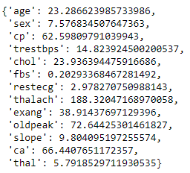
Feature Selection
Chi- Squared
Goal: To remove redundant or useless features from our dataset to improve model performance
Filter (Chi-Squared) vs Wrapper (RFE) methods
Filter = no machine learning models
Wrapper = exhaustive
Chi-Squared vs RFE
Statistical test vs brute force recursive model creation
Top and bottom features from both
RFE

Slide 7
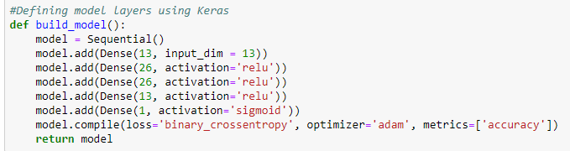
More Complex Model
Neural Network created with Keras using Tensorflow backend
5 layer sequential model
Best results with same number of neurons as input dimensions
86% accuracy on train set

Slide 8
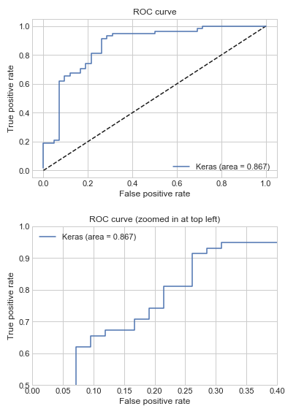
ROC curve Final Model
ROC curve helps visualize the performance of the model
Ideal scenario is curve peaks in the far top left corner
This would represent a high TPR with low FPR
TPR = TP/(TP+FN)
FPR = FP/(FP +TN)
0.867 AUC
Solid performance in comparison to ideal of 1

Slide 9
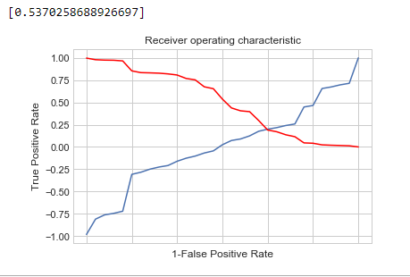
Optimal Cutoff Value
Plotting TPR vs 1-FPR
Optimal cutoff point is where TPR is high and FPR is low
Ideally TPR – (1-FPR) is as close to 0 as possible
0.537 is the ideal cutoff point to label a positive class
i.e. when our model has an output value of 0.62 we would label that as positive for heart disease
We can change this value in an attempt to manipulate the number of FP’s or FN’s

Slide 10
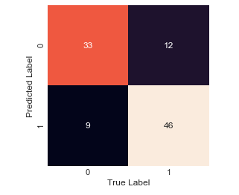
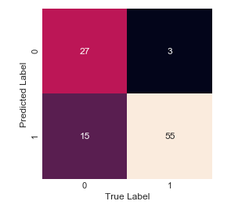
Final Confusion Matrix Comparison
Decrease cutoff to combat false negatives
Slowly stepped down on test set
Optimal cutoff is more balanced
Accuracy actually became higher by dropping the cutoff significantly
Cutoff = 0.537
Cutoff = 0.10

