Slide 1
Unit Tests: The Foundation of Software Quality
with Patrick Turley

Slide 2
Who is this guy?
Lead developer at ThoughtWorks
Worked at more than 10 clients in many different domains
Professionally coded in Ruby, PHP, Java, Javascript, and others
Been on teams as small as 4 and as large as 50
Interested in music, travel, and tasty food

Slide 3
Agenda
Introduction to unit testing
Test Driven Development
Pair Programming
Continuous Integration
Continuous Delivery

Slide 4
Introduction to unit testing

Slide 5
What are unit tests?
Definition: Pieces of code that test the smallest possible logical slice of your application code.
Isolated so that we can trace back the problem quickly
Mocks and Stubs
Fast feedback!
Developer owned!

Slide 6
Let’s see an example
describe User do
it "should require a name" do
no_name_user = User.new(:name=>””)
no_name_user.should_not be_valid
end
end

Slide 7
Let’s write one!
Notes:
it "should make all sandwiches tasty after validation has been performed" do
item = Item.new(:name => "Club Sandwich", :description => "Has cheese")
item.valid?
item.description.should == "Has cheese and it is tasty"
end

Slide 8
Test Driven Development (TDD)

Slide 9
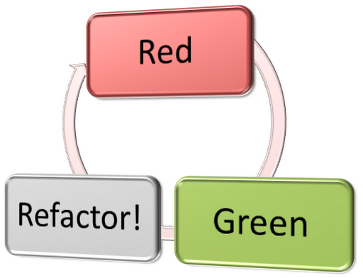
The cycle

Slide 10
You are forced to think about
API design
How an error will read
Are there too many dependencies for this unit
How can I make this new feature testable

Slide 11
Let’s try it out!
Notes:
it "calculates a 5% tax before validation" do
item = Item.new(:name => "Candy", :price => 20)
item.valid?
item.tax.should == 1.0
end
it "rejects items who's price is not numeric" do
item = Item.new(:name => "Candy", :price => "asdfasdf")
item.should_not be_valid
end
validates_numericality_of :price

Slide 12
Pair Programming

Slide 13
How is it done?
Two people, one computer
Both people focused on the same goal
Driver and Navigator
Lots of tactical approaches
Ball and Board
Time based switching
Ping pong

Slide 14
Two people! How will I make up the capacity?
Think long term!
Reduced defect count
Simpler solutions are found
Defects tend to be simpler to fix
Knowledge is shared throughout the team so no more code reviews
Focus focus focus!

Slide 15
Continuous Integration (CI)

Slide 16
Integrate early and often
Keeps teams from having large difficult merge conflicts
Provides early alarms that something has gone wrong
Encourages automation of all frequent tasks to save time

Slide 17
Continuous Delivery (CD)

Slide 18
Some links and books that might be of interest
Ruby and Rails lessons
www.rubykoans.com
ruby.railstutorial.org
Extreme Programming Explained by Kent Beck and Cynthia Andres
Test Driven Development: By Example by Kent Beck
Refactoring by Martin Fowler and others
Continuous Integration by Paul M. Duvall
Continuous Delivery by Jez Humble and Dave Farley

Slide 19
Questions?

