Slide 1
newssup
Get the latest news updates from various news channels: Google, BBC etc.
Top Stories, World, Business, Sports update all in one click.
Read and listen to the news updates.

Slide 2
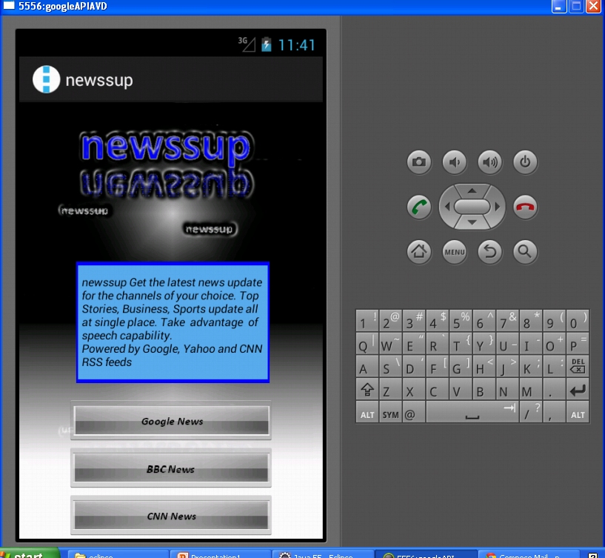
Application Main Screen

Slide 3
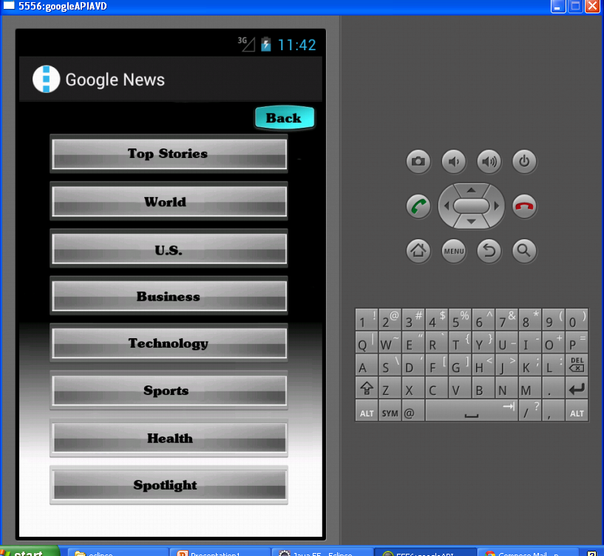

Slide 4
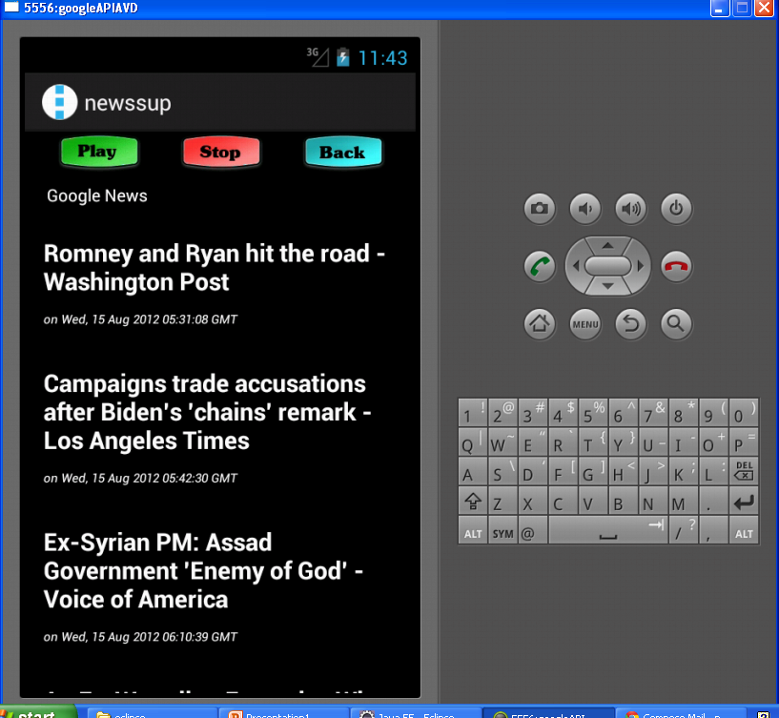

Slide 5
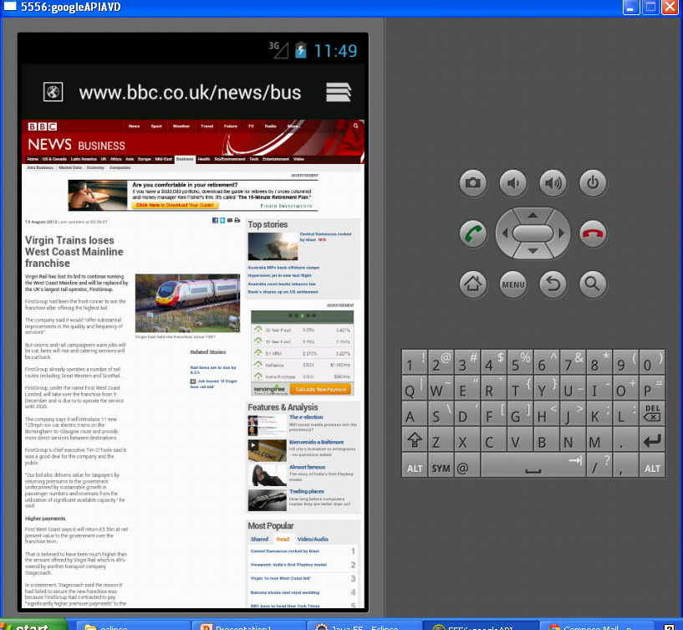

Slide 6
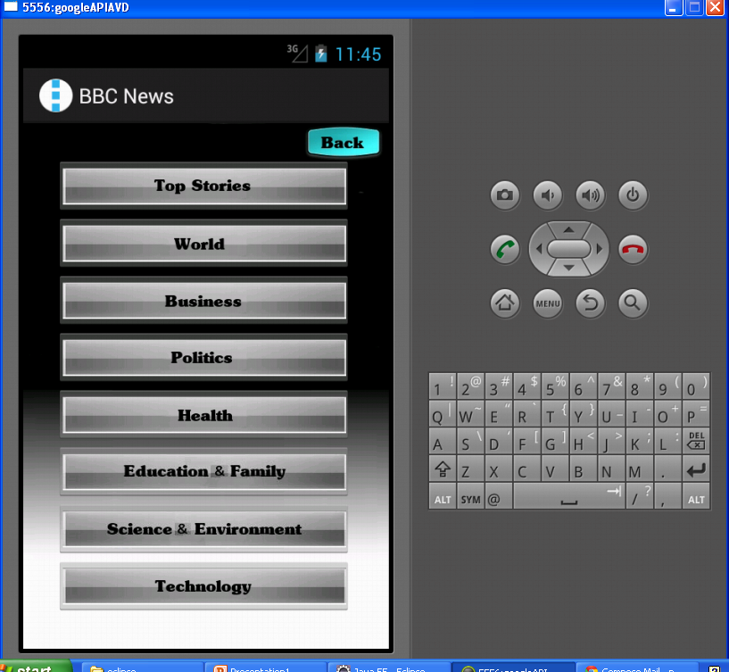

Slide 7
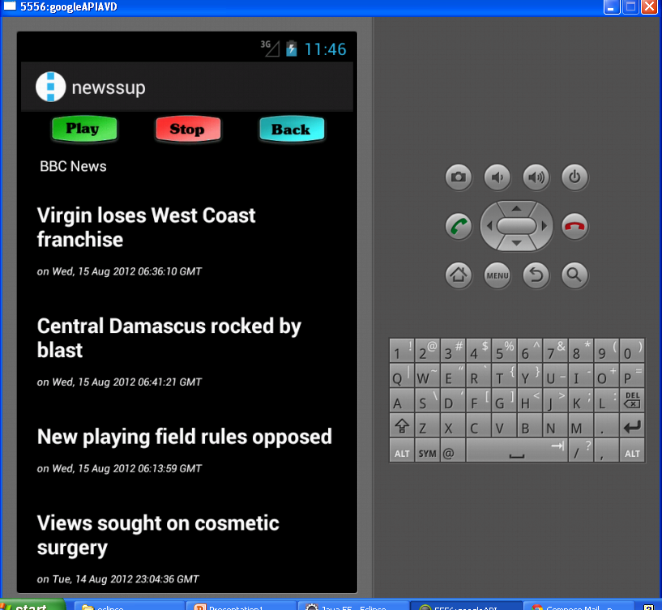

Slide 8
Future Enhancements
Add other news providers.
Make the application dynamic
Allow app to take speech input

