Slide 1
newssup Developed by: Pratibha Natani <pnatani@pdx.edu> / <en.pratibha@gmail.com> Powered by Google and BBC News APIs.
Get the latest news updates from various news channels: Google, BBC etc.
Top Stories, World, Business, Sports update all in one click.
Now you can read and listen to the news updates.

Slide 2
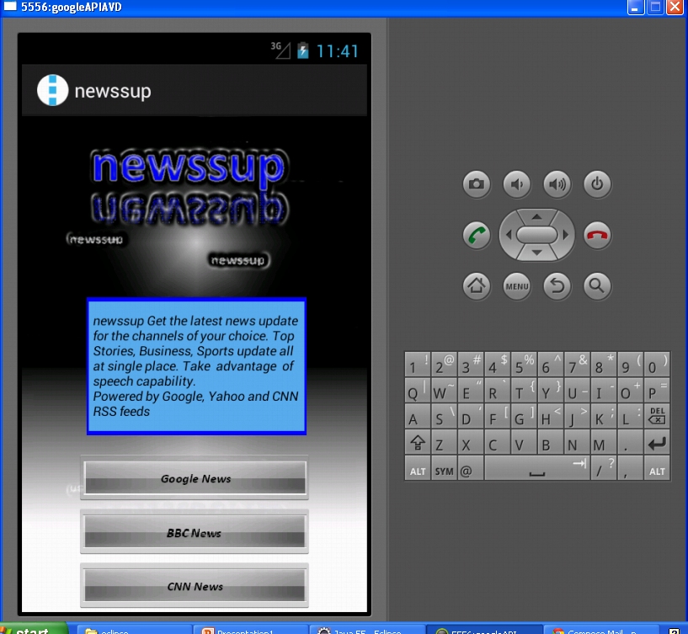
Application Main Screen

Slide 3
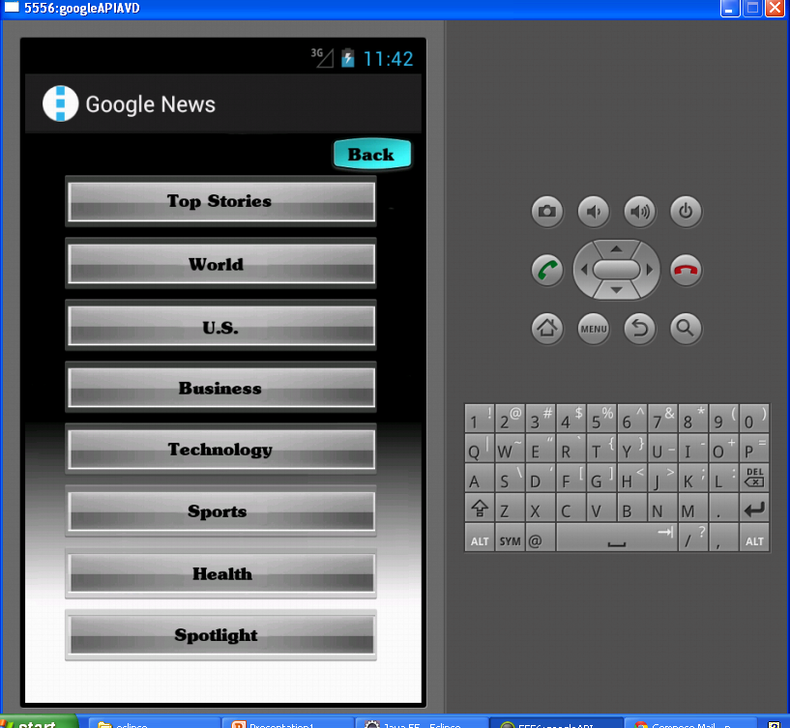

Slide 4
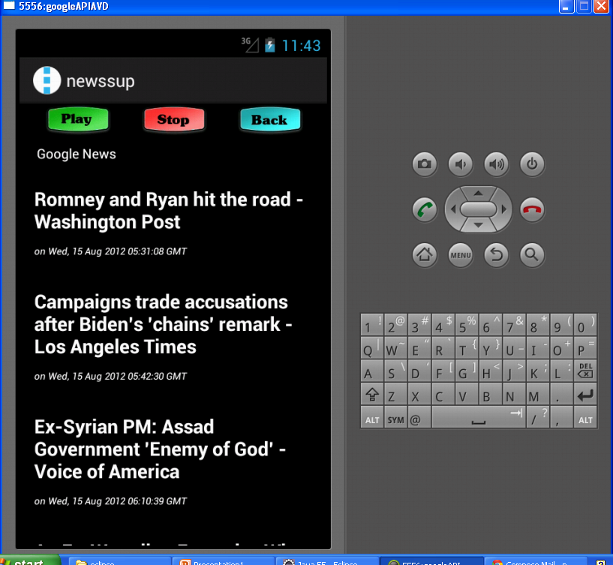

Slide 5
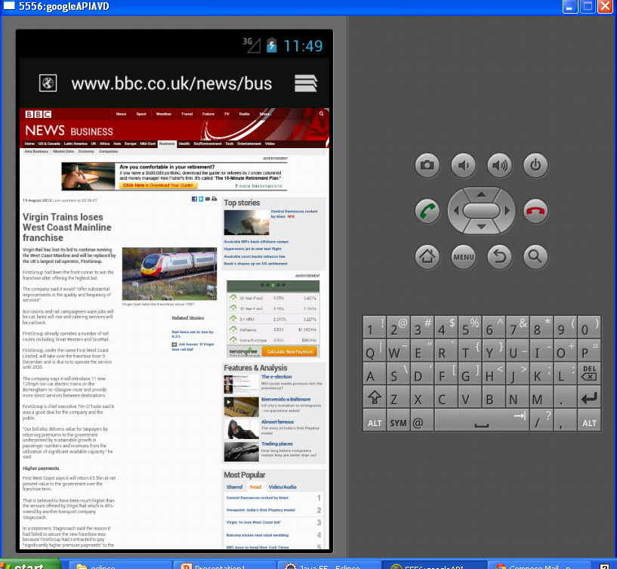

Slide 6
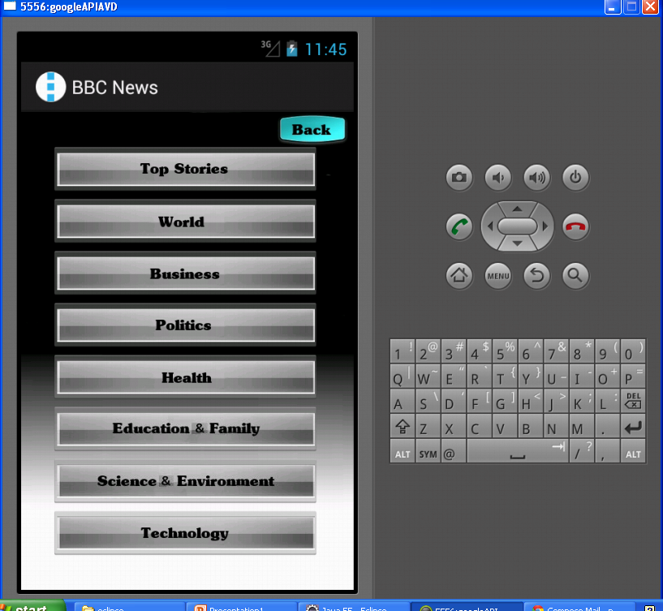

Slide 7
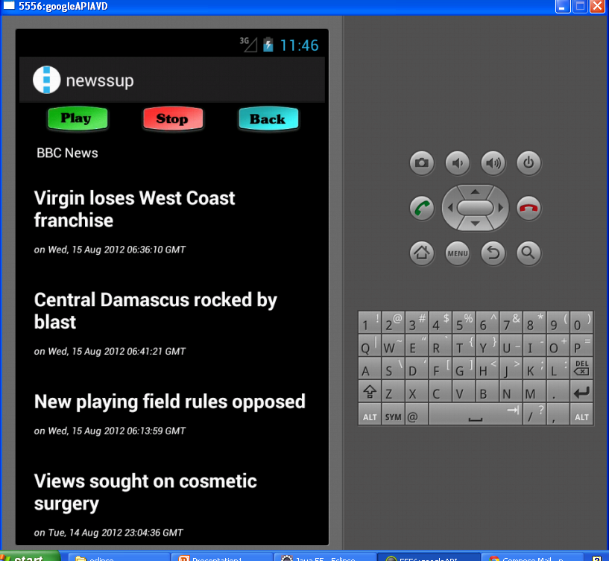

Slide 8
Future Enhancements
Add other news providers e.g. Yahoo, CNN etc.
Make the application dynamic, user can add APIs of his choice.
Allow app to take speech input

