Slide 1
Introduction to JAVA…
Parikshith Nayaka S K
Asst. Professor
Dept of CSE
AIET, Moodbidri

Slide 2
Reference Book…
The Complete Reference Java by Herbert Schildt, Seventh Edition, 2007, Tata McGraw-Hill

Slide 3
Java is related to C++, which is a direct descendent of C
From C, Java derives its syntax
Many of Java’s object-oriented features were influenced by C++
Java was conceived by James Gosling, Patrick Naughton, Chris Warth, Ed Frank, and Mike Sheridan at Sun Microsystems, Inc. in 1991

Slide 4
This language was initially called “Oak” but was renamed “Java” in 1995
Java can be used to create two types of programs: applications and applets
An application is a program that runs on your computer, under the operating system of that computer
An applet is an application designed to be transmitted over the Internet and executed by a Java-compatible Web browser

Slide 5
An applet is actually a tiny Java program, dynamically downloaded across the network, just like an image, sound file, or video clip
An applet is a program that can react to user input and dynamically change—not just run the same animation or sound over and over

Slide 6
Security
When you use a Java-compatible Web browser, you can safely download Java applets without fear of viral infection or malicious intent
Java achieves this protection by confining a Java program to the Java execution access to other parts of the computer environment and not allowing it

Slide 7
Java is portable across many types of computers and operating systems that are in use throughout the world

Slide 8
Java’s Magic: The Bytecode
The output of a Java compiler is not executable code ; rather, it is bytecode
Bytecode is a highly optimized set of instructions designed to be executed by the Java run-time system, which is called the Java Virtual Machine (JVM)

Slide 9
JVM is an interpreter for bytecode

Slide 10
Translating a Java program into bytecode helps makes it much easier to run a program in a wide variety of environments
The reason is straightforward: only the JVM needs to be implemented for each platform
When a program is interpreted, it generally runs substantially slower than it would run if compiled to executable code
The use of bytecode enables the Java run-time system to execute programs much faster than you might expect

Slide 11
Sun supplies its Just In Time (JIT) compiler for bytecode, which is included in the Java 2 release
When the JIT compiler is part of the JVM, it compiles bytecode into executable code in real time, on a piece-by-piece, demand basis
The JIT compiles code as it is needed, during execution

Slide 12
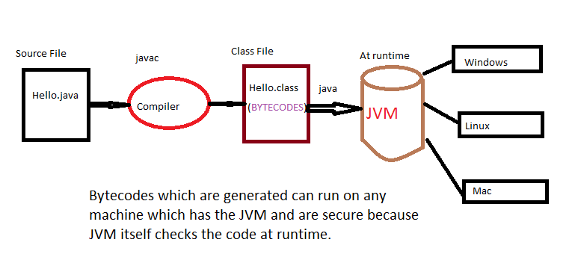

Slide 13
The Java Buzzwords (Features of Java)
Simple
Secure
Portable
Object-oriented
Robust
Multithreaded
Architecture-neutral
Interpreted
High performance
Distributed
Dynamic

Slide 14
Simple
If you already understand the basic concepts of object-oriented programming, learning Java will be even easier
Because Java inherits the C/C++ syntax and many of the object-oriented features of C++, most programmers have little trouble learning Java
Beyond its similarities with C/C++, Java has another attribute that makes it easy to learn: it makes an effort not to have surprising features

Slide 15
Object oriented
The object model in Java is simple and easy to extend, while simple types, such as integers, are kept as high-performance nonobjects

Slide 16
Robust
Ability to create robust programs was given a high priority in the design of Java
To better understand how Java is robust, consider two of the main reasons for program failure: memory management mistakes and mishandled exceptional conditions (that is, run-time errors)

Slide 17
Memory management can be a difficult, tedious task in traditional programming environments
For example, in C/C++, the programmer must manually allocate and free all dynamic memory
Programmers will either forget to free memory that has been previously allocated or, worse, try to free some memory that another part of their code is still using

Slide 18
Java virtually eliminates these problems by managing memory allocation and deallocation for you
Java provides object-oriented exception handling

Slide 19
Multithreaded
Java supports multithreaded programming, which allows you to write programs that do many things simultaneously
The Java run-time system comes with an elegant yet sophisticated solution for multiprocess synchronization that enables you to construct smoothly running interactive systems

Slide 20
Architecture-Neutral
Operating system upgrades, processor upgrades, and changes in core system resources can all combine to make a program malfunction
Java Virtual Machine in an attempt to alter this situation
Their goal was “write once; run anywhere, any time, forever.”

Slide 21
Interpreted and High Performance
Java enables the creation of cross-platform programs by compiling into an intermediate representation called Java bytecode
This code can be interpreted on any system that provides a Java Virtual Machine
the Java bytecode was carefully designed so that it would be easy to translate directly into native machine code for very high performance by using a just-in-time compiler

Slide 22
Distributed
Java is designed for the distributed environment of the Internet, because it handles TCP/IP protocols
Remote Method Invocation (RMI) feature of Java brings an unparalleled level of abstraction to client/server programming

Slide 23
Dynamic
Java programs carry with them substantial amounts of run-time type information that is used to verify and resolve accesses to objects at run time.

Slide 24
An Overview of Java

Slide 25
Object-oriented programming is at the core of Java
all computer programs consist of two elements: code and data
A program can be conceptually organized around its code or around its data

Slide 26
That is, some programs are written around “what is happening” and others are written around “who is being affected.”
The first way is called the process-oriented model
The process-oriented model can be thought of as code acting on data

Slide 27
The second approach, Object-oriented programming organizes a program around its data (that is, objects) and a set of well-defined interfaces to that data

Slide 28
Concept of Abstraction

Slide 29
The Three OOP Principles:
Encapsulation - is the mechanism that binds together code and the data it manipulates, and keeps both safe from outside interference and misuse
Inheritance - the process by which one object acquires the properties of another object

Slide 30
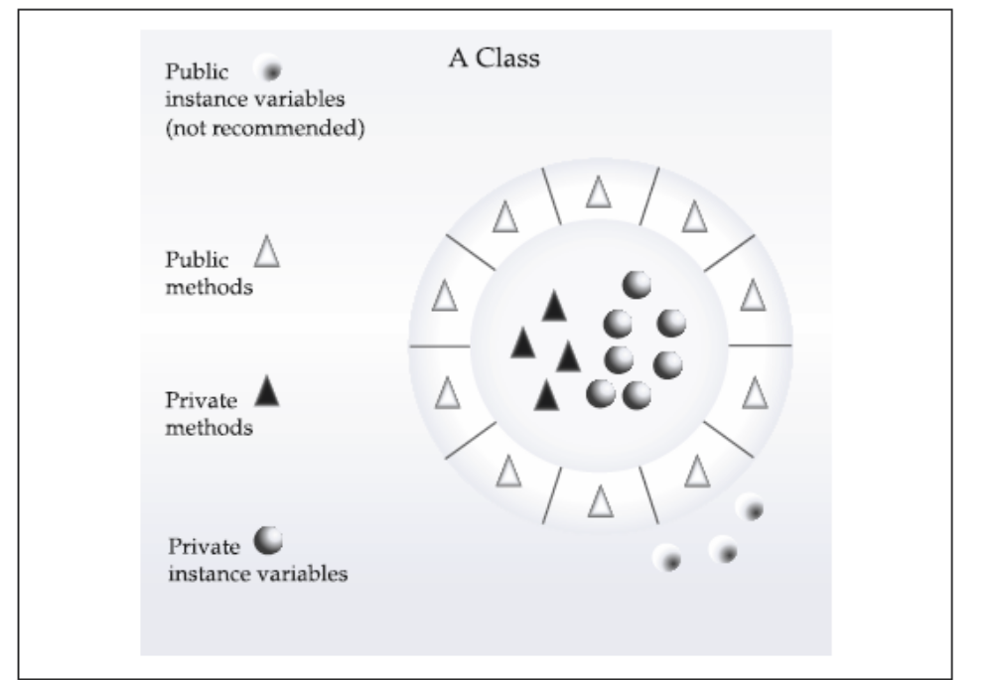

Slide 31
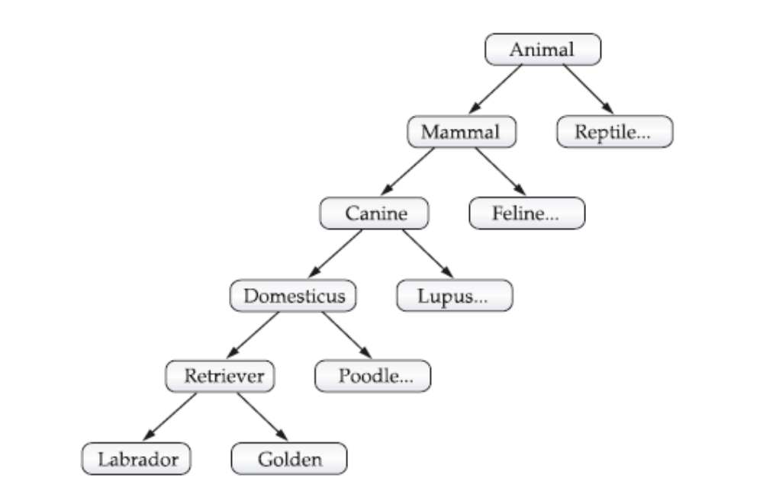

Slide 32
Polymorphism - is a feature that allows one interface to be used for a general class of actions

Slide 33
A First Simple Program
/* This is a simple Java program.
Call this file "Example.java".*/
class Example {
// Your program begins with a call to main()
public static void main(String args[]) {
System.out.println("This is a simple Java program.");
}
}

Slide 34
Compiling the Program
C:\>javac Example.java
The javac compiler creates a file called Example.class that contains the bytecode version of the program
The output of javac is not code that can be directly executed

Slide 35
To actually run the program, you must use the Java interpreter, called java.
C:\>java Example
When a class member is preceded by public, then that member may be accessed by code outside the class in which it is declared

Slide 36
The keyword static allows main( ) to be called without having to instantiate a particular instance of the class
The keyword void simply tells the compiler that main( ) does not return a value

Slide 37
A Second Short Program
class Example2 {
public static void main(String args[]) {
int num; // this declares a variable called num
num = 100; // this assigns num the value 100
System.out.println("This is num: " + num);
num = num * 2;
System.out.print("The value of num * 2 is ");
System.out.println(num);
}
}

Slide 38
Two Control Statements
The if Statement:
if(condition) statement;
if(num < 100)
System.out.println("num is less than 100");

Slide 39
The for Loop:
for(initialization; condition; iteration) statement;
class ForTest {
public static void main(String args[]) {
int x;
for(x = 0; x<10; x = x+1)
System.out.println("This is x: " + x);
}
}

Slide 40
Using Blocks of Code:
using { and }

Slide 41
Lexical Issues
Whitespace:
  Java is a free-form language
  In Java, whitespace is a space, tab, or newline
Identifiers:
- Identifiers are used for class names, method names, and variable names
- Java is case-sensitive

Slide 42
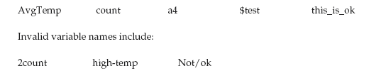

Slide 43
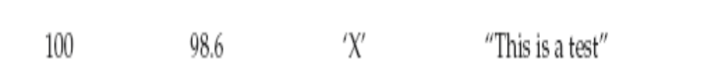
Literals:
A constant value in Java is created by using a literal representation of it

Slide 44
Comments
There are three types of comments defined by Java.
Single-line and multiline
The third type is called a documentation comment
This type of comment is used to produce an HTML file that documents your program
The documentation comment begins with /** and ends with */

Slide 45
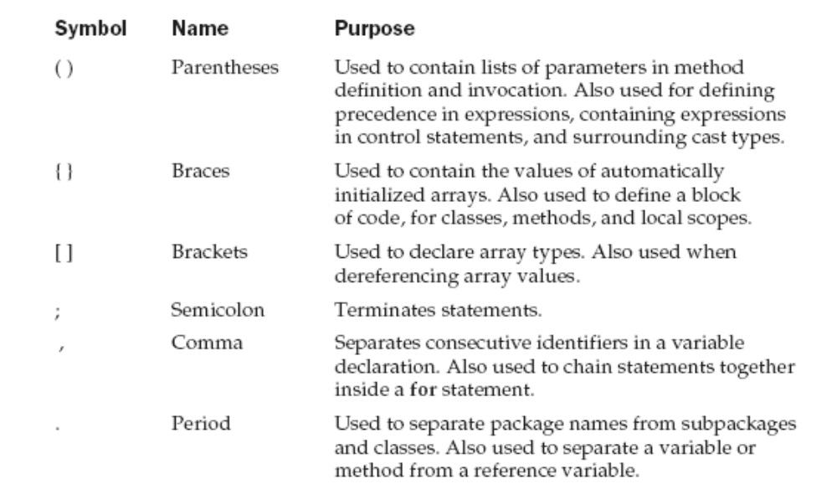
Separators

Slide 46
The Java Keywords
There are 49 reserved keywords currently defined in the Java language

Slide 47
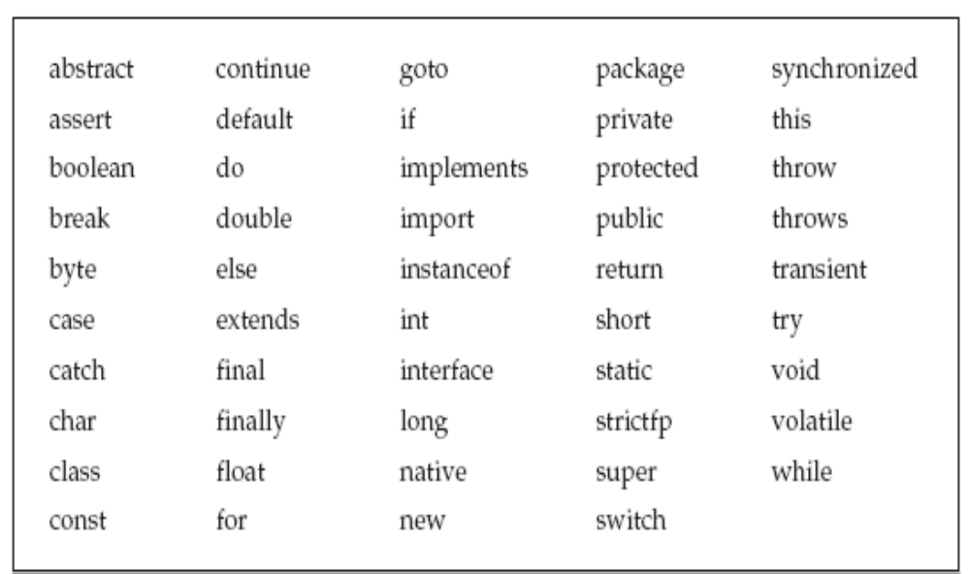

Slide 48
Data Types, Variables, and
Arrays

Slide 49
Java Is a Strongly Typed Language
Every variable has a type, every expression has a type, and every type is strictly defined
All assignments, whether explicit or via parameter passing in method calls, are checked for type compatibility
The Java compiler checks all expressions and parameters to ensure that the types are compatible

Slide 50
The Simple Types
Java defines eight simple (or elemental) types of data: byte, short, int, long, char, float, double, and boolean

Slide 51
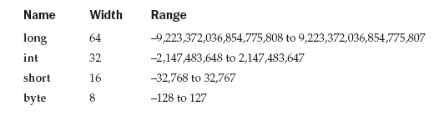
Integers

Slide 52
class Light {
public static void main(String args[]) {
int lightspeed;
long days;
long seconds;
long distance;
// approximate speed of light in miles per second
lightspeed = 186000;
days = 1000; // specify number of days here
seconds = days * 24 * 60 * 60; // convert to seconds
distance = lightspeed * seconds; // compute distance
System.out.print("In " + days);
System.out.print(" days light will travel about ");
System.out.println(distance + " miles.");
}
}

Slide 53
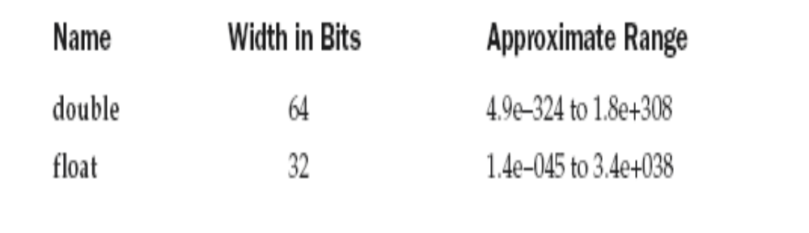
Floating-Point Types

Slide 54
class Area {
public static void main(String args[ ]) {
double pi, r, a;
r = 10.8; // radius of circle
pi = 3.1416; // pi, approximately
a = pi * r * r; // compute area
System.out.println("Area of circle is " + a);
}
}

Slide 55
Characters
char in Java is not the same as char in C or C++.
In C/C++, char is an integer type that is 8 bits wide
Instead, Java uses Unicode to represent
characters
Unicode defines a fully international character set that can represent all of the characters found in all human languages

Slide 56
In Java char is a 16-bit type
The range of a char is 0 to 65,536
There are no negative chars

Slide 57
class CharDemo {
public static void main(String args[ ]) {
char ch1, ch2;
ch1 = 88; // code for X
ch2 = 'Y';
System.out.print("ch1 and ch2: ");
System.out.println(ch1 + " " + ch2);
}
}

Slide 58
class CharDemo2 {
public static void main(String args[ ]) {
char ch1;
ch1 = 'X';
System.out.println("ch1 contains " + ch1);
ch1++; // increment ch1
System.out.println("ch1 is now " + ch1);
}
}

Slide 59
Booleans
Can have only one of two possible values, true or false

Slide 60
class BoolTest {
public static void main(String args[]) {
boolean b;
b = false;
System.out.println("b is " + b);
b = true;
System.out.println("b is " + b);
// a boolean value can control the if statement
if(b) System.out.println("This is executed.");
b = false;
if(b) System.out.println("This is not executed.");
// outcome of a relational operator is a boolean value
System.out.println("10 > 9 is " + (10 > 9));
}
}
The output generated by this program is shown here:
b is false
b is true
This is executed.
10 > 9 is true

Slide 61
Integer Literals – Decimal, Hexa and Octal
Floating-Point Literals
  For example, 2.0, 3.14159, and 0.6667 represent valid standard - notation floating-point numbers
  - Scientific notation uses a standard-notation, floating-point number plus a suffix that specifies a power of 10 by which the number is to be multiplied eg. 6.022E23, 314159E–05, and 2e+100

Slide 62
Boolean Literals – true , false
Character Literals
  Characters in Java are indices into the Unicode character set
  They are 16-bit values that can be converted into integers and manipulated with the integer operators, such as the addition and subtraction operators
  - A literal character is represented inside a pair of single quotes

Slide 63
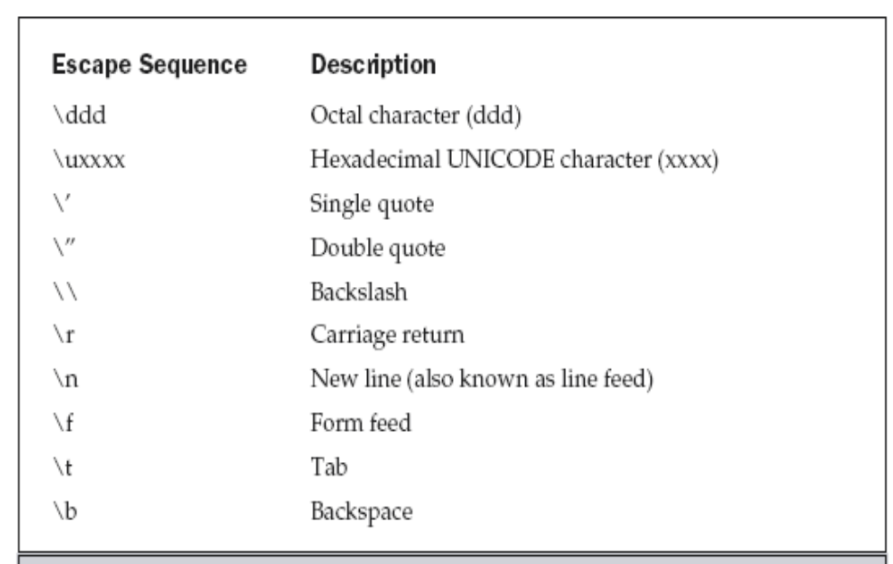

Slide 64
String Literals
“Hello World”
“two\nlines”
“\”This is in quotes\””

Slide 65
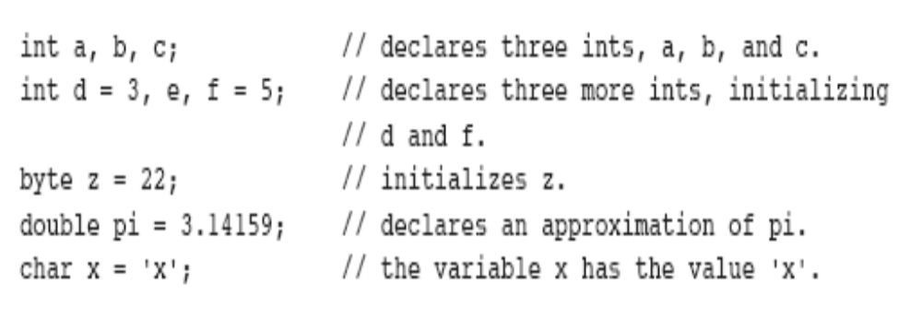
Declaring a Variable
type identifier [ = value][, identifier [= value] ...] ;

Slide 66
Dynamic Initialization
class DynInit {
public static void main(String args[]) {
double a = 3.0, b = 4.0;
// c is dynamically initialized
double c = Math.sqrt(a * a + b * b);
System.out.println("Hypotenuse is " + c);
}
}

Slide 67
The Scope and Lifetime of Variables
Java allows variables to be declared within any block
A block is begun with an opening curly brace and ended by a closing curly brace
A block defines a scope

Slide 68
In Java, the two major scopes are those defined by a class and those defined by a method
As a general rule, variables declared inside a scope are not visible (that is, accessible) to code that is defined outside that scope
Scopes can be nested
Objects declared in the outer scope will be visible to code within the inner scope ; but reverse not true

Slide 69
class Scope {
public static void main (String args[]) {
int x; // known to all code within main
x = 10;
if(x == 10) { // start new scope
int y = 20; // known only to this block
// x and y both known here.
System.out.println("x and y: " + x + " " + y);
x = y * 2;
}
// y = 100; // Error! y not known here
// x is still known here.
System.out.println("x is " + x);
}
}

Slide 70
class LifeTime {
public static void main(String args[]) {
int x;
for(x = 0; x < 3; x++) {
int y = -1; // y is initialized each time block is entered
System.out.println("y is: " + y); // this always prints -1
y = 100;
System.out.println("y is now: " + y);
}
}
}

Slide 71
class ScopeErr {
public static void main(String args[]) {
int bar = 1;
{ // creates a new scope
int bar = 2; // Compile-time error – bar already defined!
}
}
}

Slide 72
Type Conversion and Casting
When one type of data is assigned to another type of variable, an automatic type conversion will take place if the following two conditions are met:
■ The two types are compatible.
■ The destination type is larger than the source type.

Slide 73
Casting Incompatible Types
what if you want to assign an int value to a byte variable?
This conversion will not be performed automatically, because a byte is smaller than an int
narrowing conversion

Slide 74
(target-type) value
target-type specifies the desired type to convert the specified value to
    int a;
    byte b;
    // ...
    b = (byte) a;

Slide 75
class Conversion {
public static void main(String args[]) {
byte b;
int i = 257;
double d = 323.142;
System.out.println("\nConversion of int to byte.");
b = (byte) i;
System.out.println("i and b " + i + " " + b);
System.out.println("\nConversion of double to int.");
i = (int) d;
System.out.println("d and i " + d + " " + i);
System.out.println("\nConversion of double to byte.");
b = (byte) d;
System.out.println("d and b " + d + " " + b);
}
}

Slide 76
Output:
Conversion of int to byte.
i and b 257 1
Conversion of double to int.
d and i 323.142 323
Conversion of double to byte.
d and b 323.142 67

Slide 77
Automatic Type Promotion in Expressions
Example:
    byte a = 40;
    byte b = 50;
    byte c = 100;
    int d = a * b / c;
Java automatically promotes each byte or short operand to int when evaluating an expression

Slide 78
Subexpression a * b is performed using integer
byte b = 50
b = b * 2
// error: Cannot assign an int to a byte
In this case we need to explicitly specify:
byte b = 50;
b = (byte) (b*2);

Slide 79
The Type Promotion Rules
All byte and short values are promoted to int
If one operand is a long, the whole expression is promoted to long
If one operand is a float, the entire expression is promoted to float
If any of the operands is double, the result is double

Slide 80
class Promote {
public static void main(String args[ ]) {
byte b = 42;
char c = 'a';
short s = 1024;
int i = 50000;
float f = 5.67f;
double d = .1234;
double result = (f * b) + (i / c) - (d * s);
System.out.println((f * b) + " + " + (i / c) + " - " + (d * s));
System.out.println("result = " + result);
}
}

Slide 81
double result = (f * b) + (i / c) - (d * s);
In the first subexpression, f * b, b is promoted to a float and the result of the subexpression
is float
Next, in the subexpression i / c, c is promoted to int, and the result is of type int
In d * s, the value of s is promoted to double, and the type of the subexpression is double

Slide 82
The outcome of float plus an int is a float
Then the resultant float minus the last double is promoted to double, which is the type for the final result of the expression

Slide 83
Arrays
An array is a group of like-typed variables that are referred to by a common name
A specific element in an array is accessed by its index

Slide 84
One-Dimensional Arrays
type var-name[ ]; - No array exists
array-var = new type[size]; - allocating memory
Example:
int month_days[] = new int[12]

Slide 85
Arrays can be initialized when they are declared
An array initializer is a list of comma-separated expressions surrounded by curly braces
There is no need to use new

Slide 86
class AutoArray {
public static void main(String args[ ]) {
int month_days[] = { 31, 28, 31, 30, 31, 30, 31, 31, 30, 31,30, 31 };
System.out.println("April has " + month_days[3] + " days.");
}
}

Slide 87
class Average {
public static void main(String args[]) {
double nums[] = {10.1, 11.2, 12.3, 13.4, 14.5};
double result = 0;
int i;
for(i=0; i<5; i++)
result = result + nums[i];
System.out.println("Average is " + result / 5);
}
}

Slide 88
Multidimensional Arrays
To declare a multidimensional array variable,
specify each additional index using another set of square brackets
Example:
int twoD[][] = new int[4][5];

Slide 89
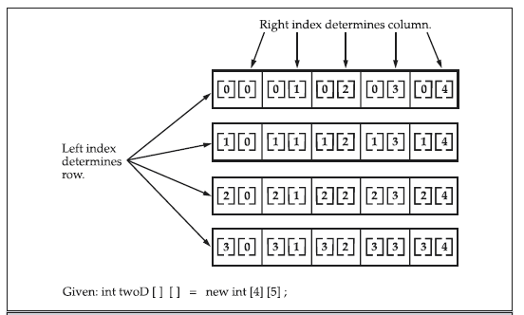

Slide 90
class TwoDArray {
public static void main(String args[]) {
int twoD[][]= new int[4][5];
int i, j, k = 0;
for(i=0; i<4; i++)
for(j=0; j<5; j++) {
twoD[i][j] = k;
k++;
}
for(i=0; i<4; i++) {
for(j=0; j<5; j++)
System.out.print(twoD[i][j] + " ");
System.out.println();
}
}
}

Slide 91
When you allocate memory for a multidimensional array, you need only specify the memory for the first (leftmost) dimension
You can allocate the remaining dimensions
separately
Example:
  int twoD[][] = new int[4][];
  twoD[0] = new int[5];
  twoD[1] = new int[5];
  twoD[2] = new int[5];
  twoD[3] = new int[5];

Slide 92
When you allocate dimensions manually, you do not need to allocate the same number of elements for each dimension
Since multidimensional arrays are actually arrays of arrays, the length of each array is under your control

Slide 93
class TwoDAgain {
public static void main(String args[]) {
int twoD[][] = new int[4][];
twoD[0] = new int[1];
twoD[1] = new int[2];
twoD[2] = new int[3];
twoD[3] = new int[4];
int i, j, k = 0;
for(i=0; i<4; i++)
for(j=0; j<i+1; j++) {
twoD[i][j] = k;
k++;
}
for(i=0; i<4; i++) {
for(j=0; j<i+1; j++)
System.out.print(twoD[i][j] + " ");
System.out.println();
} } }

Slide 94
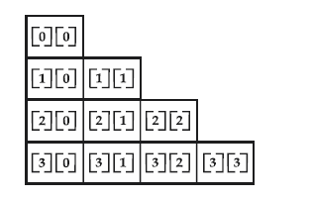

Slide 95
It is possible to initialize multidimensional arrays
You can use expressions as well as literal values inside of array initializers

Slide 96
class Matrix {
public static void main(String args[]) {
double m[ ][ ] = {
{ 0*0, 1*0, 2*0, 3*0 },
{ 0*1, 1*1, 2*1, 3*1 },
{ 0*2, 1*2, 2*2, 3*2 },
{ 0*3, 1*3, 2*3, 3*3 }
};
int i, j;
for(i=0; i<4; i++) {
for(j=0; j<4; j++)
System.out.print(m[i][j] + " ");
System.out.println();
}
}
}

Slide 97
Output:
  0.0 0.0 0.0 0.0
  0.0 1.0 2.0 3.0
  0.0 2.0 4.0 6.0
  0.0 3.0 6.0 9.0

Slide 98
Alternative Array Declaration Syntax
There is a second form that may be used to declare an array:
type[ ] var-name;
Example: These two are equivalent
int al[ ] = new int[3];
int[ ] a2 = new int[3];
The following declarations are also equivalent:
char twod1[ ][ ] = new char[3][4];
char[ ][ ] twod2 = new char[3][4];

Slide 99
Note:
Java does not support or allow pointers
Java cannot allow pointers, because doing so would allow Java applets to breach the firewall between the Java execution environment and the host computer
Java is designed in such a way that as long as you stay within the confines of the execution environment, you will never need to use a pointer, nor would there be any benefit in using one

Slide 100
Operators

Slide 101
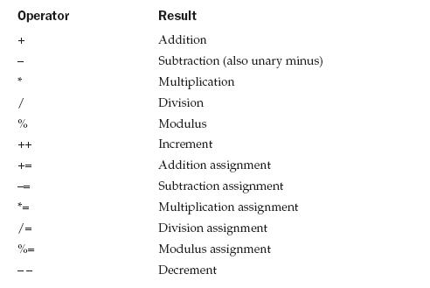
Arithmetic Operators

Slide 102
class BasicMath {
public static void main(String args[]) {
// arithmetic using integers
System.out.println("Integer Arithmetic");
int a = 1 + 1;
int b = a * 3;
int c = b / 4;
int d = c - a;
int e = -d;
System.out.println("a = " + a);
System.out.println("b = " + b);
System.out.println("c = " + c);
System.out.println("d = " + d);
System.out.println("e = " + e);
// arithmetic using doubles
System.out.println("\nFloating Point Arithmetic");
double da = 1 + 1;
double db = da * 3;
double dc = db / 4;
double dd = dc - a;
double de = -dd;
System.out.println("da = " + da);
System.out.println("db = " + db);
System.out.println("dc = " + dc);
System.out.println("dd = " + dd);
System.out.println("de = " + de);
}
}

Slide 103
The modulus operator, %, returns the remainder of a division operation
It can be applied to floating-point types as well as integer types
This differs from C/C++, in which the % can only be applied to integer types

Slide 104
class Modulus {
public static void main(String args[]) {
int x = 42;
double y = 42.25;
System.out.println("x mod 10 = " + x % 10);
System.out.println("y mod 10 = " + y % 10);
}
}
When you run this program you will get the following output:
x mod 10 = 2
y mod 10 = 2.25

Slide 105
Arithmetic Assignment Operators
a = a + 4;
a += 4;
Any statement of the form
var = var op expression;
can be rewritten as
var op= expression;

Slide 106
Operator
+=
-=
*=
/=
%=
Example
x += y
x -= y
x *= y
x /= y
x %= y
Equivalent To
x = x + y
x = x - y
x = x * y
x = x / y
x = x % y

Slide 107
The Bitwise Operators
~ Bitwise unary NOT
& Bitwise AND
| Bitwise OR
^ Bitwise XOR
>> Shift Right
>>> Shift Right zero fill
<< Shift left
& = Bitwise AND Assignment
|= Bitwise OR Assignment
^= Bitwise XOR Assignment
>>= Shift Right Assignment
>>>= Shift Right zero fill Assignment
<<= Shift Left Assignment

Slide 108
class BitLogic {
public static void main(String args[]) {
String binary[ ] = {
"0000", "0001", "0010", "0011", "0100", "0101", "0110", "0111",
"1000", "1001", "1010", "1011", "1100", "1101", "1110", "1111"
};
int a = 3; // 0 + 2 + 1 or 0011 in binary
int b = 6; // 4 + 2 + 0 or 0110 in binary
int c = a | b;
int d = a & b;
int e = a ^ b;
int f = (~a & b) | (a & ~b);
int g = ~a & 0x0f;
System.out.println(" a = " + binary[a]);
System.out.println(" b = " + binary[b]);
System.out.println(" a|b = " + binary[c]);
System.out.println(" a&b = " + binary[d]);
System.out.println(" a^b = " + binary[e]);
System.out.println("~a&b|a&~b = " + binary[f]);
System.out.println(" ~a = " + binary[g]);
}
}

Slide 109
The Left Shift
It has this general form:
value << num
If you left-shift a byte value, that value will first be promoted to int and then shifted
This means that you must discard the top three bytes of the result if what you want is the result of a shifted byte value
The easiest way to do this is to simply cast the result back into a byte

Slide 110
class ByteShift {
public static void main(String args[]) {
byte a = 64, b;
int i;
i = a << 2;
b = (byte) (a << 2);
System.out.println("Original value of a: " + a);
System.out.println("i and b: " + i + " " + b);
}
}
Output:
Original value of a: 64
i and b: 256 0

Slide 111
The Right Shift
The right shift operator, >>, shifts all of the bits in a value to the right a specified number of times
value >> num
int a = 32;
a = a >> 2; // a now contains 8
int a = 35;
a = a >> 2; // a still contains 8

Slide 112
11111000 –8
>>1
11111100 –4
Sign extension

Slide 113
// Masking sign extension.
class HexByte {
static public void main(String args[]) {
char hex[] = {
'0', '1', '2', '3', '4', '5', '6', '7',
'8', '9', 'a', 'b', 'c', 'd', 'e', 'f'
};
byte b = (byte) 0xf1;
System.out.println("b = 0x" + hex[(b >> 4) & 0x0f] + hex[b & 0x0f]);
}
}

Slide 114
The Unsigned Right Shift
Unsigned, shift-right operator, >>>, which always shifts zeros into the high-order bit
int a = -1;
a = a >>> 24;
Here is the same operation in binary form to further illustrate what is happening:
11111111 11111111 11111111 11111111 –1 in binary as an int
>>>24
00000000 00000000 00000000 11111111 255 in binary as an int

Slide 115
// Unsigned shifting a byte value.
class ByteUShift {
static public void main(String args[]) {
char hex[] = {
'0', '1', '2', '3', '4', '5', '6', '7',
'8', '9', 'a', 'b', 'c', 'd', 'e', 'f'
};
byte b = (byte) 0xf1;
byte c = (byte) (b >> 4);
byte d = (byte) (b >>> 4);
byte e = (byte) ((b & 0xff) >> 4);
System.out.println(" b = 0x“ + hex[(b >> 4) & 0x0f] + hex[b & 0x0f]);
System.out.println(" b >> 4 = 0x“ + hex[(c >> 4) & 0x0f] + hex[c & 0x0f]);
System.out.println(" b >>> 4 = 0x“ + hex[(d >> 4) & 0x0f] + hex[d & 0x0f]);
System.out.println("(b & 0xff) >> 4 = 0x“ + hex[(e >> 4) & 0x0f] + hex[e & 0x0f]);
}
}

Slide 116
Output
  b = 0xf1
  b >> 4 = 0xff
  b >>> 4 = 0xff
  (b & 0xff) >> 4 = 0x0f

Slide 117
Bitwise Operator Assignments
a = a >> 4;
a >>= 4;
a = a | b;
a |= b;

Slide 118
Relational Operators
> greater than
>= greater than or equal to
< less than
<= less than or equal to
= = equal to
!= not equal to

Slide 119
int a = 4;
int b = 1;
boolean c = a < b;
int done;
// ...
if(!done) ... // Valid in C/C++
if(done) ... // but not in Java.
In Java, these statements must be written like this:
if(done == 0)) ... // This is Java-style.
if(done != 0) ...

Slide 120
In Java, true and false are nonnumeric values which do not relate to zero or nonzero

Slide 121
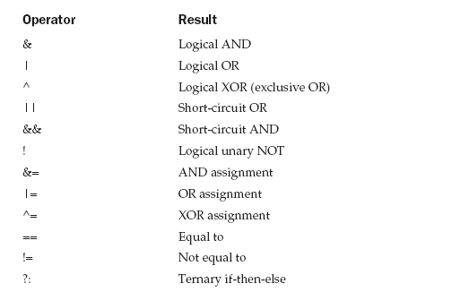
Boolean Logical Operators

Slide 122
Short-Circuit Logical Operators
Java will not bother to evaluate the right-hand operand when the outcome of the expression can be determined by the left operand alone
Example 1:
if (denom != 0 && num / denom > 10)
Example 2:
if(c==1 && e++ < 100) d = 100;

Slide 123
The Assignment Operator
var = expression;
int x, y, z;
x = y = z = 100; // set x, y, and z to 100

Slide 124
The ?: Operator (ternary if)
expression1 ? expression2 : expression3
Example:
if (a > b) { max = a; } else { max = b; }
max = (a > b) ? a : b;
ratio = (denom == 0) ? 0 : num / denom;

Slide 125
Operator Precedence
Highest
( ) [] .
++ -- ~ !
* / %
+ -
>> >>> <<
> >= < <=
= = !=
&
^
|
&&
||
?:
= op=
Lowest

Slide 126
Example:
a | 4 + c >> b & 7
(a | (((4 + c) >> b) & 7))

Slide 127
Parentheses (redundant or not) do not degrade the performance of your program
Therefore, adding parentheses to reduce ambiguity does not negatively affect your program

Slide 128
Control Statements

Slide 129
If:
if (condition) statement1;
else statement2;
Nested If:
if(i == 10) {
if(j < 20) a = b;
if(k > 100) c = d; // this if is
else a = c; // associated with this else
}
else a = d; // this else refers to if(i == 10)

Slide 130
The if-else-if Ladder:
if(condition)
statement;
else if(condition)
statement;
else if(condition)
statement;
...
else
statement;

Slide 131
switch
switch (expression) {
case value1:
// statement sequence
break;
case value2:
// statement sequence
break;
...
case valueN:
// statement sequence
break;
default:
// default statement sequence
}
The expression must be of type byte, short, int, or char;

Slide 132
Nested switch Statements
switch(count) {
case 1:
switch(target) { // nested switch
case 0:
System.out.println("target is zero");
break;
case 1: // no conflicts with outer switch
System.out.println("target is one");
break;
}
break;
case 2: // ...

Slide 133
Iteration Statements
While:
while(condition) {
// body of loop
}

Slide 134
class NoBody {
public static void main(String args[]) {
int i, j;
i = 100;
j = 200;
// find midpoint between i and j
while(++i < --j) ; // no body in this loop
System.out.println("Midpoint is " + i);
}
}

Slide 135
do-while
do {
// body of loop
} while (condition);

Slide 136
// Using a do-while to process a menu selection
class Menu {
public static void main(String args[])
throws java.io.IOException {
char choice;
do {
System.out.println("Help on:");
System.out.println(" 1. if");
System.out.println(" 2. switch");
System.out.println(" 3. while");
System.out.println(" 4. do-while");
System.out.println(" 5. for\n");
System.out.println("Choose one:");
choice = (char) System.in.read();
} while( choice < '1' || choice > '5');
System.out.println("\n");
switch(choice) {
case '1':
System.out.println("The if:\n");
System.out.println("if(condition) statement;");
System.out.println("else statement;");
break;
case '2':

Slide 137
System.out.println("The switch:\n");
System.out.println("switch(expression) {");
System.out.println(" case constant:");
System.out.println(" statement sequence");
System.out.println(" break;");
System.out.println(" // ...");
System.out.println("}");
break;
case '3':
System.out.println("The while:\n");
System.out.println("while(condition) statement;");
break;
case '4':
System.out.println("The do-while:\n");
System.out.println("do {");
System.out.println(" statement;");
System.out.println("} while (condition);");
break;
case '5':
System.out.println("The for:\n");
System.out.print("for(init; condition; iteration)");
System.out.println(" statement;");
break;
}
}
}

Slide 138
for
for(initialization; condition; iteration) {
// body
}

Slide 139
class Comma {
public static void main(String args[]) {
int a, b;
for(a=1, b=4; a<b; a++, b--) {
System.out.println("a = " + a);
System.out.println("b = " + b);
}
}
}

Slide 140
Some for Loop Variations
boolean done = false;
for(int i=1; !done; i++) {
// ...
if(interrupted()) done = true;
}

Slide 141
// Parts of the for loop can be empty.
class ForVar {
public static void main(String args[]) {
int i;
boolean done = false;
i = 0;
for( ; !done; ) {
System.out.println("i is " + i);
if(i == 10) done = true;
i++;
}
}
}

Slide 142
for( ; ; ) {
// ...
}
This loop will run forever, because there is no condition under which it will terminate
Nested Loops - concept

Slide 143
Jump Statements
Using break to Exit a Loop:
class BreakLoop {
public static void main(String args[]) {
for(int i=0; i<100; i++) {
if(i == 10) break; // terminate loop if i is 10
System.out.println("i: " + i);
}
System.out.println("Loop complete.");
}
}

Slide 144
More than one break statement may appear in a loop
Too many break statements have the tendency to destructure your code
The break that terminates a switch statement affects only that switch statement and not any enclosing loops

Slide 145
Using break as a Form of Goto
Java defines an expanded form of the break statement
By using this form of break, you can break out of one or more blocks of code
The general form of the labeled break statement is :
break label;

Slide 146
A label is any valid Java identifier followed by a colon
You can use a labeled break statement to exit from a set of nested blocks
You cannot use break to transfer control to a block of code that does not enclose the break statement

Slide 147
class Break {
public static void main(String args[]) {
boolean t = true;
first: {
second: {
third: {
System.out.println("Before the break.");
if(t) break second; // break out of second block
System.out.println("This won't execute");
}
System.out.println("This won't execute");
}
System.out.println("This is after second block.");
}
}
}

Slide 148
class BreakLoop4 {
public static void main(String args[]) {
outer: for(int i=0; i<3; i++) {
System.out.print("Pass " + i + ": ");
for(int j=0; j<100; j++) {
if(j == 10) break outer; // exit both loops
System.out.print(j + " ");
}
System.out.println("This will not print");
}
System.out.println("Loops complete.");
}
}

Slide 149
// This program contains an error.
class BreakErr {
public static void main(String args[]) {
one: for(int i=0; i<3; i++) {
System.out.print("Pass " + i + ": ");
}
for(int j=0; j<100; j++) {
if(j == 10) break one; // WRONG
System.out.print(j + " ");
}
}
}

Slide 150
Using continue
class Continue {
public static void main(String args[]) {
for(int i=0; i<10; i++) {
System.out.print(i + " ");
if (i%2 == 0) continue;
System.out.println("");
}
}
}

Slide 151
As with the break statement, continue may specify a label to describe which enclosing loop to continue
class ContinueLabel {
public static void main(String args[]) {
outer: for (int i=0; i<10; i++) {
for(int j=0; j<10; j++) {
if(j > i) {
System.out.println();
continue outer;
}
System.out.print(" " + (i * j));
}
}
System.out.println();
}
}

Slide 152
Output:
0
0 1
0 2 4
0 3 6 9
0 4 8 12 16
0 5 10 15 20 25
0 6 12 18 24 30 36
0 7 14 21 28 35 42 49
0 8 16 24 32 40 48 56 64
0 9 18 27 36 45 54 63 72 81

Slide 153
return
Used to explicitly return from a method
The return statement immediately terminates the method in which it is executed
class Return {
public static void main(String args[]) {
boolean t = true;
System.out.println("Before the return.");
if(t==true) return; // return to caller
System.out.println("This won't execute.");
} }

Slide 154
return causes execution to return to the Java run-time system, since it is the run-time system that calls main( )

Slide 155
I/O
Java programs perform I/O through streams
A stream is an abstraction that either produces or consumes information
A stream is linked to a physical device by the Java I/O system
All streams behave in the same manner, even if the actual physical devices to which they are linked differ

Slide 156
Thus, the same I/O classes and methods can be applied to any type of device
This means that an input stream can abstract many different kinds of input: from a disk file, a keyboard, or a network socket
Likewise, an output stream may refer to the console, a disk file, or a network connection

Slide 157
Java defines two types of streams: byte and character
Byte streams provide a convenient means for handling input and output of bytes
Byte streams are used, for example, when reading or writing binary data
Character streams provide a convenient means for handling input and output of characters

Slide 158
Byte streams are defined by using two class hierarchies
At the top are two abstract classes: InputStream and OutputStream
Each of these abstract classes has several concrete subclasses that handle the differences between various devices, such as disk files, network connections, and even memory buffers

Slide 159
Character streams are defined by using two class hierarchies
At the top are two abstract classes, Reader and Writer
These abstract classes handle Unicode character streams
Java has several concrete subclasses of each of these

Slide 160
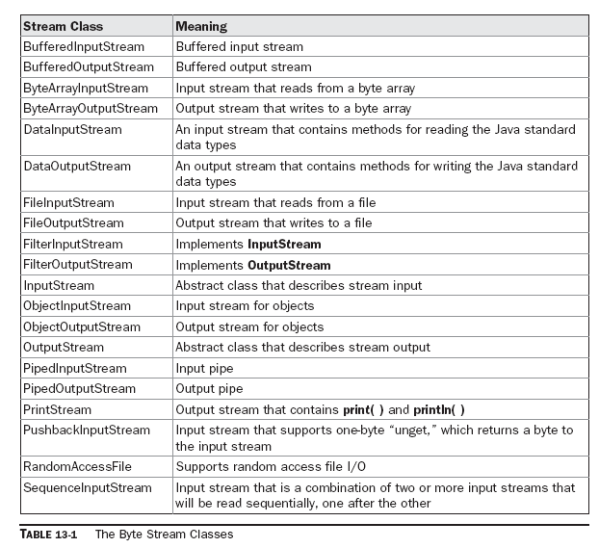

Slide 161
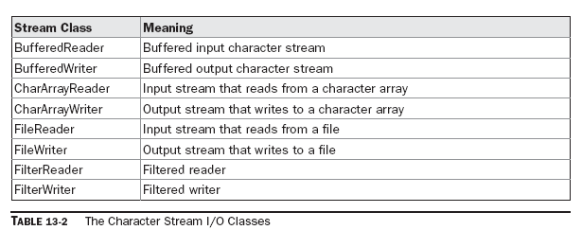

Slide 162
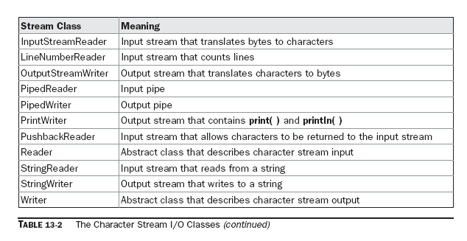

Slide 163
All Java programs automatically import the java.lang package
This package defines a class called System, which encapsulates several aspects of the run-time environment

Slide 164
System also contains three predefined stream variables: in, out, and err
These fields are declared as public, static, and final within System
This means that they can be used by any other part of your program and without reference to a specific System object

Slide 165
System.out refers to the standard output stream
By default, this is the console
System.in refers to standard input, which is the keyboard by default
System.err refers to the standard error stream, which also is the console by default
However, these streams may be redirected to any compatible I/O device

Slide 166
System.in is an object of type InputStream
System.out and System.err are objects of type PrintStream
These are byte streams, even though they typically are used to read and write characters from and to the console

Slide 167
Reading Console Input…
In Java, console input is accomplished by reading from System.in
To obtain a character based stream that is attached to the console, wrap System.in in a BufferedReader object
BufferedReader supports a buffered input stream Its most commonly used constructor :
BufferedReader(Reader inputReader)

Slide 168
Here, inputReader is the stream that is linked to the instance of BufferedReader that is being created
Reader is an abstract class
One of its concrete subclasses is InputStreamReader, which converts bytes to characters

Slide 169
To obtain an InputStreamReader object that is linked to System.in, use the following constructor:
InputStreamReader(InputStream inputStream)
Because System.in refers to an object of type InputStream, it can be used for inputStream.

Slide 170
Putting it all together, the following line of code creates a BufferedReader that is connected to the keyboard:
InputStreamReader varname=new InputStreamReader(System.in)
BufferedReader d = new BufferedReader ( varname);
or
BufferedReader d = new BufferedReader ( new InputStreamReader(System.in));
After this statement executes, d is a character-based stream that is linked to the console through System.in

Slide 171
Reading Characters…
// Use a BufferedReader to read characters from the console.
import java.io.*;
class BRRead {
public static void main(String args[]) throws IOException
{
char c;
BufferedReader d = new BufferedReader(new InputStreamReader(System.in));
System.out.println("Enter characters, 'q' to quit.");
// read characters
do {
c = (char) d.read();
System.out.println(c);
} while(c != 'q');
}
}

Slide 172
Reading Strings…
To read a string from the keyboard, use the version of readLine( ) that is a member of the BufferedReader class
Its general form is shown here:
String readLine( ) throws IOException
it returns a String object.

Slide 173
// Read a string from console using a BufferedReader.
import java.io.*;
class BRReadLines {
public static void main(String args[])
throws IOException
{
// create a BufferedReader using System.in
BufferedReader d = new BufferedReader(new InputStreamReader(System.in));
String str;
System.out.println("Enter lines of text.");
System.out.println("Enter 'stop' to quit.");
do {
str = d.readLine();
System.out.println(str);
} while(!str.equals("stop"));
}
}

Slide 174
We can use DataInputStream class also…
DataInputStream d = new DataInputStream(System.in);
    :
    :
    :
    String s = d.readLine()
    :
    :

Slide 175
static double Double.parseDouble(String str)
throws NumberFormatException
Returns the double equivalent of the number contained in the string specified by str using radix 10

Slide 176
static String toString(double num)
Returns the string equivalent of the value specified by num

Slide 177
static int Integer.parseInt(String str) throws NumberFormatException
Returns the integer equivalent of the number contained in the string specified by str using radix 10.

Slide 178
static String toString(int num)
Returns a string that contains the decimal equivalent of num

Slide 179
static float Float.parseFloat(String str) throws NumberFormatException
Returns the float equivalent of the number contained in the string specified by str using radix 10

Slide 180
static String toString(float num)
Returns the string equivalent of the value specified by num

Slide 181
static long parseLong(String str) throws NumberFormatException
Returns the long equivalent of the number contained in the string specified by str in radix 10

Slide 182
static String toString(long num)
Returns a string that contains the decimal equivalent of num

Slide 183
static Long valueOf(long num)
Returns a Long object containing the value passed in num.
static Long valueOf(String str) throws NumberFormatException
Returns a Long object that contains the value specified by the string in str

Slide 184
static Integer valueOf(int num)
Returns an Integer object containing the value passed in num.
static Integer valueOf(String str) throws NumberFormatException
Returns an Integer object that contains the value specified by the string in str

Slide 185
static Float valueOf(float num)
Returns a Float object containing the value passed in num.
static Float valueOf(String str) throws NumberFormatException
Returns the Float object that contains the value specified by the string in str

Slide 186
static Double valueOf(double num)
Returns a Double object containing the value passed in num.
static Double valueOf(String str) throws NumberFormatException
Returns a Double object that contains the value specified by the string in str

Slide 187
float floatValue( )
Returns the value of the invoking object as a float
Similarly
double doubleValue( )
long longValue( )
int intValue( )

Slide 188
Example…
Float.valueOf(param).floatValue();
Param could be String or float number…

Slide 189
import java.io.*;
class A1
{
int a, b;
public static void main(String args[])
{
A1 obj = new A1();
DataInputStream in = new DataInputStream(System.in);
String s = new String();
// String s = null;
try
{
s = in.readLine();
}
catch(IOException ie)
{ }

Slide 190
try
{
obj.a = Integer.parseInt(s);
obj.b = obj.a + 20;
System.out.println("a=" + obj.a + " b=" + obj.b);
int c;
c=Integer.valueOf(s).intValue();
c=c+1;
System.out.println("c=" + c);
}
catch(NumberFormatException ne)
{
System.out.println("Number Format Not Proper");
}
}
}

Slide 191
Thank You …

