Slide 1

ONLINE FOOD ORDERING SYSTEM UNDER E-COMMERCE
SCHOOL OF ENGINEERING
DEPARTMENT OF COMPUTER SCIENCE & ENGINEERING
By
B.Pavan – 237Z1A0511 J.Charan – 237Z1A0563
B.Nithil – 237Z1A0525
Under the Guidance of
Mr.CH.Ravi
Assistant Professor

Slide 2

CONTENTS
Abstract
Problem Statement
Literature Survey
Existing System
Proposed System
System Architecture
Software and Hardware Requirements
Modules
System Design (UML Diagrams)
Output Screenshots
Conclusion
Future Enhancement
References

Slide 3
Abstract
The rapid growth of internet and digital technologies has significantly influenced modern business practices, especially in the field of electronic commerce. This mini project focuses on the design and development of an Online Ordering System under an E- Commerce Website that enables customers to conveniently browse products, place orders, and complete purchases through an online platform. The system provides core functionalities such as user registration and authentication, product catalog display, shopping cart management, order processing, and secure online payment. An administrative module is also included to manage product details, monitor customer orders, and update order status efficiently. By automating the ordering process, the system reduces manual effort, minimizes errors, and improves overall operational efficiency. The user-friendly interface enhances customer experience and accessibility, while real-time order management ensures timely and accurate service. This project demonstrates the practical application of e-commerce concepts and offers a scalable solution suitable for small to medium-sized online businesses in today’s competitive digital marketplace.
Keywords—: Admin Management System, User Authentication, Product Catalog Shopping Cart

Slide 4
Problem Statement
Existing online ordering systems lack proper automation, leading to inefficiencies, delays, errors, poor customer experience, and limited real-time administrative control.

Slide 5
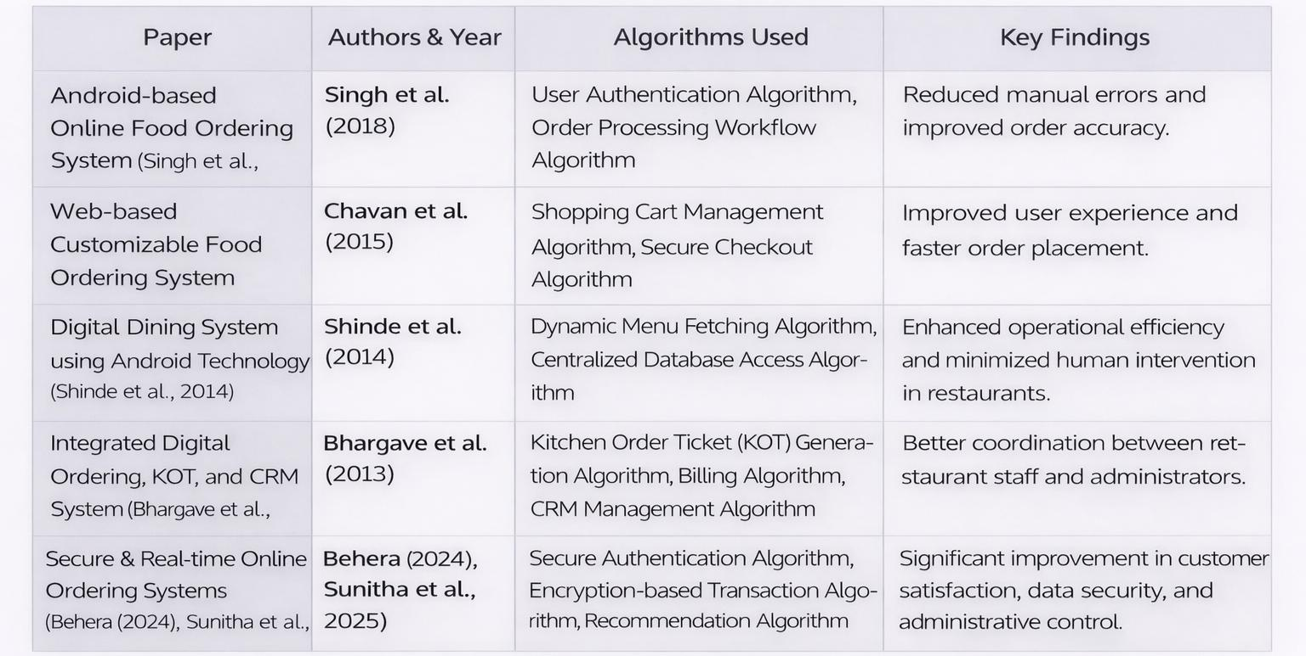
Literature Survey

Slide 6
Existing System
Manual or phone-based order processing
Time-consuming and inefficient operations
Difficult menu and order management
High dependency on human intervention

Slide 7
Proposed System
Provide secure user registration and authentication for customers.
Enable product catalog display for easy browsing and selection of products.
Implement shopping cart functionality and order placement process.
Support secure order processing with online payment options.
Develop an administrative module for product management and order monitoring.
Provide real-time order status updates to improve efficiency and user experience.

Slide 8
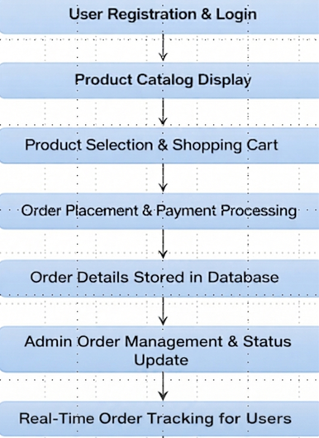
System Architecture

Slide 9
Software and Hardware Requirements
Software Requirements
Frontend Technologies:HTML, CSS, JavaScript
Backend Technology: Python (Django)
Database: MySQL
Web Server: Apache
Development Tools: VS Code
Browser: Google Chrome

Slide 10
Hardware Requirements
Processor: Intel Core i3 or higher
RAM: Minimum 4 GB
Hard Disk: 100 GB free space
System Type: 64-bit architecture
Internet Connection: Required
Input Devices: Keyboard, Mouse
Output Devices: Monitor

Slide 11
Modules
User management module
Restaurant Browsing Module
Cart Management Module
Order Management Module
Payment Processing Module
Delivery Tracking Module
Admin Management Module

Slide 12
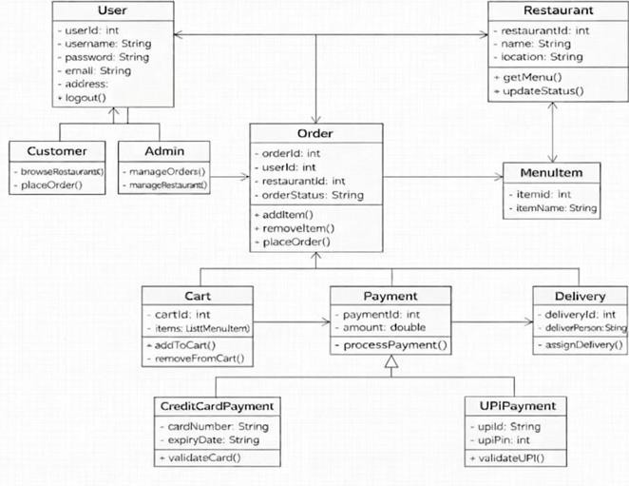
System Design
Class diagram

Slide 13
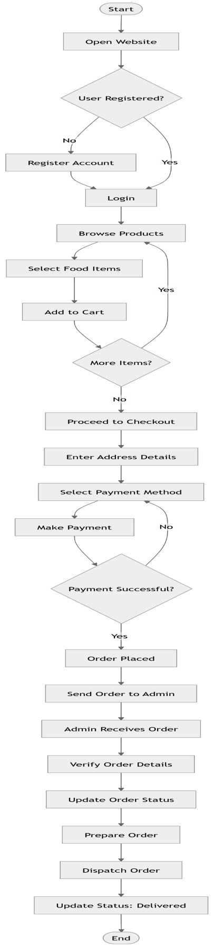
Activity Diagram

Slide 14
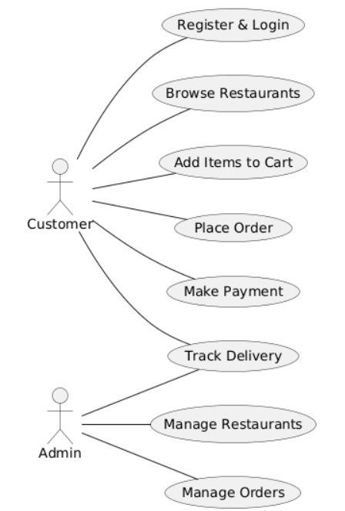
Usecase Diagram

Slide 15
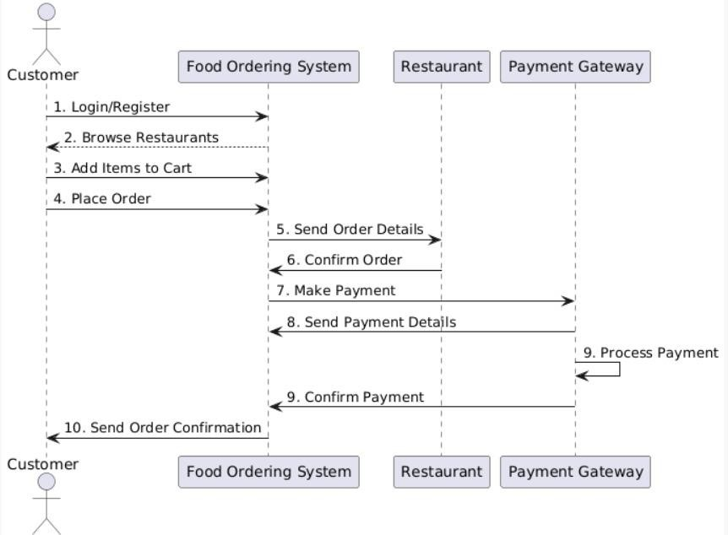
Sequence Diagram

Slide 16
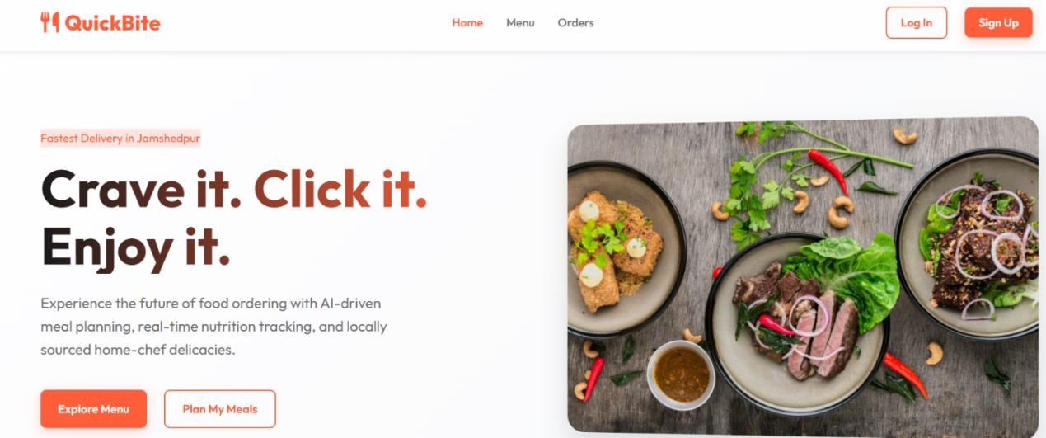
Output Screenshots

Slide 17
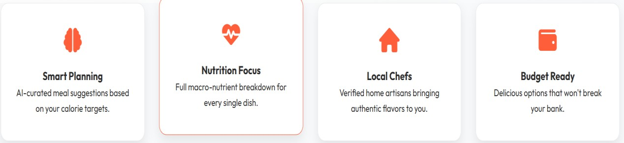
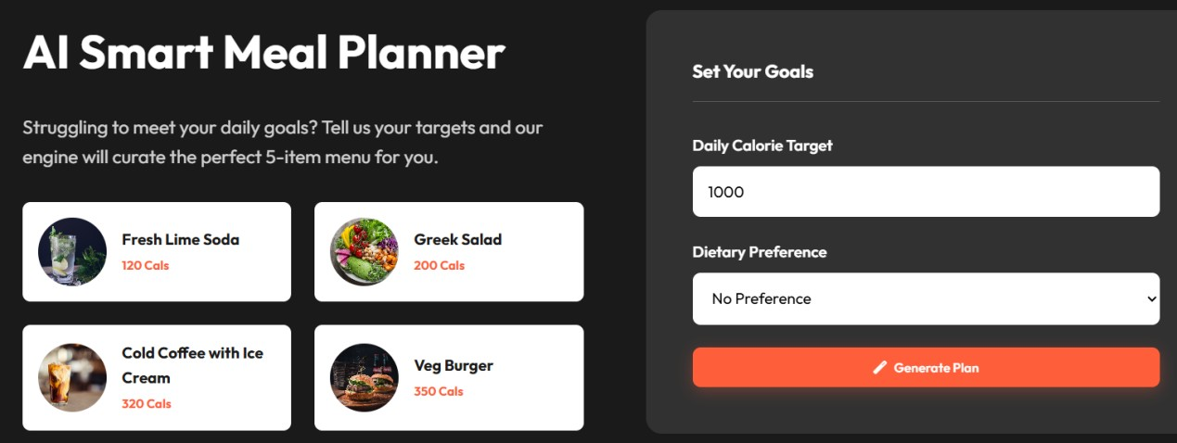

Slide 18
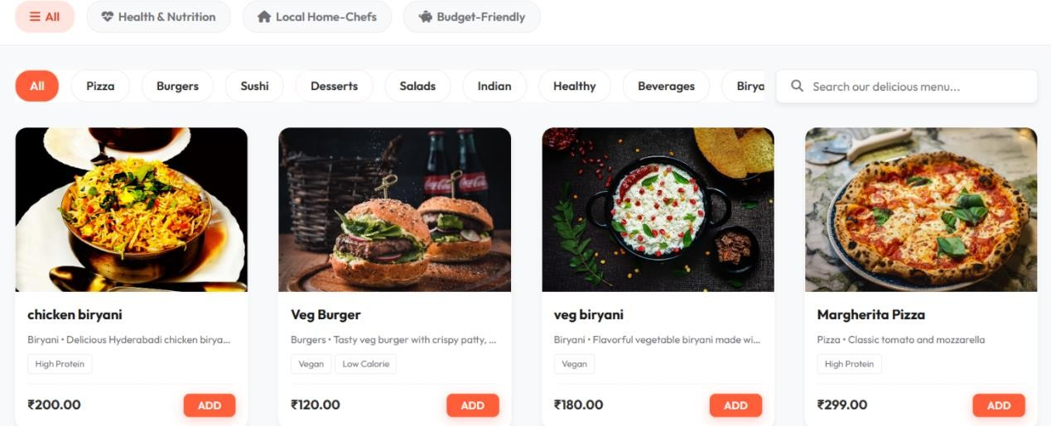

Slide 19
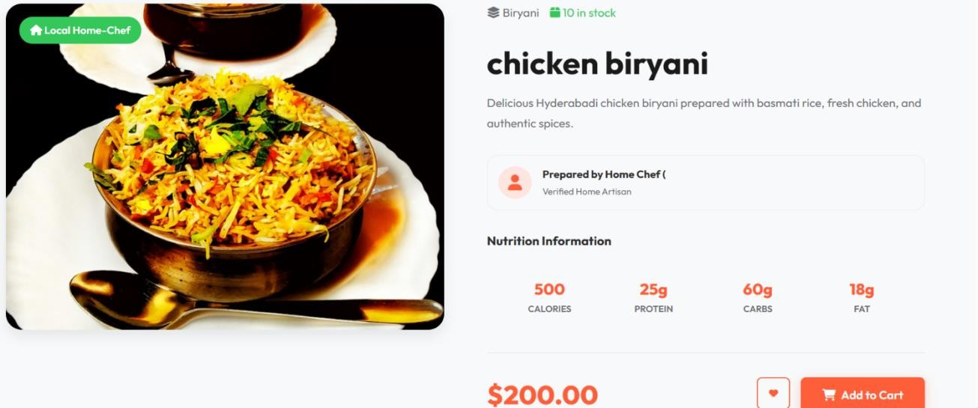

Slide 20
Conclusion
The Online Food Ordering System was developed to make the process of ordering food simple, fast, and convenient for users. The system allows customers to browse food items, add them to the cart, and place orders through an online platform.

Slide 21
Future Enhancement
The Online Food Ordering System can be further improved by adding advanced features to enhance functionality and user experience. In the future, the system can include real-time order tracking so that customers can monitor the status of their orders from preparation to delivery. Multiple secure payment options such as UPI, debit cards, credit cards, and digital wallets can be integrated to make the payment process more convenient.

Slide 22
References
Books
Python: Python Crash Course, Eric Matthes
Web Development: HTML and CSS: Design and Build Websites, Jon Duckett
Database Management: Database System Concepts, Abraham Silberschatz
Sites
https://www.zomato.com
https://www.swiggy.com
https://www.ubereats.com
https://www.dominos.co.in
https://www.foodpanda.com

