Slide 1
AI/ML in Practice / Midterm
Payments Guidelines
Query Expert
Answers to payment questions, with sources you can check
[Team ID] | [Team member names]
Payments Guidelines Query Expert / Midterm capstone
01
Notes:
Our project is Payments Guidelines Query Expert. It helps payments professionals ask questions about documented requirements and inspect the sources behind an answer. We have started with NPCI circulars across multiple payment products. The intended product is broader, but this is the coverage implemented today. For this midterm, we are presenting a working local prototype, its design choices, a preliminary retrieval comparison and the work still needed to evaluate answer quality. The product name describes the task it supports. The output remains AI assistance that a user should review, rather than an authoritative compliance decision.
Evidence: evidence/20261003T172349Z/retrieval.json; evidence/20261003T172349Z/live.json; evidence/browser-query-expert/report.json; evidence/simple-demo/answer.json; evidence/simple-demo-friend/answer.json.
Initial corpus: NPCI circulars. Evaluation: AI-assisted UPI cases, independent review pending.

Slide 2
Problem Statement and Motivation
The Why / For product, operations and compliance teams in banks and fintechs
01
02
03
Find the requirement
Understand conditions
Verify the answer
One question may span
several circulars and
later clarifications.
A relevant passage can
still omit a qualification
elsewhere in the source.
Users need to see which
guideline supports each
important statement.
Goal: reduce research effort while keeping source checking part of the task.
Payments Guidelines Query Expert / Midterm capstone
02
Notes:
Our intended users are product, operations and compliance teams in banks and fintechs. A question about one payment feature may require several circulars, including later clarifications. A user must first find the right documents, then identify the relevant conditions, and finally check which source supports each statement. Manual searching makes this slow, while a fluent AI answer can hide missing conditions. We want to make this question-to-source journey easier. We have not yet measured time savings. A useful outcome would be a user finding the necessary requirement with fewer searches while still checking the original guideline before acting.
Evidence: evidence/20261003T172349Z/retrieval.json; evidence/20261003T172349Z/live.json; evidence/browser-query-expert/report.json; evidence/simple-demo/answer.json; evidence/simple-demo-friend/answer.json.
Initial corpus: NPCI circulars. Evaluation: AI-assisted UPI cases, independent review pending.

Slide 3
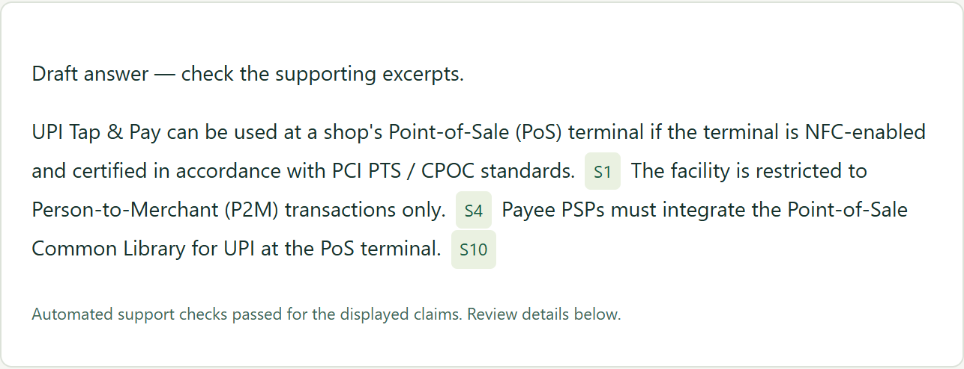
Proposed Solution
A plain-language question, a cited answer and a source the user can inspect
QUESTION ASKED
Can I use UPI Tap & Pay at a shop’s card machine?
Follow S1
UPI OC 186A
Page 1
NFC means
contactless
tap technology.
Also available: guideline search and inspection, summaries and document comparisons.
Payments Guidelines Query Expert / Midterm capstone
03
Notes:
The prototype helps users ask questions, inspect sources, and summarise or compare circulars. Here the user asks: Can I use UPI Tap and Pay at a shop's card machine? No circular number is needed in the question. The recorded local response says the terminal must be NFC-enabled and appropriately certified, and cites the supporting clause. NFC is the contactless technology used for tapping a device. The response also provides merchant-only and integration conditions. The slide uses enlarged captures from the application rendering of this saved response; the answer text has not been rewritten for the presentation. This shows how the user can follow an answer back to a circular. It is one illustrative case, not an accuracy result.
Evidence: evidence/20261003T172349Z/retrieval.json; evidence/20261003T172349Z/live.json; evidence/browser-query-expert/report.json; evidence/simple-demo/answer.json; evidence/simple-demo-friend/answer.json.
Initial corpus: NPCI circulars. Evaluation: AI-assisted UPI cases, independent review pending.

Slide 4
Data Sources and Tools
The How / An attributed knowledge base, starting with NPCI
From circulars to search indexes
Local model and storage stack
1 Split by page, heading and clause
2 Long blocks: ≤220 words; 35 overlap
3 Keep document ID, page and links
4 Index text in BM25; vectors in Chroma
Qwen3.5 9B / answer generation
Qwen3 embeddings / semantic search
MiniLM / candidate reranking
Chroma + SQLite / vectors + metadata
Payments Guidelines Query Expert / Midterm capstone
04
Notes:
The knowledge base starts with Markdown circulars and product inventory records. We preserve each document and page before splitting its text. A recognised heading or numbered clause begins a new block. A long block is split into windows of at most 220 words, with 35 words repeated between adjacent windows to preserve some context. We never combine text from different circulars into one chunk. Each chunk retains its document ID, page, heading and links to its neighbours. The same text feeds BM25 keyword search and Qwen embeddings stored in Chroma. SQLite stores identities, filters and relationships. This structure lets us search by words or meaning while tracing every selected passage back to its source.
Evidence: evidence/20261003T172349Z/retrieval.json; evidence/20261003T172349Z/live.json; evidence/browser-query-expert/report.json; evidence/simple-demo/answer.json; evidence/simple-demo-friend/answer.json.
Initial corpus: NPCI circulars. Evaluation: AI-assisted UPI cases, independent review pending.

Slide 5
How the System Works
The How / Retrieval brings source evidence into the model’s context
Prepare
Source text
and inventory
Preserve document
and page identity
Split into
focused chunks
Build keyword
and vector indexes
Store metadata
and source links
Answer
Question
and filters
Retrieve and
rank passages
Select evidence
within limits
Generate answer
and check support
Display answer
and source links
Exact search finds references; semantic search finds similar meanings.
Payments Guidelines Query Expert / Midterm capstone
05
Notes:
At question time, product and document filters first narrow the search. BM25 finds exact words and circular references, while Qwen embeddings find passages with similar meaning. Hybrid retrieval combines these results. A local MiniLM reranker scores candidates for focused questions. Summary and comparison routes instead select evidence across document sections and bypass reranking. We assemble a bounded set of passages and pass it to Qwen3.5 through Ollama. Citation and support checks run before display, and the reader can inspect the sources. We use pretrained models without fine-tuning because our first requirement is access to attributable documents. Local inference avoids paid model calls, but the 32 GB machine limits speed and context. Automated support checks use the same model and can share its mistakes.
Evidence: evidence/20261003T172349Z/retrieval.json; evidence/20261003T172349Z/live.json; evidence/browser-query-expert/report.json; evidence/simple-demo/answer.json; evidence/simple-demo-friend/answer.json.
Initial corpus: NPCI circulars. Evaluation: AI-assisted UPI cases, independent review pending.

Slide 6
What the Preliminary Evaluation Tells Us
Purpose: does more complex search find better evidence? Same 50 UPI cases and corpus.
Search method | Evidence found | Negatives with no result | Search time (ms)
BM25 | 55/55 | 6/6 | 12.0
Vector | 55/55 | 5/6 | 83.0
Hybrid | 55/55 | 5/6 | 78.0
Hybrid + reranker | 55/55 | 5/6 | 160.5
55/55 = all expected passages found. 6/6 = no passages returned for all negative cases.
Payments Guidelines Query Expert / Midterm capstone
06
Notes:
This experiment asks whether more complex retrieval gives us better evidence than a simple keyword baseline. All four methods ran the same 50 UPI cases on the same corpus. Expected evidence found means the required source passages appeared in the retrieved context: all methods found 55 out of 55. It does not mean 55 correct AI answers. The second measure tests six cases that should return no evidence. BM25 returned nothing in all six; each semantic variant returned irrelevant passages in one case. The last column measures retrieval time only, excluding answer generation. BM25 was fastest; adding reranking to hybrid increased the median from 78 to 160.5 milliseconds without improving coverage here. The conclusion is to keep BM25 as a strong baseline and test harder cases before claiming a benefit from extra complexity. Many queries name circulars and 15 coverage routes bypass reranking. The AI-assisted dataset still needs independent review, so this cannot determine overall answer quality or the best method for every question. Some questions need more than one passage, which is why there are 55 expected evidence matches across 50 cases.
Evidence: evidence/20261003T172349Z/retrieval.json; evidence/20261003T172349Z/live.json; evidence/browser-query-expert/report.json; evidence/simple-demo/answer.json; evidence/simple-demo-friend/answer.json.
Initial corpus: NPCI circulars. Evaluation: AI-assisted UPI cases, independent review pending.

Slide 7
Implementation Roadmap
From a working prototype to an evaluated, repeatable local demonstration
NOW · Cited Q&A, source reader, summaries and comparisons implemented
Weeks 1–2
Weeks 3–5
Weeks 6–8
Validate answers
Improve reliability
Test with users
Review the 50 cases.
Freeze unseen questions.
Fix source and answer failures.
Shorten long summaries.
Compare search settings.
Observe research tasks.
Package setup and final demo.
DELIVERABLE
DELIVERABLE
DELIVERABLE
Reviewed test set +
answer-quality scorecard
Tested revision +
quality / latency comparison
User-task results +
repeatable demonstration
Indicative weeks after midterm; reviewer access is a dependency. Another payments source is an optional later extension.
Payments Guidelines Query Expert / Midterm capstone
07
Notes:
The roadmap now identifies work, timing and a concrete output. The midterm milestone is complete at the prototype level: cited questions and answers, source inspection, summaries and comparisons. In the first two weeks after midterm, we plan to review the existing 50 cases with an independent reviewer and freeze unseen questions. The output is a reviewed test set and an answer-quality scorecard. In weeks three to five, we will fix source and answer failures, improve overly long summaries, and compare retrieval choices. The output is a tested revision with a documented quality and latency comparison. In weeks six to eight, payments users will try research tasks, and we will prepare reproducible setup and a final demo. The output is a user-task readout and a repeatable local demonstration. These are indicative planning windows, dependent on reviewer access. A second payments source is an optional extension after validation, not a condition for completing the core capstone.
Evidence: evidence/20261003T172349Z/retrieval.json; evidence/20261003T172349Z/live.json; evidence/browser-query-expert/report.json; evidence/simple-demo/answer.json; evidence/simple-demo-friend/answer.json.
Initial corpus: NPCI circulars. Evaluation: AI-assisted UPI cases, independent review pending.

Slide 8
Discussion and Feedback
Feedback requested on the next stage of this capstone
01
Scope
Is the question-to-source workflow useful and manageable?
02
Evaluation
Which multi-document and missing-evidence cases should come first?
03
Usefulness
What task outcomes would demonstrate value to payments teams?
Immediate priority: validate answers and improve failures before expanding coverage.
Payments Guidelines Query Expert / Midterm capstone
08
Notes:
We would like feedback on three decisions. First, is this focused question-and-source workflow a useful and manageable capstone scope for payments teams? Second, which questions should the independently reviewed evaluation prioritise, especially when requirements span several documents? Third, what evidence would convince you that the assistant is useful in practice: task completion, fewer corrections, time spent, or a combination? Our immediate priority is to validate the answers and improve the failures before expanding coverage. The current prototype demonstrates a complete local RAG flow. The remaining work is to establish how reliably it answers realistic questions and how effectively users can verify those answers.
Evidence: evidence/20261003T172349Z/retrieval.json; evidence/20261003T172349Z/live.json; evidence/browser-query-expert/report.json; evidence/simple-demo/answer.json; evidence/simple-demo-friend/answer.json.
Initial corpus: NPCI circulars. Evaluation: AI-assisted UPI cases, independent review pending.

