Slide 1








地面と平行な消失点
$$h$$
地面
同一地面にある2点
$$f$$
$$f$$
$$v_{r2}$$
$$v_{e2}$$
$$v_{r1}$$
$$h$$
$$v_{e1}$$

Slide 2











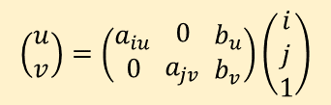
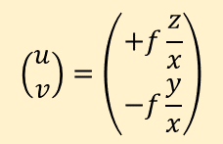







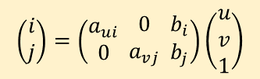




$$z$$
$$u$$
$$i$$
$$α$$
$$x$$
$$f$$
$$j$$
$$v$$
$$y$$
$$z$$
$$x$$
$$x$$
$$f$$
$$β$$
$$y$$
$$f,t$$
$$\left(i,j\right)$$
$$\left(\begin{aligned}i \\ j\end{aligned}\right)=\left(\begin{aligned}a_{ui} \\ 0\end{aligned} \begin{aligned}0 \\ a_{vj}\end{aligned} \begin{aligned}b_{i} \\ b_{j}\end{aligned}\right)\left(\begin{aligned}u \\ v \\ 1\end{aligned}\right)$$
$$\left(u,v\right)$$
$$\left(\begin{aligned}u \\ v\end{aligned}\right)=\left(\begin{aligned}+f\frac{z}{x} \\ −f\frac{y}{x}\end{aligned}\right)$$
$$\left(x,y,z\right)$$
$$\left(α,β\right)$$
$$\left(\begin{aligned}u \\ v\end{aligned}\right)=\left(\begin{aligned}+f\tan\left(α\right) \\ −f\tan\left(β\right)\end{aligned}\right)$$
$\left(\begin{aligned}α \\ β\end{aligned}\right)=\left(\begin{aligned}atan2\left(f,u\right) \\ atan2\left(f,−v\right)\end{aligned}\right)$
$$\left(\begin{aligned}x \\ y \\ z\end{aligned}\right)=\left(\begin{aligned}+t \\ −t\frac{v}{f} \\ +t\frac{u}{f}\end{aligned}\right)$$
$$\left(\begin{aligned}u \\ v\end{aligned}\right)=\left(\begin{aligned}a_{iu} \\ 0\end{aligned} \begin{aligned}0 \\ a_{jv}\end{aligned} \begin{aligned}b_{u} \\ b_{v}\end{aligned}\right)\left(\begin{aligned}i \\ j \\ 1\end{aligned}\right)$$

