Slide 1


Lesson 5
Objects, Factory methods
OCTOBER 17, 2016

Slide 2
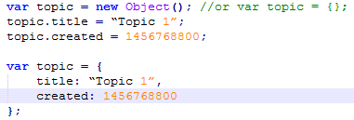
Javascript Object
Declaration
An Object is a standalone entity, with properties and type.
You can declare it with the ‘new Object()’ command, the ‘{ }’ literal (Object initializer) or using a custom constructor function.
The results in the case of the object initializer and the ‘new Object()’ command are the same:

Slide 3



Javascript Object
Declaration
The Object initializers syntax:
A value of an objects property can be an object:
Or an array of objects:

Slide 4
Javascript Object
Property accessors
Unassigned properties of an object are undefined (and not null): topic.brief // undefined
Property names are case sensitive: topic.Title // undefined
Properties can be accessed or set using bracket notation: topic.title === topic[“title”];
If the property name is not a valid javascript identifier, you can only access it with square bracket notation. topic[“;;---!%”] = “text”;
You can access a property using a string value stored in a variable: var property = “title”; topic[property]

Slide 5
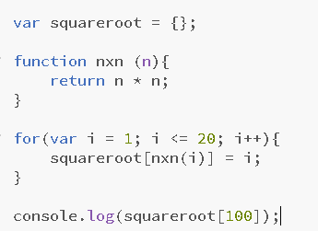
Javascript Object
Property accessors
Square brackets can contain not just variables but any expression which returns a string (or any result that can be converted into a string)

Slide 6

Javascript Object
Property accessors
If you assign a value to a property more than one time, a last value will be set:

Slide 7

Javascript Object
Property accessors
A property of an object can also refer to a function or a getter or setter method.

Slide 8
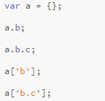
Javascript Object
Let’s access the properties
What will be the result?
-> undefined
-> Uncaught TypeError:Cannot read property 'c' of undefined
-> undefined
-> undefined

Slide 9
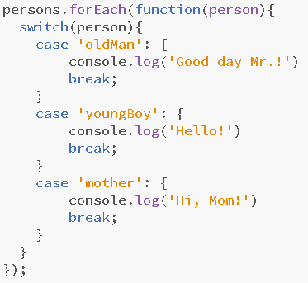
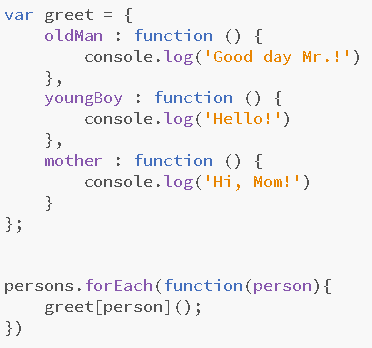
Javascript Object
TRICKS
Switch case constructs can be replaced with object literals

Slide 10
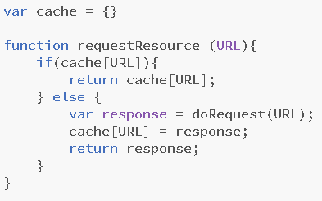
Javascript Object
TRICKS
Caching

Slide 11
Javascript Object
Iteration
You can iterate over an object’s key-value pairs with for...in: for(var property in topic) {
var value = topic[property];
}
Object.keys: Object.keys(topic).forEach( function( key ) {
var value = topic[key];
} );

Slide 12
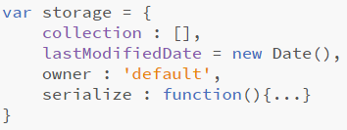
Javascript Object
Remove properties
How do you remove a property from an object?
setting to undefined
use delete
storage.owner = undefined
delete storage.owner

Slide 13
Javascript Object
Remove properties
What is the result? storage.owner ➔ undefined
And what is the difference?
storage.hasOwnProperty(’owner’)
Setting to undefined ➔ true
Using delete ➔ false
Iterating over the keys only excludes owner if the delete keyword was used

Slide 14
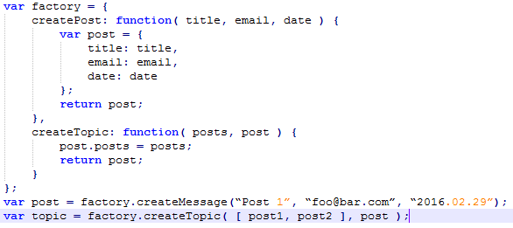
Factory functions

Slide 15
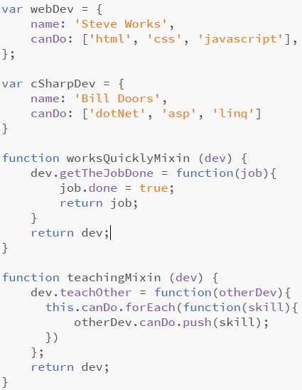
Mixins
Like factory functions but working on existing objects

Slide 16
JSON
JSON vs. JS object
JavaScript Object Notation Not the same as the object literal notation: - The key must be double-quoted
- The values can only be string, numbers, arrays, boolean values, null or another JSON object
- Function can not be assigned to a property
You can parse a string to JSON with JSON.parse( str ) command.
Use JSON.stringify(obj) to do it the other way.

Slide 17
Practice
Adding Topics, Message view
OCTOBER 17, 2016

Slide 18

Well done
OCTOBER 17, 2016

