Slide 1
HTML and CSS
Zoltán Gábor Makranczi

Slide 2
Training overview
Introduction, tools, access + high level HTML and HTTP
HTML document layout, HTML 5 elements, CSS selectors, Media query
Box model, positioning
JavaScript language, JSON, Scopes
Module pattern, OO, prototype, publish-subscribe
Module pattern, OO, prototype, publish-subscribe
Events, Timers, jQuery DOM manipulation
Handlebars, jQuery Ajax

Slide 3
Agenda
HTML page structure
HTML5 elements
CSS
Media queries
Sass

Slide 4
Agenda
HTML page structure
HTML5 elements
CSS
Media queries
Sass

Slide 5

HTML Page structure
Section

Slide 6
doctype & <html>
HTML Page structure
<!doctype html>
Must be the first element on a page
Tells the browser what type of document we’re dealing with
<html>
Wraps the page
Not strictly necessary element

Slide 7
Head
HTML Page structure
<head>…</head>
Contains the page <title>
Contains meta information about the page
<meta …>
May define or contain references to external resources
<link rel=“stylesheet” href=“…”>
<script src=“”></script>
<style>…<style>
Notes:
Meta:
Favicon
Encoding
Keywords
Etc.
Resources
Style
Link
Script

Slide 8
Body
HTML Page structure
<body>…</body>
All the content is here
May contain scripts as well (optimization)

Slide 9
Agenda
HTML page structure
HTML5 elements
CSS
Media queries
Sass

Slide 10

HTML5 elements
Section

Slide 11

New in HTML5
HTML5 elements
Elements
<article>
<header>, <footer>
<nav>, <aside>
<main>
<section>
<canvas>, <svg>
<audio>, <video>
…
Types, attributes
color, email, tel, date, number, etc.

Slide 12
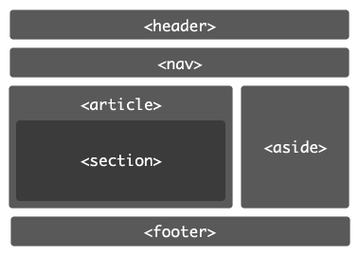
Because…
HTML5 elements
Semantics
Expressive markup
SEO
What about IE?
Older version of IE are not able to style elements that are not recognizable for it
Solution: HTML5 Shiv

Slide 13
Agenda
HTML page structure
HTML5 elements
CSS
Media queries
Sass

Slide 14
CSS
Section

Slide 15
CSS basics
CSS
Cascading Style Sheets
Used to apply styles for a HTML document
Can be:
Inline (<style>)
External (<link rel=“stylesheet” href=“…”>)

Slide 16
CSS definitions
CSS
Selector + rules
<selector> { <rule1>: <value1>; <rule2>: <value2>; }
Selectors
ID selector – #my-element
Class selector - .my-element
Pseudo selectors - :hover, :active, :visited, :checked, :focus, :not(), :nth-child(n), …
Pseudo elements - ::after, ::before, ::selection, ::first-letter, ::first-line
Tag selector: body, p, input, …
Rules
display: block; …

Slide 17
CSS Specificity
CSS
<a id=“my-link” class=“big red” href=“…”>…</a> #my-link { color: black; } (0, 1, 0, 0) .big.red { color: red; font-size: 48px; } (0, 0, 2, 0) a#my-link.big:hover { color: yellow; } (0, 1, 2, 1)
Determines which rule should apply among clashing ones
Based on
Inline styles
ID
Class, attributes and pseudo-classes
Elements and pseudo-elements

Slide 18
Agenda
HTML page structure
HTML5 elements
CSS
Media queries
Sass

Slide 19

Media queries
Section

Slide 20
What is a media query?
Media queries
Conditional block of CSS definitions
Logical operators
and (and)
or (,)
Conditions include:
screen / print
min-width, max-width
min-height, max-height
orientation
resolution
…
Example
@media (max-width: 600px) and (orientation: portrait) { <CSS definitions come here> }

Slide 21
Agenda
HTML page structure
HTML5 elements
CSS
Media queries
Sass

Slide 22

SASS
Section

Slide 23
What is Sass?
SASS
CSS preprocessor
.scss -> .css
Features
Modularization
Cleaner and more compact code
Compatible with CSS
Variables, expressions
Mixins
Extension

Slide 24
Examples
SASS
Variables
$background-color: #999;
Nesting CSS: ol { … } ol li { … } ol li a { … } ol li a:hover { … } Sass: ol { … li { … a { … &:hover { … } } } }

Slide 25
Examples
SASS
Partials and import
Name starts with an underscore
Contains reusable snippets
Can be imported using the @import directive
Example
//file: _reset.scss html, body { margin: 0; padding: 0; } //file: site.scss @import ‘reset’;

Slide 26
Examples
SASS
Mixins
Defined with @mixin
Can be called using the @include directive
Example
@mixin box-sizing($box) { -webkit-box-sizing: $box; /* Safari 3.0 - 5.0, Chrome 1 - 9, Android 2.1 - 3.x */ -moz-box-sizing: $box; /* Firefox 1 - 28 */ box-sizing: $box; /* Safari 5.1+, Chrome 10+, Firefox 29+, Opera 7+, IE 8+, Android 4.0+, iOS any */ } div { @include box-sizing(border-box); }

Slide 27
Examples
SASS
Inheritance
.toast { border: 1px solid #333; position: fixed; background-color: yellow; … } .error { @extend .toast; background-color: red; }

Slide 28
References
New elements in HTML5
html5shiv
Pseudo classes and elements
Specificity Calculator
Media queries
Sass

Slide 29

Section

Slide 30
Footer
Assignments and exercises
Classnames to use:
epam-logo
copyright
attribution
Replicate this to topic.html

Slide 31
Basic page layout
Assignments and exercises
header, .main-container, footer
The content of the page (L76) should be at least 320px ($min-width) wide (below that, a scrollbar should appear)
The content of the page (L76) should be of full width
Descendants of these, that have the class “content”, should
Be of full width, but NO MORE THAN 1000px ($max-content-height)
Be centered
Have side paddings of 12px ($h-padding)

Slide 32
Implement .input-group
Assignments and exercises
All immediate descendants should be of $input-group-height
All immediate input descendants should have line height of 16px
Convert to em
All immediate span descendants should never break into more lines
All immediate button descendants of the span (mentioned in the previous point) should have a side padding of 24px and a margin to the left of 8px
.input-group should be displayed as a table
All immediate descendants should be displayed as a cell in the table
Also should be vertically aligned

Slide 33
Create the sprite class common rules
Assignments and exercises
Examine the sprite image
Add the properties that are common to ALL sprites on the page to the .sprite definition
Examine the “extensions” – the more precise selectors below
Identify sprites in HTML and add the appropriate classes (as defined in the CSS) to them
What problems may arise? (span as sprite)
background: <color> <image> <repeat> <h-pos> <v-pos>
display: inline-block
vertical-align: middle

Slide 34
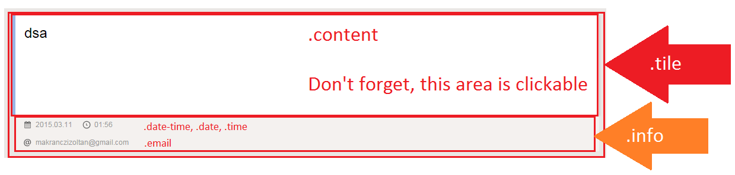
Create HTML for topic (index.html)
Assignments and exercises
Is this something reusable?
Let’s look at the target…
Duplicate to have more of them (3-4)

Slide 35
Create HTML for message (topic.html)
Assignments and exercises
Let’s look at the target…
Apply the markup
Very similar to the previous one
The content, in this case, is not clickable

Slide 36
Enhance the logo
Assignments and exercises
The text should be in the HTML for accessibility reasons
How to make it disappear?
Also, make sure that the browser wouldn’t do any decoration when the user moves the mouse over the logo
text-indent: -9999px ;
overflow: hidden;
&.hover { text-decoration: none; }

Slide 37
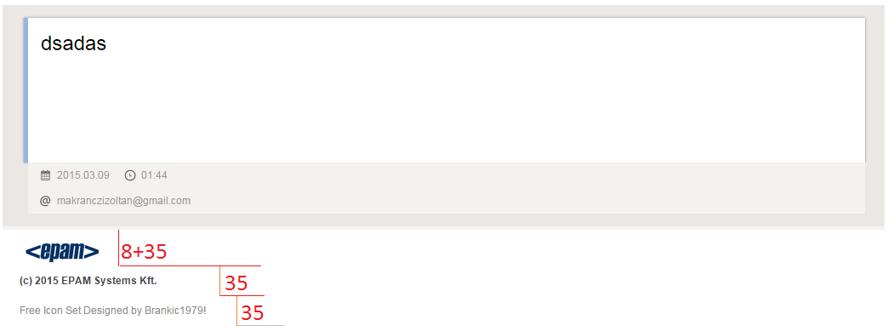
Same height of elements in the footer
Assignments and exercises

Slide 38
Box shadow and transition
Assignments and exercises
Look at the target
Look at the available mixins
Box shadow shouldn’t be offset, color #888 and blur on a 3px area
A transition of 1s must be used for the background-color on the tile’s .content, with easing ‘ease-in-out’

Slide 39
Section
Again ☺

