Slide 1
Box Model & Positioning
László Szikszai

Slide 2
Training overview
Introduction, tools, access + high level HTML and HTTP
HTML document layout, HTML 5 elements, CSS selectors, Media query
Box model, positioning
JavaScript language, JSON, Scopes
Module pattern, OO, prototype, publish-subscribe
Module pattern, OO, prototype, publish-subscribe
Events, Timers, jQuery DOM manipulation
Handlebars, jQuery Ajax

Slide 3
Agenda
Box Model
Positioning

Slide 4
Agenda
Box Model
Positioning

Slide 5
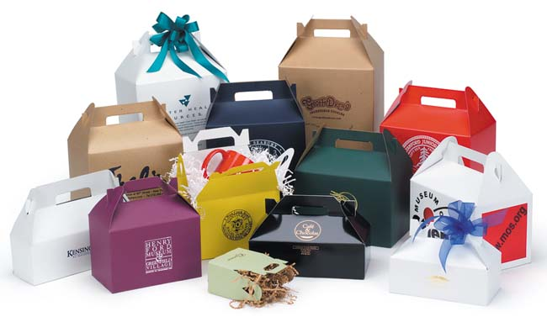
Box model
Section

Slide 6
Definition
Box model
The box model is the specification that defines how a box and its attributes relate to each other.
Attributes
Width, height
Padding
Border
Margin

Slide 7
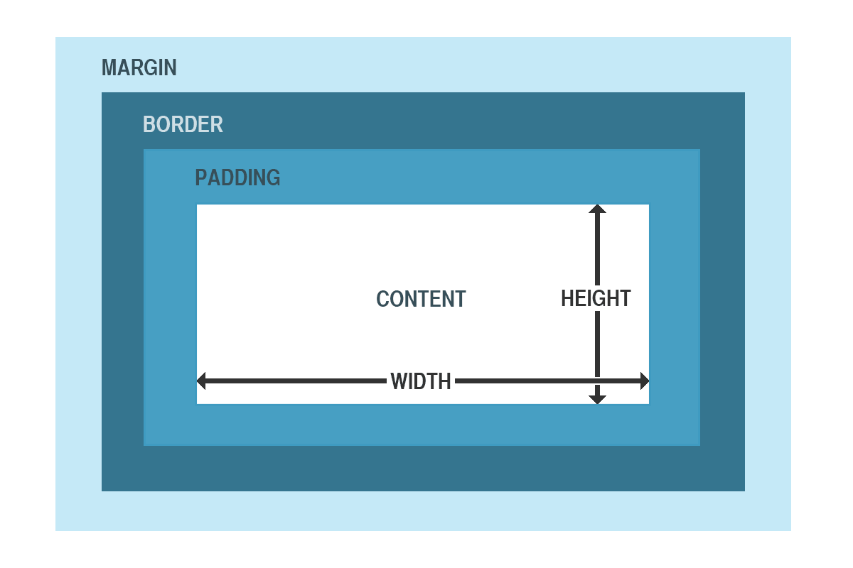
Let’s see it…
Box model
Notes:
Explanation of each

Slide 8
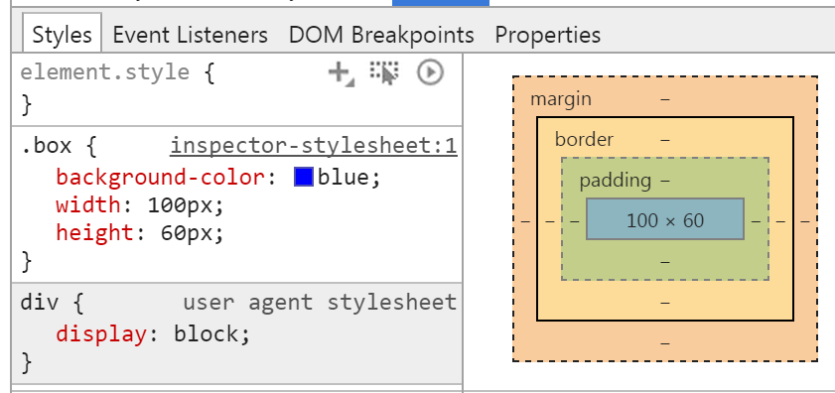
Examples
Box model
In it’s simplest form:
Notes:
As specified (and expected), the dimensions are 100 by 60.

Slide 9
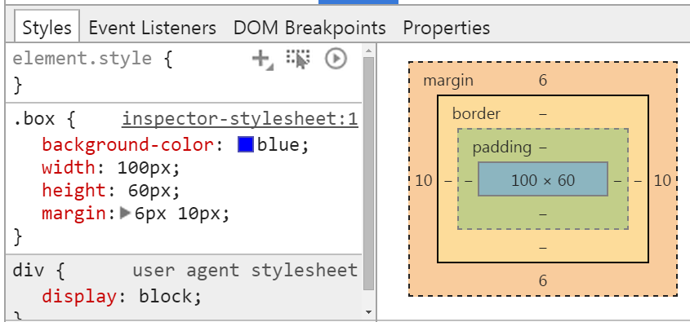
Examples
Box model
Let’s see it with margin:
Notes:
Again, as specified (and expected), the dimensions are 100 by 60.

Slide 10
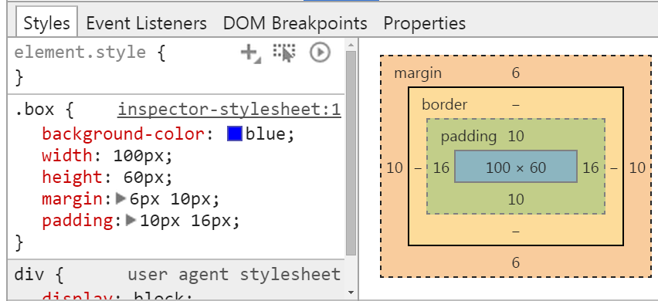
Examples
Box model
Let’s see it with padding (things start to happen):

Slide 11
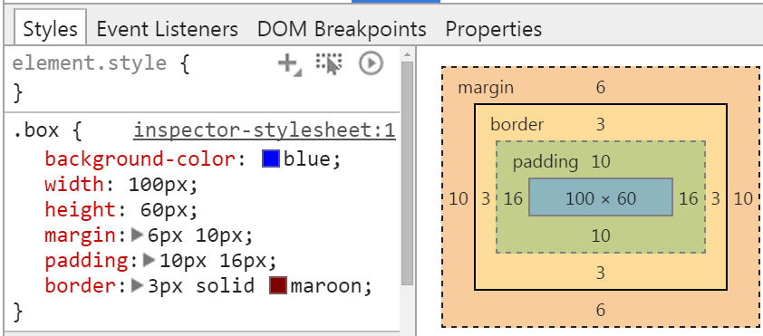
Examples
Box model
And now with border:

Slide 12

As a summary
Box model
So what we’ve seen:
The padding and border are added to the width, not included in it
Can you think of any problems which may arise?

Slide 13
The problem
Box model
<section class=“container”> <article class=“blog-post”>…</div> </div> .container { background-color: lightgreen; padding: 20px 0; width: 500px; margin: 0 auto; .blog-post { width:100%; background-color: yellow; padding: 6 10px; } }
Notes:
Can somebody tell what the outcome is?

Slide 14
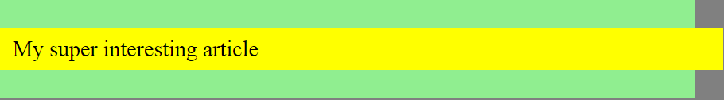
The result
Box model

Slide 15
The solution
Box model
New in CSS3:
box-sizing
Values:
content-box (default)
border-box

Slide 16
content-box
Box model
It applies the padding and border properties on top of the width and height
This is the default value

Slide 17
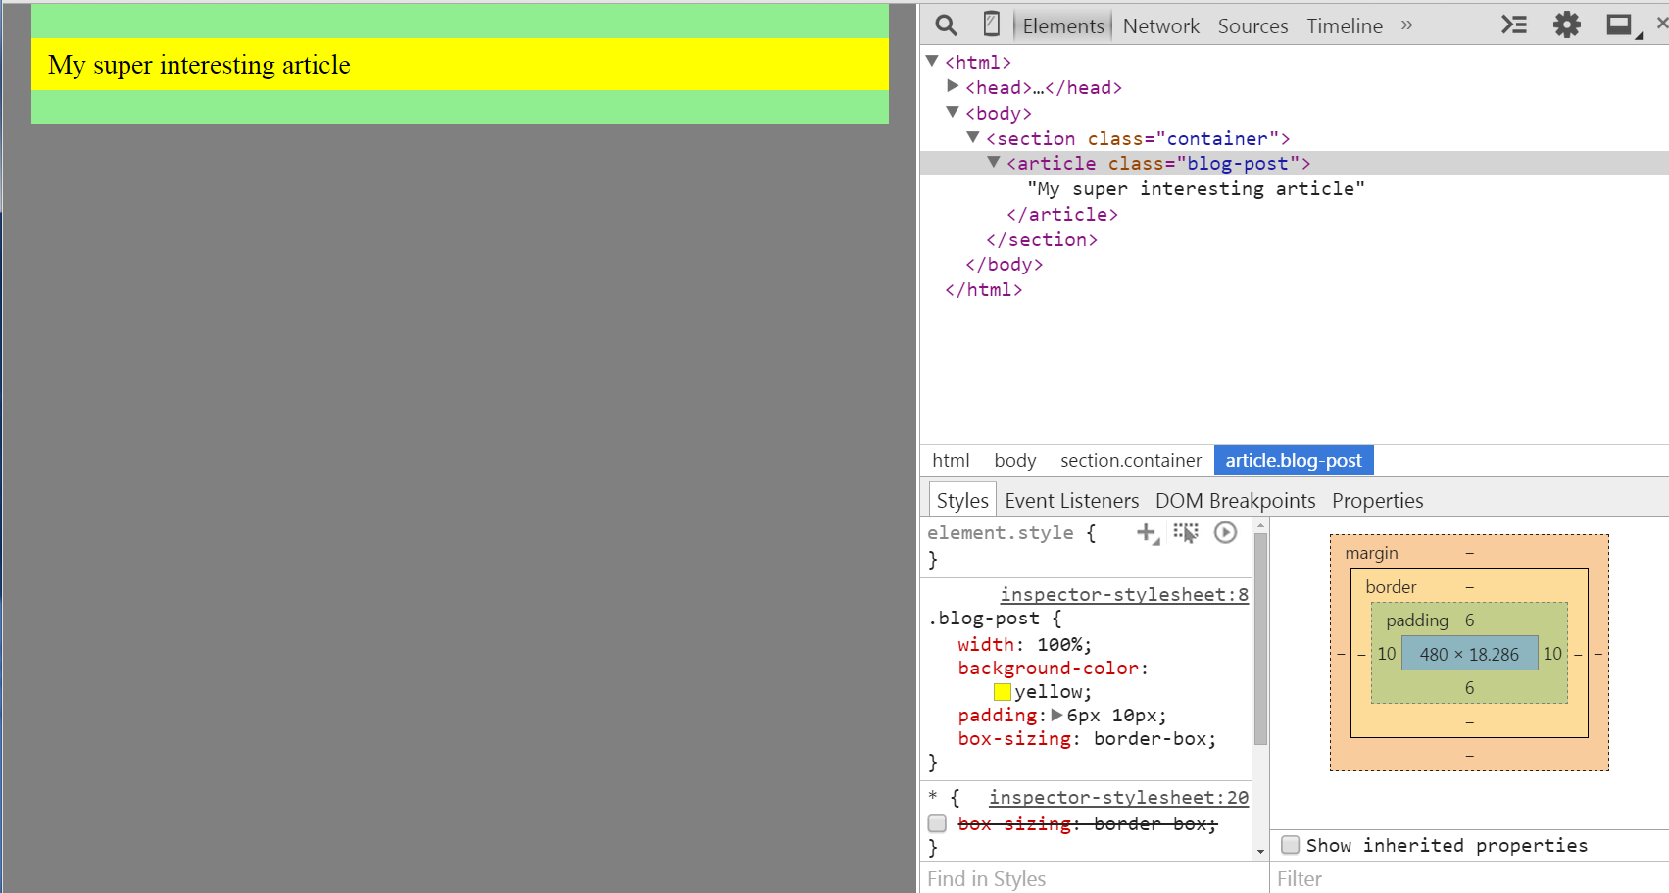
border-box
Box model
It applies the width and height including the padding and border

Slide 18
Conclusion
Box model
In general, it’s best to use border-box for all elements
* { -webkit-box-sizing: border-box; -moz-box-sizing: border-box; box-sizing: border-box; }

Slide 19

Positioning
Section

Slide 20
What methods do we have?
positioning
margin
float
position

Slide 21

Margin
Section

Slide 22
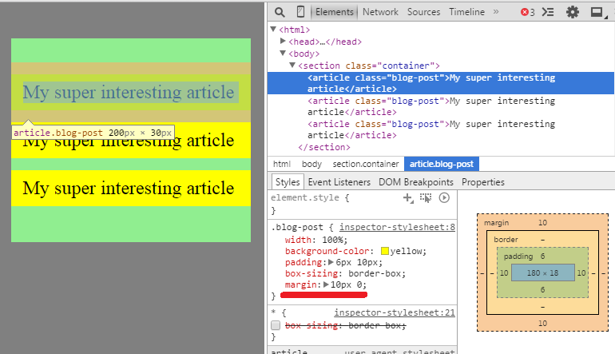
Margin
Positioning / margin
Move the element away from it’s “natural” position
Margin collision

Slide 23

Float
Section

Slide 24
Float
Positioning / float
Floating an elements moving an element horizontally to the furthermost position
Elements will use only the space they need (e.g. block-level elements will NOT take up the space horizontally)
The element will be taken out of the normal flow
As they are taken out, the parent containers will NOT adapt to the floated elements’ height
Thus needs to be cleared

Slide 25
Float in CSS
Positioning / float
float: left / right / none; clear: left / right / both / none;
Hint: always set the width for floated elements!
Notes:
Otherwise the results can be unpredictive

Slide 26
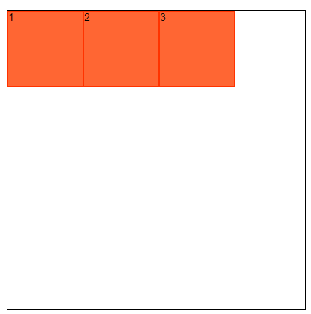
Examples
Positioning / float
Notes:
Note that the container’s height is given in CSS!

Slide 27
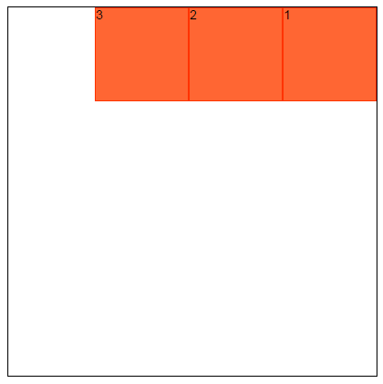
Examples
Positioning / float
Notes:
Note that the container’s height is given in CSS!

Slide 28
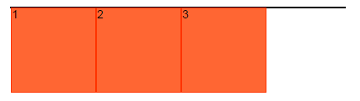
Examples
Positioning / float
If the container’s height is not set
Solution: clear the float
Notes:
That’s the container’s height – 0, because taken out of the normal flow.

Slide 29
Clearing the float
Positioning / float
Method 1:
overflow: hidden for the parent element (hacky)
Method 2:
Extra element, whose purpose is clearing <div class=“container”> <div class=“floated”></div> <div class=“floated”></div> <div class=“clearfix”></div> </div> .floated { float: left; } .clearfix { clear: both; }
Notes:
Note that a clear: left would be sufficient.
Loses semantics: extra element in HTML, just for formatting

Slide 30
Clearing the float
Positioning / float
Method 3
Adding a pseudo element after the container .container:after { content: “ “; visibility: hidden; display: block; height: 0; clear: both; }

Slide 31
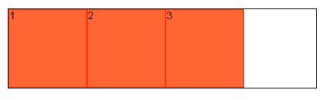
Clearing in action
Positioning / float
If the container’s height is not set and we’re clearing the float using any technique from the previous slide:
Notes:
That’s the container’s height – 0, because taken out of the normal flow.

Slide 32
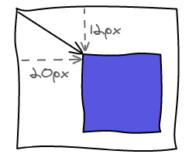
Positioning
Section

Slide 33
CSS Position
Positioning / Position
position
static (default)
relative (offset)
absolute (offset)
fixed (offset)
Properties
top, right, bottom, left
z-index

Slide 34
Types
Positioning / Position
Natural / static
Position the element to it’s natural place, in the normal document flow
Offset
Creates a positioning context
If no offset parent is defined, then the topmost tag will act as the offset parent

Slide 35
Relative
Positioning / Position
A relative positioned element is positioned relative to its normal position

Slide 36
Absolute
Positioning / Position
An absolute position element is positioned relative to the first offset parent.

Slide 37
Fixed
Positioning / Position
An element with a fixed position is positioned relative to the browser window, and will not move even if the window is scrolled

Slide 38
Demo
Positioning / Position
http://jsfiddle.net/L4kag5y5/
A product is relative positioned
The “New” is absolute
We’re making use of the :after pseudo-element
Notes:
Explain how these are laid out

Slide 39

Section

Slide 40
Box-sizing
TASKS
Make rules to screen.scss, to make sure that every element’s box-sizing is border-box
Use box-sizing mixin
Notes:
*, *:before, *:after {
@include box-sizing(border-box);
}

Slide 41
Floating helpers
TASKS
Make pull-left and pull-right helper classes, that are floating the element left and right.
Make clearfix class, what implements the 3rd clearing solution.
Notes:
.pull-right { float: right; }
.pull-left { float: left; }
.clearfix:after {
content: " "; // Older browser do not support empty content
visibility: hidden;
display: block;
height: 0;
clear: both;
}

Slide 42
Header & footer
TASKS
Modify the header and footer elements style:
Header should be fixed to the top of the screen and the height of it must be less or equal than $header-max-height
Footer should be fixed to the bottom of the screen and the height of it must be less or equal than $footer-max-height
Fix the page paddings to support fixed header and footer
Notes:
header, footer { z-index: $z-index-header-footer; }
header { max-height: $header-max-height; }
footer { max-height: $footer-max-height; }
header { @include position(fixed, 0, 0, auto, 0);
footer { @include position(fixed, auto, 0, 0, 0);
.main-container { margin: $header-max-height auto $footer-max-height auto;
.topics { margin-top: $header-max-height + $topic-l-tile-v-spacing; }

Slide 43
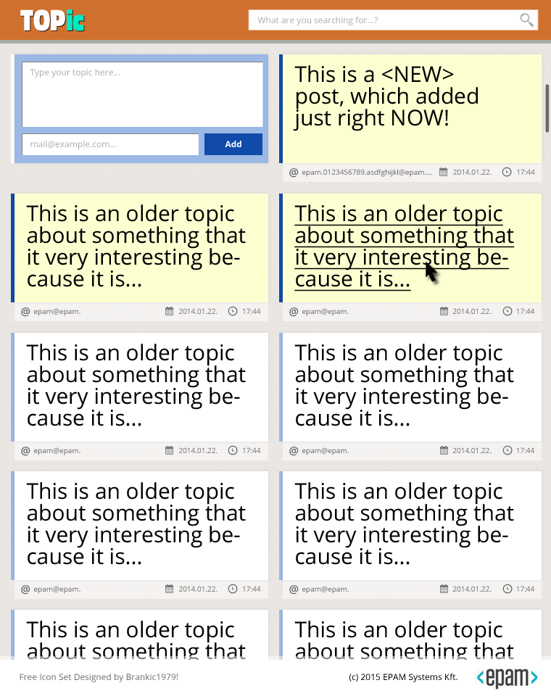

Footer
TASKS
Make the footer look like in the design plan:
Pull right EPAM logo and copyright information
Pull left iconset copyright design information
Notes:
.epam-logo {
position: absolute;
top: 0;
right: $h-padding;
}
.attribution {
margin: 0 30px 0 20px;
color: #888;
line-height: $epam-logo-height;
}

Slide 44
Search
TASKS
Put the search form on the right side of the header and style it like in the picture:
Notes:
.search-form {
padding: 0 $h-padding;
@include position(absolute, 3px, 0, auto, auto);
@include transition(width, 0.6s, ease-in-out);
width: 400px;
.search {
position: absolute;
right: $h-padding + 5;
top: 5px;
}
input {
width: 100%;
padding-right: 27px;
font-size: 0.8em;
}
}

Slide 45
Tiles
TASKS
Make the topic/message informations look like in the design plan:
Pull right the date/time informations
Use text-overflow in the email information
Notes:
.date-time {
@include position(absolute, auto, 0, auto, auto);
width: 165px;
.info {
height: 2.5em;
position: relative;

Slide 46
Forms
TASKS
Make the topic/message form look like in the design plan:
Notes:
&.form {
width: 100%;

Slide 47
Media queries
TASKS
The default view is large.
Make medium view media query with breakpoint: $breakpoint-medium
Make small view media query with breakpoint: $breakpoint-small
Notes:
@media (max-width: $breakpoint-medium) {
}
@media (max-width: $breakpoint-small) {
}

Slide 48
Boxes
TASKS
On large view, show 3 boxes in 1 row
Float or inline-block
On medium view, show 2 boxes in 1 row
On small view, show 1 box in 1 row
Notes:
.tile {
position: relative;
display: inline-block;
vertical-align: top;
width: $topic-l-tile-width;
<!– comments →
.main-container {
.tile {
width: $topic-m-tile-width;
margin-left: $topic-m-tile-h-spacing;
margin-right: $topic-m-tile-h-spacing;
}
}
.main-container {
.tile,
.messages .message-feed .tile {
width: 100%;
margin-left: 0;
margin-right: 0;
}
}

Slide 49
Messages
TASKS
Make message boxes width 80% of the content
Make odd message boxes aligned to the left and even message boxes to the right
On small view make message boxes take up the full width of the content
Notes:
.tile {
width: 80%;
&:nth-child(2n) {
float: right;
}
&:nth-child(2n+1) {
float: left;
}
.main-container {
.tile,
.messages .message-feed .tile {
width: 100%;
margin-left: 0;
margin-right: 0;
}
}

Slide 50
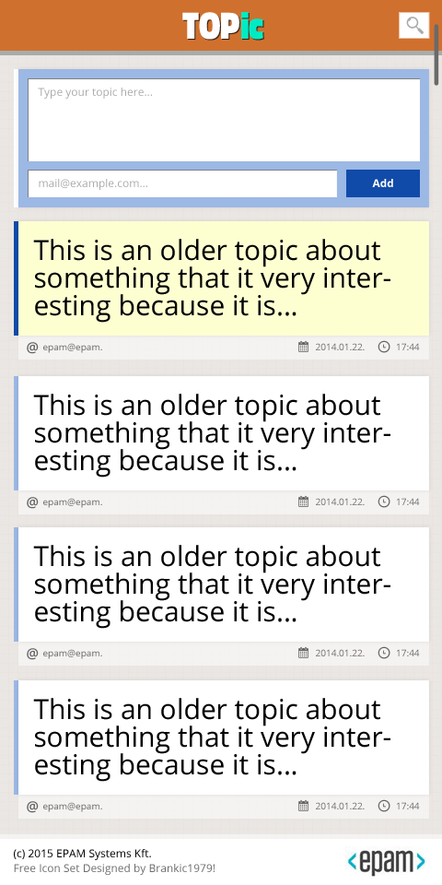
Header/footer medium/small view
TASKS
On medium and small view align the TOPic logo center and narrow the search form according to the design
Notes:
header {
.content {
text-align: center;
}
.search-form {
width: 50px + (2 * $h-padding);
input {
// Hide the placeholder by changing it's color to be the same as the background
@include placeholder {
color: #fff;
}
}
}
}

Slide 51
Header/footer medium/small view
TASKS
On medium and small view make the footer appear on its natural position
On medium and small view make the footer look like in the design plan
Notes:
footer {
position: static;
max-height: none;
header {
.content {
text-align: center;
}
.search-form {
width: 50px + (2 * $h-padding);
input {
// Hide the placeholder by changing it's color to be the same as the background
@include placeholder {
color: #fff;
}
}
}
}

