Slide 1
Events, Timers, jQuery DOM manipulation
Balazs Lehotai

Slide 2
FYI – before we start
Material and starting project of lesson 5 is accessible at
https://www.assembla.com/code/epam-ui-2015/git/nodes/lesson-5

Slide 3
Training overview
Introduction, tools, access + high level HTML and HTTP
HTML document layout, HTML 5 elements, CSS selectors, Media query
Box model, positioning
JavaScript language, JSON, Scopes
Module pattern, OO, prototype, publish-subscribe
Module pattern, OO, prototype, publish-subscribe
Events, Timers, jQuery DOM manipulation
Handlebars, jQuery Ajax

Slide 4
Agenda
Events
Timers
jQuery DOM manipulation

Slide 5
EVENTS

Slide 6
Event
An event is a „thing” that can happen to a HTML element.
We can listen to an event and react to it, once it happened
Purpose: programmatic interaction with the DOM elements

Slide 7
Examples of events
When the browser finishes loading the document, it fires an onload event
When we click to somewhere with the mouse, an onclick event is called on the object which the mouse clicked on

Slide 8
When are the following events are called?
onmouseover
onmouseout
onkeydown
onchange

Slide 9
When are the following events are called?
onmouseover - when we hover over an element’s area
onmouseout - when the pointer left the element’s area
onkeydown - when a key is pressed
onchange - when the content of a form element is changed

Slide 10
Event families
Mouse
Keyboard
Frame/Object
Form
Drag
Clipboard
Print
Media
Animation
Touch
Etc…

Slide 11
An event
<button onclick='doThisForMe("param")' >
Clickety-click
</button>
JavaScript command or funciton call

Slide 12
Timers

Slide 13
Purpose of timers
To delay execution of a code segment
To repeat execution of a code segment
JS has two built-in function pairs
- setTimeout() vs. clearTimeout() - setInterval() vs. clearInterval()

Slide 14
Delaying code execution – setTimeout()
setTimeout(function, delay);
delay – millisecs to wait before execute code
code – function to execute
Guaranteed to run once at the given time, or later, if another timer runs at that point
setTimeout(function(){ alert("Hello"); }, 3000);

Slide 15
Cancel code execution delay – clearTimeout()
To cancel a timed execution
myVar = setTimeout(function(){
console.log("Hello");
}, 3000);
clearTimeout(myVar);

Slide 16
Set periodic code execution – setInterval()
Executes the given code in every given millisecond
If cannot run on time, might be dropped
setInterval(function, millis);
setInterval( function(){ console.log('tik-tak'); }, 1000);

Slide 17
Cancel periodic execution delay – clearInterval()
To cancel a periodic execution
var myInterval = setInterval( function(){ console.log('tik-tak'); }, 1000);
setTimeout(function () {clearInterval(myInterval)}, 4000);

Slide 18

Jquery dom manipulation

Slide 19
What is jQuery?
A tool to make DOM traversing and manipulation, event handling, AJAX queries and animation easier
On top of„vanilla JS” the most common used framework to speed up JS development

Slide 20
How does it work?
jQuery can be accessed as an object
$( "button.continue" ).html( "Next Step..." );
$( "a" ).addClass( "test" );

Slide 21
Selectors
Used to access and manipulate DOM elements
Pass the class or id of the desired element, as a parameter
This is the „query” in jQuery, you can think this as a query on the DOM which returns the collection of the selected elements as a result
Then, the returned elements can be manipulated

Slide 22
Selectors
<div class=”cl1” >foo</div> <div class=”cl2”>bar</div>
$(”.cl1”).text(”lorem”);
lorem
bar

Slide 23
Selectors
<div class=”cl1 common” >foo</div> <div class=”cl2”>dolor</div>
<div class=”cl3 common”>bar</div>
$(”.common”).text(”lorem”);
lorem
dolor
lorem

Slide 24
Selectors & chaining
<div class=”cl1 common” >foo</div> <div class=”cl2”>dolor</div>
<div class=”cl3 common”>bar</div>
$('.common').text('lorem').addClass('sitamet');
<div class=”cl1 common sitamet” >lorem</div> <div class=”cl2”>dolor</div>
<div class=”cl3 common sitamet”>lorem</div>

Slide 25
Traversing API
https://api.jquery.com/category/traversing/

Slide 26
Events
jQuery’s other great feature to help the developer to use events in a convenient way
.on() ⬄.off()
Alternate event handlers for common events (.click(), .mouseover(), .ready(), etc…)

Slide 27
.on()
Attach an event handler function for one or more events to the selected elements
.on( events [, selector ] [, data ], handler )
All type of HTML events can be accessed by this
$( "#dataTable tbody tr" ).on( "click", function() {
console.log( $( this ).text() );
});

Slide 28
.off()
Remove an an event hander
.off( events [, selector ], handler )

Slide 29
Alternate handlers
Shortcuts for the common event types
Example: .click()
$( "#target" ).click(function() {
alert( "Handler for .click() called." );
});

Slide 30
Alternate handlers
Shortcuts for the common event types
Example: .ready()
$( document).ready(function() {
//this logic executes when the DOM is ready
});

Slide 31
How to automatically attach an event handler to a – dynamically created - element
The jQuery way: attach an event handler to the nearest parent element.
Because of the bubbling, the event will pushed back on the element tree if not cancelled with a preventDefault() call.
$(document).on('click', '.classtype', function(evt) { /*...*/ });

Slide 32
TASKS

Slide 33
Task 0
Make sure that logo is hidden on small screens when search box is focused
open app-controller.js
Look for the searchFormInput’s event handler
append the hide-on-small-screen class on the logo element
Append the focused class at the searchFormInput’s parent

Slide 34
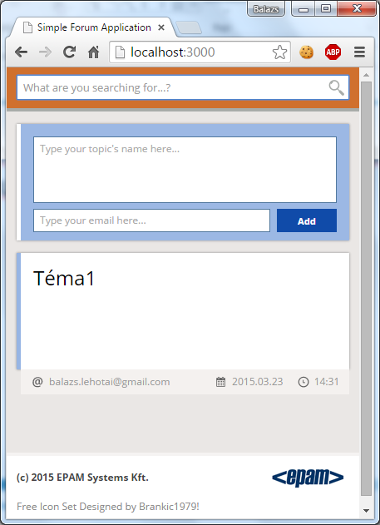
Task 0
Desired look on small screens when search box is focused:

Slide 35
Task 1
When clicked outside of search in small view: Show logo and collapse input field. It preserve the field expanded if the field is not empty
open app-controller.js
attach event handler on searchFormInput
use appropriate event handler (google it ;)
if the content is not empty, remove hide-on-small-screen from the logo
also, remove the focused class

Slide 36
Task 2
Implement toast view behaviour
- open toast-view.js
- expand the module's body to publish (return) the two following methods: show and hide
- show: a function with a message, a class type and the success handler
- it must show the toast with the given style and message, with a fade in effect, and when the effect is done, it must call the success handler
- hide: a function with a success handler
- it must hide the toast with a fadeout effect and once done, it must call the success handler

Slide 37
Task 3
Implement validation error element behaviour
Open topic-view.js
Add the following three methods:
renderValidationErrors
clearValidationErrors
clearTopicForm

Slide 38
Task 3
clearValidationErrors
Should clear all previous errors by
Hiding the error buble
Remove the error class from all affected fields

Slide 39
Task 3
clearTopicForm
Find and empty the textarea of the topic form

Slide 40
Task 3
renderValidationErrors (validationErrors)
Should call clearValidationErrors
If the validationErrors contains ‚title’, add the error class to the text area
If the validationErrors contains ‚email’, add the error class to the email area
Also, add the inline-table display property to the .error-buble

Slide 41
Task 4
Implement validation error clearing and message form clearing functionality
Open message-view.js
Implement the body of clearValidationErrors method to enable it to hide the error buble and remove error class from input fields.
Implement the body of clearMessageForm method to enable it to clear text and email address on the input form.

