Slide 1
Javascript Templating, AJAX basics
Jozsef Gal

Slide 2
Training overview
Introduction, tools, access + high level HTML and HTTP
HTML document layout, HTML 5 elements, CSS selectors, Media query
Box model, positioning
JavaScript language, JSON, Scopes
Module pattern, OO, prototype, publish-subscribe
Module pattern, OO, prototype, publish-subscribe
Events, Timers, jQuery DOM manipulation
Handlebars, jQuery Ajax

Slide 3
Agenda
Templating
AJAX basics
jQuery AJAX

Slide 4
Templating & Handlebars

Slide 5
Templating
Separate model and view (MVC)
Keeps your code clean and make it maintanable
Restricted access – display only without modifying the model
Minimal logic with embedded expressions
Basic tools:
Placeholders
Conditionals
Foreach data-loops

Slide 6
Handlebars
Logic-less templates do a great job of forcing you to separate presentation from logic
Clean syntax leads to templates that are easy to build, read, and maintain
Compiled rather than interpreted templates
Paths (ie, reaching deep into a context object).
Global helpers

Slide 7
How to create a template?
Decide what we want to show
What data is needed to do so
Identify loops, unique variables and conditions
Create a structure or demo

Slide 8
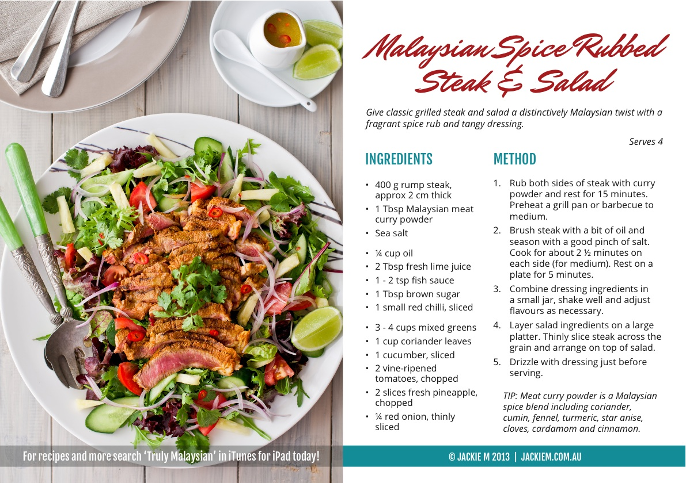
Example – The Recipe
Title
Image
Description
Method
Tip
Ingredients

Slide 9
Example – a possible data structure
{
title: "Malaysian Spice Rubbed Steak & Salad",
description: "Give classic grilled…",
imageUrl: "img/recipe/malaysian-steak.jpg",
ingredientsList: [
{quantity:"400 g", name:"rump steak"},
{quantity:"1/4 cup", name:"oil"},
],
stepList: ["Rub both…", "Brush steak…",…],
tip: "meat curry powder…"
}

Slide 10
Example – HTML represantation
<article class="recipe">
<header>
<h1>{{title}}</h1>
<p>{{description}}</p>
</header>
<aside class="image"><img src="{{imageUrl}}"></aside>
<section class="ingredients">
<h2>Ingreditents</h2>
<ul>
{{#each ingredientsList}}<li>{{quantity}} {{name}}</li>{{/each}}
</ul>
</section>
<section class="method">
<h2>Method</h2>
<ol>
{{#each stepList}}<li>{{this}}</li>{{/each}}
</ol>
</section>
{{#if tip}}<footer class="tip">Tip: {{tip}}</footer>{{/if}}
</article>

Slide 11
Example – the code
var source = $("#recipe-tpl").html();
var template = Handlebars.compile( source );
var data = {…};
$("#content-container").html( template( data ) );

Slide 12
AJAX basics

Slide 13
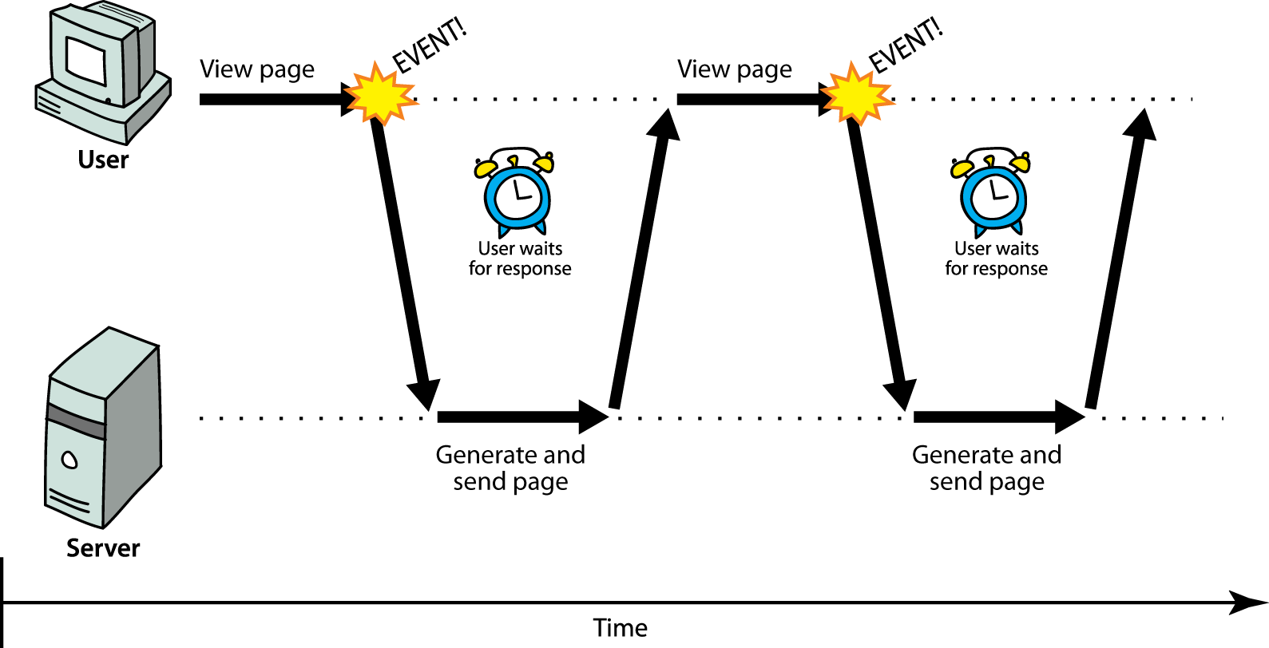
Synchronous web communication
Synchronous: the user must wait while new pages load
standard way of communication in web pages (click-wait-refresh)

Slide 14
Synchronous web communication
Why it is bad?
SLOW
Easier to program, but…
Terrible user experience

Slide 15
AJAX
Asynchronous JavaScript And XML
A particular way of using JS
Background client-server communication
Dynamically update page without reloading
Fight against:
slowness / lack of responsiveness
lack of user-friendliness
jarring nature of <click-wait-refresh> pattern

Slide 16
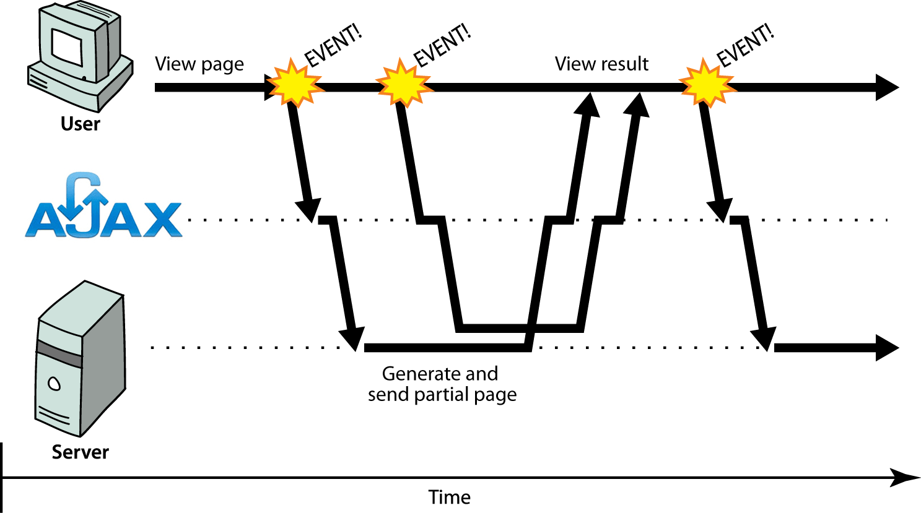
Asynchronous web communication

Slide 17
Core concept
XMLHttpRequest (XHR) object
Asynchronous – background communication, transparent to the user
Contents of fetched file can be put into current web page using DOM manipulation
Dinamically update the web page without reload

Slide 18
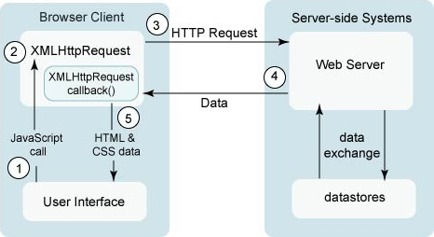
A typical AJAX request
Click event handler
Create a request, register a callback
Call a service
Server answers
Event – answer arrived; call the callback
Your callback is what really process the arrived data

Slide 19
JS code
var ajax = new XMLHttpRequest();
ajax.onreadystatechange = function() {
if ( ajax.readyState == 4 ) {
console.log( ajax.status );
console.log( ajax.responseText );
}
};
ajax.open("get",url,true);
ajax.send(null);
State | Description
0 | Not initialized
1 | Set up
2 | Sent
3 | In progress
4 | Complete

Slide 20
Limitations
Same Origin Request Policy
Can only load from the same domain via the same protocol as the page runs
Hard to handle the loaded scripts manually
responseText or responseXML?
SEO can cause difficulties
Disabled JS means disabled page

Slide 21
jQUERY AJAX

Slide 22
jQuery AJAX
Handle requests using the Deferred interface (promise pattern)
Easy to use interface, most of the config is done by the framework
Handle errors: communication, timeout, server-side errors (HTTP status codes?)
Automatically handle JS, images and stylesheets
Able to use JSON responses

Slide 23
jQuery AJAX
$.ajax({
url: "topics/",
data: {
search: "alfa"
}
type: "GET",
dataType: "JSON",
success: function(data){
console.dir( data );
},
error: function(jqXHR, statusCode){
console.log( "Error: "+statusCode );
}
});

Slide 24
Shorthands
$.get( url [, data] [, success] [, dataType] )
$.post( url, [, data] [, success] [, dataType] )
$.getJSON( url, [, data] [, success] )
$.getScript( url, [, success] );
+1:
.load( url, [, data] [, complete] )
complete( responseText, textStatus, jqXHR )

Slide 25
Excercises

Slide 26
Exercise #1 - templates
Create a template with id topic-template in the index.html file
Use the fields described in helper file
Pre-render the template in topic-view.js
Use this template to render the topic
Apply the topic elements to the template
Add these elements after the form (first article)
Helper file: exc-801-topictpl.txt

Slide 27
Exercise #2 – Load topic list via AJAX
Implement the getAllTopics method in the ajax-storage.js file
Url: /forum/topics
Parameters:
searchString (string)
Response:
Array of topic
Pre-process the response to return an array containing topic object
Modify the code to allow only JSON response
Extra: in case of any error display a message containing „Can’t load topic list” using the ToastController
Helper file: exc-802-topic-list.txt

Slide 28
Exercise #3 – Create new topic
Implement the createTopic method in ajax-storage.js
Url: /forum/topics
Parameters:
title: the new topic’s title
email: the creator’s email address
Helper file: exc-803-create-topic.txt

Slide 29
Exercise #4 – get topic messages
Implement the getAllMessages method to retrieve a topics messages
Url: /forum/topic/[topicId]/messages
Service accepts param: searchString
Pre-process the result with a then call and return an array containing Topic objects
Extra: in case of any error display a toast message „Cannot fetch messages” and write the http status code into the console
Helper file: exc-804-get-messages.js

Slide 30
QUESTions?

Slide 31
Please fill in this feedback form before leave!
http://goo.gl/X3nbpH

Slide 32

Thank you for your attention!

