Slide 1


CSS
(syntax, selectors, box model, positioning / layouts, media queries, SASS)
BALÁZS PETRÓ
OCTOBER 11, 2016

Slide 2
AGENDA
1
CSS syntax, selectors and specificity
2
Box Model
3
Positioning
4
Media Queries
5
SASS

Slide 3
AGENDA
1
CSS syntax, selectors and specificity
2
Box Model
3
Positioning
4
Media Queries
5
SASS

Slide 4
What is CSS?
CSS stands for Cascading Style Sheets
A markup language that describes the presentation of a document (eg. HTML).
Describes elements how to be displayed on screen, paper or other media.
CAN BE
External
<link rel="stylesheet" type="text/css" href="styles.css">
<style> h1 { color: blue; margin-top: 32px; } </style>
Internal
Inline
<h1 style="color:blue;margin-top:32px;">This is a heading.</h1>

Slide 5
Syntax & Selectors
elements
IDs
classes
pseudo classes
pseudo elements
SYNTAX
<selector> { <property1>: <value1>; <property2>: <value2>; }
SELECTORS
body, p, h1, article, input, section, nav, …
#my-element
.my-element
:hover, :active, :visited, :first-child, :checked, :focus,
:nth-child(n), :not(), …
::first-line, ::first-letter, ::before, ::after, ::selection

Slide 6
Selector Specificity
When multiple selectors match the same element, this determines which CSS rule is applied by the browser.
Specificity is the reason why your CSS rules don’t apply to some elements, although you think they should.
There are four distinct categories which define the specificity level of a given selector: inline styles, IDs, classes+attributes and elements.
Every selector has it’s own place in the specificity hierarchy.
Rules with more specific selectors have a greater specificity. (Try to avoid them, write modular CSS instead.)
If two selectors apply to the same element, the one with higher specificity wins.
When selectors have an equal specificity value, the rule, that’s declared last wins.
Notes:
- Amikor több selector illeszkedik ugyanarra az elementre, a specificity határozza meg, hogy melyik szabály lesz alkalmazva a browser által.
A specificity az oka, ami mi miatt a szabályok nem alkalmazódnak, hiába gondolod azt.
Négy kategória határozza meg a specificity-t: inline style, ID selector, class és attribútum selectorok, valamint element selectorok.
Minden selectornak megvan a saját helye a specificity hierarchiában.
Minél specifikusabb egy selector, a specificity értéke annál magasabb lesz.
Ha kettő (vagy több) selector illik ugyanarra az elementre, az a selector lesz alkalmazva, amelyiknek magasabb a specificity értéke.
Ha a selectoroknak megegyezik a specificity értéke, az utoljára deklarált szabály lesz érvényes. (Ezért fontos a specificity hierarchia)

Slide 7
Selector Specificity
Do not use !important keyword! If you have to use it, that means you do something wrong.
The inline style sheet has the greatest specificity, this overrides every other rules.
ID selectors have a higher specificity than attribute selectors.
A class selector beats any number of element selectors.
The universal selector (*) has the lowest specificity.
You can calculate CSS specificity.
Notes:
Ne használd az !important kulcsszót! Ha használnod kell, az azt jelenti, hogy valamit rosszul csinálsz.
Az inline style-nak van a legmagasabb specificity-je, ez felülír minden szabályt.
Az ID selectorok specificity-je magasabb, mint a class vagy attribútum selector-oké.
A class selectorok specificity-je magasabb, mint az element selector-oké.
Az univerzális selector-nak van a legkisebb specificity értéke.

Slide 8
Learn Some Math!
Count the number of ID selectors in the selector
Count the number of class selectors, attributes selectors, and pseudo-classes in the selector
Count the number of type selectors and pseudo-elements in the selector
Ignore the universal selector
(= a)
(= b)
(= c)
Repeated occurrences of the same simple selector are allowed and do increase specificity!
Notes:
Ugyanazon típus selector ismétlése nem fogja felülírni egy erősebb típusú selector specificity-jét. (pl. 101 class selector nem lesz erősebb, mint egy ID selector [összeadásos számolás])

Slide 9
Learn Some Math! - Excercises
(a – ID, b - classes, attributes & pseudo-classes, c - elements & pseudo-elements)
a, b, c
*
li
li:first-line
ul li
ul ol+li
h1 + *[rel=up]
ul ol li.red
li.red.level
style=””
p
div p
.my-class
div p.my-class
#my-id
body #my-id .my-class p

Slide 10
Learn Some Math! - Solutions
(a – ID, b - classes, attributes & pseudo-classes, c - elements & pseudo-elements)
a, b, c
*
li
li:first-line
ul li
ul ol+li
h1 + *[rel=up]
ul ol li.red
li.red.level
style=””
p
div p
.my-class
div p.my-class
#my-id
body #my-id .my-class p
0, 0, 0, 0
0, 0, 0, 1 (one element)
0, 0, 0, 2 (one element, one pseudo-element)
0, 0, 0, 2 (two elements)
0, 0, 0, 3 (three elements)
0, 0, 1, 1 (one attribute, one element)
0, 0, 1, 3 (one class, three elements)
0, 0, 2, 1 (two classes, one element)
1, 0, 0, 0 (one inline styling)
0, 0, 0, 1 (one HTML selector)
0, 0, 0, 2 (two HTML selectors)
0, 0, 1, 0 (one class selector)
0, 0, 1, 2 (two HTML selectors and a class selector)
0, 1, 0, 0 (one id selector)
0, 1, 1, 2 (HTML selector, id selector, class selector, HTML selector; 1+100+10+1)

Slide 11
One Thing to Always Keep in Mind!
Selectors are processed from right to left, not left to right!
The reasion is simple: the browser is looking at most of the selectors it's considering don't match the element in question.

Slide 12
AGENDA
1
CSS syntax, selectors and specificity
2
Box Model
3
Positioning
4
Media Queries
5
SASS

Slide 13
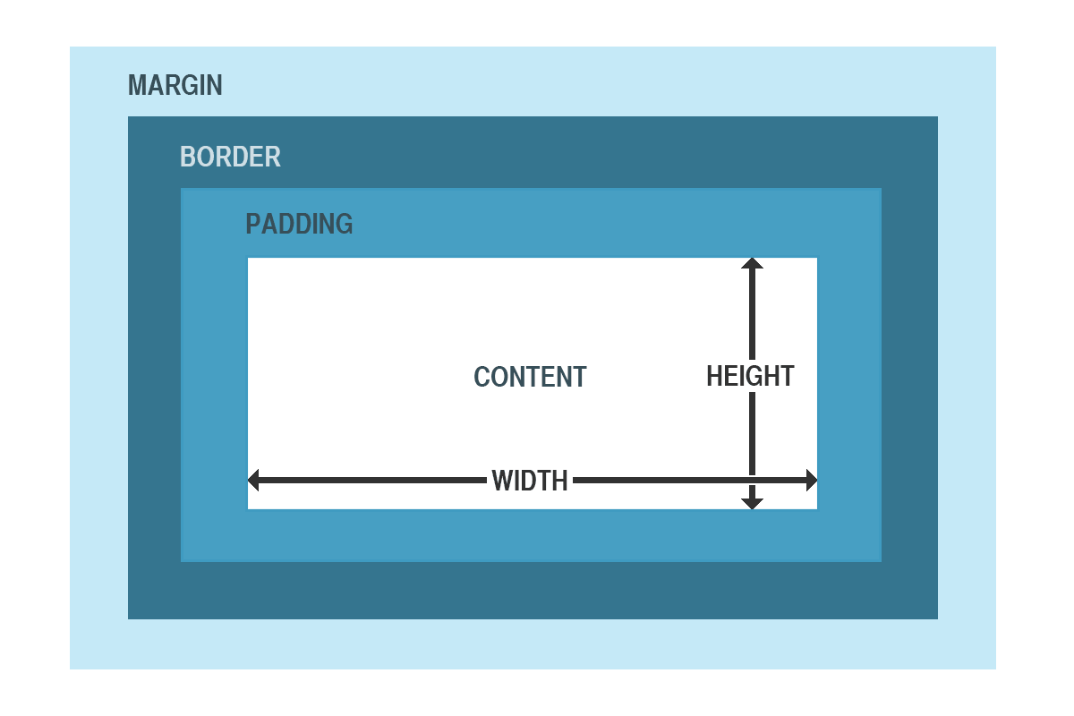
Understanding Box Model
The box model is the specification that defines how a box and it’s attributes relate to each other.
Consists of:
width, height
margin
padding
border

Slide 14
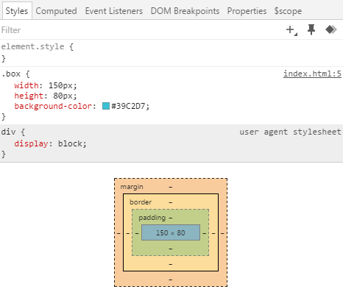
Box Model in Action
In it’s simplest form:

Slide 15
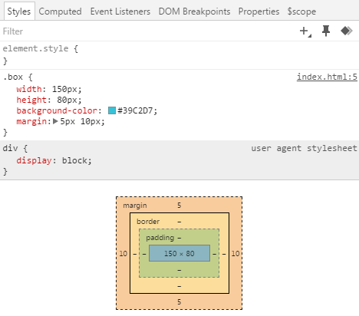
Box Model in Action
Let’s see it with margin:

Slide 16
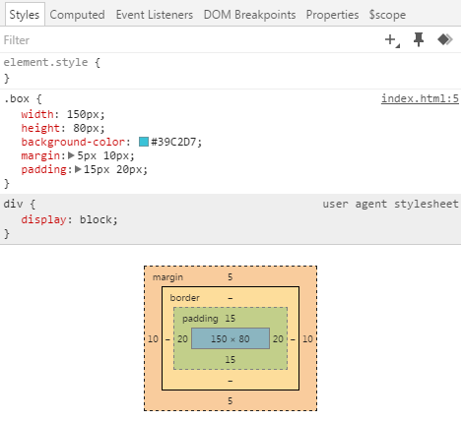
Box Model in Action
Add some padding:

Slide 17
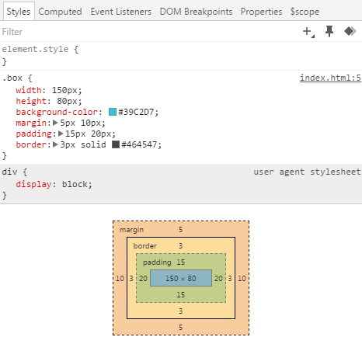
Box Model in Action
And some border:

Slide 18
Summary
The padding and border are added to the width, not included in it
Can you think of any problems which may arise?

Slide 19
The Problem
<section class="container"> <article class="blog-post">…</article> </section>
.container { background-color: #A3C644; padding: 20px 0; width: 500px; margin: 0 auto; .blog-post { width: 100%; background-color: #39C2D7; padding: 6px 10px; } }

Slide 20

The Result

Slide 21
The Solution
CSS3 box-sizing property
Used to tell the browser what the sizing properties (width and height) should include
Values:
content-box (default)
applies the padding and border properties on top of the width and height
border-box
applies the width and height including the padding and border
Notes:
A box-sizing property azt mondja meg, hogy a szélesség és a magasság property értékeket az elemnek magában kell-e foglalnia.
Content box: a padding-ot és a border-t a szélességen és a magásságon FELÜL alkalmazza (az értékek összeadódnak)
Border box: a szélességet és a magasságot úgy számolja ki, hogy a padding-ot és a border-t magában foglalja

Slide 22
Conclusion
In general it’s best to use something CSS reset library (eg. normalize.css)
Or you can use a very lightweight solution for this issue:
* { -webkit-box-sizing: border-box; -moz-box-sizing: border-box; box-sizing: border-box; }

Slide 23
AGENDA
1
CSS syntax, selectors and specificity
2
Box Model
3
Positioning
4
Media Queries
5
SASS

Slide 24
Positioning

Slide 25
What methods do we have?
margin
float
position

Slide 26
Positioning Methods
1
margin
2
float
3
position

Slide 27
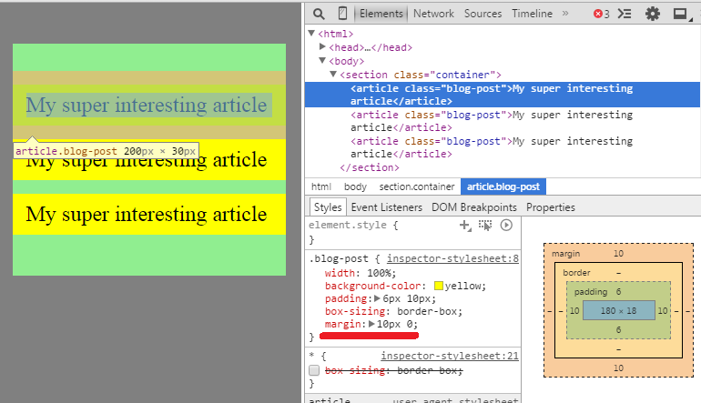
Margin
Moves the element away from its ”natural” position.
Notes:
Elmozgatja az elemet a természetes pozíciójából (horizontálisan és vertikálisan is tudjuk mozgatni az elemet).

Slide 28
Positioning Methods
1
margin
2
float
3
position

Slide 29
Float
The element will be taken out of the normal flow
Floating an element means, moving an element horizontally to the furthermost position
Elements will use only the space they need (e.g. block-level elements will NOT take up the space horizontally)
As they are taken out, the parent containers will NOT adapt to the floated elements’ height
Thus needs to be cleared
Notes:
Az elemet kiveszi a normal flow-ból!
A float property horizontálisan mozgatja el az elemet a természetes pozíciójából.
Nagyon fontos, hogy float-olás esetében az elem a tartalma szélességét veszi fel!
Mivel az elem kikerül a normal flow-ból, így már nem fogja felvenni a szülő elem magasságát, ezért szükség van „clear”-elésre.

Slide 30
Float in CSS
float: left | right | none;
clear: left | right | both | none;
HINT:
It’s recommended to set the width of floated elements!

Slide 31
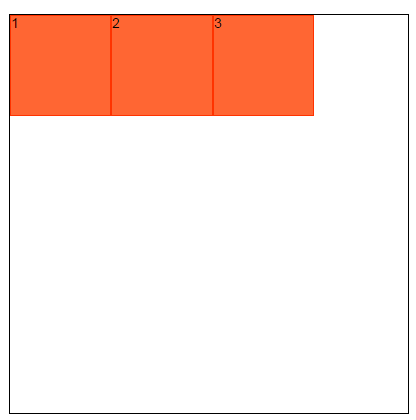
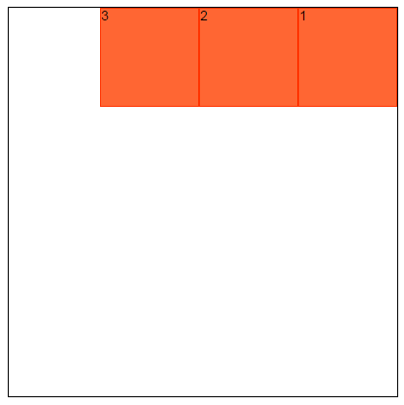
Float in CSS
float: left
float: right

Slide 32
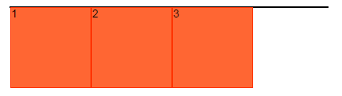
Problems with float
If the container’s height is not set
Clear the float
SOLUTION:
Notes:
Ahogy az ábrán is látható, az elemek float-olva vannak, így már nem veszik fel a szülő elem magasságát!

Slide 33
Clearing the float – With an Extra Element
METHOD 1
Extra element whose purpose is clearing
<div class="container"> <div class="floated"></div> <div class="floated"></div> <div class="clearfix"></div> </div> .floated { float: left; } .clearfix { clear: both; }
Notes:
A probléma ezzel a megoldással, hogy a DOM-ba egy új elemet kellett tennünk (div.clearfix). Régi, CSS2-es megoldás.

Slide 34
Clearing the float – With a Pseudo Element
METHOD 2
Add a pseudo element after the container
.container:after {
content: "";
visibility: hidden;
display: block;
height: 0;
clear: both;
}
Notes:
Ez már egy CSS3-as megoldás, pseudo-element segítségével.

Slide 35
Clearing the float – With .clearfix
METHOD 3
Use .clearfix class
.clearfix::after {
content: "";
display: table;
clear: both;
}
Notes:
A kedvenc megoldásom: .clearfix class. Teljesen újrahasznosítható, keretrendszerekben mindig találkozhatunk vele.

Slide 36
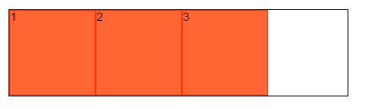
Clearing in action
If the container’s height is not set and we’re clearing the float using any technique from the previous slide:
Notes:
Ahogy az ábrán is látható, „clear”-elés után már a szülő elem felvette a float-olt elemek magasságát.

Slide 37
Positioning Methods
1
margin
2
float
3
position

Slide 38
CSS Position
Properties:
top
right
bottom
left
z-index
position: static (default) | relative | absolute | fixed;

Slide 39
Types
Default: static
Position the element to it’s natural place, in the normal document flow
Offset: relative | absolute | fixed
Creates a positioning context
relative: element is positioned relative to its normal position
absolute: element is positioned relative to the first offset parent
fixed: element is positioned relative to the browser window and will not move even if the window is scrolled
Notes:
Static: az elem természetes pozíciója a document flow-ban.
Relative: az elem a természetes pozíciójához viszonyítva lesz pozicionálva.
Absolute: az elem a legközelebb parent offset-hez viszonyítva lesz pozicionálva, ha nincs ilyen elem, akkor pedig a body elemhez viszonyítva.
Fixed: a böngésző ablakhoz viszonyítva lesz pozicionálva az elem, scroll-ozástól függetlenül.

Slide 40
AGENDA
1
CSS syntax, selectors and specificity
2
Box Model
3
Positioning
4
Media Queries
5
SASS

Slide 41
What is a media query?
A media query consists of a media type and at least one expression that limits the stylesheets' scope by using media features, such as width, height and color.
Logical operators: and, , (or), not, only
Media features: width | min-width | max-width | height | min-height | max-height | orientation | aspect-ratio | resolution | min-resolution | max-resolution | …
@media (max-width: 600px) and (orientation: portrait) {
<block of CSS properties>
}

Slide 42
AGENDA
1
CSS syntax, selectors and specificity
2
Box Model
3
Positioning
4
Media Queries
5
SASS

Slide 43

What is SASS?
SASS is a CSS pre-processor
The name stands for Syntactically Awesome Style Sheets

Slide 44
SASS Features
FEATURES
Variables
Data Types
Interpolation
Operations
Nesting
Directives
Rule directives (@import, @extend)
Mixin directives (@mixin, @include)
Control directives (@if, @for, @each, @while)
Function directives (@function)

Slide 45
Variables & Data Types
// These variables are global variables because they are defined out of a block!
$images-path: ”../assets/images”; // String variable
$animals: (”dog”, ”cat”, ”bird”, ”cow”); // List variable
$languages: (en: ”English”, hu: ”Hungarian”); // Map variable
$background-color: #ccc; // Color variable
.post {
$my-module-width: 96%; // This variable is accessible only in this block!
// Here we can use this variable because it's in the global 'scope'!
background-color: $background-color;
width: $my-module-width;
}

Slide 46
Interpolation
You can also use variables in selectors, property names and property values using #{} interpolation syntax.
$attr: border;
$background-image: ”landscape.jpg”;
$name: foo;
.#{$name} { // Interpolation in selector.
background: "assets/images/#{$background-image}"; // Interpolation in property value.
border: 1px solid;
display: block;
width: 100%;
#{$attr}-color: blue; // Interpolation in property name.
}

Slide 47
Operations
.my-class {
border: (4px / 2) solid; // 2px solid
height: 50px + 10px; // 60px
padding: 54px - 2px; // 52px
width: 100px * 2; // 200px
}

Slide 48
Nesting
SASS lets you nest your CSS selectors in a way that follows the same visual hierarchy of your HTML.
.panel {
// rules
.panel-heading {
// rules
.panel-title {
// rules
}
}
.panel-body {
// rules
}
.panel-footer {
// rules
}
}
The compiled SCSS code:
.panel { // rules }
.panel .panel-heading { // rules }
.panel .panel-heading .panel-title { // rules }
.panel .panel-body { // rules }
.panel .panel-footer { // rules }

Slide 49
Rule Directives
@import "partials/variables"; // Imports the _variables.scss file.
.box {
background: $box-bg-color;
border: 1px solid $box-border-color;
color: $box-text-color;
display: block;
padding: 5px;
}
.fixed-width-box {
@extend .box; // Extends the rules of .box class.
width: 90%;
@media (max-width: 400px) { // Media query
width: 96%;
}
}

Slide 50
Mixin Directives
@import "mixins/alert";
.alert {
border: 1px solid;
margin-bottom: 10px;
padding: 10px;
}
.alert-danger {
@include alert(#f2dede, #ebccd1, #a94442);
}
.alert-info {
@include alert(#d9edf7, #bce8f1, #31708f);
}
.alert-success {
@include alert(#dff0d8, #d6e9c6, #3c763d);
}
@mixin alert-variant($bg-color, $border-color, $text-color) {
background-color: $bg-color;
border-color: $border-color;
color: $text-color;
}

Slide 51
Control Directives - @if
$use-background: false;
$use-border: true;
.my-class-1 {
@if $use-border {
border: 1px solid #000;
}
color: #000;
display: block;
}
.my-class-2 {
@if ($use-background) {
background: #f5f5f5;
}
border: 1px solid #f5f5f5;
color: #333;
display: block;
}

Slide 52
Control Directives - @each
$animals: ("dog", "cat", "bird", "cow");
@each $animal in $animals {
.photo-#{$animal} {
background: url("assets/images/#{$animal}.png") no-repeat;
}
}

Slide 53
Control Directives - @for
@for $i from 1 through 10 {
.width-#{$i * 10}-percent {
width: percentage($i / 10);
}
}

Slide 54
Control Directives - @while
$step: 1;
@while ($step <= 20) {
$value: 5 * $step;
.width-#{$value}-pixels {
width: #{$value}px;
}
$step: $step + 1;
}

Slide 55
Function Directives
@function pow($base, $exponents) {
$raised: 1;
@for $i from 1 through $exponents {
$raised: $raised * $base;
}
@return $raised;
}

Slide 56
How to Optimize Your Code
Don’t write too specific rules, follow the „Inception Rule”
Write modular code
Organize your code into separated files
Avoid inheritance, use mixins instead
Use CSS minifier/compressor tools
Use autoprefixer
“Hey, computers are faster now! and also the internet download speeds are better!”
User who hates Front-End Engineering.

Slide 57
Exercises

