Slide 1
For Townhall

Slide 2
Artifact review process
Address scientific reproducibility crisis within the PETS community.
Authors submit their source code, datasets, user studies etc. as artifacts
At the end of the process, each paper artifact gets badges.
Prior to 2024, there were two badges: Available & Reproduced.
Main change from 2024: we introduced the Functional badge, which is “between” the Available & Reproduced bages. This aligns PETS with other conferences, such as USENIX Security and NDSS.

Slide 3
Did we have more artifact submissions this year?
 | 2024 | 2025
Number of papers | 147 | 169
Number of artifacts | 64 | 94
% of papers with (submitted & accepted) artifacts | 0.435 | 0.556

Slide 4
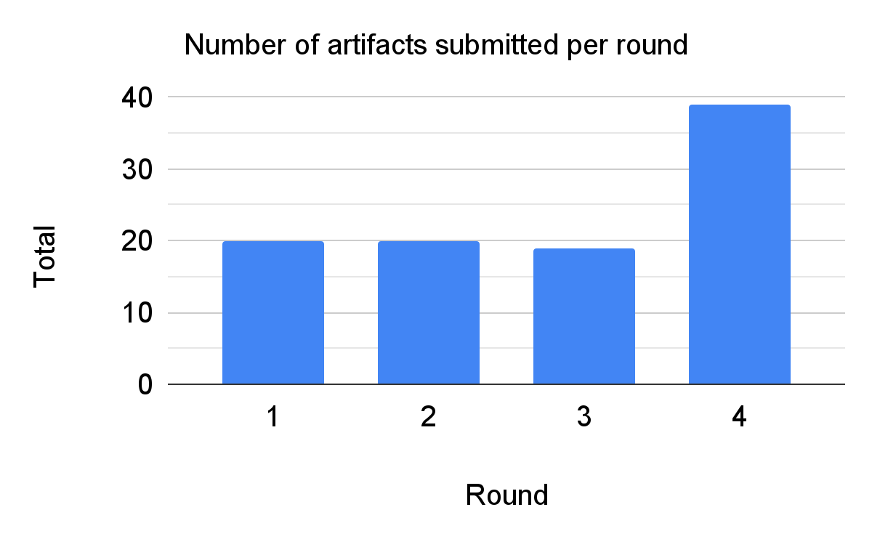
Notes:
We can see the number of artifacts submitted per round here — for the first three rounds, we had a low load of around 20 artifacts. For the last round, we had double that, of around 40 artifacts. We reviewed a total of 98 artifacts this year. We want to accept every artifact that is submitted.
In 2024, going by the PETS proceedings, we had a total of 64 badges awarded, so we’ve seen a significant increase to 94 artifacts.

Slide 5
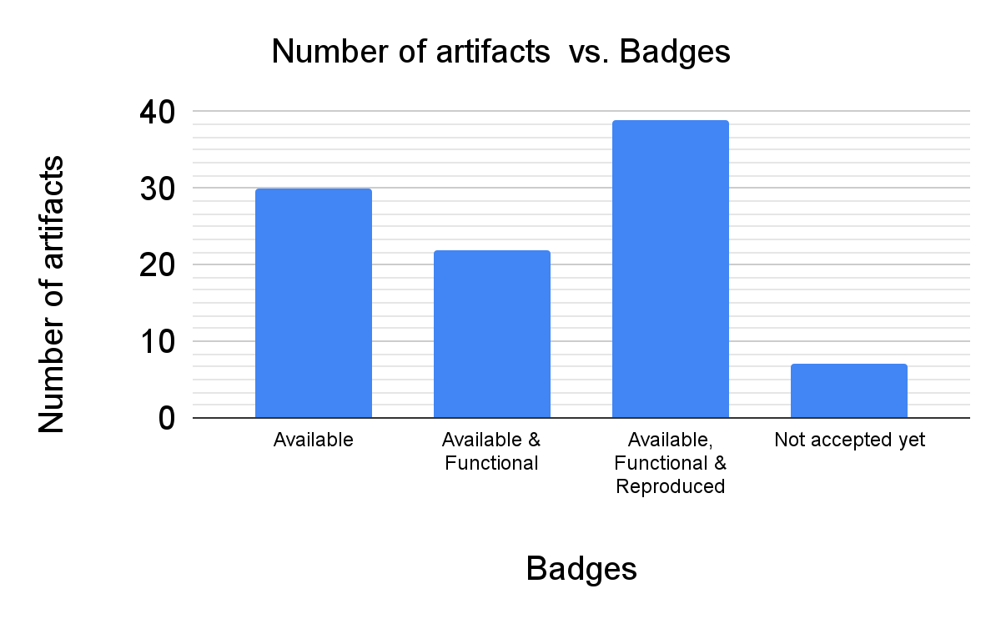
Number of artifacts by badges awarded
Notes:
We have the number of artifacts accepted under each of the three combinations of the three badges — Available, the Available & Functional, the Available, Functional & Reproduced.
In the last year, we did not run into any cases of the Functional and Reproduced badges without the Available badge.
Ten artifacts have yet to be accepted; nearly all of these artifacts are going for the Available, Functional & Reproduced badge. If you’re an author from one of those artifacts, keep an eye out on your Artifact HotCRP emails.
So most artifacts did aim for and receive all three badges; the second most popular category would be just the Available badge and the last category is the Available & Functional badges.
In 2024, going by our proceedings website, we had 28 Available and 36 Reproduced badges.
So in comparison to 2024, we have more artifacts as I mentioned earlier, and the “Functional” badge has served its purpose.

Slide 6
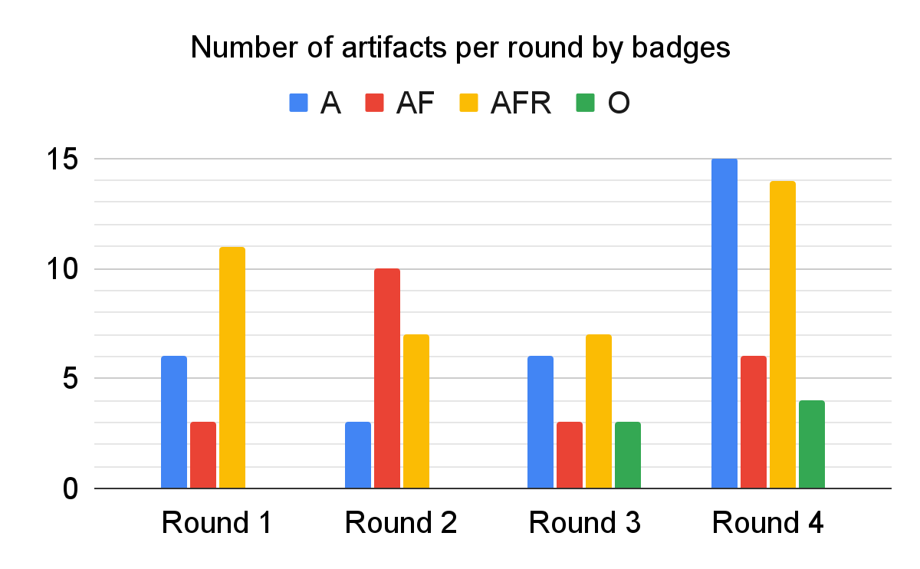
Notes:
We see a variation in the number of artifacts that are going for each category of badges by the round number.
I should note that the O category refers to artifacts that are yet to be accepted.
We find that the Artifact badge suddenly becomes rather popular in the last round, as people are scramming to meet the deadlines and prepare for the conference.
We have a lot of artifacts — between 10 and 20, counting the non-accepted ones — going for all three badges in the initial and final rounds.
We plan to use this data to assign reviewers for the next cycle.

Slide 7
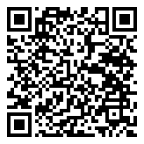
Artifact Evaluation Committee 2025/2026
Outgoing: Maximilian Noppel, Karlsruhe Institute of Technology
Me: Miti Mazmudar, University of Waterloo / Calgary
Incoming: Yohan Beugin, University of Wisconsin-Madison
Let’s thank Max for his service & let’s welcome Yohan!
Fill out the self-nomination form to volunteer for the artifact PC for PETS 2026 (on PETS website too)

Slide 8
Planned improvements
Aligning artifact review process with the paper review process.
Ensuring responsive reviews.
Acknowledging artifact reviewers in the editor’s intro for each issue?
Will discuss the items below in the BoF session on Wednesday 1:30-3pm.
Providing guidance for authors and reviewers (lots of this for the 2026 cycle): Templates for Dockerfiles, dealing with large datasets & multiple repositories per artifact, etc.
Improving HotCRP: submission & review form fields.
Access to infrastructure for reproducibility: IoT devices, VMs.
Fill out the self-nomination form to volunteer for the artifact PC for PETS 2026 (on PETS website too)
Notes:
Currently, the artifact submission deadline is 3 weeks after the paper acceptance notification for that round. But in practice, we have waited until we receive the list of papers from the “Revise” decision as well from the PC chairs, so each round is delayed to 4-5 weeks from the initial set of acceptance notifications. This backloads the last round and we had 40 artifacts in the last round, which was difficult to manage. The plan for the next year is to make the artifact HotCRP instance available at this 3 week period, and the authors whose revisions will be accepted will have one week less to prepare their artifacts, but they also have the option for submitting to the next round — for rounds 1 to 3 at least.
We also had non-responsive reviewers — so this includes both reviewers who finish significantly later, don’t submit at all, or don’t respond to authors’ changes. We’re rewarding distinguished reviewers, we’re being selective in who we invite to the committee. We’ll email more frequently. We’re gonna have shepherd for each artifact who’ll ensure that the artifact gets finalized.
There are also three more categories of planned improvements. We’ll discuss these in the BoF session.

Slide 9
For Awards ceremony

Slide 10
Runner-ups for Best PETS Artifact Award for 2025
Janus: Fast Privacy-Preserving Data Provenance For TLS
Jan Lauinger, Jens Ernstberger, Andreas Finkenzeller, Sebastian Steinhorst
Optimal Piecewise-based Mechanism for Collecting Bounded Numerical Data under Local Differential Privacy
Ye Zheng, Sumita Mishra, Yidan Hu
MProve-Nova: A Privacy-Preserving Proof of Reserves Protocol for Monero
Varun Thakore, Saravanan Vijayakumaran
PrePaMS: Privacy-Preserving Participant Management System for Studies with Rewards & Prerequisites
Echo Meißner, Frank Kargl, Benjamin Erb, Felix Engelmann
Navigating Social Media Privacy
Pithayuth Charnsethikul, Almajd Zunquti, Gale Lucas, Jelena Mirkovic
Notes:
All papers received all three badges.

Slide 11
Best PETS Artifact Award for 2025
PIGEON: A High Throughput Framework for Private Inference of Neural Networks using Secure Multiparty Computation
Badges: Available, Functional & Reproduced
Christopher Harth-Kitzerow (Technical University of Munich (TUM), BMW Group), Yongqin Wang (University of Southern California), Rachit Rajat (University of Southern California), Georg Carle (Technical University of Munich (TUM)), Murali Annavaram (University of Southern California)
Notes:
PIGEON: A High Throughput Framework for Private Inference of Neural Networks using Secure Multiparty Computation
Pigeon is a great example of an artifact that is both useful to reproduce the main results of the paper and is extensible for further development. The authors of this paper have also submitted code for other components of their High Performance MPC library for artifact review at PETS, and we hope that this library will be useful for the community in the future.

Slide 12
What makes a good artifact reviewer?
Providing actionable items & questions for each badge.
Following up and responding to authors’ comments in a timely manner.
Rerunning the artifact after the authors’ changes and finalizing the artifact.
Going above & beyond: Reviewers who have volunteered for artifacts that require hardware resources etc.
New in 2025: Distinguished Artifact Reviewers!

Slide 13
Distinguished artifact reviewers for 2025
- Mir Masood Ali
- Yohan Beugin
- Darion Cassel
- Panos Chatzigiannis
- Marc Damie
- Kasra Edalatnejad
- Yongming Fan
- Preston Haffey
- Simon Koch
- Elena Long
- Caterina Maidhof
- Alexandra Nisenoff
- Nathan Reitinger
- Guruprasad Viswanathan Ramesh
- Arul Thileeban Sagayam
- Harshal Shah
- Malte Wessels

Slide 14
We thank our infrastructure chairs!
Artifact Infrastructure Chair:
Tobias Fiebig, Max Planck Institute for Informatics
Administered the VMs for Artifact Review through HotCRP.
PETS Infrastructure chairs:
Ian Goldberg, University of Waterloo
Handled our HotCRP instances for Artifact Review.
Notes:
measurement.network

Slide 15
For BoF session

Slide 16
Planned improvements
Three categories:
Providing guidance for authors and reviewers (lots of this for the 2026 cycle)
Updating the Artifact Review page on the PETS website.
Updating our email templates for artifact submissions, bidding and reviews.
Improving HotCRP: submission & review form fields.
Access to infrastructure for reproducibility.

Slide 17
Providing guidance for reviewers
What makes a good review?
Providing actionable items & questions for each badge.
Following up and responding to authors’ comments in a timely manner.
Rerunning the artifact after the authors’ changes and finalizing the artifact.
Formalizing criteria for the “Award Worthiness” option in the HotCRP review form.

Slide 18
Providing guidance for authors
Dealing with large datasets: Artifacts still(!) use Google Drive links for datasets
GitHub has a 100MiB file size limit. Trying to use Git LFS for large files still runs into this problem (2GB limit).
Artifacts have used Zenodo & HuggingFace.
For Zenodo, the per record limitation is 50GB / 100 files + one-time quota increase up to 200GB per record
We plan to recommend Zenodo for hosting datasets
An alternative is using OCI artifacts, especially for AI/ML models.
Artifacts that involve multiple repositories
We can only point to one repository; our recommendation is to use Git submodules.

Slide 19
Providing guidance for authors
Should I focus on having a good Dockerfile or a Docker image or a VM?
Use a VM only if Docker does not work (e.g. Tor / Shadow VM artifacts)
Always focus on a good Dockerfile.
We will provide Dockerfile templates based on popular setups that we’ve encountered e.g., privacy-preserving ML artifacts that require Nvidia CUDA, virtual network with docker compose, etc.
We will link to examples for CI workflows so that the Docker image can be automatically built and packaged for you, based on the Dockerfile.
Authors can use these templates early on in their project, so that it’s easy for them to work with (and not just for the AE process).
The goal is to remove cognitive burden from authors so that they can focus on their work and not on how-to-containerize.

Slide 20
HotCRP improvements (1/3)
Author-facing changes — new submission form fields as follows:
Field for the final artifact link, after authors implement changes & reviewers approve: This will help the process of updating the website with the necessary badges & links.
Artifacts that require temporary access credentials such as Cloud API keys, SSH keys, etc.: Authors will be expected to provide this in a new field in the submission.
Enable authors to rate reviews on HotCRP.

Slide 21
HotCRP improvements (2/3)
Reviewer-facing changes:
Bidding process: Incorporate whether the reviewers have access to matching resources for the artifact.
Assigning one reviewer per artifact as a shepherd — to finalize the artifact.
Number of reviewers per artifact ∝ number of badges: 1 for Available, 2 for Functional, 2 or 3 for Reproduced
Improve accountability to others in the PC & exemplify good reviews:
For the assigned artifact, the reviewers should be able to see other reviewers’ names.
Allow any reviewer to see comments & discussions (not reviewer / author names) on other artifacts.

Slide 22
HotCRP improvements (2/3)
Reviewer-facing changes:
Review form: Separate sections for the reviewers’ notes for each badge (Available, Functional, Reproduced).
Other minor improvements to make the reviewers & chairs’ life easier:
HotCRP feature that doesn’t let reviewers view authors’ responses until they submit a review
Use HotCRP’s “Collect final submissions” feature to help make a CSV with artifact links.

Slide 23
Access to infrastructure for reproducibility
Access to IoT devices: We’ve reviewed 2 artifacts by video call, since reviewers didn’t have access to the devices.
Authors of papers on IoT / hardware S&P are advised to join the AEC process & volunteer their university hardware resources for scientific reproducibility.
Will talk to other AECs on how they handle reviews that require access to devices.
VMs: In some rounds, we’ve run out of GPU VMs as there are only two.
We are in talks with people from the SPHERE (Security and Privacy Heterogeneous Environment for Reproducible Experimentation) project: https://sphere-project.net/

Slide 24
Questions for BoF attendees
You have a paper at PETS but did not submit an artifact? We would be curious to hear from you to see if we could make some changes.
Your code/dataset is released publicly but you did not apply for the “Available” badge? Please reach out to the artifact chairs.
Other suggestions?
Fill out the self-nomination form to volunteer for the artifact PC for PETS 2026 (on PETS website too)

