Slide 1

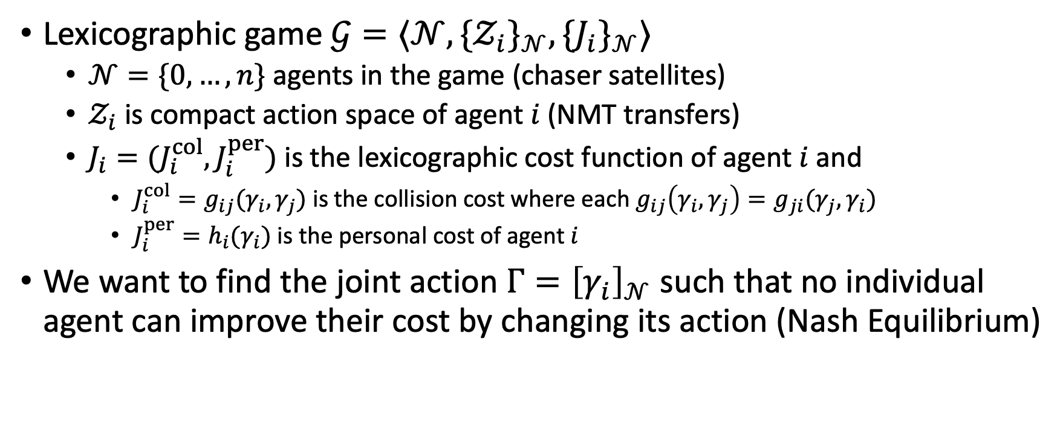
Casting the satellite APO problem as a game
Lexicographic pair
$\left(a,b\right)≼(c,d)$ if:
1. $a<c$ or
2. $a=c$ and $b≤d$
Lexicographic game $𝒢=⟨𝒩,\{{𝒵_{i}\}}_{𝒩},\{J_{i}\}_{𝒩}⟩$
$𝒩=\{0,…,n\}$ agents in the game (chaser satellites)
$𝒵_{i}$ is compact action space of agent $i$ (NMT transfers)
$J_{i}=(J_{i}^{col},J_{i}^{per})$ is the lexicographic cost function of agent $i$ and
$J_{i}^{col}=g_{ij}(γ_{i},γ_{j})$ is the collision cost where each $g_{ij}\left(γ_{i},γ_{j}\right)=g_{ji}(γ_{j},γ_{i})$
$J_{i}^{per}=h_{i}(γ_{i})$ is the personal cost of agent $i$
We want to find the joint action $Γ={\left[γ_{i}\right]}_{𝒩}$ such that no individual agent can improve their cost by changing its action (Nash Equilibrium)

Slide 2

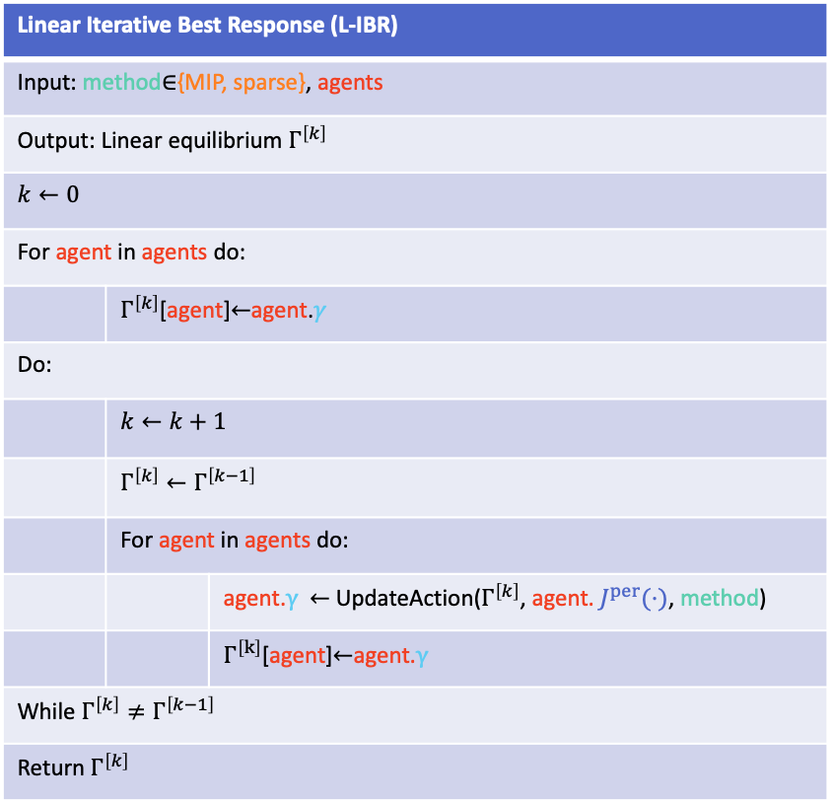


Linear Iterative Best Response
Linear Iterative Best Response (L-IBR)
Input: method$∈${MIP, sparse}, agents
Output: Linear equilibrium $Γ^{\left[k\right]}$
$$k←0$$
For agent in agents do:
 | $Γ^{\left[k\right]}$[agent]$←$agent.$γ$
Do:
 | $$k←k+1$$
 | $$Γ^{\left[k\right]}←Γ^{\left[k−1\right]}$$
 | For agent in agents do:
 |  | agent.$γ$ $←$UpdateAction($Γ^{\left[k\right]}$, agent. $J^{per}(⋅)$, method)
 |  | $Γ^{\left[k\right]}$[agent]$←$agent.$γ$
While $Γ^{\left[k\right]}≠Γ^{\left[k−1\right]}$
Return $Γ^{\left[k\right]}$
L-IBR
Agent
Agent 0
Agent 1
…
Agent N
$$\dot{x}=f(x,u)$$
$$J^{per}(⋅)$$
Update Action
$$γ$$
MIP
Sparse

Slide 3


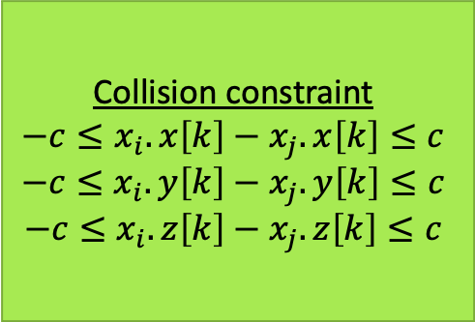

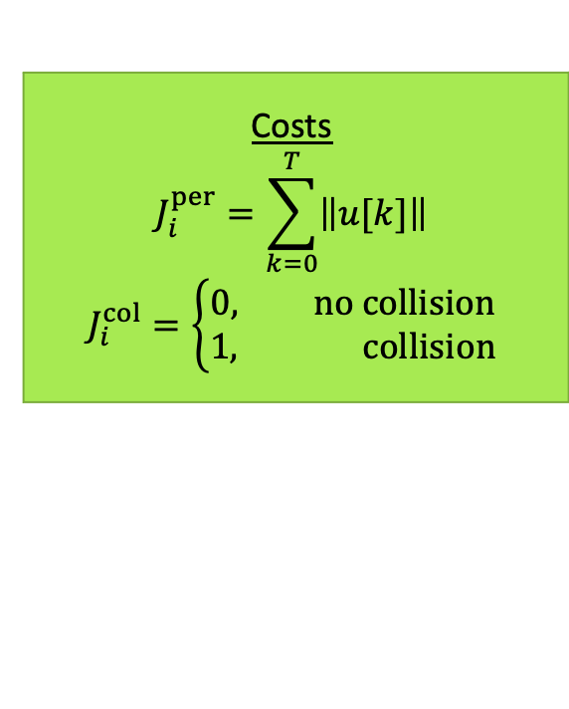
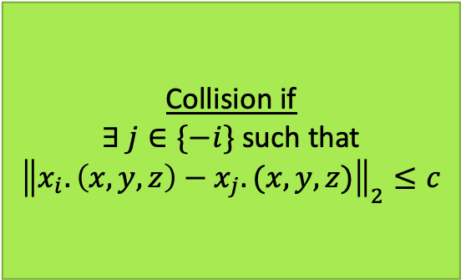
Linearizing the collision constraint
Costs
$$J_{i}^{per}=\sum_{k=0}^{T}{\left\|u[k]\right\|}$$
$$J_{i}^{col}=\left\{\begin{aligned}0, no collision \\ 1, collision\end{aligned}\right.$$
Collision constraint
$$−c≤x_{i}.x\left[k\right]−x_{j}.x\left[k\right]≤c$$
$$−c≤x_{i}.y\left[k\right]−x_{j}.y\left[k\right]≤c$$
$$−c≤x_{i}.z\left[k\right]−x_{j}.z\left[k\right]≤c$$
$$c$$
$$c$$
Collision if
$∃ j∈\{−i\}$ such that ${\left\|x_{i}.\left(x,y,z\right)−x_{j}.(x,y,z)\right\|}_{2}≤c$
Linearize using axis-aligned bounding box

Slide 4

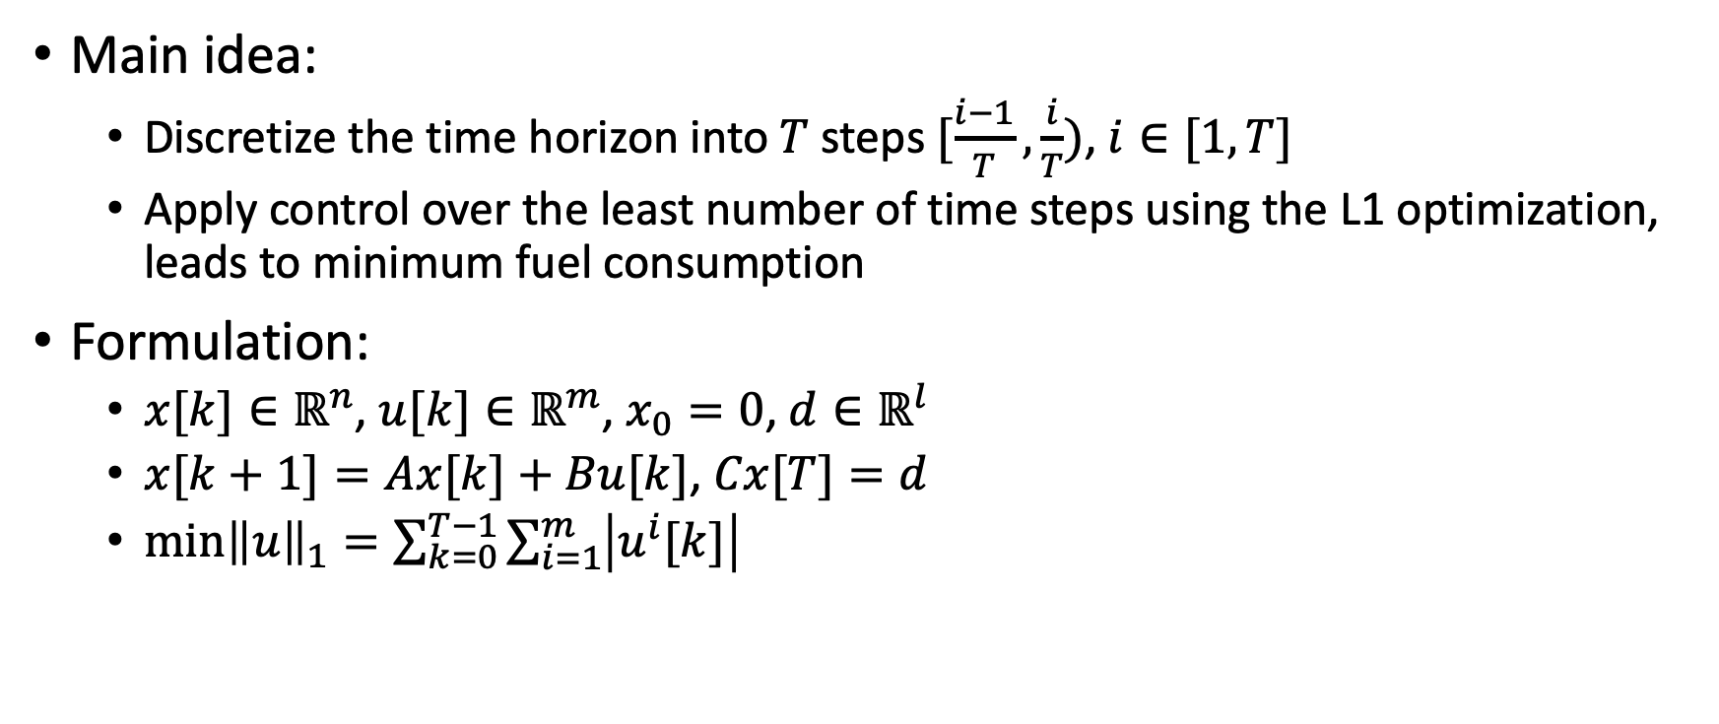
Sparse formulation
Main idea:
Discretize the time horizon into $T$ steps $[\frac{i−1}{T}, \frac{i}{T})$, $i∈[1, T]$
Apply control over the least number of time steps using the L1 optimization, leads to minimum fuel consumption
Formulation:
$x[k]∈ℝ^{n}$, $u[k]∈ℝ^{m}$, $x_{0}=0$, $d∈ℝ^{l}$
$x[k+1]=Ax[k]+Bu[k]$, $Cx[T]=d$
$\min{{\left\|u\right\|}_{1}}=\sum_{k=0}^{T−1}{\sum_{i=1}^{m}{\left|u^{i}[k]\right|}}$
Collision constraint
$$−c≤x_{i}.x\left[k\right]−x_{j}.x\left[k\right]≤c$$
$$−c≤x_{i}.y\left[k\right]−x_{j}.y\left[k\right]≤c$$
$$−c≤x_{i}.z\left[k\right]−x_{j}.z\left[k\right]≤c$$

Slide 5
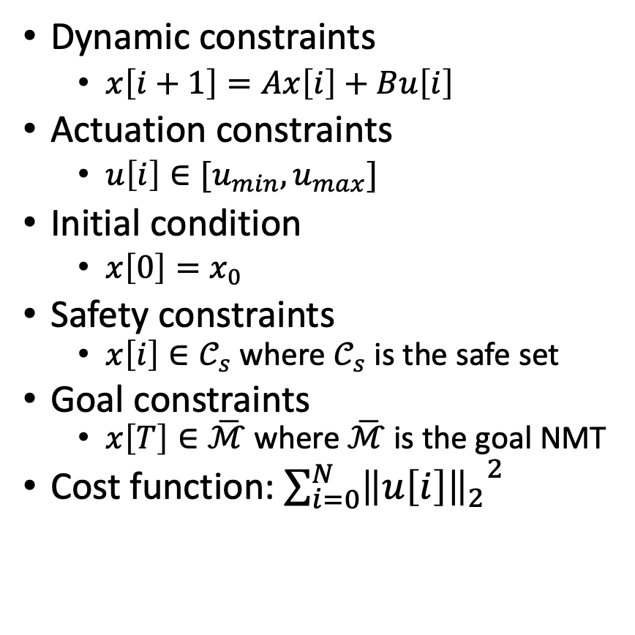
MIP formulation
Dynamic constraints
$x\left[i+1\right]=Ax\left[i\right]+Bu\left[i\right]$
Actuation constraints
$u\left[i\right]∈[u_{min}, u_{max}]$
Initial condition
$x\left[0\right]=x_{0}$
Safety constraints
$x\left[i\right]∈𝒞_{s}$ where $𝒞_{s}$ is the safe set
Goal constraints
$x\left[T\right]∈\overline{ℳ}$ where $\overline{ℳ}$ is the goal NMT
Cost function: $\sum_{i=0}^{N}{{{\left\|u\left[i\right]\right\|}_{2}}^{2}}$
Here, we try to directly minimize the fuel cost using the L2 norm
Collision constraint
$$−c≤x_{i}.x\left[k\right]−x_{j}.x\left[k\right]≤c$$
$$−c≤x_{i}.y\left[k\right]−x_{j}.y\left[k\right]≤c$$
$$−c≤x_{i}.z\left[k\right]−x_{j}.z\left[k\right]≤c$$

Slide 6
Experimental setup
Ideate several interesting APO examples, ranging from 2 chasers to 10? chasers
Show agent trajectories during APO missions
Show computational time between MIP and sparse formulations
Show fuel costs between MIP and sparse formulations

Slide 7
Progress
Done
To do
Prototype sparse and MIP formulations finished
Agent class created
Skeleton of L-IBR
Flesh out L-IBR, make it easier to use
Fix sparse controller
Clean up MIP formulation
Write up documentation

