Slide 1
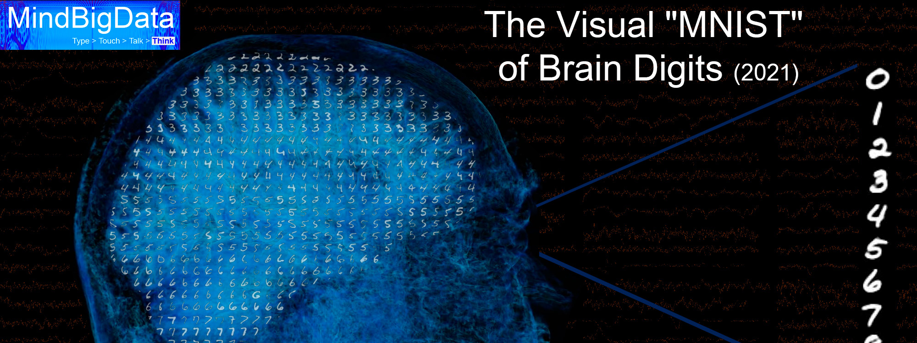
The Visual "MNIST" of Brain Digits
Nitzan Shitrit
Priel Salomon

Slide 2
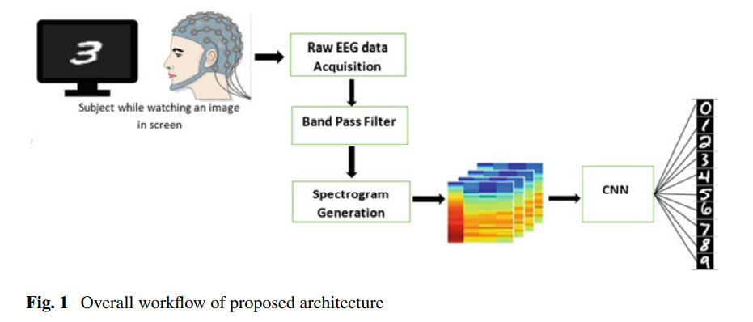
Introduction

Slide 3
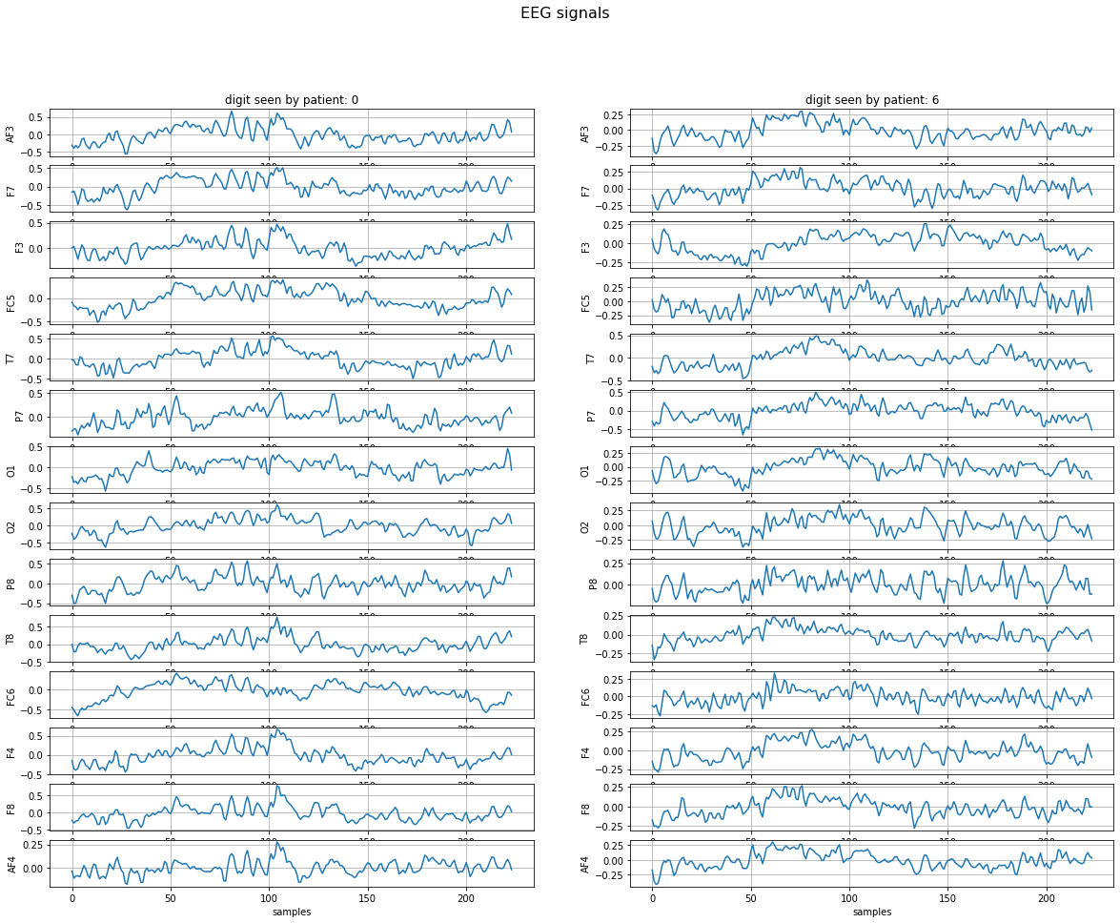
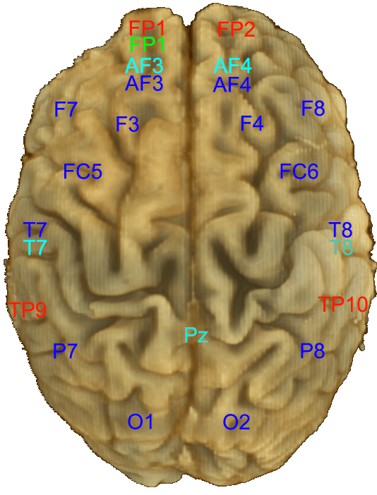
The Dataset
Data set is composed of records of 2s of EEG signals sampled at 128Hz using non-medical grade headsets.
The subject was presented digits (0 - 9) on a computer and tried to focus on the digit for 2sec.
Data include subject identity, brain location of the signal, number of samples and more.
labels include digit been thought/seen, with possible values 0,1,2,3,4,5,6,7,8,9 or -1 for random captured signals not related to any of the digits.
BRAIN LOCATIONS:
Each EEG device capture the signals via different sensors, located in these areas of the brain.
We used EPOC with 14 channels, as described in the following figure, marked with blue colour.

Slide 4
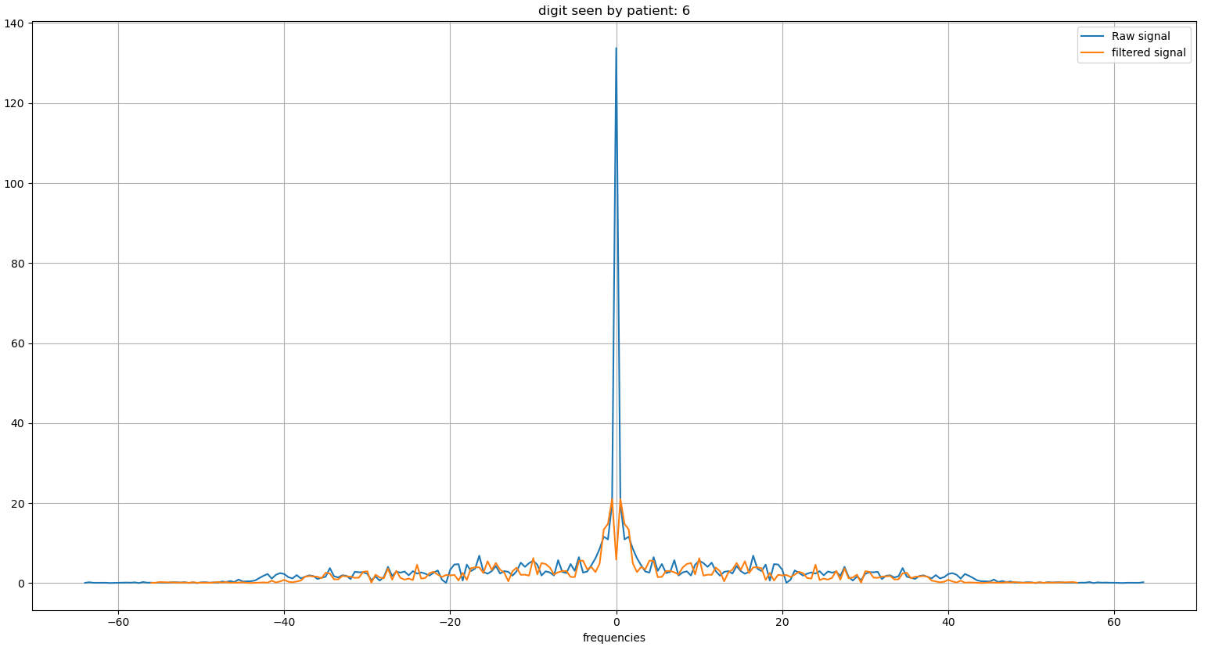
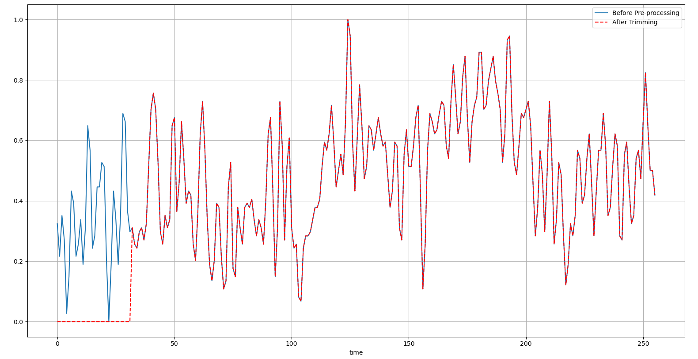
Pre-processing EEG data
Applying 6th order Butterworth filter between 0.5-63Hz and notch filter at 50Hz to get the frequency bands that consists the data we are interested in.
Trimming 250ms of the begging of the signal, to avoid sensor power on noise.
Scaling and Standardization of input data.

Slide 5




Baseline

Slide 6
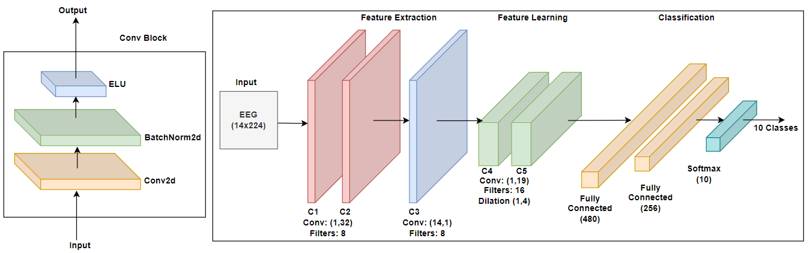
CNN Architecture
C4 & C5 are used
for feature Learning
C1 & C2 blocks extracts the spectral representation of the EEG input.
C3 block conducts spatial filtering, as it performs convolutions across channels.
The final fully connected layers used for classification into 10 labels.

Slide 7
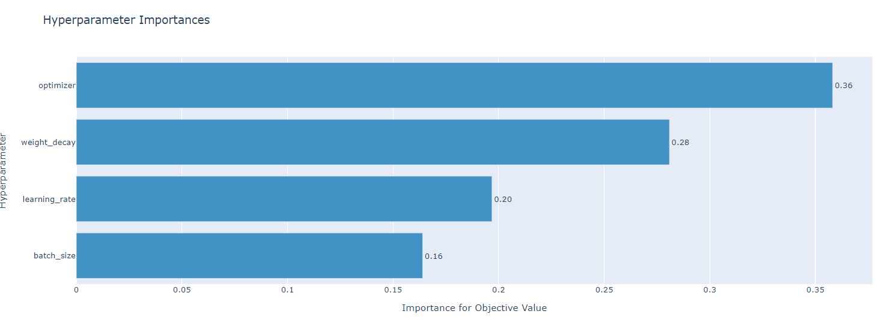
Training
Hyperparameters optimized using Optuna:
learning_rate: 0.06126780713210273
weight_decay: 0.0009132236890722897
batch_size: 215
optimizer: SGD

Slide 8
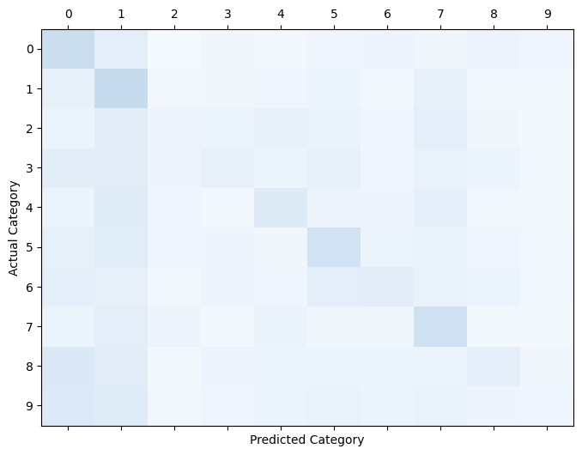
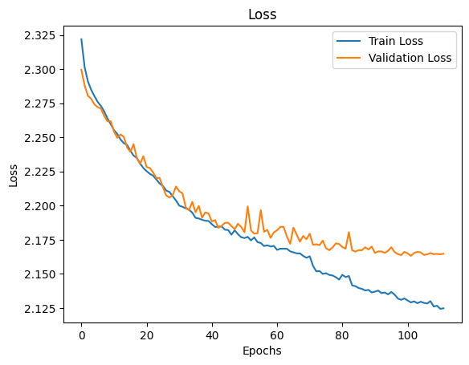
Results - CNN
Test Accuracy: 20.992%
2025/05/22
2025/05/22

Slide 9
Comparison of Previous Work
Research | Methodology | Accuracy (%)
Bird et al. [1] | LSTM | 27.0718
Grover et al. [2] | GRU | 33.8
Previous work | CNN | 20.432
CNN+Bandpass+Normalization | CNN | 20.992
Notes:
[1] Jordan J. Bird, A Deep Evolutionary Approach to Bioinspired Classifier Optimisation for Brain-Machine Interaction, School of Engineering and Applied Science, Aston University, Birmingham B4 7ET, UK
[2] Manraj S. Grover Universal EEG Encoder for Learning Diverse Intelligent Tasks, MIDAS Lab, IIIT-Delhi

Slide 10
Conclusion
The proposed CNN model was able to classify the inputs extracted from the MindBigData dataset to identify 10 different classes based on the digit that the subject was viewing while the EEG was captured.
A future extension to the work may include testing the model on other datasets acquired through different visual stimuli.
Application wise, this technique can find varied implementations in the field of brain fingerprinting and early abnormality detection in children by asking them to visualize any object that is shown to them on screen.

Slide 11

Thank You

