Slide 1
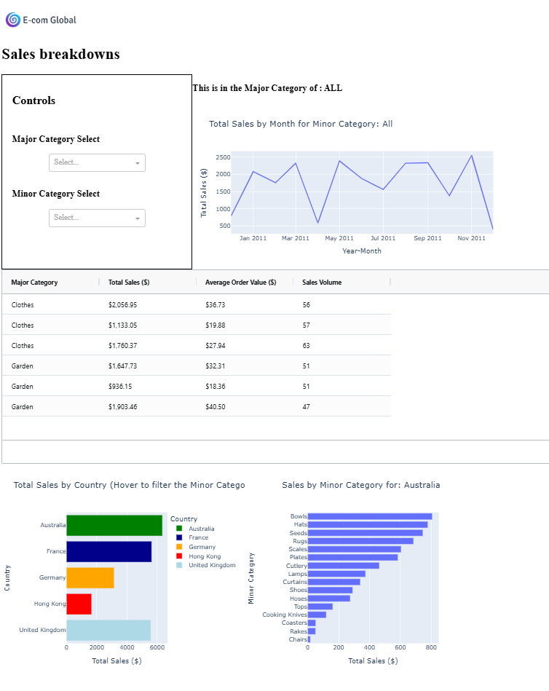
A line chart of monthly sales filtered by major and minor categories.
A dropdown for each category, where the minor options update based on the major selection.
A table showing aggregated stats for those categories.
A bar chart of total sales by country.
Another bar chart showing minor category sales that updates when hovering over the country chart.

Slide 2
app.layout = [
html.Img(src=logo_link, style={'margin':'30px 0px 0px 0px' }),
html.H1('Sales breakdowns'),
html.Div([
html.H2('Controls'),
html.Br(),
html.H3('Major Category Select'),
dcc.Dropdown(id='major_cat_dd',
options=[{'label':category, 'value':category} for category in major_categories],
style={'width':'200px', 'margin':'0 auto'}),
html.Br(),
html.H3('Minor Category Select'),
dcc.Dropdown(id='minor_cat_dd', style={'width':'200px', 'margin':'0 auto'})],
style={'width':'350px', 'height':'360px', 'display':'inline-block', 'vertical-align':'top', 'border':'1px solid black', 'padding':'20px'}),
html.Div([
html.H3(id='chosen_major_cat_title'),
dcc.Graph(id='sales_line')],
style={'width':'700px', 'height':'380px','display':'inline-block', 'margin-bottom':'5px'}),
# Insert the AG Grid
grid,
html.Div([
html.Div(dcc.Graph(id='major_cat', figure=bar_fig_country), style={'display':'inline-block'}),
html.Div(dcc.Graph(id='minor_cat'), style={'display':'inline-block'})],
style={'width':'1000px', 'height':'650px','display':'inline-block'})
]

Slide 3
@callback(
Output('minor_cat_dd', 'options'),
Output('chosen_major_cat_title', 'children'),
Input('major_cat_dd', 'value'))
def update_dd(major_cat_dd):
major_minor = ecom_sales[['Major Category', 'Minor Category']].drop_duplicates()
relevant_minor = major_minor[major_minor['Major Category'] == major_cat_dd]['Minor Category'].values.tolist()
minor_options = [dict(label=x, value=x) for x in relevant_minor]
if not major_cat_dd:
major_cat_dd = 'ALL'
major_cat_title = f'This is in the Major Category of : {major_cat_dd}'
return minor_options, major_cat_title
@callback(
Output('sales_line', 'figure'),
Input('minor_cat_dd', 'value'))
def update_line(minor_cat):
minor_cat_title = 'All'
ecom_line = ecom_sales.copy()
if minor_cat:
minor_cat_title = minor_cat
ecom_line = ecom_line[ecom_line['Minor Category'] == minor_cat]
ecom_line = ecom_line.groupby('Year-Month')['OrderValue'].agg('sum').reset_index(name='Total Sales ($)')
line_graph = px.line(ecom_line, x='Year-Month', y='Total Sales ($)', title=f'Total Sales by Month for Minor Category: {minor_cat_title}', height=350)
return line_graph

Slide 4
@callback(
Output('minor_cat', 'figure'),
Input('major_cat', 'hoverData'))
def update_min_cat_hover(hoverData):
hover_country = 'Australia'
if hoverData:
hover_country = hoverData['points'][0]['customdata'][0]
minor_cat_df = ecom_sales[ecom_sales['Country'] == hover_country]
minor_cat_agg = minor_cat_df.groupby('Minor Category')['OrderValue'].agg('sum').reset_index(name='Total Sales ($)')
ecom_bar_minor_cat = px.bar(minor_cat_agg, x='Total Sales ($)', y='Minor Category', orientation='h', height=450, width=480,title=f'Sales by Minor Category for: {hover_country}')
ecom_bar_minor_cat.update_layout({'yaxis':{'dtick':1, 'categoryorder':'total ascending'}, 'title':{'x':0.5}})
return ecom_bar_minor_cat

