Slide 1

SR University
Course : AI Assistant Coding
Instructor : Sallauddin Mohammed
Title : Event Management System
Team Details : Pochampally Varshitha (2303A51160)

Slide 2
SR University
Introduction :
The Event Management System is a web-based application designed to simplify the process of organizing and managing events. It allows users to view available events, register for them, and manage their participation through a centralized platform.
The system also includes an Admin Panel that enables administrators to create, update, and delete events, as well as monitor user registrations. This reduces manual effort and improves efficiency in event handling.

Slide 3
SR University
Objective :
To develop a web-based event management platform
To allow users to register and participate in events
To provide admin control for managing events
To ensure secure and efficient data handling
To demonstrate full-stack development skills

Slide 4
SR University
Stakeholders :
Users: Register and participate in events
Admin: Manage events and users
Developers: Maintain and improve the system
Organization: Use system for managing events efficiently

Slide 5
SR University
Technologies Used :
Frontend
HTML
CSS
JavaScript
Backend
Node.js
Express.js
Database
JSON (data.json)
Tools
GitHub
VS Code

Slide 6
SR University
AI Prompts Used :
“Debug JSON data handling issues in Express application”
“Create a user registration and login system using Node.js and Express”
“Build an event management API with CRUD operations”
“Design a simple HTML frontend for event dashboard”
“Fix authentication errors in Node.js backend”
“Connect frontend forms with backend API using fetch”
“Improve UI layout for event listing page”
“Create admin dashboard to manage events (add, delete, update)”

Slide 7
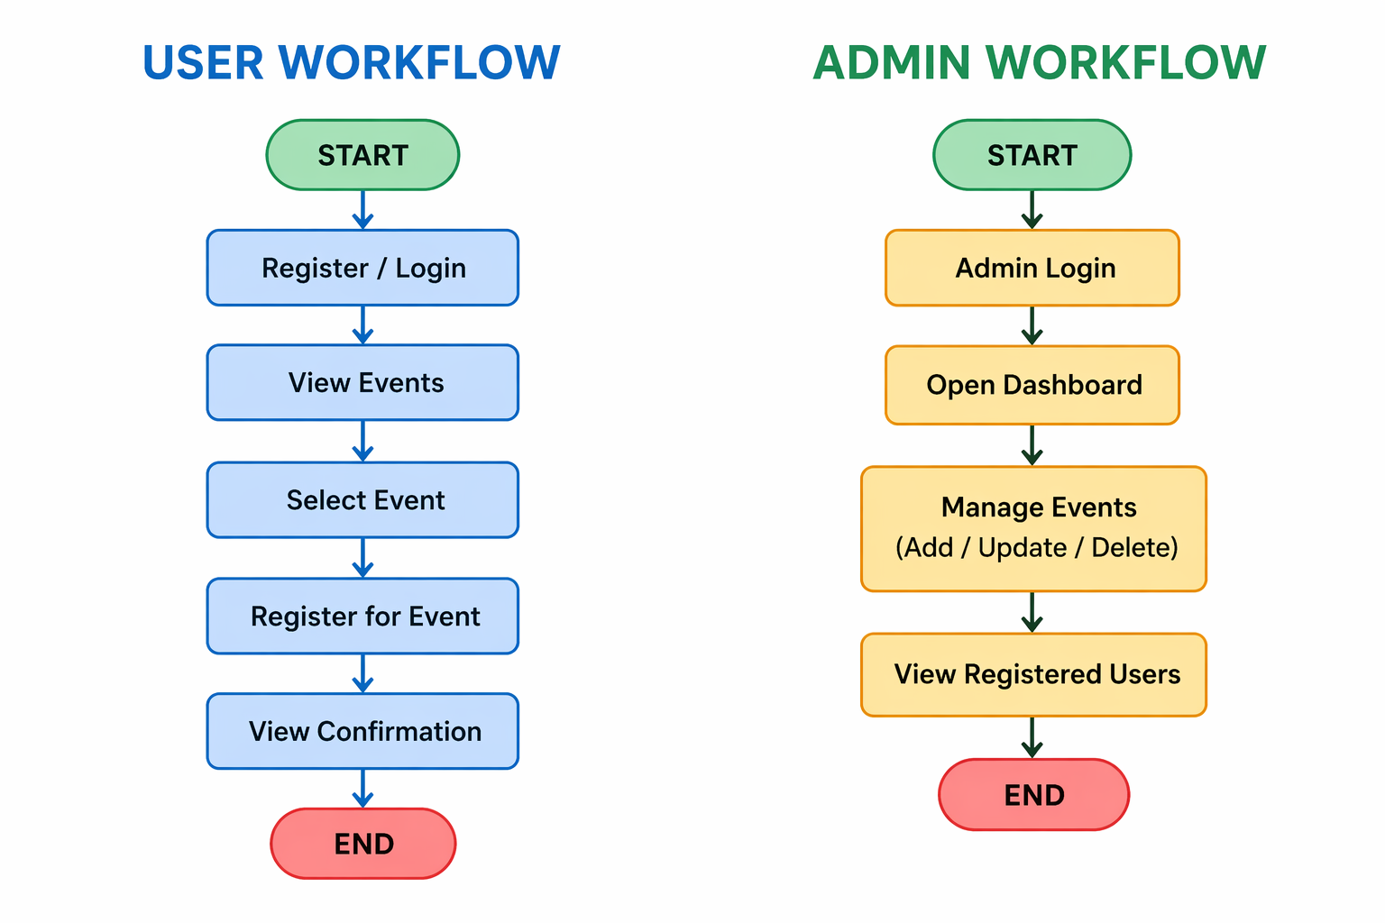
SR University

Slide 8

SR University

Slide 9

SR University

Slide 10
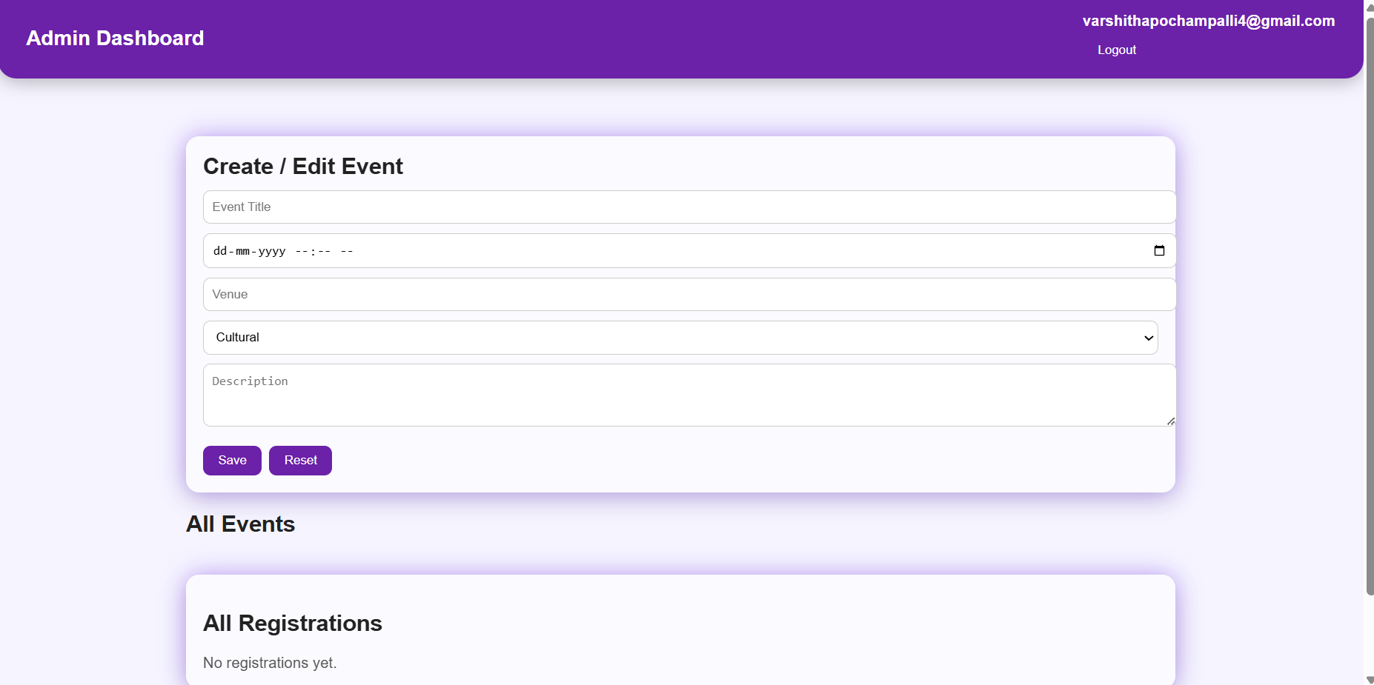
SR University

Slide 11
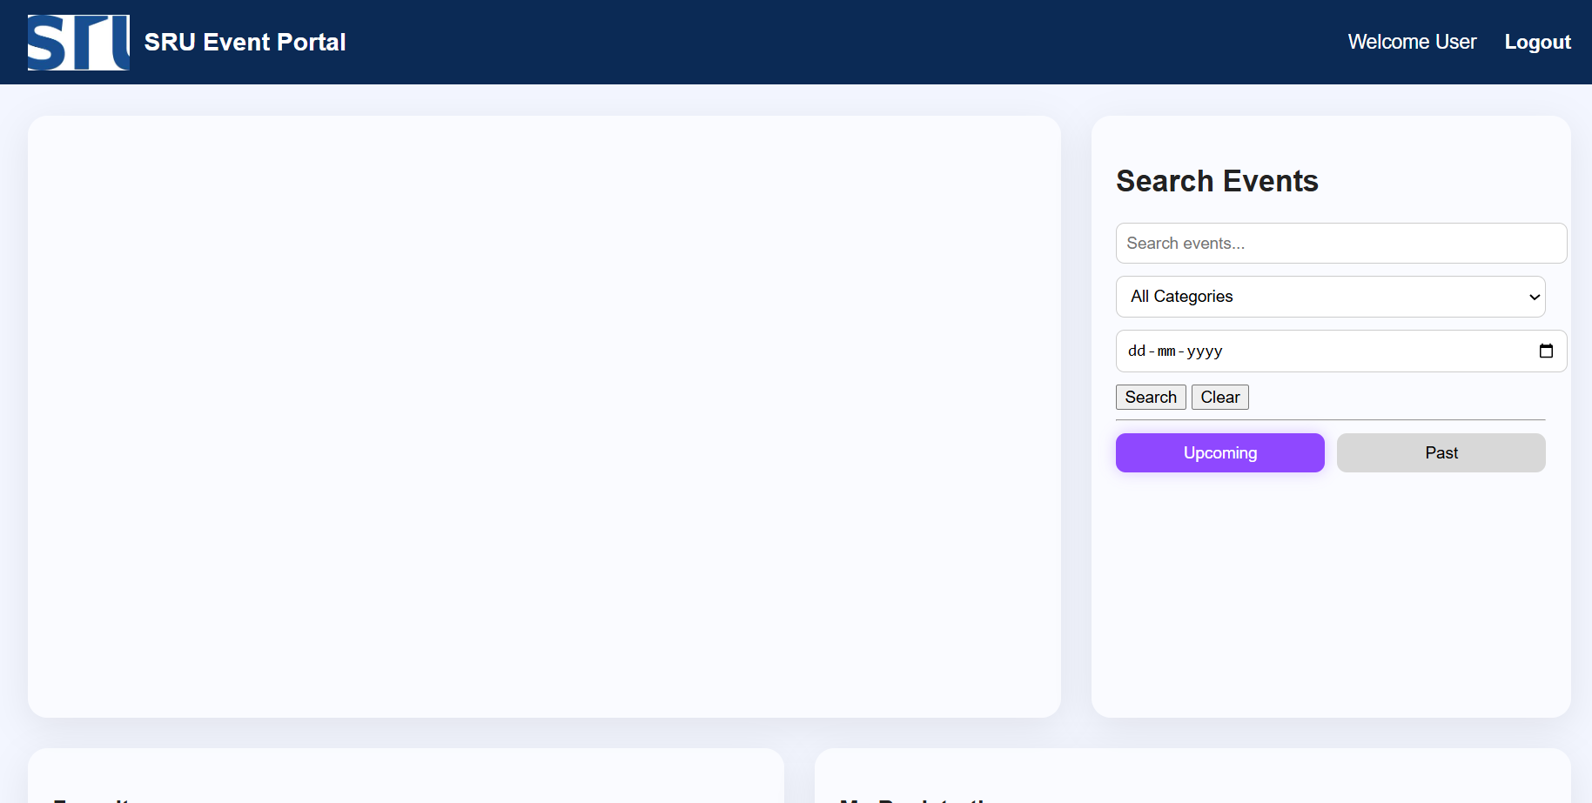
SR University

Slide 12
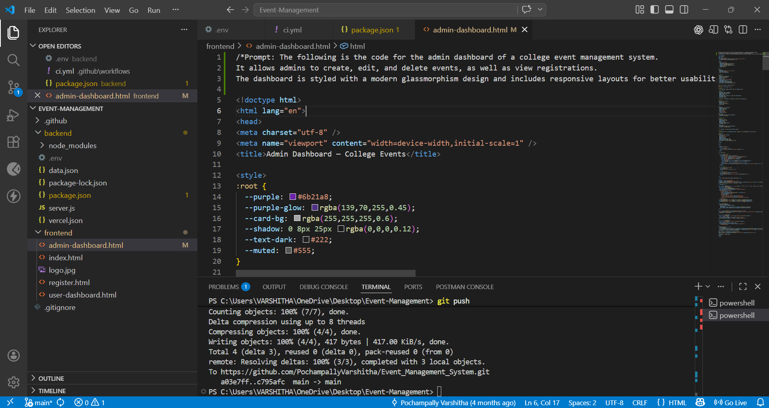
SR University
Proof Of AI Prompts :

Slide 13
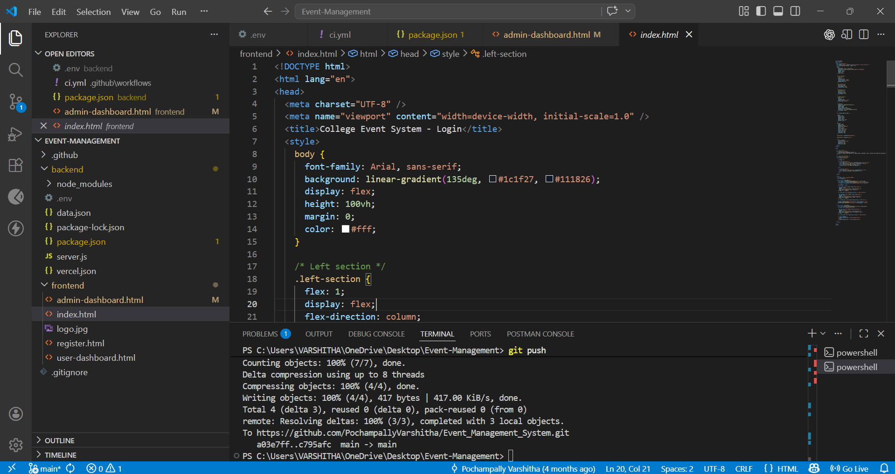
SR University

Slide 14
SR University
References
Node.js Official Documentation
Express.js Official Documentation
MDN Web Docs (HTML, CSS, JavaScript)
GitHub Documentation
OpenAI ChatGPT (for code assistance and debugging)
Stack Overflow (for troubleshooting and solutions)

Slide 15
SR University
Github Link
https://github.com/PochampallyVarshitha/Event_Management_System

Slide 16
SR University
THANK YOU!

