Slide 1
Core Proteins in Exocytosis and Endocytosis
Dong Liu and Wesley Maddox

Slide 2
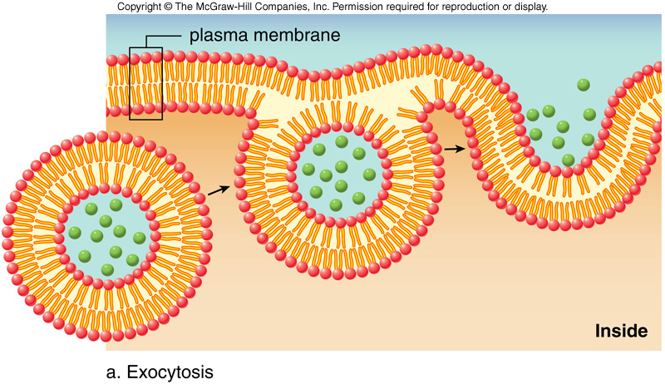
Exocytosis: cell directs the contents of secretory vesicles out of
the cell membrane and into the extracellular space.

Slide 3
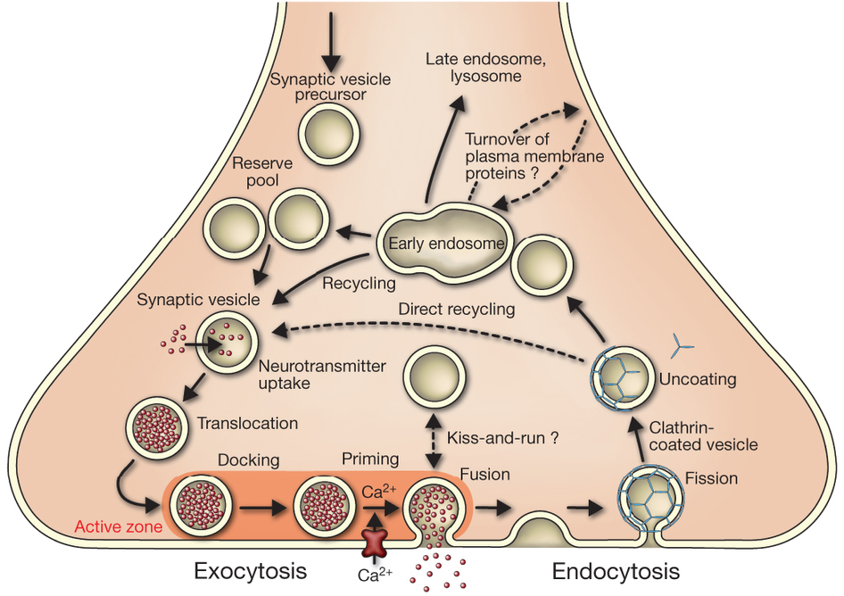
Exocytosis: complicate

Slide 4
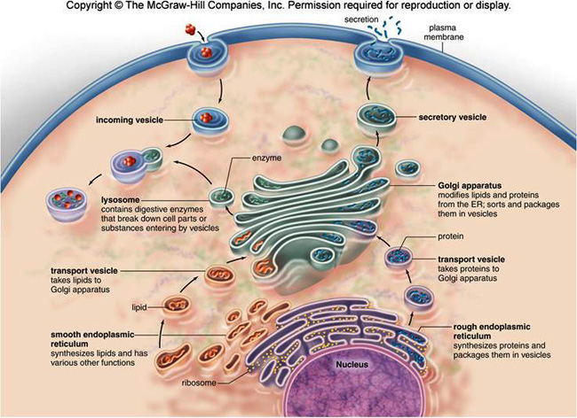
Exocytosis: very complicate

Slide 5
The project purpose
Find the core proteins connect the exocytosis and endocytosis.
Set up Exocytosis and Endocytosis PPI database
Computer analyze the database

Slide 6
Methods
First determine if there is evidence of a core structure
Then determine what the core proteins actually are

Slide 7
Methods
First determine if there is evidence of a core structure
Then determine what the core proteins actually are

Slide 8


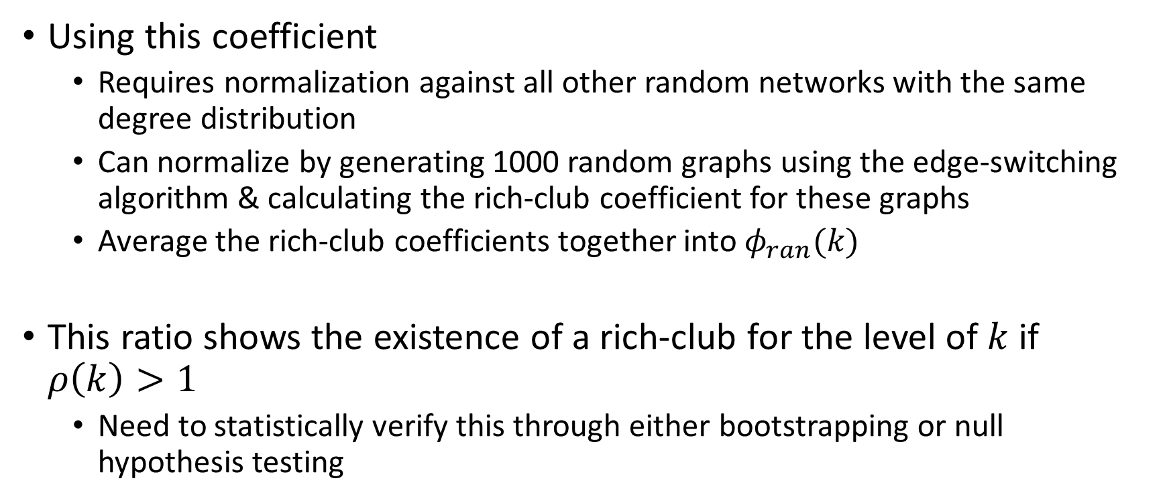
Rich-Club Coefficient
Using this coefficient
Requires normalization against all other random networks with the same degree distribution
Can normalize by generating 1000 random graphs using the edge-switching algorithm & calculating the rich-club coefficient for these graphs
Average the rich-club coefficients together into $φ_{ran}(k)$
This ratio shows the existence of a rich-club for the level of $k$ if $ρ\left(k\right)>1$
Need to statistically verify this through either bootstrapping or null hypothesis testing

Slide 9
Methods
First determine if there is evidence of a core structure
Then determine what the core proteins actually are
First Principal Components
Core/Periphery Analysis

Slide 10
Methods
First determine if there is evidence of a core structure
Then determine what the core proteins actually are
First Principal Components
Core/Periphery Analysis

Slide 11

Determination of “Core” Network Proteins: First Principal Components
First Principal Component: weighed measure that averages together 8 separate measures that describe a network
Includes:
Degree
Betweenness
Closeness
Clustering coefficient
K-shell decomposition
Eigenvector centrality
Semi-local centrality
Network motif centrality

Slide 12
Methods
First determine if there is evidence of a core structure
Then determine what the core proteins actually are
First Principal Components
Core/Periphery Analysis

Slide 13
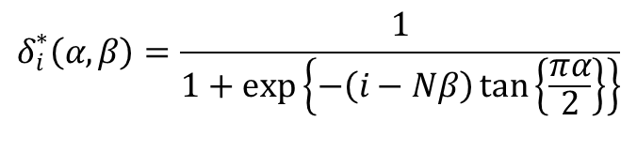
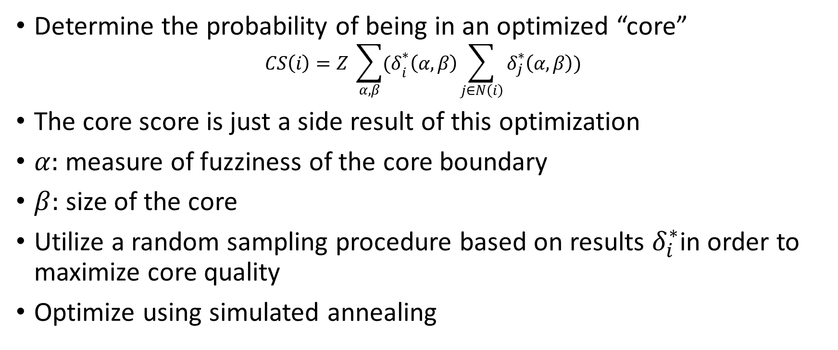
Determination of “Core” Network Proteins: Core/Periphery Analysis
Determine the probability of being in an optimized “core”
$$CS\left(i\right)=Z \sum_{α,β}{{(δ}_{i}^{∗}\left(α, β\right)\sum_{j∈N\left(i\right)}{δ_{j}^{∗}\left(α,β\right)})}$$
The core score is just a side result of this optimization
$α:$measure of fuzziness of the core boundary
$β:$ size of the core
Utilize a random sampling procedure based on results $δ_{i}^{∗}$in order to maximize core quality
Optimize using simulated annealing
$$δ_{i}^{∗}\left(α,β\right)=\frac{1}{1+\exp\left\{−\left(i−Nβ\right)\tan\left\{\frac{πα}{2}\right\}\right\}}$$

Slide 14
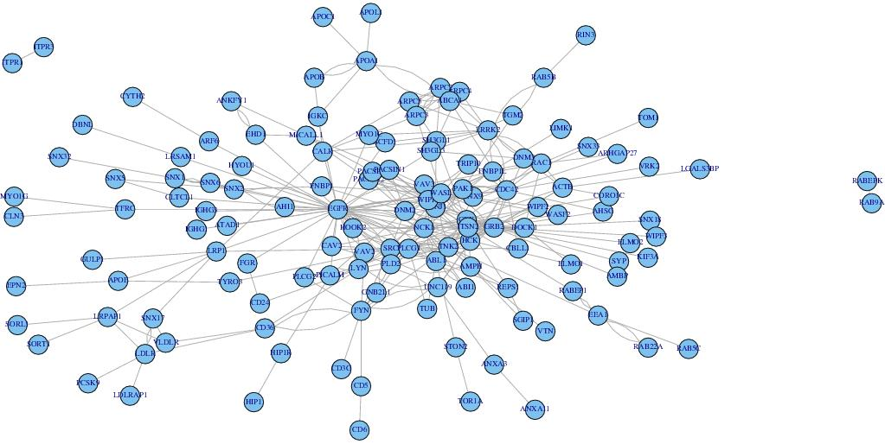
Result
Endocytosis
Top five FPC scores proteins:
TNK2: activation of CDC42
CDC42:GTPase of the Rho family
SRC: cell growth
GRB2: EGF receptor
EGFR: EGF receptor
Four subtyped category:
clathrin-mediated endocytosis
non-clathrin-mediated endocytosis
Macropinocytosis
Phagocytosis

Slide 15
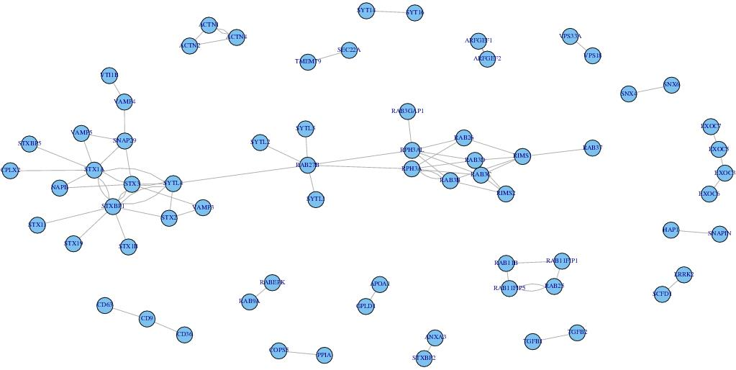
Result
Exocytosis
Top five FPC scores proteins:
RPH3AL: Rab GTPase effector
STXBP1: Syntaxin-binding protein 1
STX1A: vesicle fusion process
SYTL4: Synaptotagmin-like protein 4
RAB27B: vesicle fusion process
Conclusion: all the core proteins belong to SNARE complex,
which means SNARE complex is very important
SNARE complex fuse the vesicle into the membrane

Slide 16
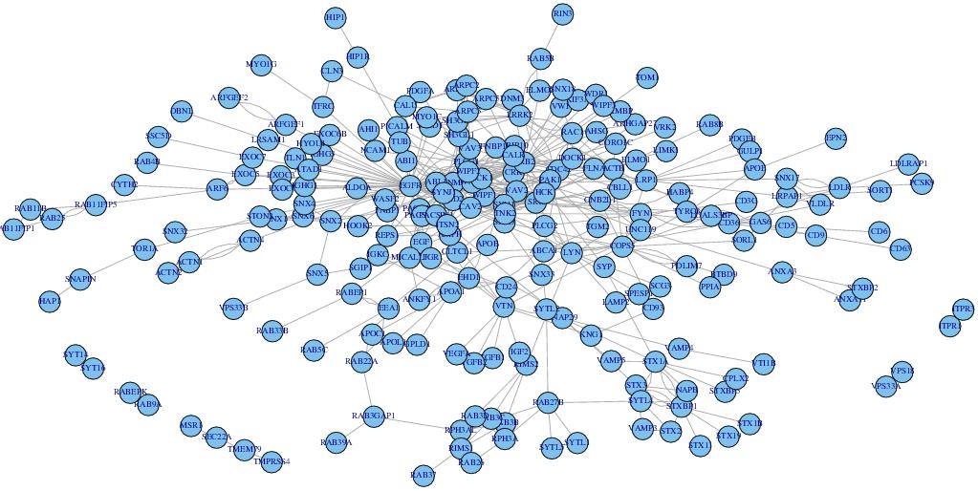
Result
Endocytosis or exocytosis
Top five FPC scores proteins:
COPS5: regulator of E3 ligase
LYN: association with receptor
SRC: cell growth
GRB2: EGF receptor
EGFR: EGF receptor
Conclusion: when we have the full sight of the network,
we find new core proteins for the regulation of the
exocytosis and endocytosis

Slide 17
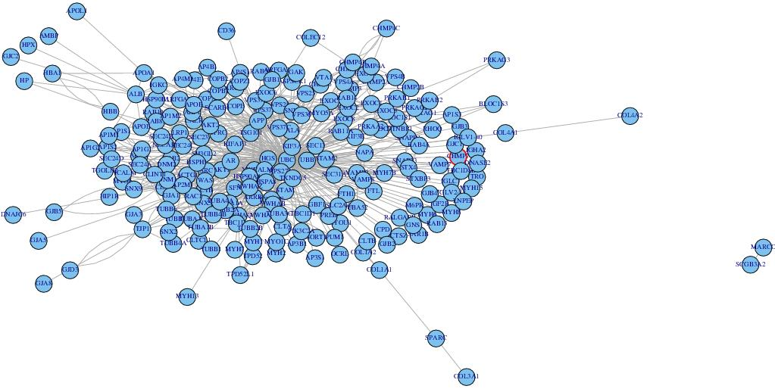
Result
Top five FPC scores proteins:
ALB: binding to water, Ca(2+), Na(+), K(+)
CLTC: Clathrin heavy chain 1
ARRB1: Arrestin beta 1
YWHAQ: mediate signal transduction
UBC: ubiquitin

Slide 18
Primary Validation
Sample validation procedure is to:
For each node in the network
Remove that node, perform the same analysis (FPC or core/periphery)
Combine the results from removing every node one at a time
Performed for each analysis type on each network

Slide 19
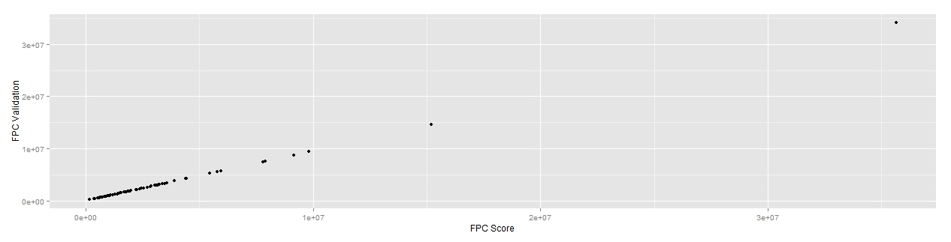
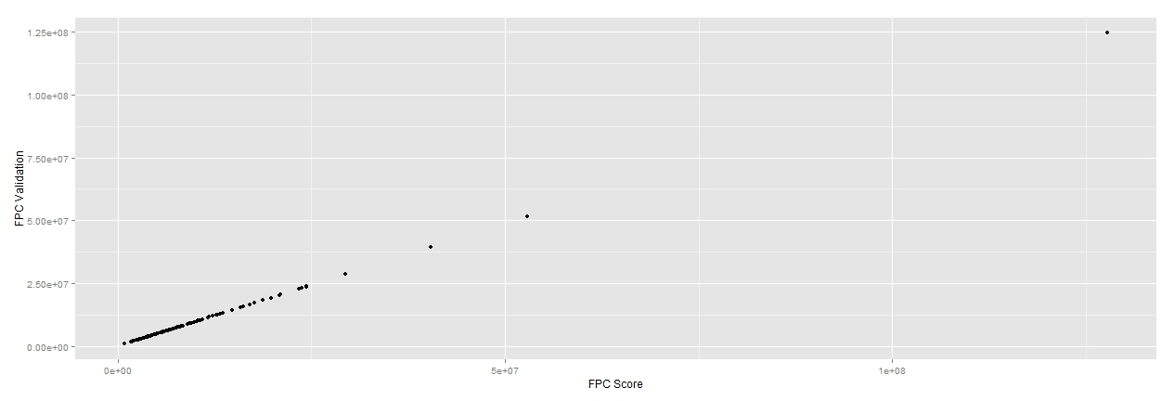
Results of Primary Validation
Endocytosis validation FPC score plotted against original FPC score
Full PPI Network validation FPC score plotted against original FPC score

Slide 20
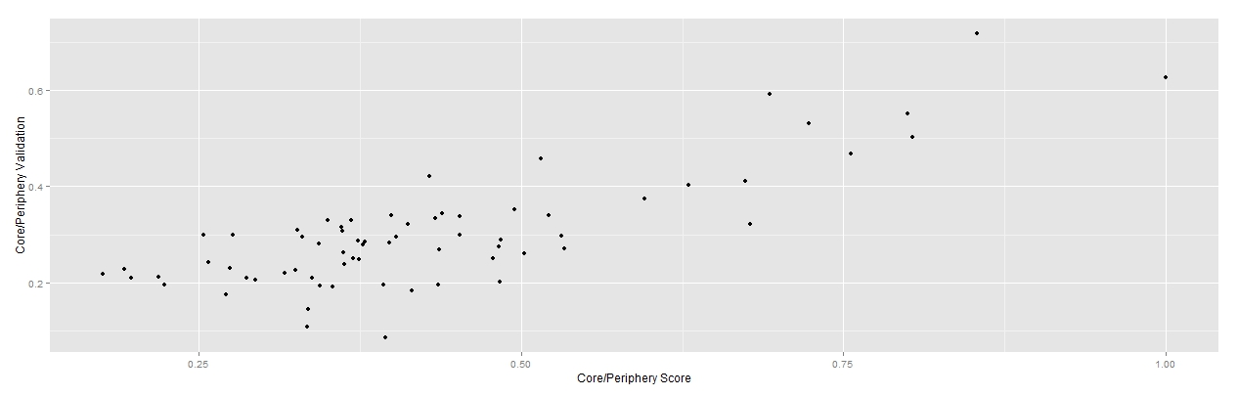
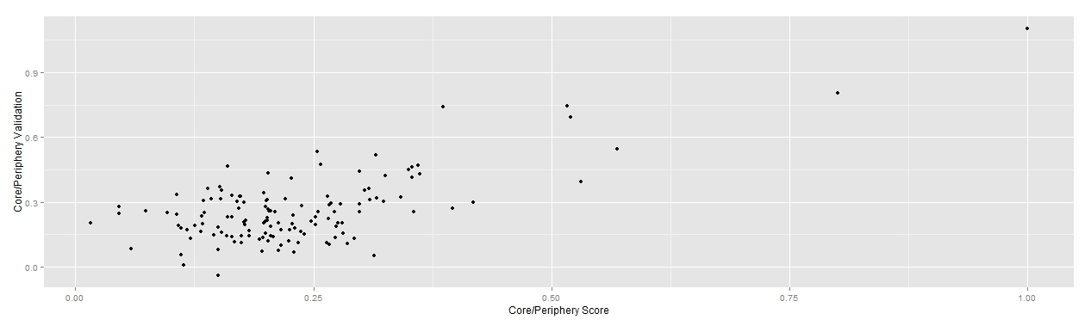
Results of Primary Validation
Exocytosis Core Periphery Score Validation
Endocytosis Core Periphery Score Validation

Slide 21
Secondary Validation
While looking at the results, we noticed that Gene Ontology was missing some proteins implicated in both exocytosis and endocytosis
Utilized all proteins utilized in the vesicle transport methods as a secondary validation procedure

