Slide 1
Computational Goals
Determine if there are statistically significant “core” proteins in the endocytosis/exocytosis protein-protein interaction network
Determine the “core” proteins in the endocytosis/exocytosis PPI

Slide 2
Computational Goals
Determine if there are statistically significant “core” proteins in the endocytosis/exocytosis protein-protein interaction network
Determine the “core” proteins in the endocytosis/exocytosis PPI

Slide 3
Existence of Core Proteins
Can utilize the rich-club coefficient to determine if our network has a “rich-core”

Slide 4

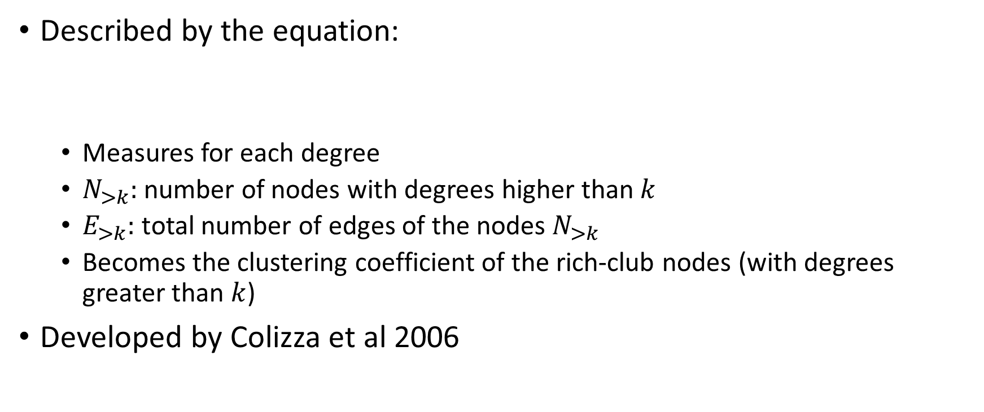
Rich-Club Coefficient
Described by the equation:
Measures for each degree
$N_{>k}:$ number of nodes with degrees higher than $k$
$E_{>k}:$ total number of edges of the nodes $N_{>k}$
Becomes the clustering coefficient of the rich-club nodes (with degrees greater than $k$)
Developed by Colizza et al 2006

Slide 5


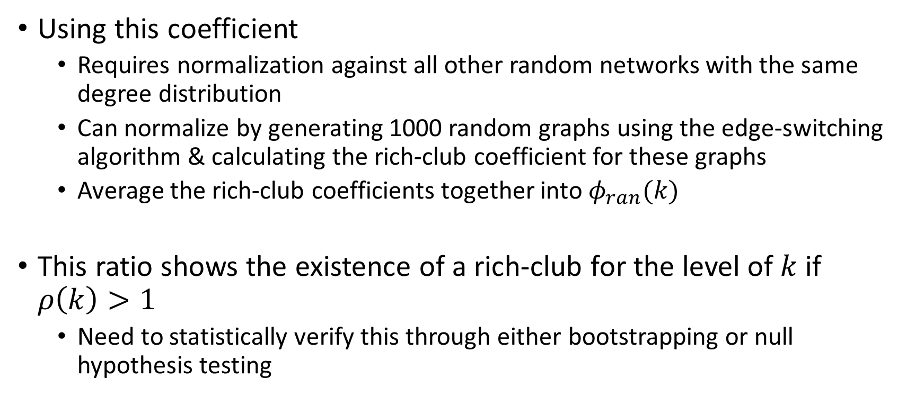
Rich-Club Coefficient
Using this coefficient
Requires normalization against all other random networks with the same degree distribution
Can normalize by generating 1000 random graphs using the edge-switching algorithm & calculating the rich-club coefficient for these graphs
Average the rich-club coefficients together into $φ_{ran}(k)$
This ratio shows the existence of a rich-club for the level of $k$ if $ρ\left(k\right)>1$
Need to statistically verify this through either bootstrapping or null hypothesis testing

Slide 6

Rich-Club Coefficient
Want to examine what $ρ(k)$ looks like and determine its significance biologically

Slide 7
Computational Goals
Determine if there are significant “core” proteins in the endocytosis/exocytosis protein-protein interaction network
Determine the “core” proteins in the endocytosis/exocytosis PPI

Slide 8
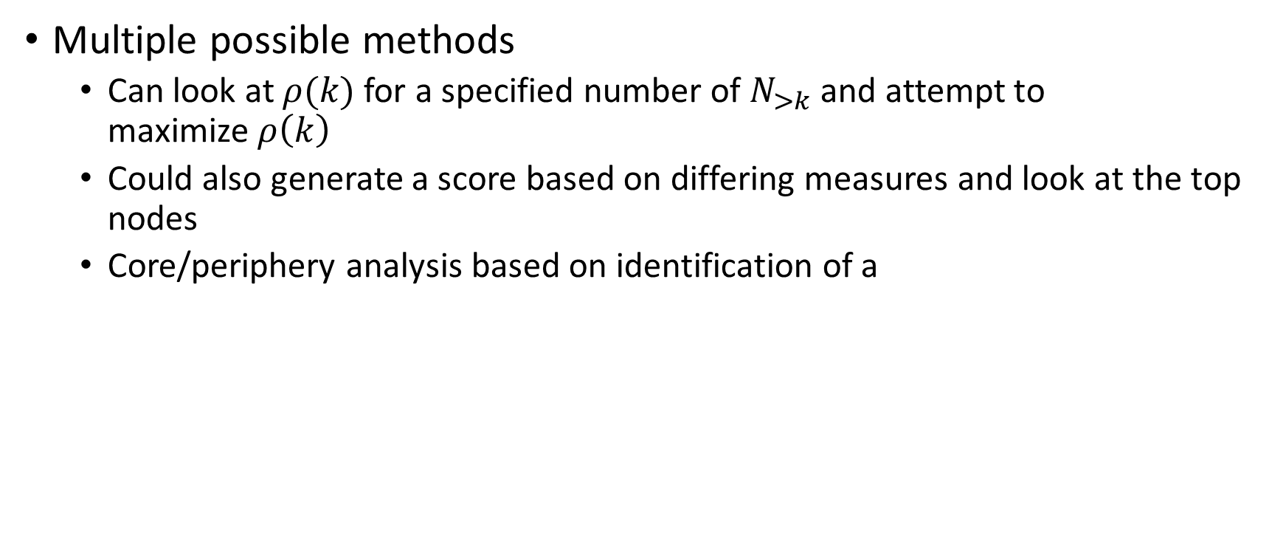
Determination of “Core” Network Proteins
Multiple possible methods
Can look at $ρ(k)$ for a specified number of $N_{>k}$ and attempt to maximize$ρ\left(k\right)$
Could also generate a score based on differing measures and look at the top nodes
Core/periphery analysis based on identification of a

Slide 9
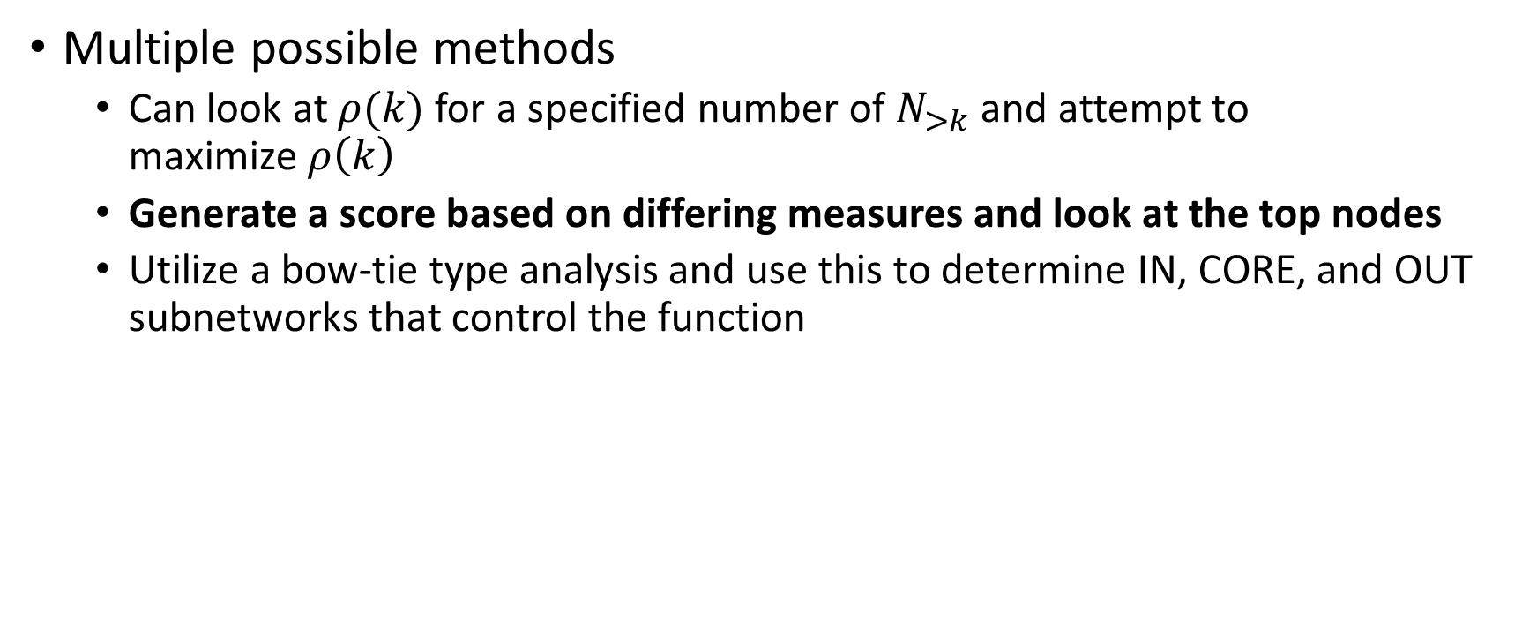
Determination of “Core” Network Proteins
Multiple possible methods
Can look at $ρ(k)$ for a specified number of $N_{>k}$ and attempt to maximize$ρ\left(k\right)$
Generate a score based on differing measures and look at the top nodes
Utilize a bow-tie type analysis and use this to determine IN, CORE, and OUT subnetworks that control the function

Slide 10

Determination of “Core” Network Proteins
First Principal Component: weighed measure that averages together 8 separate measures that describe a network
Includes:
Degree
Betweenness
Closeness
Clustering coefficient
K-shell
Eigenvector centrality
Semi-local centrality
Number of appearences in network motifs

Slide 11
Utilizing First Principal Component
From linear algebra: can use the biggest eigenvalue to determine the weights for the FPC sum
Can also use the percentile groups as generated by the FPC score and perform “rich-club” analysis
Will allow us to have a set of “core,” or significant nodes in the PPI dataset via the proteins with the maximum FPC scores

Slide 12
Spatial Connections
For a more complete picture, may want to subdivide the PPI network into spatial sub-networks (ie where the protein is located in the cell)
Perform the same analysis (rich-club, FPC) on each sub-network to understand what proteins are dominant at what location
May be different proteins that are exposed as “structurally dominant” than in the entire network as a whole

Slide 13
Verification
Compare results between “bow-tie” analysis and FPC scored nodes via cross-checking the results
Compare nodes found to be “structurally dominant” with their annotations in the literature

Slide 14
References
Colizza, V., Flammini, M., Serrano, A., and Vespignani, A. Detecting rich-club ordering in complex networks. Nature Physics 2, 110–115.
Dennis, E.L., Zhan, L., Jahanshad, N., Mueller, B.A., Jin, Y., Lenglet, C., Yacoub, E., Sapiro, G., Ugurbil, K., Harel, N., et al. (2014). Rich Club Analysis of Structural Brain Connectivity at 7 Tesla Versus 3 Tesla. In Computational Diffusion MRI and Brain Connectivity, (Springer), pp. 209–218.
Jiang, Z.-Q., and Zhou, W.-X. (2008). Statistical significance of rich-club phenomena in complex networks. New Journal of Physics 10.
McAuley, J.J., da Fontoura Costa, L., and Caetano, T.S. (2007). Rich-club phenomenon across complex network hierarchies. Applied Physics Letters 91, 084103.
Pei Wang, Xinghuo Yu, and Jinhu Lu (2014). Identification and Evolution of Structurally Dominant Nodes in Protein-Protein Interaction Networks. IEEE Transactions on Biomedical Circuits and Systems 8, 87–97.
Vitali, S., Glattfelder, J.B., and Battiston, S. (2011). The Network of Global Corporate Control. PLoS ONE 6, e25995.
Wuchty, S., Adams, J.H., and Ferdig, M.T. (2009). A comprehensive Plasmodium falciparum protein interaction map reveals a distinct architecture of a core interactome. PROTEOMICS 9, 1841–1849.

Slide 15
Workflow
Identify all proteins related to endocytosis/exocytosis
Generate and rich-club coefficient for the network
Perform first principal component analysis on the PPI network, as described in Wang et al
Perform bow-tie analysis on the undirected PPI network
Perform rich-club, FPC, and bow-tie analysis on sub-networks divided by location within cell

Slide 16
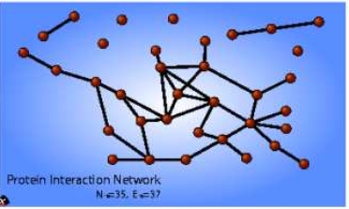
Structure of Yeast PPI Network
Richest 35 nodes of the yeast PPI network
From: Colizza et al 2006

Slide 17
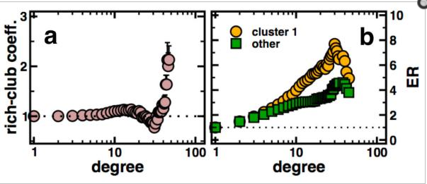
Distribution of P. falciparium Rich-Club Coefficient
As degree increases, rich-club coefficient generally also increases, suggesting an “oligarchy of highly interacting and intertwining proteins”
From: Wuchty et al 2011

Slide 18
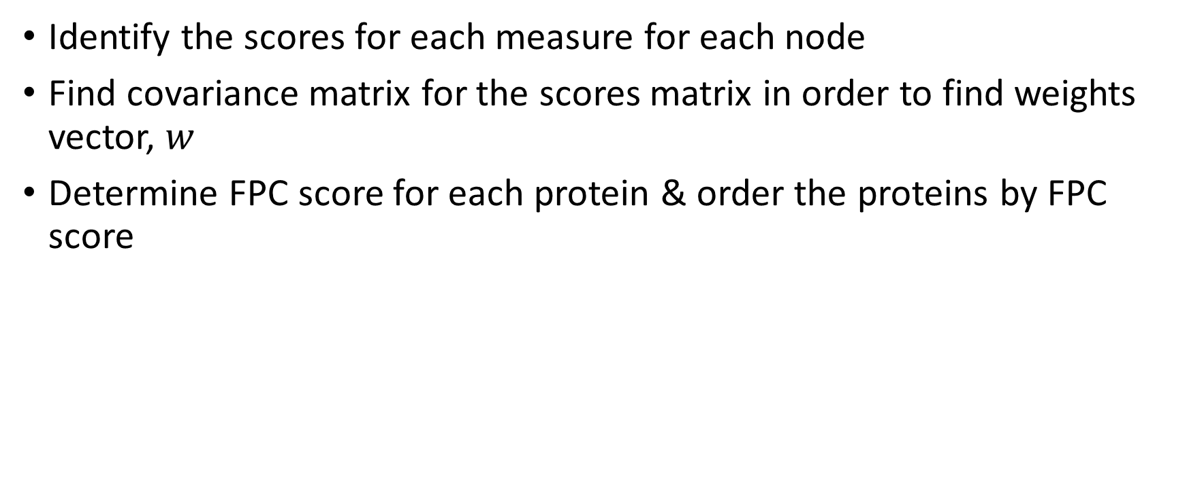
FPC Workflow
Identify the scores for each measure for each node
Find covariance matrix for the scores matrix in order to find weights vector, $w$
Determine FPC score for each protein & order the proteins by FPC score

Slide 19
Other Applications of Rich-Club
Often used in analyzing the connections between the different structures of the human brain
A generalized version of the rich-club analysis was used in analyzing what companies “control” the global corporate network

Slide 20
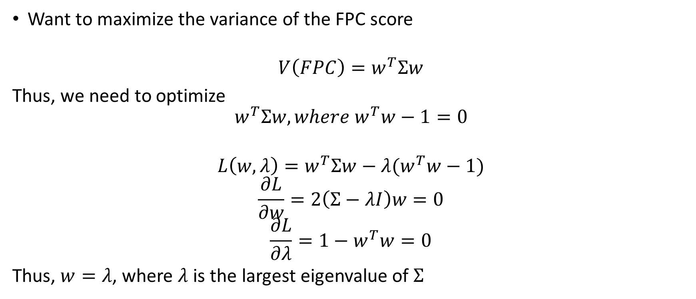
Optimization of FPC
Want to maximize the variance of the FPC score
$$V\left(FPC\right)=w^{T}Σw$$
Thus, we need to optimize
$$w^{T}Σw, where w^{T}w−1=0$$
$$L\left(w,λ\right)=w^{T}Σw−λ(w^{T}w−1)$$
$$\frac{∂L}{∂w}=2\left(Σ−λI\right)w=0$$
$$\frac{∂L}{∂λ}=1−w^{T}w=0$$
Thus, $w=λ$, where $λ$ is the largest eigenvalue of $Σ$

Slide 21
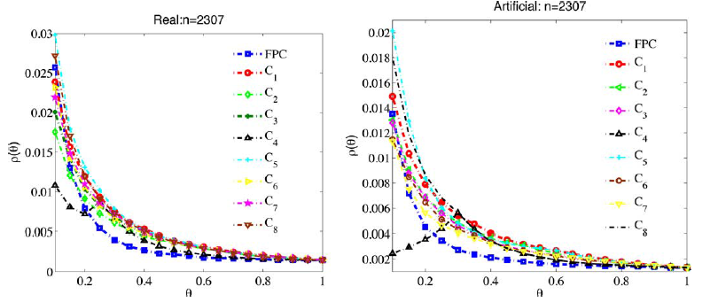
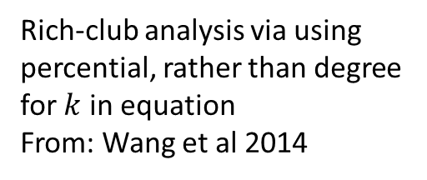
Validation of FPC
Rich-club analysis via using percential, rather than degree for $k$ in equation
From: Wang et al 2014
Can see that FPC method decreases the quickest as percentile increases across order by score
Other methods decrease more slowly

