Slide 1

Statistics in industry
Scope & opportunities…
A statistician develops and applies statistical theories to obtain useful insights that helps solve real-world problems…
Rakesh Poduval, 22th October 2021
Notes:
First of congratulations for enrolling yourself into this course. Being a statistician/Data scientist is like have the coolest job title in the current century.

Slide 2

Contents…
Salary standards: How much will I get paid ? How much am I worth ?
Roles: What are the various roles I will be playing in the industry ? How are they different from each other ?
Popularity & Demand: How much I am in demand in the market ? Am I choosing the right career ? How safe is my job in the future ?
Skill sets: What skill sets are required to fit in the various roles in the industry ? What is a must to survive in the industry ? What statistical concepts are relevant in the market today ? What are the popular tools I should be familiar with ? How to decide the tools I need to master myself to get noticed ? How can I evaluate and rate myself as per industry standard ?
Domains & Companies: What are the various domains I can explore in my career ? Which are the most popular companies people dream to be a part of ?
Additional courses & certifications: How can I improve my qualities required by industry ?
Networking: How to stay updated with current trends and market ? Whom should I follow in professional networking sites ? How can communicate with other professionals around the world ?
Rakesh Poduval, 22th October 2021

Slide 3
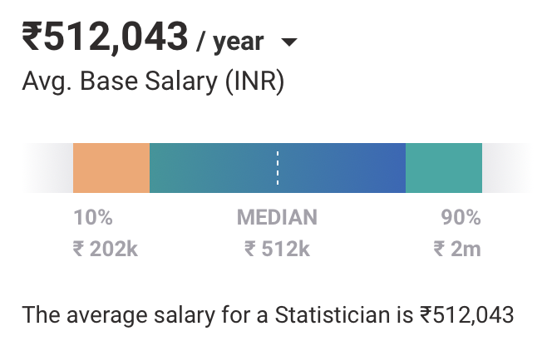
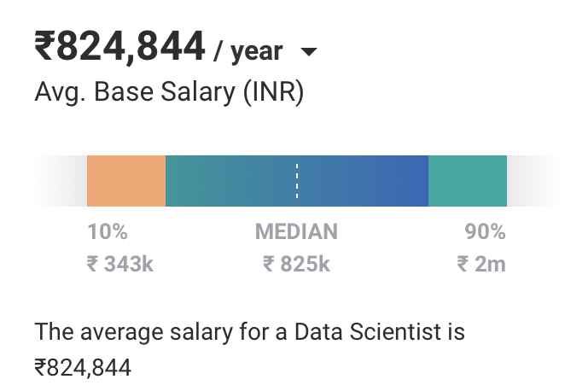





Salary standards
Rakesh Poduval, 22th October 2021
Notes:
The chart shows average salary in India for a 1-2 years experienced statisticians & data scientist
This could vary based upon location.
Salary for freshers are also now days attractive. Specially clinical trial companies are paying way too high these days.
What is the difference between being statistician and data scientist ?
How come being a statistician lead to a better data scientist ?
How is the growth in terms of salary with respect to years of experience ?

Slide 4
Roles
Statistician | Product analyst | Data scientist | Applied scientist | R programmer
Data analyst | Research scientist | Operations research scientist | Research engineer | Statistical programmer
Quantitative analyst | Data engineer | Machine learning engineer | Business analyst | Principle statistician
Software developer | Statistical consultant | Clinical statistical programmer | Applied statistician | DevOps specialist
Predictive modeller | Data miner | Python developer | SAS programmer | …
Rakesh Poduval, 22th October 2021
Notes:
Does the required knowledge level in statistics for the various roles differ ?
Which are the most popular roles ?
How can know which one is the best fit for me ?

Slide 5

Popularity & Demand - I
Between 2016 - 2019 data scientist was named the number one job in the U.S. The average salary is $111,200 and average job satisfaction is 4.25/5 - Glassdoor
Hiring for these roles grew nearly 46% since 2019 - LinkedIn
The projected growth rate for a Statistician is 35.4% with median salary $92,270 and for a Data scientist is 31.4% with a median pay $98,230. These occupations will become more popular as people continue to work from home and online. - CNBC
Several reports agree that ‘Data Scientist’ is the coolest job of the 21st century. Not surprising then that it is at the top of the list highest paid jobs. A data scientist with a fair amount of experience can make up to US$800K in the US, and in India, nearly 90 Lakh rupees per annum. - India Today
… Google for more information !!
Rakesh Poduval, 22th October 2021
Notes:
Quoting statements found online

Slide 6
Popularity & Demand - II
Top 10 jobs in America in 2021 by glassdoor
Rank | Job title | Median base salary | Job satisfaction/5 | Job opening
1 | Java developer | $90,830 | 4.2 | 10,103
2 | Data scientist | $113,736 | 4.1 | 5,971
3 | Product Manager | $121,107 | 3.9 | 14,515
4 | Enterprise Architect | $131,361 | 4.0 | 10,069
5 | Devops engineer | $110,003 | 3.9 | 6,904
6 | Information Security Engineer | $110,000 | 4.0 | 5,621
7 | Business Development Manager | $82,182 | 4.1 | 8,827
8 | Mobile Engineer | $94,301 | 4.1 | 4,631
9 | Software Engineer | $110,245 | 3.8 | 40,564
10 | Dentist | $134,122 | 4.0 | 4,315
Rakesh Poduval, 22th October 2021
Notes:
https://www.glassdoor.com/List/Best-Jobs-in-America-LST_KQ0,20.htm
The Glassdoor job score is determined by weighing three factors equally:
Earning potential (median annual base salary)
Overall job satisfaction rating
Number of job openings.
Results represent job titles that rate highly among all three categories. The Glassdoor job score is based on a 5-point scale (5.0=best job, 1.0=bad job). For a job title to be considered, it must receive at least 100 salary reports and at least 100 job satisfaction ratings shared by U.S.-based employees over the past year (12/11/19-12/10/20). A job title must also have at least 2,000 job openings as of 12/07/20 to be considered for this list. This report takes into account job title normalisation that groups similar job titles. C-suite and intern level jobs were excluded from this report.
Demand, it is the coolest job in the century.
Who all are jumping to the field
New course programs introduced.
New organisations in the market.
Onshore and offshore opportunities.

Slide 7
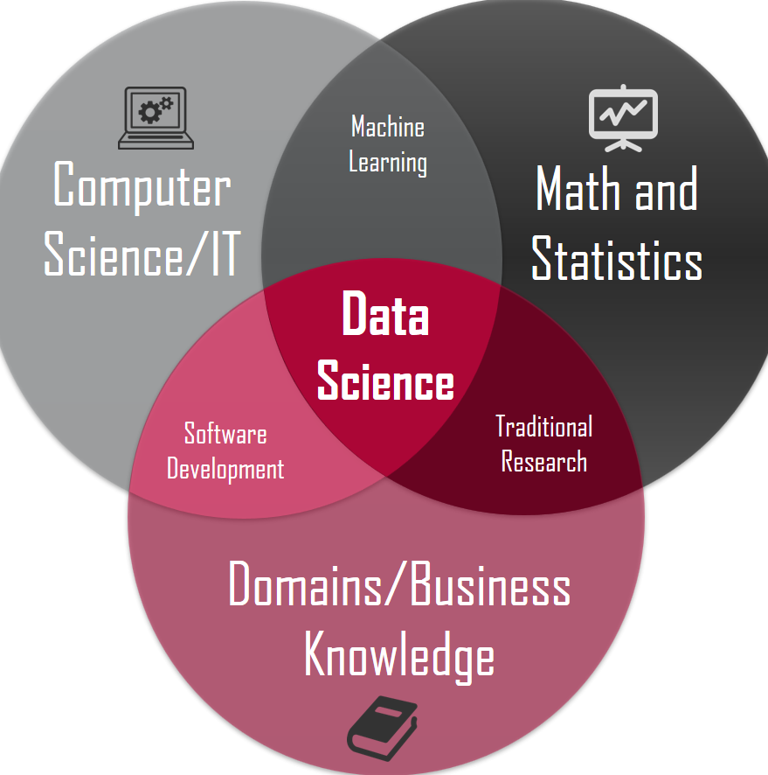








Skill sets
Concepts & techniques : Basic statistics, Testing hypothesis, Linear regression & classification techniques, Cluster analysis, Principle components, Multivariate analysis, Linear algebra, …
IT Knowledge: MS Office (Outlook, Excel, Power point, Word, Teams), Basic windows operations, System performance checks.
Database knowledge: MySQL, Oracle, MS SQL, MongoDB, …
Tools: R, Python, SAS, Tableau
Reporting: MS Word & Power point, R Markdown, Jupyter notebooks
Deployment: R Plumber, Python Flask, Docker, …
Communication & presentation skills: Decent fluency in English. Explaining technical concepts in a very simpler way.
Challenge yourself: https://www.kaggle.com, https://www.techgig.com
Rakesh Poduval, 22th October 2021
Notes:
What are the current trend and demand in terms of technology ?
How to map a statisticians with a data scientists ?

Slide 8
Domains & Companies
Domain: Retail & Consumer analytics Companies: Fractal, UST, Latent view | Domain: Risk & Fraud analytics Companies: Ford, CTC, Uber, Wipro | Domain: Actuaries & Insurance Companies: HSBC, Allianz, MetLife
Domain: Market research Companies: Nielson, IRI, IQVIA | Domain: Real estate Companies: Price Hubble, IAZI, JLL, | Domain: Healthcare Companies: Cognub, Krythium, Genpro
Domain: Pharmaceuticals Companies: Pfizer, Novartis, IQVIA | Domain: Government& Banking Companies: Credit Swiss, Doha development bank, … | Domain: Financial services Companies: EY, KPMG, Fidelity, UBS
Domain: Sports analytics Companies: STATS, Krossover, TrueMedia, … | Domain: Freelance consulting Companies: Freelancer, Upwork, Toptal, … | Domain: Software development Companies: RStudio, Tableu, SAS, Minitab, …
Rakesh Poduval, 22th October 2021
Notes:
Does the required knowledge level in statistics for the various roles differ ?
Which are the most popular roles ?
How can know which one is the best fit for me ?

Slide 9







Additional course & certifications
https://www.coursera.org/in
https://www.datacamp.com
https://www.jigsawacademy.com
https://www.udemy.com
https://www.upgrad.com
https://www.edx.org
https://www.linkedin.com
https://www.business-science.io
Rakesh Poduval, 22th October 2021

Slide 10
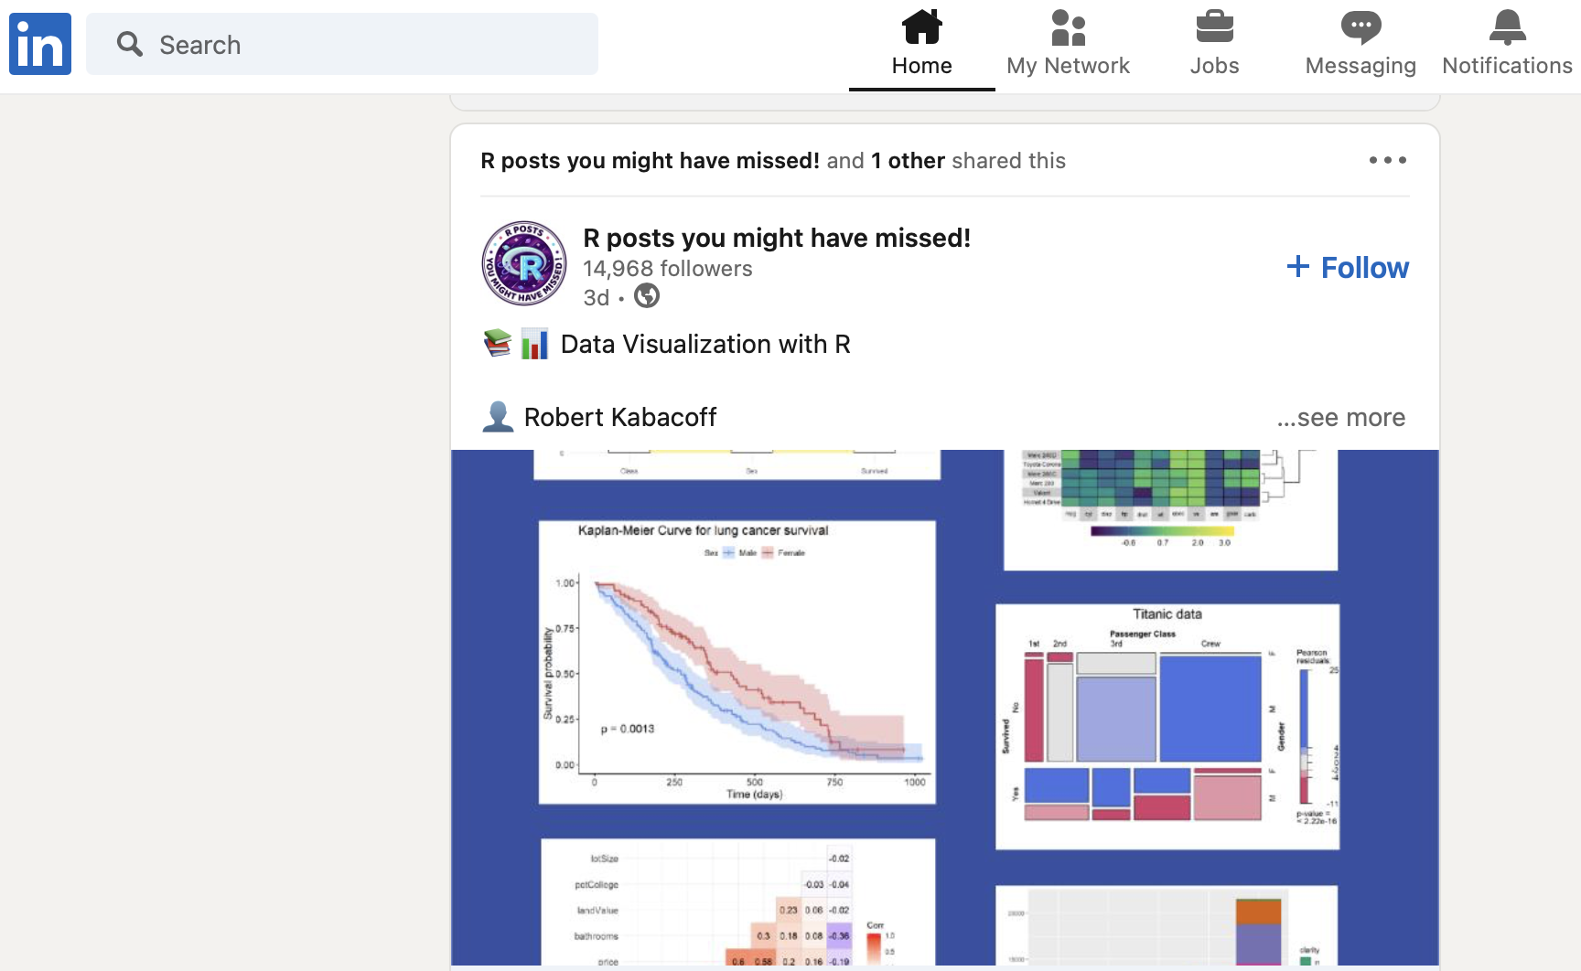
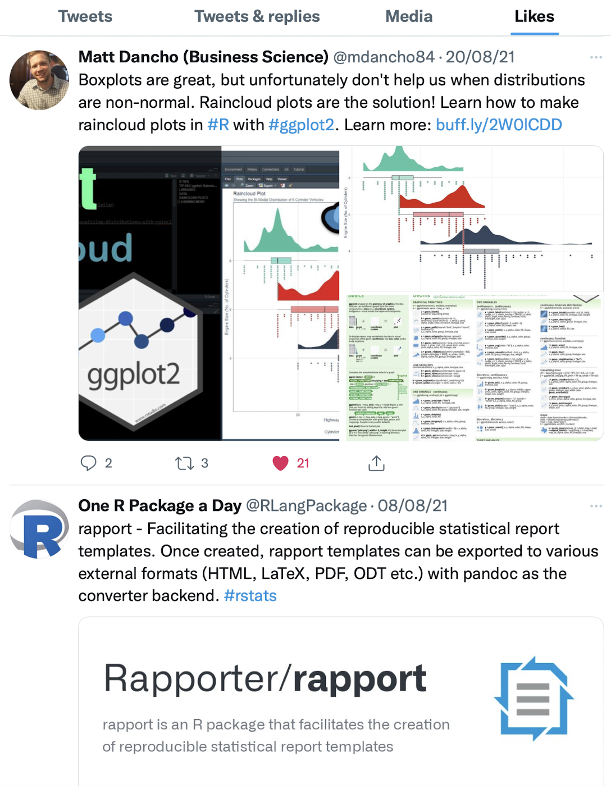
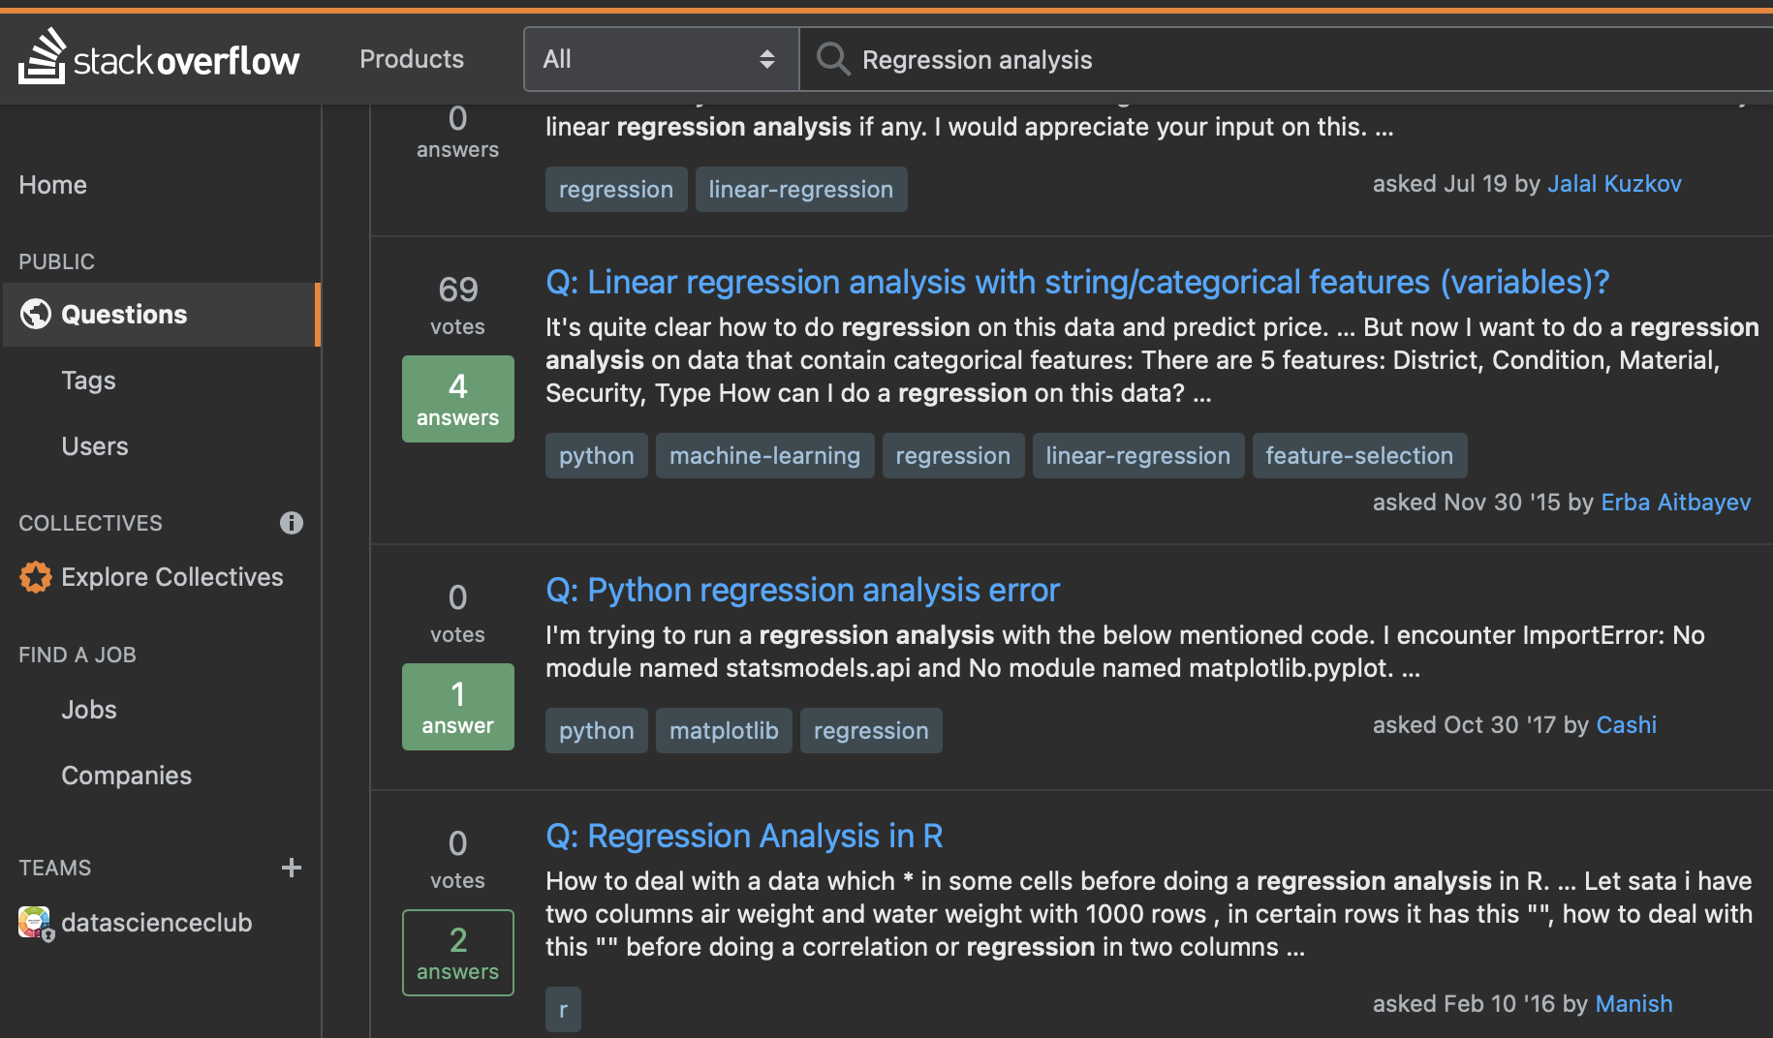
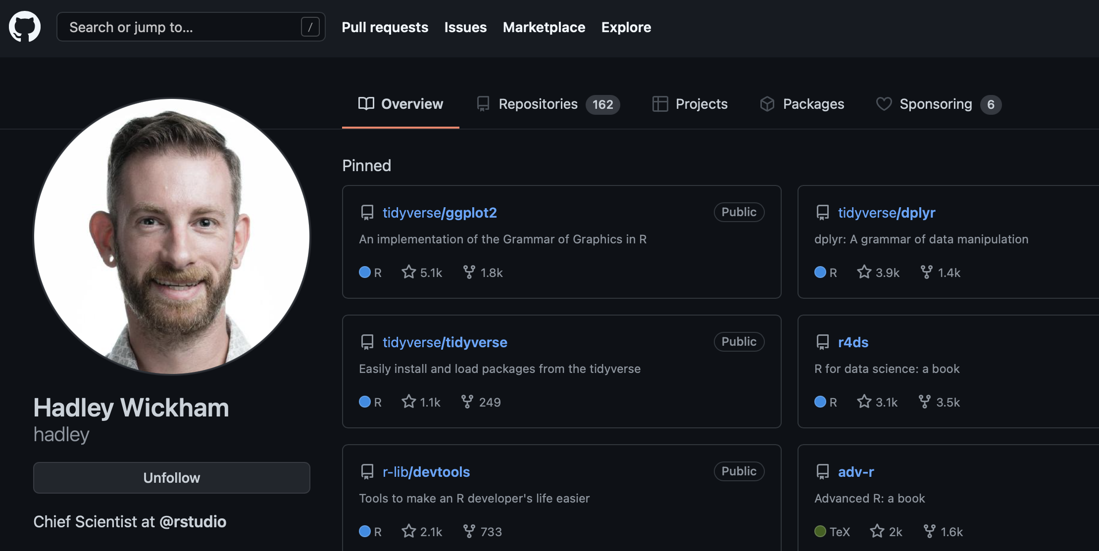
Networking
https://towardsdatascience.com
https://stackoverflow.com
https://www.analyticsvidhya.com
https://www.linkedin.com
https://twitter.com
https://github.com
Rakesh Poduval, 22th October 2021
Notes:
Follow the right people
Follow the relevant tags
Follow popular groups

Slide 11
Thank you !!!
Questions ?

