Slide 1
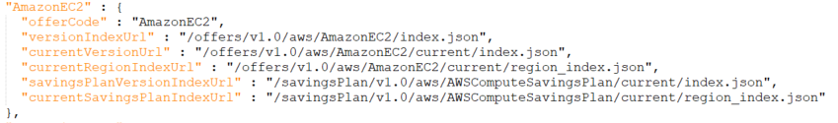
Process
1
SKU lookup
https://pricing.us-east-1.amazonaws.com/offers/v1.0/aws/AmazonEC2/current/index.json
2
Offer index file
https://pricing.us-east-1.amazonaws.com/offers/v1.0/aws/index.json
3
Get region_index.json

Slide 2
Process
}, {
"discountedSku" : "TBV6C3VKSXKFHHSC",
"discountedUsageType" : "USE2-BoxUsage:t3a.xlarge",
"discountedOperation" : "RunInstances",
"discountedServiceCode" : "AmazonEC2",
"rateCode" : "RQRC4CUNT9HUG9WC.TBV6C3VKSXKFHHSC",
"unit" : "Hrs",
"discountedRate" : {
"price" : "0.0679",
"currency" : "USD"
}
4
SKU lookup
[“products”]
"sku" : "RQRC4CUNT9HUG9WC",
"productFamily" : "ComputeSavingsPlans",
"serviceCode" : "ComputeSavingsPlans",
"usageType" : "ComputeSP:3yrAllUpfront",
"operation" : "", "attributes" :
{ "purchaseOption" : "All Upfront",
"granularity" : "hourly",
"purchaseTerm" : "3yr",
"locationType" : "AWS Region",
"location" : "Any" }
}

Slide 3
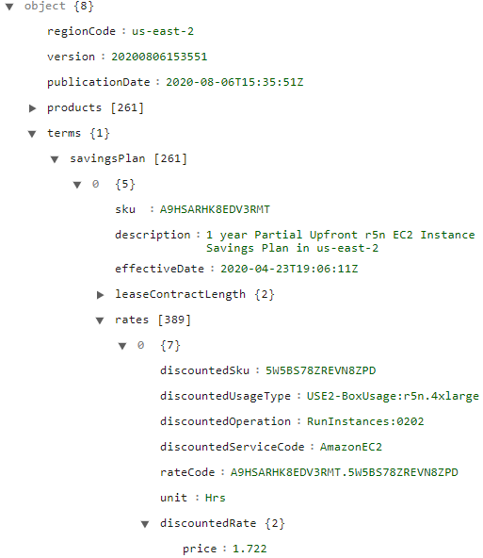
JSON schema for regional Savings Plan
Notes:
https://jsoneditoronline.org/#left=url.https%3A%2F%2Fpricing.us-east-1.amazonaws.com%2FsavingsPlan%2Fv1.0%2Faws%2FAWSComputeSavingsPlan%2F20200806153551%2Fus-east-2%2Findex.json

Slide 4
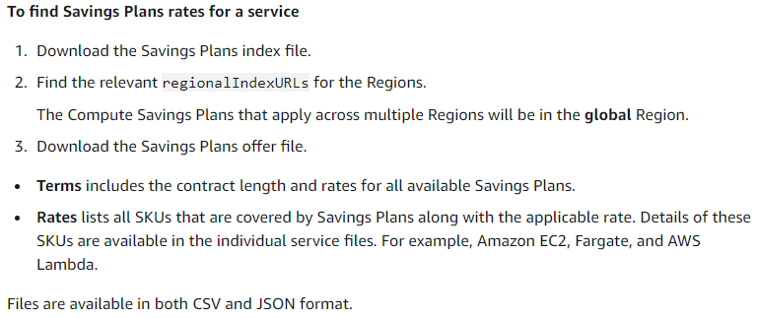
Reference

