Slide 1
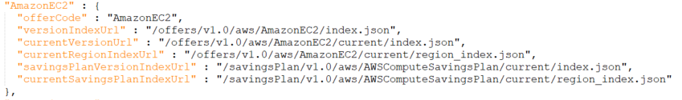
Process
1
SKU lookup
https://pricing.us-east-1.amazonaws.com/offers/v1.0/aws/AmazonEC2/current/index.json
2
Offer index file
https://pricing.us-east-1.amazonaws.com/offers/v1.0/aws/index.json
3
Get region_index.json

Slide 2
Process
4
SKU lookup

Slide 3
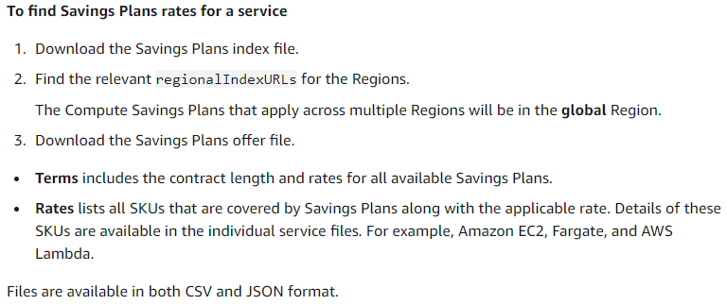
Reference

