Slide 1
Nasdaq Intraday Program
INTRODUCTION
Private funding deck for a CTA-registration-first 12-month build/test runway
Target raise: $145,000 | First test tier: Nasdaq Intraday Mini
CONFIDENTIAL RESEARCH DRAFT. HYPOTHETICAL/BACKTESTED PERFORMANCE IS NOT INDICATIVE OF FUTURE RESULTS.

Slide 2
Risk Disclosure Statement
RESEARCH DRAFT
The risk of loss in futures trading can be substantial. Futures are leveraged instruments; adverse moves, gaps, liquidity events, data failures, or order-routing failures can produce losses materially different from historical tests.
This deck presents hypothetical and backtested research, not audited live CTA performance. It is intended to support a private build-and-validation discussion. No compensated futures advice, managed client trading, or client account direction should begin until counsel confirms the required registration/exemption, disclosure, broker, tax, accounting, and compliance path.
Risk Area | Control Intent
Execution | Match live order sequencing to post-session replay and broker-paper reviews.
Sizing | Use historical intrabar stress drawdown as the account-sizing anchor.
Operational | Stale-feed blocks, daily flattening, position reconciliation, and manual kill switch.
Investor use | Private diligence only until CTA registration/exemption and counsel-approved materials exist.
Stops and protective orders cannot guarantee fills at intended prices during fast markets.
CONFIDENTIAL RESEARCH DRAFT - HYPOTHETICAL/BACKTESTED PERFORMANCE - COUNSEL REVIEW REQUIRED

Slide 3
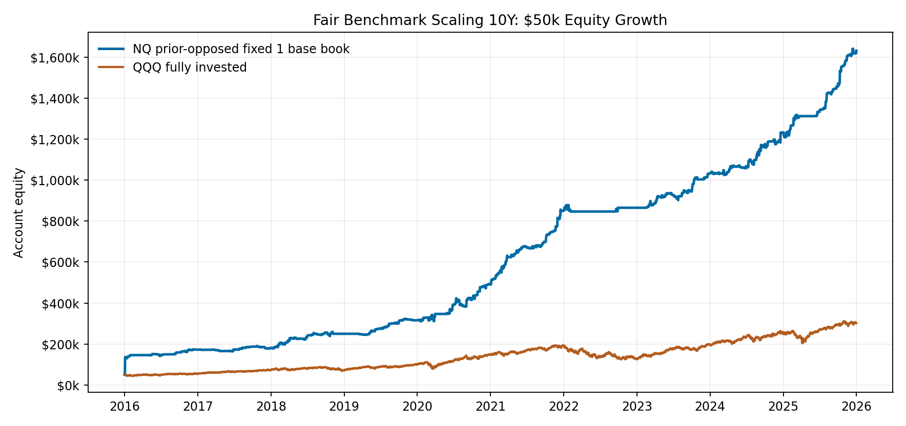
Fair Benchmark Scaling 10Y
$50K EQUITY GROWTH
Fixed one-base-book NQ study
A $50k starting account is used here only as a fair benchmark scaling exhibit against fully invested QQQ. This fixed-base NQ study is not the 3x-stress live sizing recommendation.
The exhibit shows the historical path that produced the table below. It is a research comparison, not a promise of capacity or future returns.
2016-2025
Sleeve | End Capital | Net | Max DD | Return | Net/DD | Peak Size
Prior-opposed intraday NQ fixed 1 base book | $1,632,101 | $1,582,101 | $-63,617 | 3164.2% | 24.87 | 5 units
QQQ fully invested | $301,589 | $251,589 | $-67,833 | 503.2% | 3.71 | full ETF capital
CONFIDENTIAL RESEARCH DRAFT - HYPOTHETICAL/BACKTESTED PERFORMANCE - COUNSEL REVIEW REQUIRED

Slide 4
Program Description
MECHANICAL INTRADAY FUTURES
Nasdaq futures
Liquidity run
Prior opposing condition
Mechanical price-action campaign
The model observes an early directional move and waits for the market to reveal an adversarial setup rather than chasing every break.
A higher-timeframe proprietary condition, including prior-month reference context, must be known before the campaign can arm.
Once eligible, execution is handled by a fixed intraday playbook with predefined entries, exits, stops, and session-end flattening.
Optimization work remains conservative: reduce or downshift exposure when very large opening ranges historically degraded edge, while preserving most upside when the setup remains clean.
CONFIDENTIAL RESEARCH DRAFT - HYPOTHETICAL/BACKTESTED PERFORMANCE - COUNSEL REVIEW REQUIRED

Slide 5
Main Features
WHAT THE PROGRAM IS DESIGNED TO DO
Agnostic but selective
The strategy can accept either long or short exposure on a given day, but only after the proprietary condition allows it.
Adversarial NQ behavior
The research is designed around the Nasdaq's tendency to punish the first obvious impulse and reward cleaner conditional follow-through.
Low market-beta dependence
Daily returns in the current research set are not simply a proxy for QQQ. The strategy is meant to diversify stock-heavy portfolios.
Execution first
The build phase focuses on matching live order flow, saved data, and post-session replay before any broader capital discussion.
CONFIDENTIAL RESEARCH DRAFT - HYPOTHETICAL/BACKTESTED PERFORMANCE - COUNSEL REVIEW REQUIRED

Slide 6
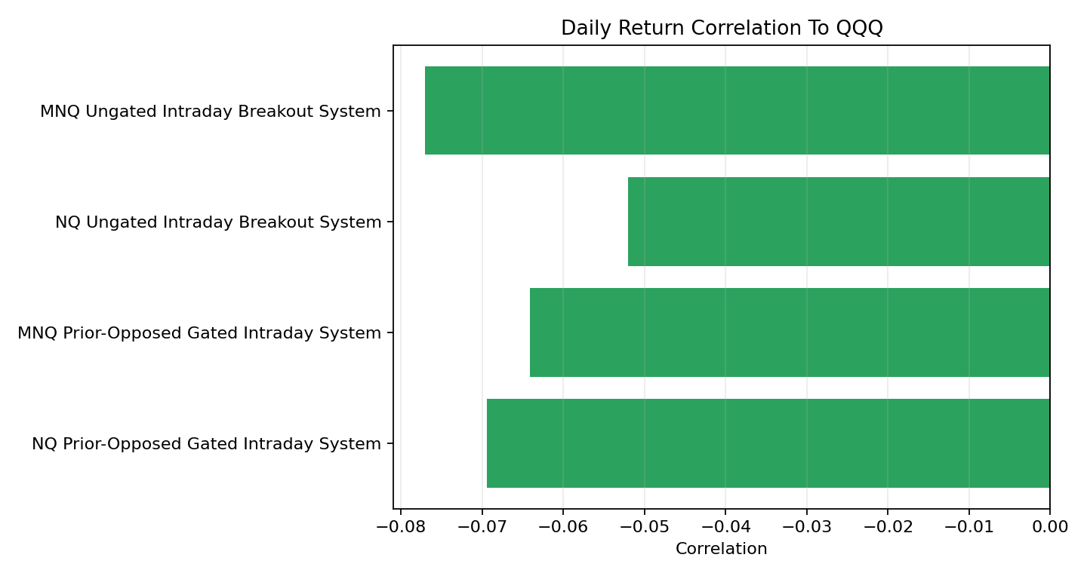
Behavior In Different Market Regimes
QQQ CONTEXT
System | Corr | QQQ Down-Year Avg
MNQ Prior-Opposed | -0.06 | 21.7%
NQ Prior-Opposed | -0.07 | 39.1%
MNQ Ungated | -0.08 | 19.5%
NQ Ungated | -0.05 | 40.1%
• The strategy is not designed to be continuously long Nasdaq exposure.
• In the 2020 shock/recovery year, the fixed NQ study returned 349.5% vs QQQ at 46.0%.
• The weakest historical stress came from execution/range conditions rather than broad market direction alone.
• Large-range degradation filters reduce exposure in lower-quality regimes while trying to preserve the core upside.
CONFIDENTIAL RESEARCH DRAFT - HYPOTHETICAL/BACKTESTED PERFORMANCE - COUNSEL REVIEW REQUIRED

Slide 7
Source Of Edge & Risk Management
EXECUTION QUALITY BEFORE SCALE
Source of Edge
The research seeks to exploit sessions where a visible directional impulse creates an opposing, mechanically confirmable opportunity. The initial condition is not the main profit center; the follow-on campaign is.
Risk Management
Three layers of risk mitigation:
1)
Execution parity:
Live sequencing, broker-paper fills, and saved data must reproduce the post-session review path before capital is increased.
2)
Stress-based account sizing:
The sizing anchor is 3x historical intrabar MTM drawdown. A day that reaches the historical max stress level becomes a macro review day before continuation.
3)
Selective regime filters:
Known degradation zones, including unusually large opening ranges, are candidates for size reduction or exclusion if they preserve upside while reducing exposure.
The objective of this stage is not to maximize advertised returns; it is to reduce execution risk to an acceptable level while preserving the historical edge profile.
CONFIDENTIAL RESEARCH DRAFT - HYPOTHETICAL/BACKTESTED PERFORMANCE - COUNSEL REVIEW REQUIRED

Slide 8
Systems Selected For The Build/Test Runway
GATED AND UNGATED INTRADAY
System | Norm Scale | Norm Net | Norm Return | Net/DD | $1M Books | $1M Net | $1M Return
Gated intraday | 5.74x | $6,799,226 | 733.3% | 22.00 | 6 | $7,107,510 | 710.8%
Ungated intraday | 2.62x | $2,269,999 | 244.8% | 7.34 | 2 | $1,734,710 | 173.5%
Flagship gated system
Ungated price-action system
• Primary research candidate.
• More selective and historically more capital efficient.
• Requires stricter sequencing/tick proof before live confidence.
• Secondary system and operational benchmark.
• Simpler all-day rule family.
• Useful for testing cloud runtime, OCO lifecycle, fills, and reporting.
Normalized rows use the same stress-capital anchor from the research tracker; fractional scale is comparison math, not live sizing.
CONFIDENTIAL RESEARCH DRAFT - HYPOTHETICAL/BACKTESTED PERFORMANCE - COUNSEL REVIEW REQUIRED

Slide 9
Founder Partner Alignment
WHY EARLY SUPPORT MATTERS
Family and friends are taking the earliest calculated risk: funding an unproven live-test build before there is an audited managed-account record. That support creates the operating proof needed to build an auditable track record.
Exchange | Draft founder benefit
Early risk capital | Priority access to validated strategy capacity if the program launches.
Trust before audited performance | Target founder terms: 0% management / 10% performance fee.
Track-record runway | Ability to carry a validated allocation forward or withdraw at defined review points.
Alignment signal | Founder capital remains visibly aligned with the platform's long-term operating record.
Founder account principle
Compliance caveat
Early supporters should not be treated like later outside allocators if the firm succeeds. The intended model is a documented founder class or side letter.
No fee, capacity, withdrawal, or account-management commitment is final until counsel-approved agreements exist.
CONFIDENTIAL RESEARCH DRAFT - HYPOTHETICAL/BACKTESTED PERFORMANCE - COUNSEL REVIEW REQUIRED

Slide 10
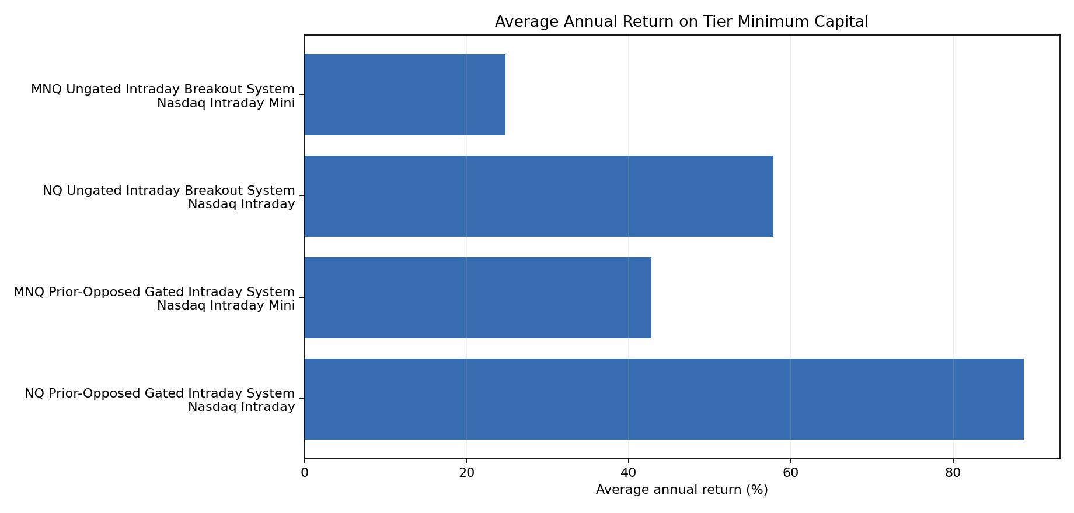
Conservative Performance Framing
TOP 3 ANNUAL NET YEARS REMOVED
Tier | System | Market | Min | Window | Adv Avg/Yr | Adv Return/Yr | Corr
Nasdaq Intraday | Gated | NQ | $250,000 | 2021-03-04-2026-03-06 | $128,249 | 51.3% | -0.07
Nasdaq Intraday Mini | Gated | MNQ | $50,000 | 2021-03-04-2026-03-03 | $13,323 | 26.6% | -0.06
Nasdaq Intraday | Ungated | NQ | $250,000 | 2021-03-04-2026-03-06 | $85,889 | 34.4% | -0.05
Nasdaq Intraday Mini | Ungated | MNQ | $50,000 | 2021-03-04-2026-03-06 | $6,891 | 13.8% | -0.08
Full annual tables remain in the memo; the displayed average removes the three best net years before calculating the headline expected-return framing.
CONFIDENTIAL RESEARCH DRAFT - HYPOTHETICAL/BACKTESTED PERFORMANCE - COUNSEL REVIEW REQUIRED

Slide 11
12-Month Funding And Cost Model
STONEX SCHEDULE INCLUDED
Category | Amount
Founder development stipend | $36,000
Segregated MNQ research/test capital | $50,000
Broker/API/exchange/commission/slippage allowance | $10,000
NFA/Series 3/registration admin | $2,500
CTA disclosure/legal/compliance/audit reserve | $30,000
Contingency | $10,000
StoneX Item | Fee
 | $2,000
 | $5,000
 | $1.29/side
 | $0.50/side
 | $49.95/month
Target raise: $145,000
• Fee schedule is founder-supplied and requires account-opening confirmation.
• CTA registration/disclosure reserve is now a first-class cost before client trading.
• Commission-only model estimates are exported in the package exhibits.
• Exchange, NFA, clearing, market-data, margin-interest, wire, and slippage costs remain live-account assumptions.
The first runway funds engineering, data, CTA registration/disclosure prep, and MNQ test capital. NQ remains a future tier after execution evidence.
CONFIDENTIAL RESEARCH DRAFT - HYPOTHETICAL/BACKTESTED PERFORMANCE - COUNSEL REVIEW REQUIRED

Slide 12
12-Month Validation Roadmap
EVIDENCE BEFORE SCALE
Months
1-3
Months
4-6
Months
7-9
Months
10-12
Build The Rails
Paper The System
Extend The Pilot
Decision Package
CTA counsel kickoff, Series 3/NFA prep, source audit, CQG/StoneX adapter, feed shadowing, and replay parity.
Disclosure draft/review, MNQ broker-paper trial, restart drills, emergency flatten drills, slippage/cost audit, and first readiness review.
Longer funded-paper or small-live MNQ observation, ungated comparison, investor reporting packet, and incident cadence.
Regime review, QQQ comparison refresh, compliance/accounting packet, registration/disclosure status, and final MNQ/NQ go/no-go.
Reporting templates cover equity/margin status, daily P&L, annual and monthly returns, open exposure, fill reconciliation, and operational incidents.
CONFIDENTIAL RESEARCH DRAFT - HYPOTHETICAL/BACKTESTED PERFORMANCE - COUNSEL REVIEW REQUIRED

Slide 13
Founder Background
POE KGENGWENYANE
Market Research & Systems
Relevant Operating Experience
• Four years of market research across forex, futures, and systematic trade design.
• Futures systems developer focused on broker-like replay, automated execution, and reporting.
• Current objective: convert research into a monitored, reviewable, multi-tenant platform.
• Security-critical distributed systems at Thales across TypeScript, Python, and C++.
• Automated test frameworks for REST APIs, event-driven microservices, OpenAPI, pytest, Jest/Supertest, and BDD/Behave.
• Backend platform engineering across Elixir/Phoenix, Ruby on Rails, Node/NestJS, AWS, OAuth, metrics, fraud controls, and service migrations.
• Quality automation and release testing experience in cybersecurity environments.
• Bachelor of Science in Computer Science; Bachelor's Degree in Biomedical and Mechanical Engineering.
• Practical infrastructure skills include Kubernetes, NoSQL, REST APIs, Docker, CI/CD, monitoring, and reporting.
Contact
tshepok13@gmail.com linkedin.com/in/poe-k-722858111
CONFIDENTIAL RESEARCH DRAFT - HYPOTHETICAL/BACKTESTED PERFORMANCE - COUNSEL REVIEW REQUIRED

