Slide 1

Welcome to Python Fundamentals!

Slide 2
🐍 Python Fundamentals
1. 👋 Welcome & why Python
2. ⚙️ Python basics, syntax & variables
3. 🧩 Data types & data structures
4. 🔁 Control flow
5. 📦 Functions and modules
6. 🛠️ In-built modules
7. 📁 File handling
8. ❓Q&A

Slide 3

WHY Learn PYTHON
✅ Easy to read – almost like English
✅ Powerful – used by Google, NASA, Netflix
✅ Free & open-source – runs on any laptop
✅ Perfect for automation – Excel, files, emails
✅ Huge community – help is always available
🎯 Real office uses:
- Rename 100 files in 2 seconds
- Extract data from PDFs
- Auto send weekly reports

Slide 4
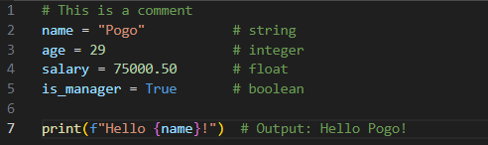
Python Basics: Syntax & Variables
🔑 Key Rules:
No semicolons
Indentation matters (use 4 spaces)
Variables are created when assigned
Use f-strings for easy printing

Slide 5

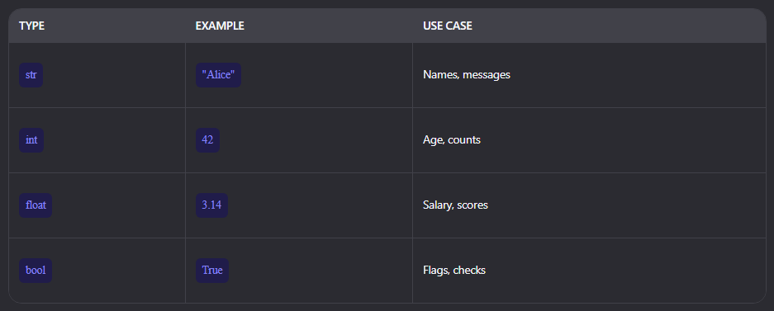

Core Data Types in Python
Variables and data types (int, str, bool, list, dict)

Slide 6
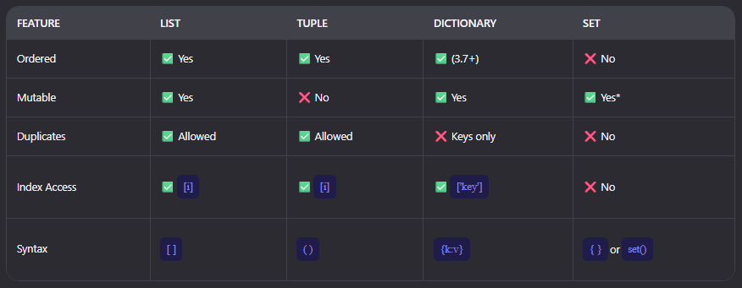
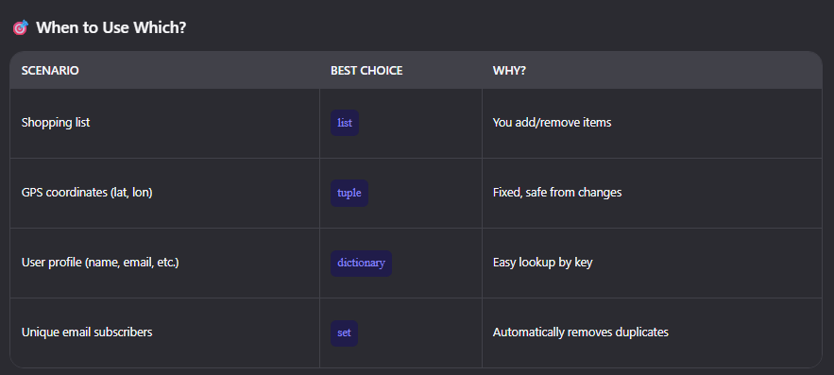
Data Structures – List, Tuple, Dictionary & Set

Slide 7
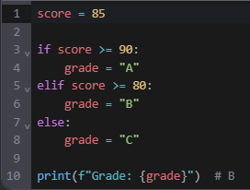
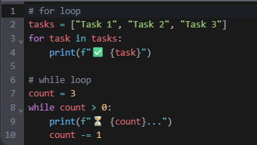
Control flow
if/elif/else - Making Decisions
Loops - Repeat Tasks Automatically
🎯 Use Cases:
# Send reminders to a list
# Process files one by one

Slide 8
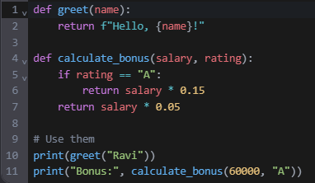
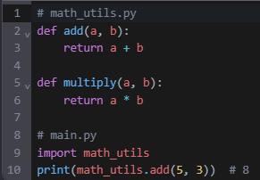
Functions – Reusable Code/ Your Mini Programs
🎯 Analogy:
Function = Hammer
Module = Toolbox
Modules – Organize Your Tools / Group Related Functions

Slide 9



In-Built Modules (Standard Library)
os, sys, datetime, random, math etc

Slide 10
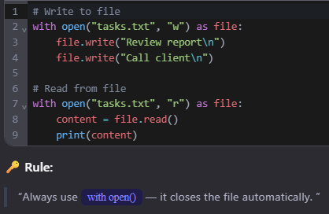
File Handling – Read & Write
File Handling: Save & Load Data

Slide 11

Thank you
Chandan Sahoo
+919439859378
Chandan.sahoo@vodafone.com
https://github.com/Pogopeck

