Slide 1
Data Analysis on Tweets
Team1
ZheLiu, JingZhou

Slide 2
1. Goals of the project
Process Twitter datasets to extract meaningful analysis by performing Machine Learning.
In this project, we utilize information available through the Twitter API
to gather information about the tweets and their users.

Slide 3
2.Use case
User will input
Keywords or Nothing
User will get
A visualization result such as a bar chart represent the sentiments of tweets with those keywords at that date
A visualization result such as a bar chart represent the top hashtags at that moment

Slide 4
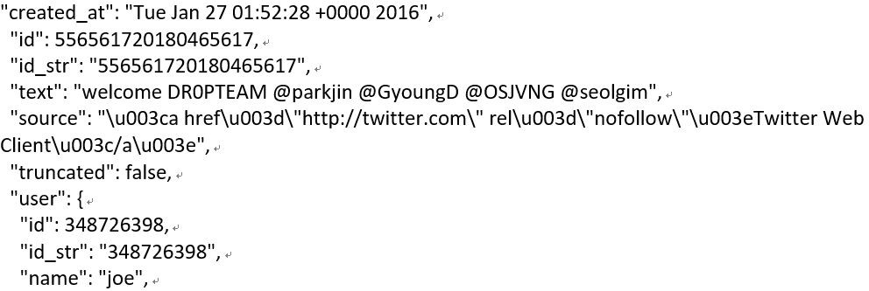
3.Methodology
Parse tweets(JSON format)
Text field
User field
Created_at field - Date
Location field and etc.
Clean and break down the text field into words
Filter the tweets by keyword
Identify and mark the word sentiment using Stanford NLP
Visualization using Apache Zeppelin

Slide 5
4.Data sources
Tweets Search API: based on certain parameters like keyword, language, location, etc can be set to define what data to request
Tweets Streaming API: Data size: more than 100,000 tweets
Store and renew the tweets to reduce the response time
Reference:http://140dev.com/twitter-api-programming-tutor ials/aggregating-tweets-search-api-vs-streaming-api/

Slide 6
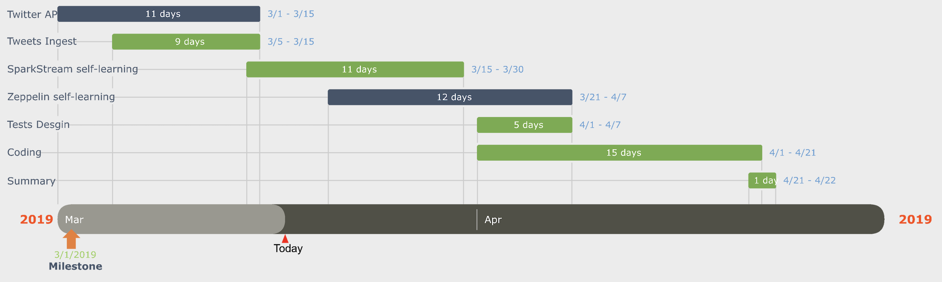
5. Milestones

Slide 7
6. Programming in Scala and code repository
Most part of project will be programed in scala including
Parsing
Cleaning
Filtering
Identifying
Calculating
unit test
Code repository - GitHub
https://github.com/PoiBilibili/CSYE7200_FinalProject

Slide 8
7. Acceptance criteria
Verify analysis results with test tweets (created by ourselves).
The accuracy should reach 90%
Verify analysis results with input like “APPLE” is “bad” on a certain date (check against stock market).
The accuracy should above 60%
Response time with input like “APPLE”
The response time should less than 30 seconds

Slide 9
Thank you!

